Slide 1

Developing the role of the Controlled Drugs Accountable Officer
Tim Donaldson
Chief Pharmacist/Controlled Drugs Accountable Officer
Cumbria, Northumberland Tyne and Wear
NHS Foundation Trust

Slide 2
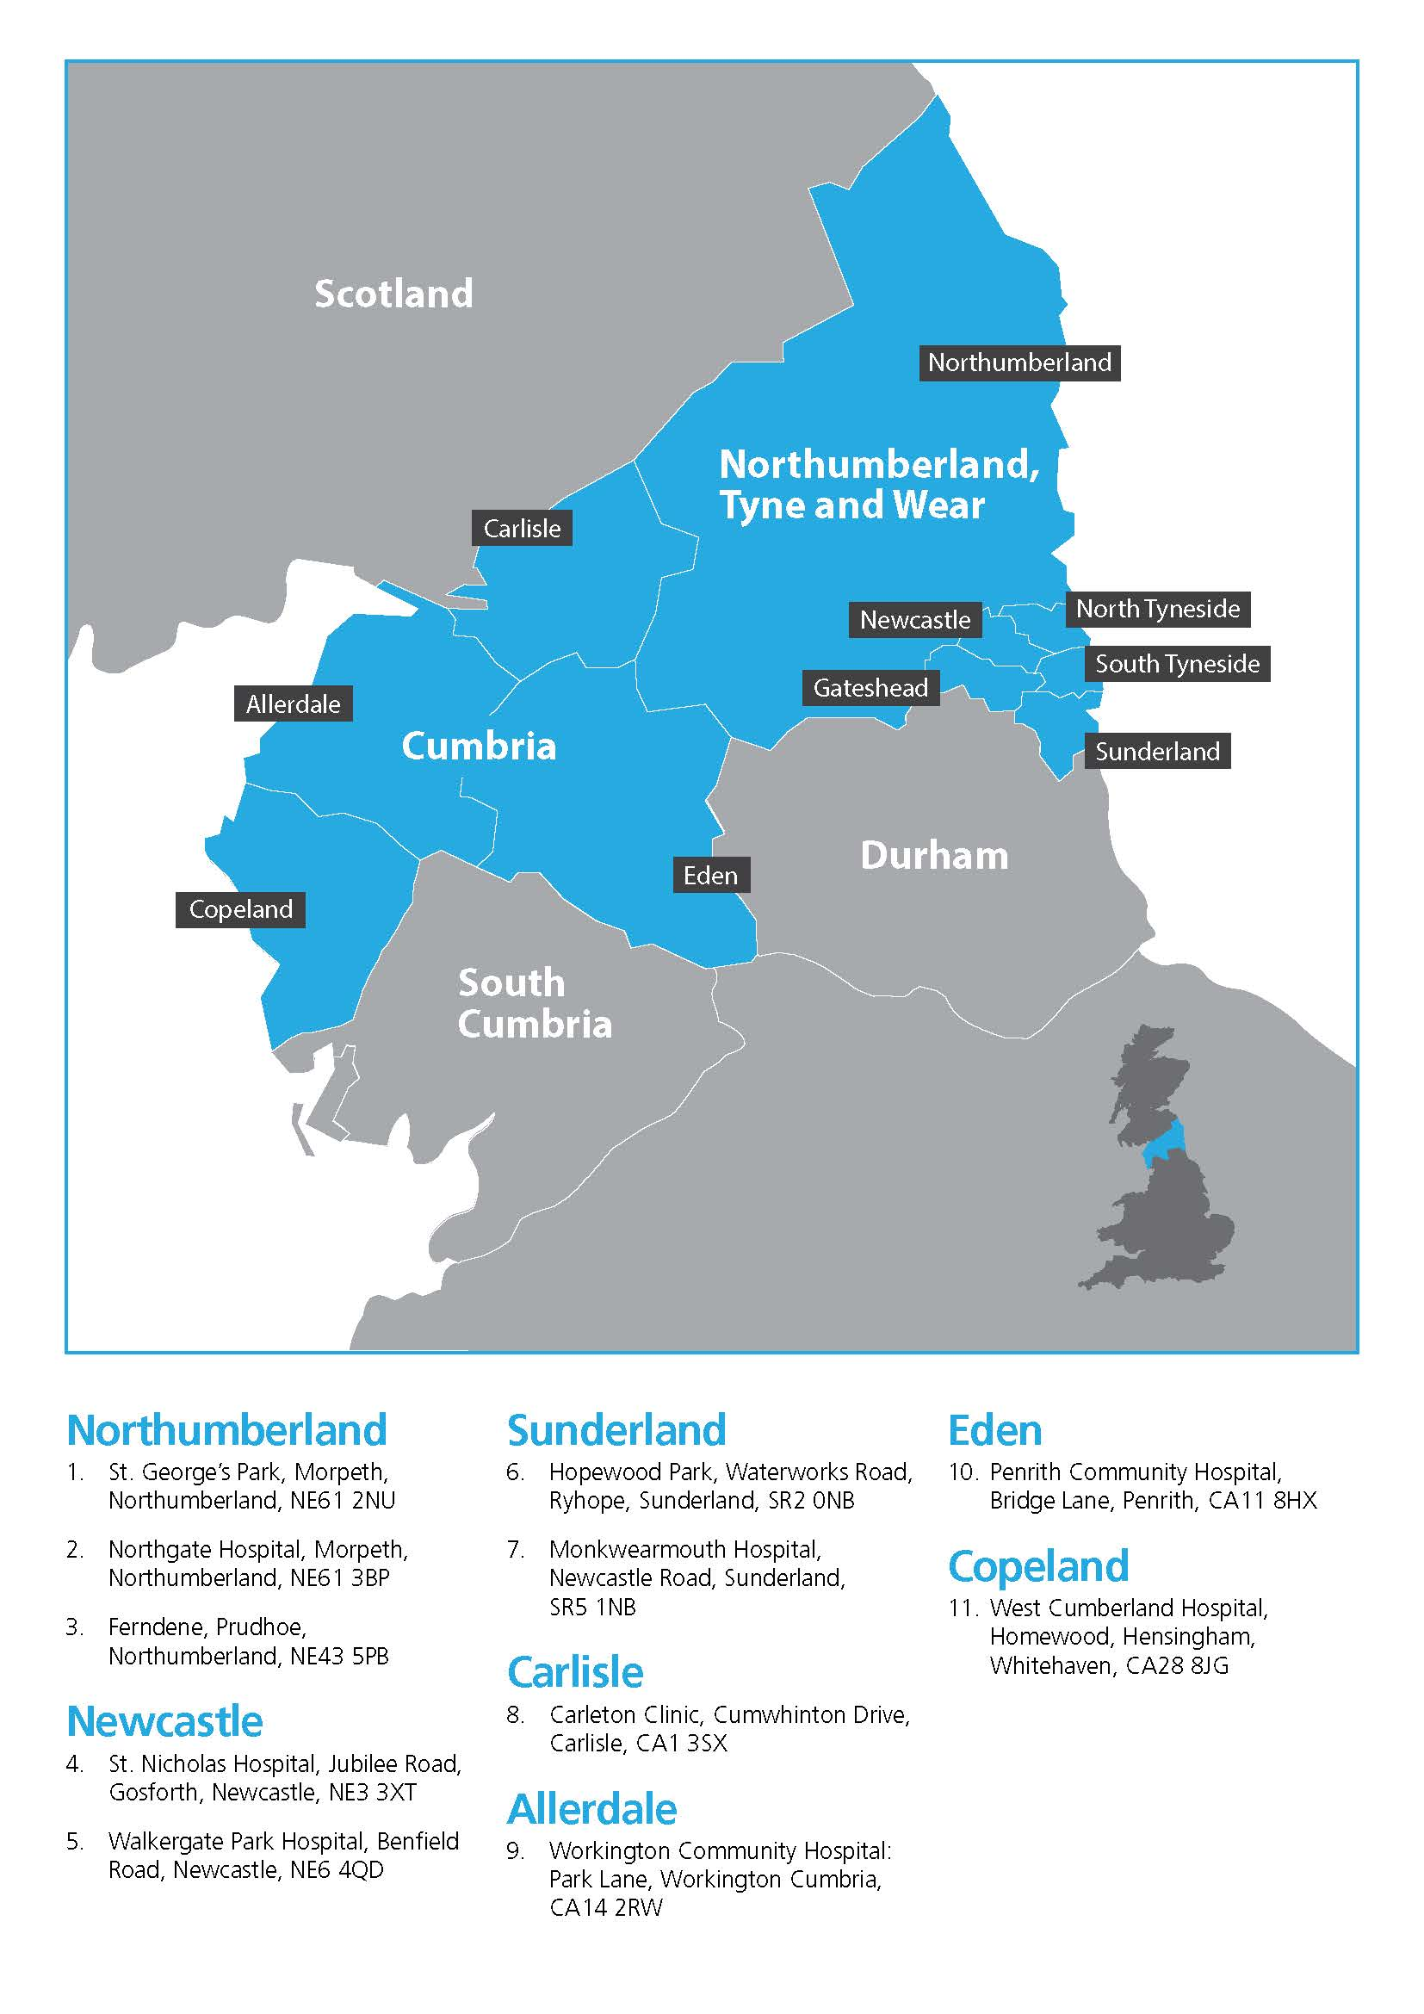
Cumbria, Northumberland Tyne And Wear NHS FT
One of the largest mental health and disability NHS Trusts in England
8920 staff operating from over 100 sites across 4,800 square miles
Secondary care services to 1.4m people
Regional and national specialist services, including neurological
Rated ‘Outstanding’ by CQC 2016 & 2018

Slide 3
Agenda
Setting the scene – the governance framework
Ensuring adequate time for the role
How to get assurance on controlled drugs governance, e.g. policies, procedures and audit
Reporting, investigating and closing incidents
Monitoring adherence to the NICE Guideline on the Safer Management of Controlled Drugs
Top tips
Discussion

Slide 4
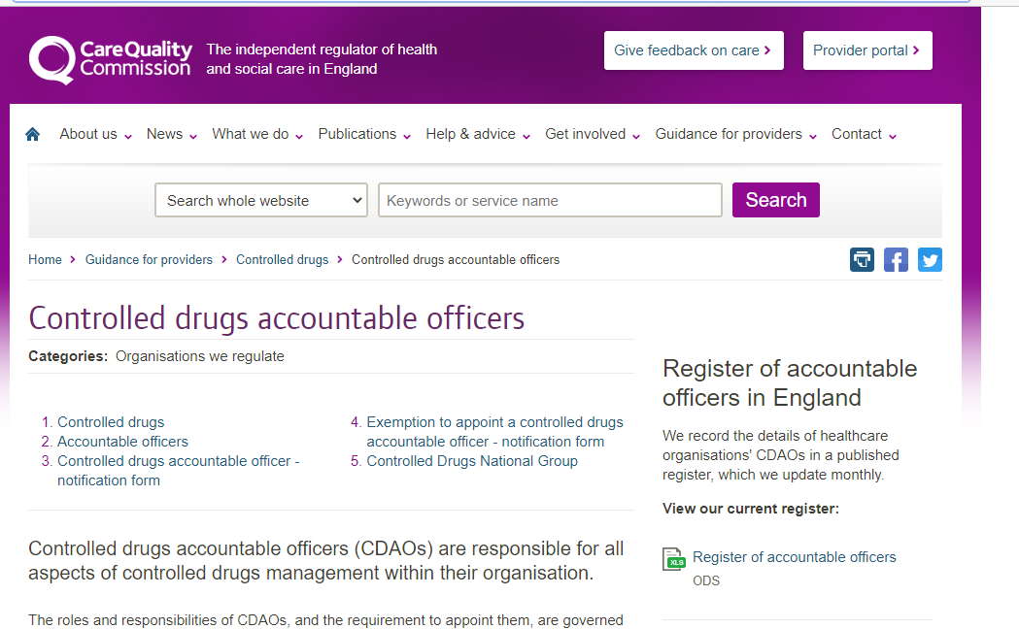
Setting the Scene

Slide 5
Statutory Responsibilities
Controlled Drugs (Supervision of Management and Use) Regulations 2013
A CDAO of a provider body must establish and operate appropriate arrangements for securing the safe management and use of CDs and to review them as appropriate. To:
  ensure the safe and effective use and management of CDs within their own organisations and by anybody or person providing services to their organisation
  ensure monitoring and auditing of the management and use of CDs
  maintain a record to assess and investigate concerns regarding relevant individuals
  take appropriate action if there are well-founded concerns
  establish arrangements for sharing information
  produce quarterly reports of CD occurrences for the lead CDAO
  ensure adequate and up to date standard operating procedures (SOPs) are in place in relation to the management and use of CDs
  ensure relevant individuals receive appropriate information, education or training to ensure adequate destruction and disposal arrangements for CDs

Slide 6
Controlled Drugs Regulations 2013
Regulation 11(3) - CDAOs must ensure they have systems to record concerns (including complaints) and incident reporting systems for untoward incidents which involve the safe management and use of controlled drugs
The details of the incident or concern should be recorded and investigated, where appropriate, using locally agreed procedures.
The information must continue to be recorded such as on an internal secure database with restricted access
It may be that incidents in isolation may not require further investigation but these should still be recorded and stored for future review and to establish whether trends develop
Depending on the nature of the incident, CDAOs will need to determine to which other organisations concerns and incidents are reported e.g. NRLS, CDLIN

Slide 7
NICE Guideline: Controlled drugs: safe use and management (NG46)
Recommendation 1.4 - Processes for reporting controlled drug-related incidents
1.4.1 When multiple systems (e.g. internal, CDLIN, NRLS) are used for reporting controlled drug-related incidents, consider developing a local process that coordinates these systems within the organisation. This may include:
  reviewing arrangements regularly to reflect local and national learning
  carrying out risk assessments of incidents
  sharing learning
1.4.2 Include in local processes for reporting controlled drug-related concerns or incidents:
  how to inform the controlled drugs accountable officer or nominated person
  reporting incidents in a timely way, ideally within 48 hours

Slide 8
NICE Guideline: Controlled drugs: safe use and management (NG46)
Recommendation 1.9.3 - Systems for reporting concerns and incidents
1.9.3 Controlled drugs accountable officers must ensure that robust systems are in place for raising and reporting concerns or incidents about controlled drugs in a timely way (including systems for starting investigations) in line with Regulations 11 and Regulation 13 of the 2013 Regulations. This should involve liaising with the following responsible bodies:
  a designated body
  Care Quality Commission
  NHS Counter Fraud Authority
  Police

Slide 9
NICE Guideline: Controlled drugs: safe use and management (NG46)
Recommendation 1.9.4 - Identifying and reporting trends and barriers
1.9.4 NHS England lead controlled drugs accountable officers should consider identifying trends in incidents reported and barriers to reporting.
Recommendation 1.9.5 - Reviewing concerns and incidents and sharing information
An organisation's controlled drugs accountable officer or nominated person should:
  review controlled drug-related concerns or incidents and take any action needed on a case-by-case basis
  share information and learning throughout the organisation from CDLINs

Slide 10
Ensuring adequate time for the role
Ensure appropriate lines of accountability
Identify process for delegation/escalation
Incorporate CDAO role in job description/person spec
Identify appropriate support resources
  operational managers
  clinical governance
  patient safety
  CDLO/police liaison officer
  CDLIN/Trusted peer support
  Technical
Ensure local practice guidance/SOPs are easily accessible
Protect time in weekly schedule/job plan

Slide 11

How to get assurance on controlled drugs governance (1)
Use CQC self –assessment toolkit
  CD Governance (SOPs, Audits, etc)
  Obtaining & receiving CDs
  Storage
  Prescribing
  Dispensing & supply
  Destruction
  Transport
  Controlled stationary
  Reporting and learning

Slide 12
How to get assurance on controlled drugs governance (2)
Promote and support an open learning culture
Encourage incident reporting
Undertake regular audit/re-audit
Report audit findings to both operational and governance committees
Identify themes and mitigate risks
‘Stuck’ improvement actions - engage operational managers/Directors
Escalate to Board/CDLIN as appropriate

Slide 13
Reporting, investigating and closing incidents
Why report?
What to report?
What to investigate
How to investigate
Closing incidents

Slide 14
Why report?
A key enabler of CDAO role
Meets legal obligations & ensures best practice
Protects patients from harm
Provides Board and CQC assurance
Enables reflection and shared learning
Informs development of risk assessments, monitoring systems & audits
Identifies clinical practice or persons of concern
Supports local investigation of CD occurrences, in association with CDLOs, CFS and CD Local Intelligence Networks

Slide 15
What to include within incident reports?
A summary of incident, date, time and location
Details of the CD and administration route
Impact or likely impact on the health and well-being of the patient(s)
Immediate remedial action taken by those involved
Whether external agencies have been notified, for example the police or the local authority
Outcome of any investigation and any subsequent action (submitted as an update notification)
All concerns should be reported immediately to the CDAO

Slide 16
What to investigate (not exhaustive list)
Incidents resulting in patient harm
Incidents/concerns about alleged or suspected diversion of CDs
Alleged of suspected fraudulent activity
Unaccounted-for CD losses
Concerns about fitness to practice

Slide 17
How to investigate
Maintain a contemporaneous record
Use local procedure for incident investigation (where available)
Undertake data analysis
Root cause analysis (RCA)
Use locally available experts e.g. LSMS/patient safety team, CDLO, CDLIN
Check that appropriate well-being support is being offered to staff under investigation

Slide 18
Closing incidents
Identify clear aims & objectives
  Learning lessons
  Prevention of diversion
  Detection of diversion
Engage operational managers
Named leads for improvement action
Agree clear timelines for completion
Provide regular updates to Board
Report closed when objectives achieved

Slide 19
Monitoring adherence to the NICE Guideline on the Safer Management of Controlled Drugs
Use NICE Baseline Assessment toolkit for Controlled Drugs
  Assess relevance
  Current evidence/activity?
  Recommendation met?
  Required improvement actions?
  Associated risk (if not implemented)?
  Cost/saving?
  Deadline & lead(s)
Report findings to Audit Committee/MOC/Board

Slide 20
Challenges & Reflections
‘top tips’

Slide 21

Top tip #1
Know who you are

Slide 22

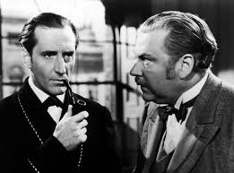
Detective?
Notes:
Brenda Blethyn as DCI Vera Stanhope in the ITV detective series ‘Vera’
Basil Rathbone as Sherlock Holmes and Nigel Bruce as Dr Watson in the 1939 classic ‘The Adventure of Sherlock Holmes’

Slide 23

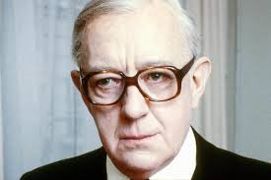
Secret agent?
Notes:
Diana Rigg as Emma Peel in The Avengers
Alec Guinness as George Smiley in the landmark BBC dramatisation of John Le Carre’s novel ‘Tinker, Tailor, Soldier, Spy’ (1979)

Slide 24

Great Protector?
Notes:
Judge Dredd

Slide 25
Top tip # 2 – Assume Nothing
“It ain’t what you know that gets you into trouble. It’s what you know for sure that just ain’t so”
Mark Twain
“Trust is like love - declarations are good,but proof is better”
Emmanuel Macron
Notes:
Unfortunately, being “sure” isn’t a major feature of the CDAO role and anyone looking for it is going to have to learn to live with disappointment.

Slide 26

Top tip # 3
Find a Yoda, you must

Slide 27
Thanks for listening

