Slide 1
Managing & Supporting Doctors in Difficulty
Dr Jeremy Rushmer
Executive Medical Director
Northumbria Healthcare NHS Foundation Trust
@jeremyrushmer

Slide 2
developing an approach based on values based leadership
the impact of culture on behaviour and performance
ensuring open and honest communication
understanding the root cause of the problem and tackling concerns
changing the focus from resilience to support

Slide 3

Fitness to Practice: GMC
Case management: NHS Resolution PPA (NCAS) & MHPS Investigations
Detecting Concerns
Prevention

Slide 4
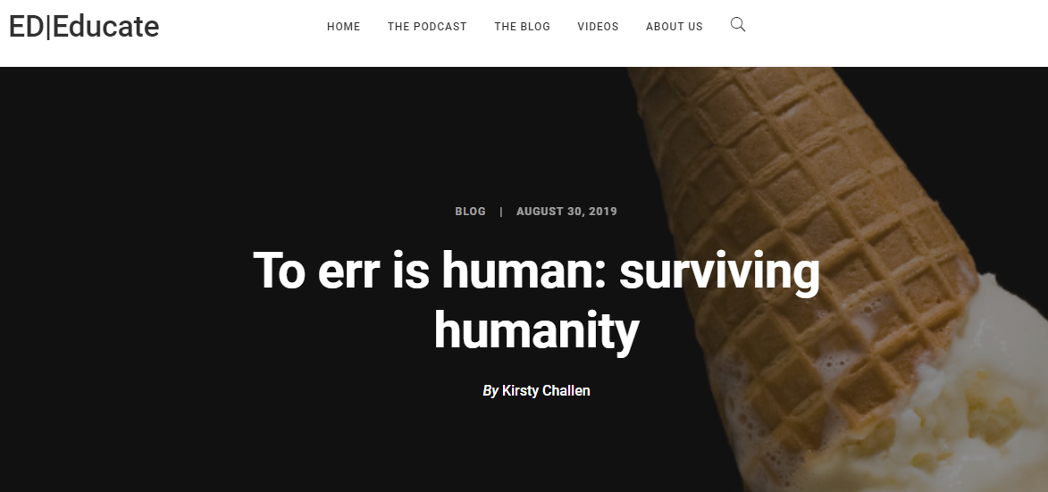
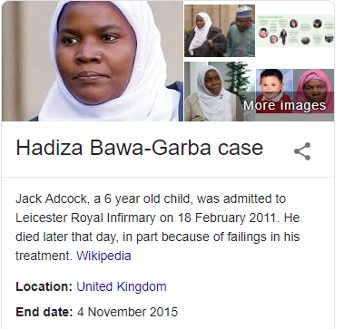
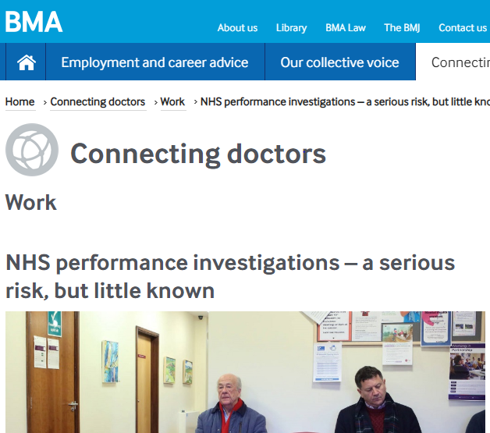
https://ededucate.co.uk/to-err-is-human-surviving-humanity
https://www.bma.org.uk/connecting-doctors/b/work/posts/nhs-performance-investigations-a-serious-risk-but-little-known

Slide 5
The GMC’s Role in Regulation
“All human beings make mistakes from time to time. Doctors are no different. While occasional one-off mistakes need to be thoroughly investigated by those immediately involved where the incident occurred and any harm put right, they are unlikely in themselves to indicate a fitness to practise problem.”
Good medical practice puts it this way:
‘Serious or persistent failures to follow this guidance will put your registration at risk’.
https://www.gmc-uk.org/-/media/documents/DC9089_Referal_Guidance.pdf_66767403.pdf
https://www.gmc-uk.org/ethical-guidance/ethical-guidance-for-doctors/good-medical-practice

Slide 6
Culture and Behaviour
The way we do things around here
Shared beliefs, values, and assumptions as evidenced by the symbols, rituals and stories in an organisation
Reciprocal Determinism
  Albert Bandura 1970’s: a person’s behaviour:
    both influences and is influenced by personal factors and the social environment.
    may be conditioned through the use of consequences
    can impact the environment
    Culture determines behaviour & behaviour determines culture.
Leadership has the single biggest impact on an organisations culture. 75% of NHS staff are led by a band 7.

Slide 7
Ensuring effective performance
Ensuring necessary resources are available & used
Normal State
Comfort Centred
Externally Driven
Self Focussed
Internally Closed
Leading State
Results Centred
Internally Driven
Other Focussed
Externally Open
Model Support & Compassion
Valuing Diversity, fairness & inclusion
Enabling learning & Innovation
Building partnerships between teams, departments & organisations

Slide 8
Prevention
Value Based OD & Induction programme
Value Based Recruitment
Collective Leadership & Good HR
Staff Focus & Psychological Safety
Just Culture

Slide 9
Components
Staff Experience = Patient Experience
Education
Learning and development
Appraisal
Succession planning
Career progression
On boarding
Continuous Improvement
Staff health and well being
Leadership Development
Conflict resolution
Inclusion
Learning culture
Reward strategies
Recruitment and retention
Job design
Accountability autonomy and responsibility
Positivity and Pride
Exemplar employment practices
Listening with fascination
Excellence in two way communications
Clear organisational strategy
Compassionate leadership

Slide 11
Difficult Doctors
There is a very clear route from being a difficult doctor to a doctor in difficulty
The link between effective team working and good patient outcomes has been established by Prof Michael West
Effective teams rely on the facilitation of good behaviours – ‘Collective Leadership’ skillset, based around inclusivity and compassion

Slide 12
The values and rules are what set your moral compass
To navigate your organisation must ensure there is reliable, visible feedback against these values from all staff and patients
Align everyone's expectations

Slide 13
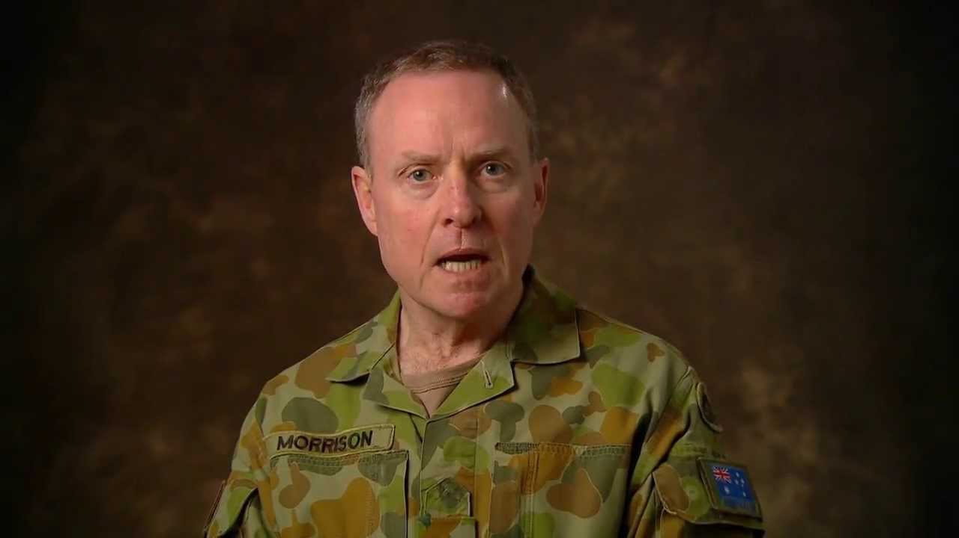
Zero Tolerance
Lt. General David Morrison
Chief of Army (Australia) 2011-2015
Australian of the Year 2016
2013
“The standard you walk past is the standard you accept”
Don’t tell me
something you don’t want me
to act on

Slide 14
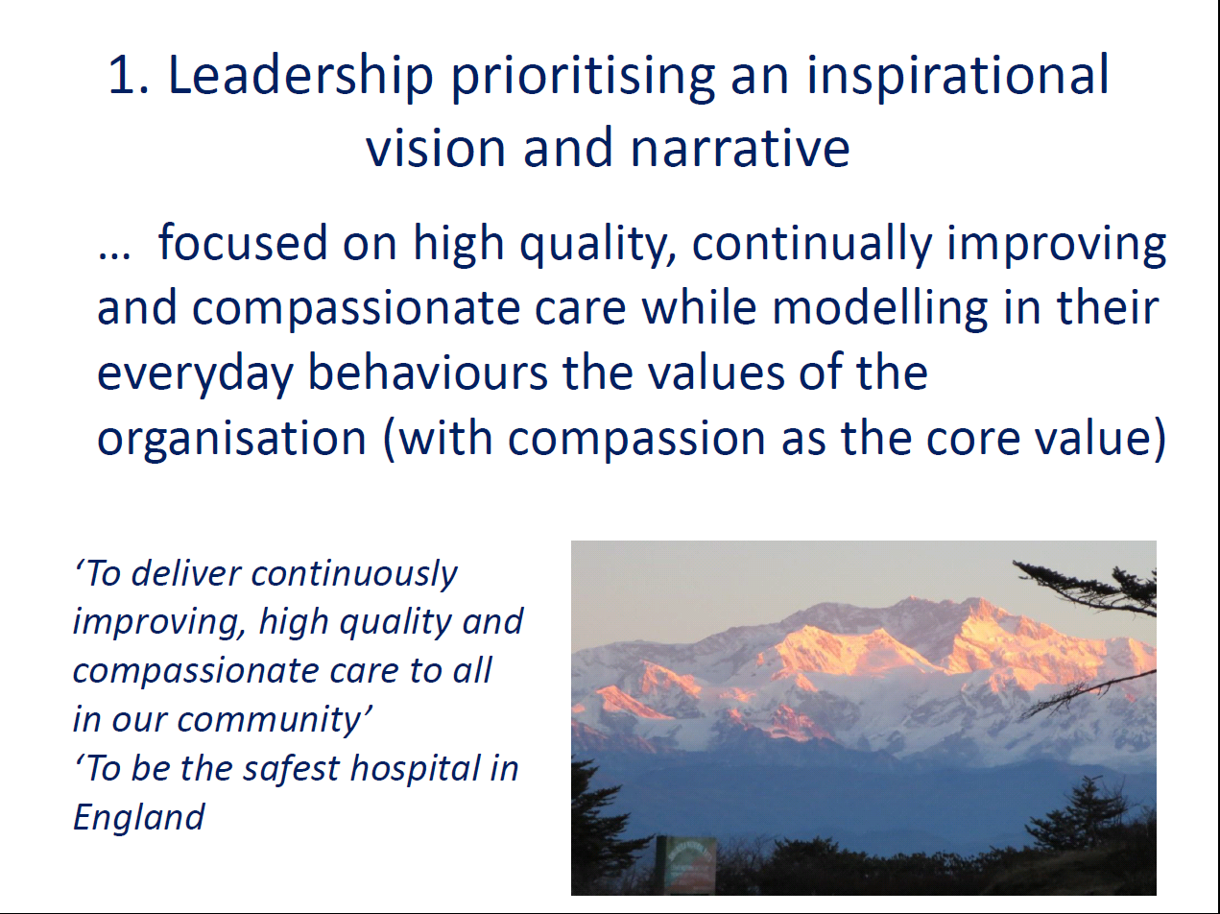

Slide 15
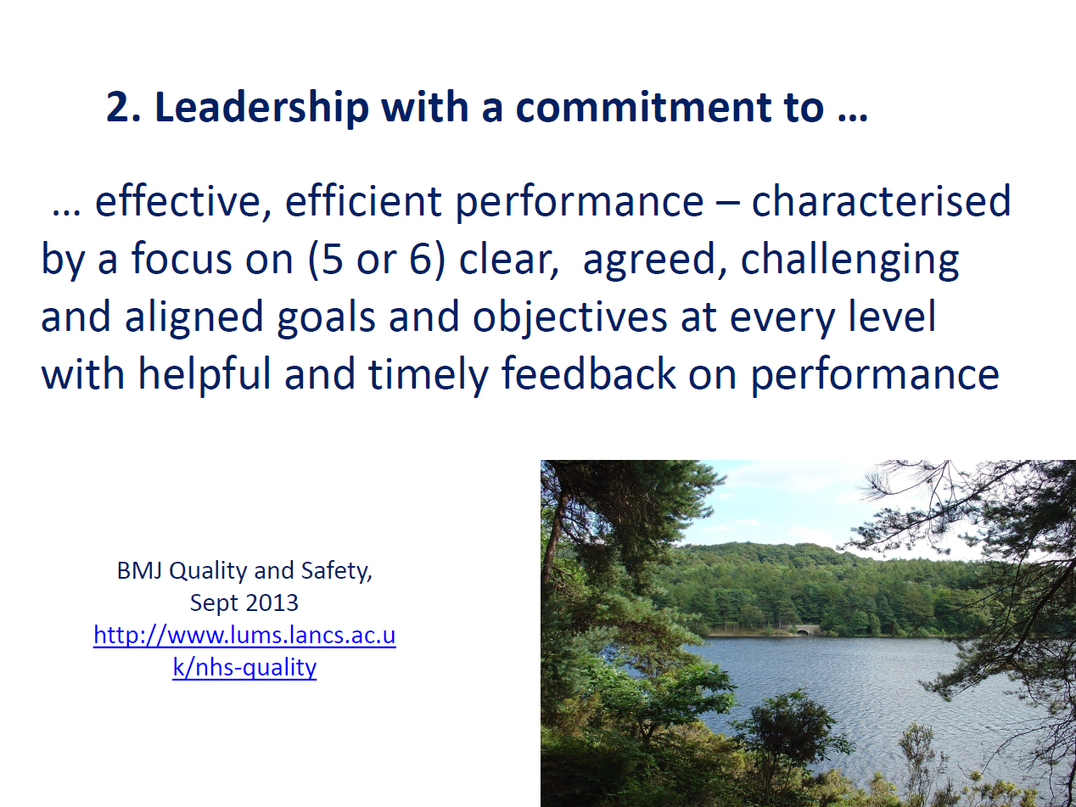

Slide 16
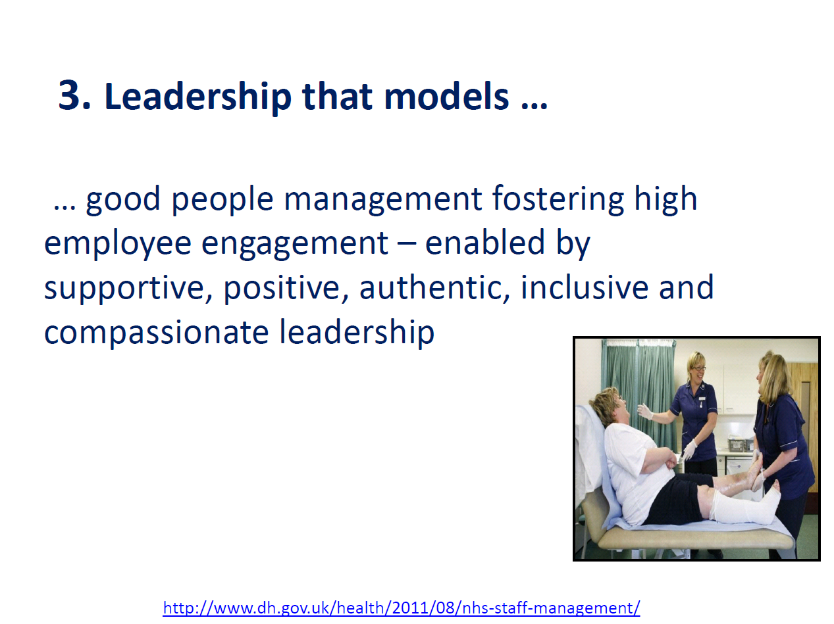

Slide 17
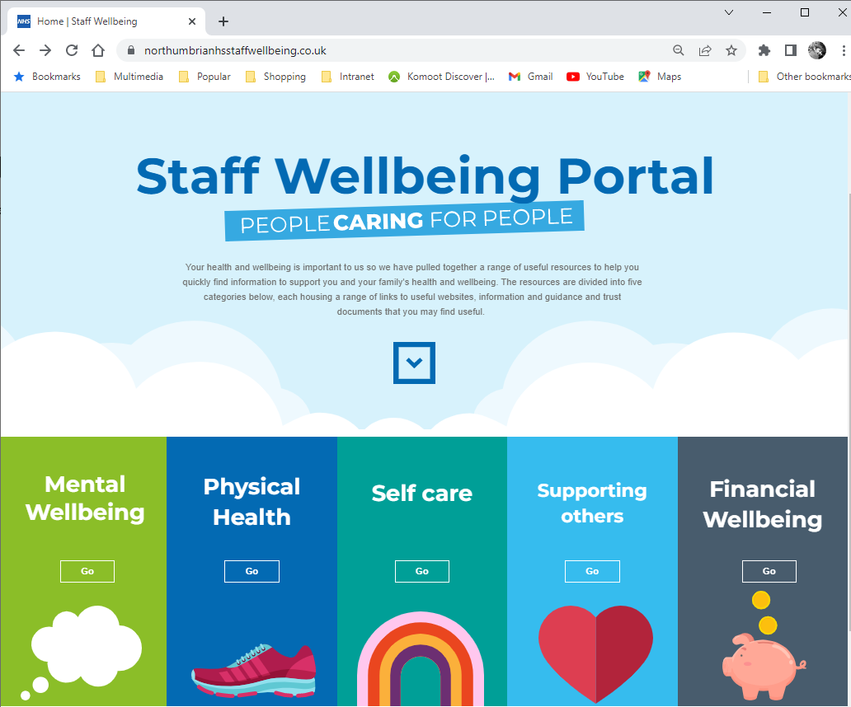


Slide 18
Northumbria Consultant Selection
Psychometric Testing, Clinical Assessment Centres &
Competency based interview:
Empathy & Sensitivity
Communication & Influencing
Personal Organisation
Coping with pressure
Team Working
Openness, Learning & Self Awareness
Leading & Managing
Organisational awareness & commitment
Decision Making
Teaching
Clinical Capability

Slide 19
SIs & Incident Reporting
Detecting Concerns
Complaints
Teams & Performance
Trainees & ARCP
Appraisal inc 360

Slide 20
What is a in a concern ?
21 % critical
incidents
20% diagnostic
skills
18% record keeping and consultation skills
20% Communication with colleagues
Communication difficulties 12% each with
  management
  patients/carers/relatives
Health Issues: Burnout/anxiety, Alcohol & Drugs, Affective disorders, cognitive impairment

Slide 21
Detecting Concerns
So there is a point to joined up, responsive, open and transparent governance ?
The core unit of this governance is ‘the team’
Staff stop reporting if listening and action doesn’t occur
Triangulation and scrutiny are important
Good teams measure and look at performance
Good teams set standards, measure, report and escalate against them

Slide 22
Detecting Concerns
Incident Reporting
Patient and Staff complaints
Clinician level performance / outcome metrics including patient experience
Appraisal with feedback
Trainees and locums as peripatetic practitioners provide unique challenges

Slide 23
Warning Signs
Disappearing Act: Bleeps, lateness, sickness
Work Rate: slowness, queues, not taking decisions
Ward rage: Bursts of temper, shouting, slights
Rigidity: difficulties with ambiguity & compromise
Bypass syndrome: Nurses and juniors ask someone else
Career concerns: disillusionment, exam difficulty
Insight failure: defensiveness, counter challenge
Disengagement: appraisal, ARCP, portfolio, lack of clinical questioning
Inappropriate attitudes to colleagues

Slide 24
Understanding the Problem
Medicine is a personality based profession:
  Great clinicians will understand their make-up and make appropriate adjustments at appropriate times
  There aren’t any personal characteristics that are only good when applied well, there is always a ‘dark side’ when misapplied
  Certain characteristics come out most when under stress
Human factors: No clinician can perform well in an impossible or excessively stressful clinical environment.
Problems in attitude can present in a variety of ways, not least because of a clinicians responsibility to keep knowledge up-to-date
No clinician performs in isolation and team relationships affect performance
Health issues must always be identified
External factors – outside the control of organisation but relevant to clinician performance

Slide 25
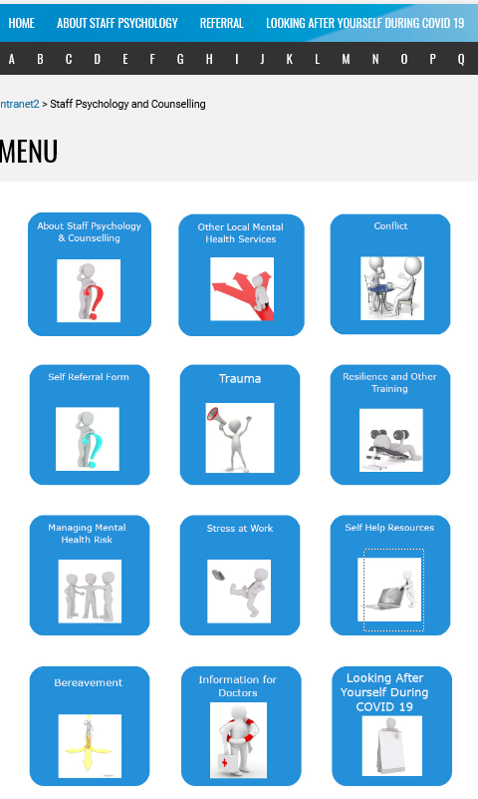

Great HR (Support)
Professional (trained) Mentoring Service
Professional Coaching Service
Access to Team Training
Access to Team Building

Slide 26
Resolving the Issues
Establishing trust and an open, professional relationship with the clinician is key to seeing the whole picture
Keep things timely
Be open and honest about expectations and thresholds
Act on facts
Once information is gathered and facts established judgement must be applied

Slide 27
Remediation
Assessment
Advice
Case management: NHS Resolution PPA (NCAS) & MHPS Investigations
Local Investigation (MHPS

Slide 28
NCAS is now the Practitioner Performance Advice section of NHS Resolution
The have broad and expert advice on a wide range of matters as well as their role in assessment and remediation. Use them via your regional link
They must be used if you are considering restriction and suspensions, or professional investigations (MHPS). They are especially useful in matters of health or other tricky issues (eg LADO) as they also understand employment law
They document all of your advice conversations. The practitioner must know you are speaking to them and will have access to all their documented advice

Slide 29
MHPS
A good case manager is the key to a good investigation, which is the key to the whole process.
It can be very hard work
Advice is needed: NCAS/GMC ELA/ Occ Health/ HR advisor/ Specialty Advisor
Be clear on the matter to be investigated, and set clear ToR accordingly
Northumbria support case managers with a Decision Making Group which documents all its advice
Everyone must be properly trained

Slide 30

Practitioner Support
The impact of a professional
investigation is rarely negligible
Reliable support for practitioners
is needed from all points after a
formal process is started
Mentor / professional colleague
Professional advice please (MPS/MDU/BMA)
Health, health psychology advice all the way through
It IS the job of the CASE MANAGER to ensure sufficient support is present

Slide 31
Criminal Prosecutions
Tribunal: Erasure
Tribunal: Suspension
Fitness to Practice: GMC
Case Examination
Provisional Enquiry

Slide 32
GMC Data 2014-2017
 | 2013 | 2014 | 2015 | 2016 | 2017 | 2017%
Doctors on register | 259,651 | 267,169 | 273,767 | 280,806 | 288,521
Total enquiries | 9,866 | 9,624 | 9,418 | 9,146 | 8,546 | 3.0%
from Persons Acting in a Public Capacity | 1,316 | 1,200 | 1,105 | 744 | 807 | 9.4%
from members of the public | 6,475 | 6,572 | 6,547 | 6,688 | 5,714 | 66.9%
from other sources | 2,075 | 1,852 | 1,766 | 1,714 | 2,025 | 23.7%
Investigation | 2,939 | 2,723 | 2,306 | 1,296 | 1,306 | 15.3%
Provisional enquiry |  | 35 | 351 | 616 | 614 | 7.2%
Refer to employer/responsible officer | 1,035 | 583 | 553 | 475 | 493 | 5.8%
Closed | 5,892 | 6,283 | 6,208 | 6,759 | 6,133 | 71.8%

Slide 33
Medical Practitioners Tribunal
An MPTS final hearing that hears the cases against doctors, decides whether the facts are proven and, if so, whether the doctor’s fitness to practise is impaired, and decides what, if any, sanctions are appropriate.
The tribunal can:
erase the doctor from the medical register
suspend the doctor from the medical register
put conditions on the doctor’s registration
agree undertakings with the doctor
give a warning to the doctor
decide to take no further action.

Slide 34
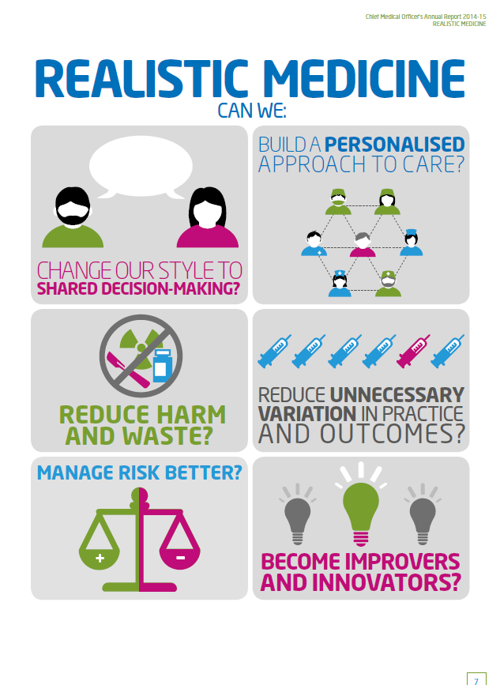
Thank you
Any Questions?

