Slide 1
IMPROVING HIP FRACTURE CARE AND OUTCOMES
Cameron Swift. King’s College School of Medicine, London
July 2022

Slide 2
Background – need & opportunity
Epidemiological and public health importance
Recognised need to raise standards
Professional & political momentum
Demographic paradigm for health care
Contemporary national Clinical Guidance (CG124 & QS16)
National audit (NHFD) and Best Practice Tariff

Slide 3
CG124 (2011 -14 -17-19) Categories
Imaging options in occult hip fracture
Timing of surgery
Analgesia
Anaesthesia
Planning the theatre team
Surgical procedures (2017 / 2019 updates)
Mobilisation strategies
Multidisciplinary management (HFP)
Patient and carer information

Slide 4
Hip Fracture Programme Model [CG124]
Acute orthopaedic or orthogeriatric ward base
Orthogeriatric assessment
Rapid optimisation of fitness for surgery
Early identification of individual goals for multidisciplinary rehabilitation to recover mobility and independence, and to facilitate return to pre-fracture residence and long-term wellbeing
Continued, coordinated, orthogeriatric and multidisciplinary review
Liaison or integration with related services, particularly mental health, falls prevention, bone health, primary care and social services
Clinical and service governance responsibility for all stages of the pathway of care and rehabilitation, including those delivered in the community.

Slide 5
Management of hip fracture
Accident & Emergency: Preliminary Assessment -
Surgical, Anaesthetic, Medical, Nursing, Rehab goals
Theatre
Orthopaedic / Specialist Ward:
Perioperative surgical, nursing and related management with
referral as required
“Usual Care”
MDM: HFP
MDR: SD
MDR: GORU
MDR: IC
MDR: MARU
MDR: SC
FINAL DISCHARGE

Slide 6
Key model inputs and CEA findings
COSTS FOR EACH
STRATEGY:
Rehab programme
Complications
Readmissions
Health care costs after
hospital discharge
Social care costs (when
living in own home or in
residential or nursing home)
HEALTH OUTCOMES
FOR EACH STRATEGY
EQ-5Ds scores for
all health states*
Life expectancy
= QALYs
HEALTH
STATES
HFP is the DOMINANT STRATEGY
(more effective, less costly)
than both GORU/MARU and usual care

Slide 7
NICE Quality Standards
Not fixed targets
Measurable high level audit measures of local quality in structure, process or outcome
Expressed as proportions – not necessarily 100% norm
Maximally evidence-based
Where possible, set in the context of national data collection – for Hip # the NHFD
Selection periodically adjusted for perceived priority improvement need.

Slide 8
QS16 Statements (1-3)
1. Adults with hip fracture are cared for within a Hip Fracture Programme at every stage of the care pathway. [2012, updated 2016]
2. Adults with hip fracture receive surgery on a planned trauma list on the day of, or the day after, admission. [2012, updated 2016]
3. Adults with displaced intracapsular hip fracture have a total hip replacement if clinically eligible, rather than hemiarthroplasty. [2012, updated 2017]

Slide 9
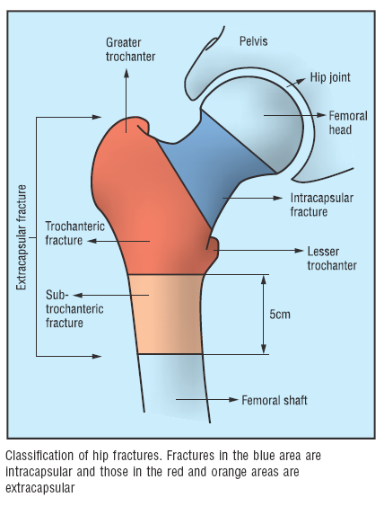
From Parker M & Johansen A (2006)

Slide 10
QS16 Statements (3-6)
4. Adults with trochanteric fractures above and including the lesser trochanter receive extramedullary implants. [2012, updated 2016]
5. Adults with subtrochanteric fracture are treated with an intramedullary nail. [new 2016]
6. Adults with hip fracture start rehabilitation at least once a day, no later than the day after surgery. [2012, updated 2016]

Slide 11
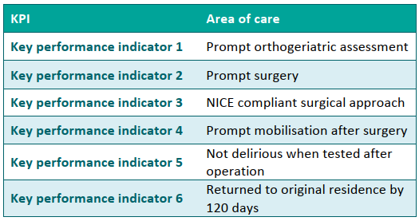
NHFD KPI’s [NHFD 2018]

Slide 12
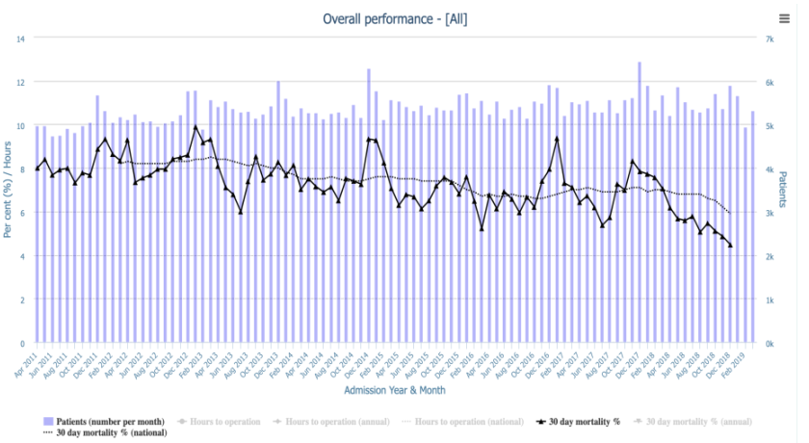
Seasonal variation in 30-day hip# mortality, 2011-2018 (NHFD 2019) (See also Griffin et al 2021: EQ-5D-5L)

Slide 13
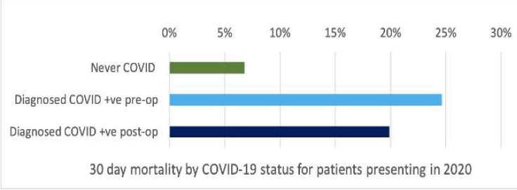
30-day mortality and COVID-19 status for people presenting with hip fracture in 2020 (overall 8.3% v 6.5% 2019) (NHFD 2021)

Slide 14
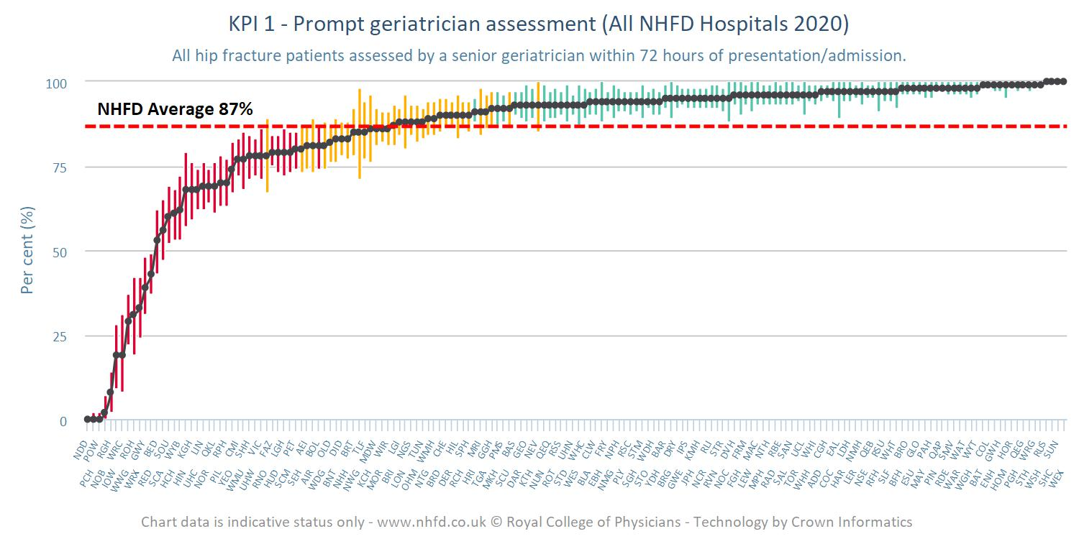
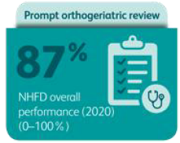
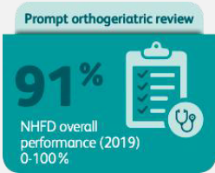
KPI 1 (72h Orthoger. Assmt) (NHFD 2021)

Slide 15
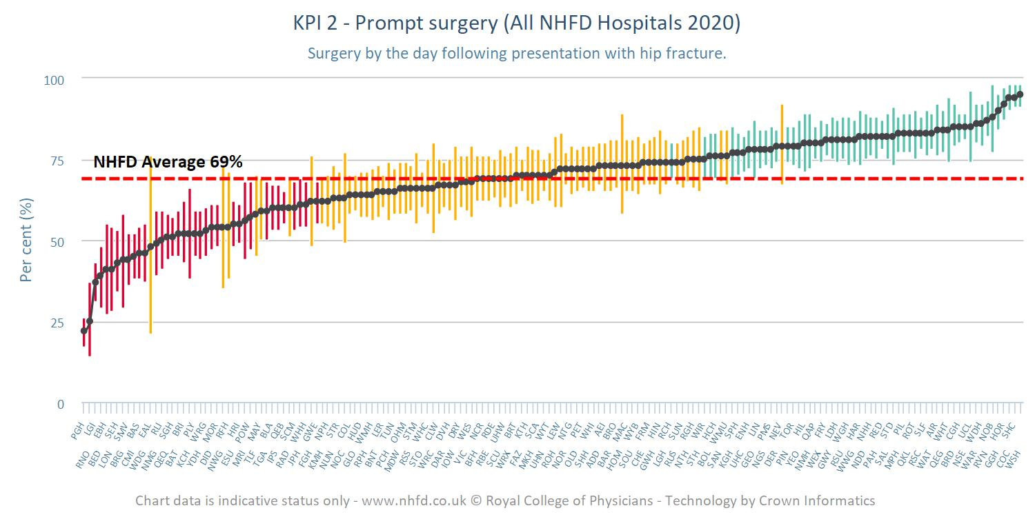
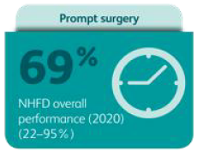
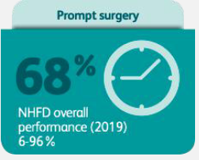
KPI 2: (Time to surg,) (NHFD 2021)

Slide 16
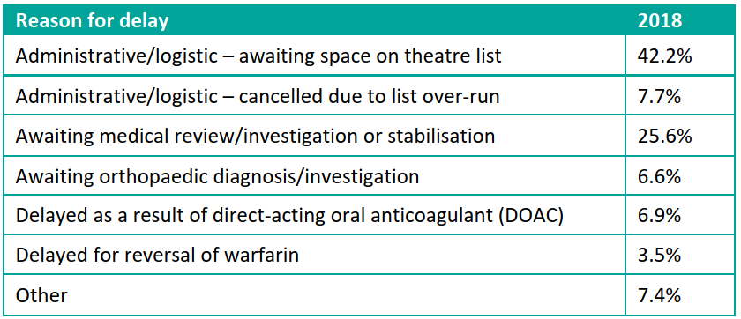
KPI 2: Reasons for surgical delay (NHFD 2019) (?case for earlier surgery)

Slide 17
Proposed DOAC Protocol (Taranu et al, 2018)

Slide 18
KPI 3: CG124-Consistent Surgical Procedure
IM nail for subtrochanteric fracture
SHS (v IM nail) for A1 / A2 trochanteric fracture
Cemented arthroplasty (hemi/THA) for displaced intracapsular fracture
THA if (i) outdoor mobile (+/- stick),
(ii) cognitively intact & (iii) medically GA fit.

Slide 19
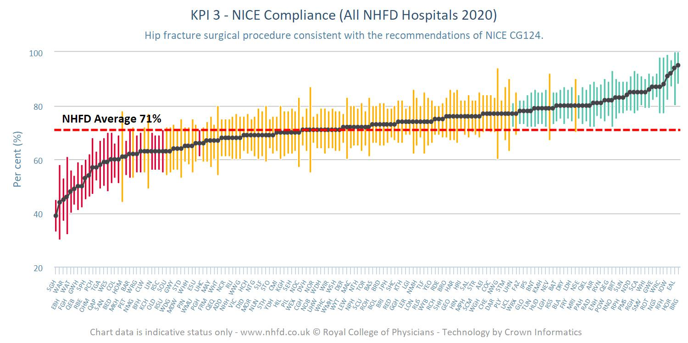
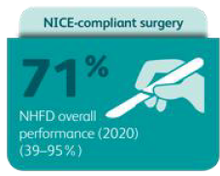
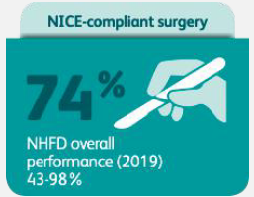
KPI 3: (CG124 Surg Proc), (33.4% - 25.3%THR) (NHFD 2021)

Slide 20
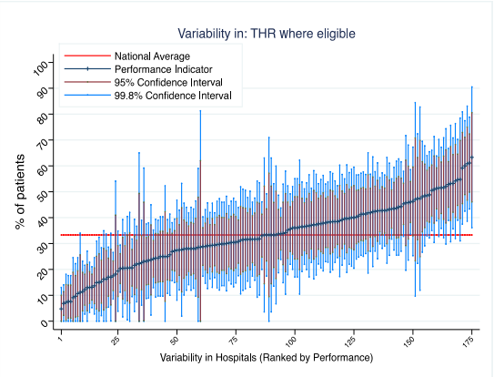
Variability in THR (NHFD 2019) (see “HEALTH” nejm 2019: Judge et al bjj 2020)

Slide 21
THR Dec 2018 – Feb 2021 (NHFD 2021) (see “HEALTH” nejm 2019: Judge et al bjj 2020)

Slide 22
Rates of THA and hemiarthroplasty set against criteria that define greatest fitness (NHFD 2021)

Slide 23
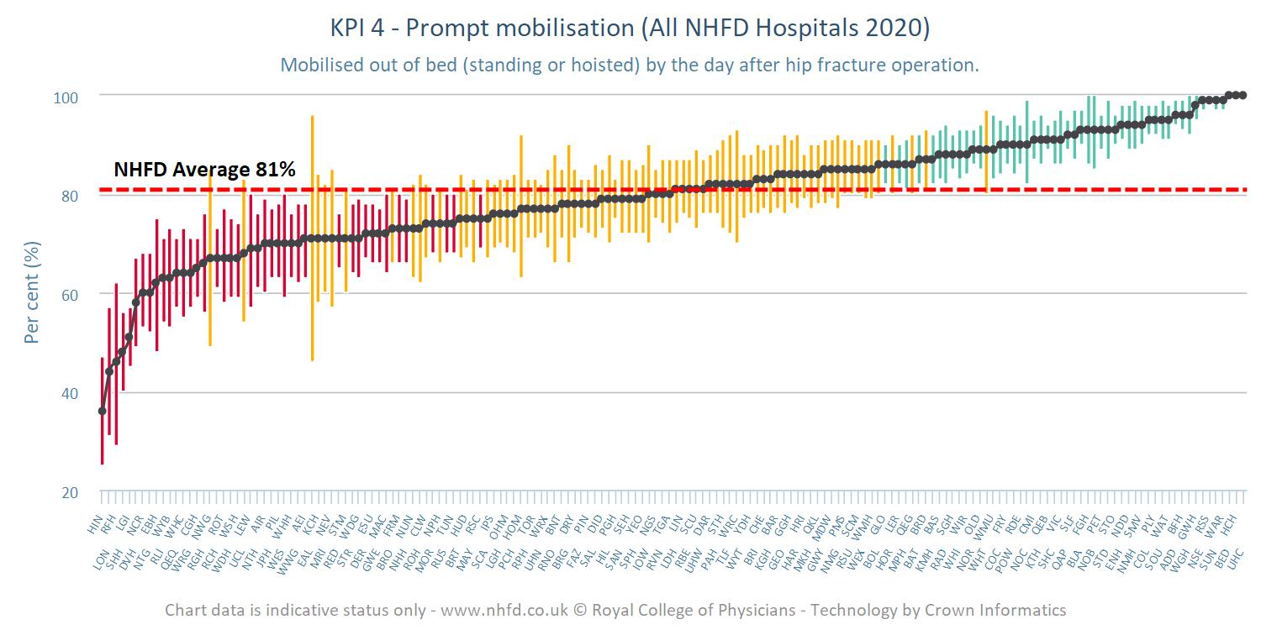
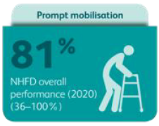
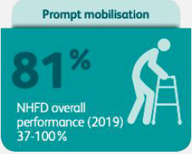
KPI 4: Mobilisation post-op (NHFD 2021)

Slide 24
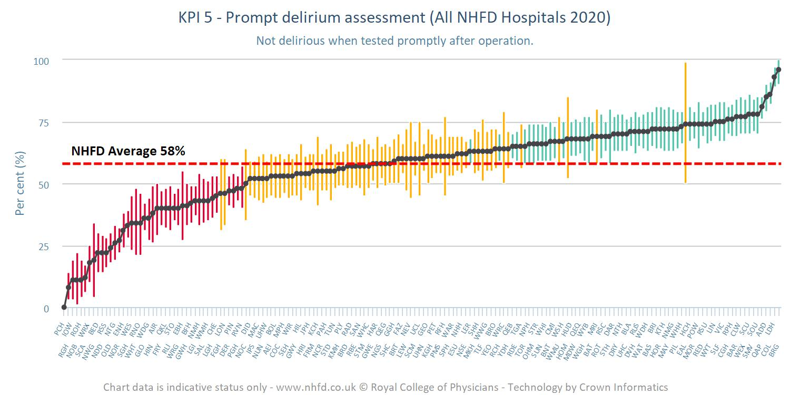
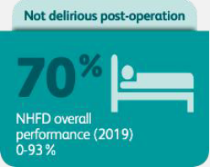
KPI 5: Prompt delirium assessment (NHFD 2021)

Slide 25
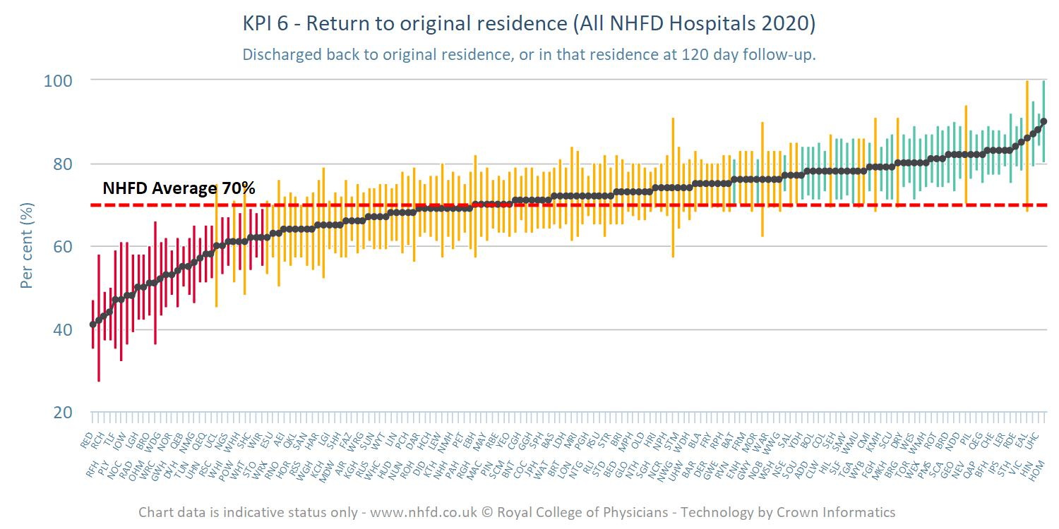
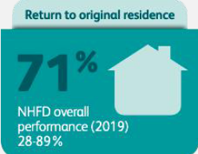
KPI 6: Discharge destination: (NHFD 2021)

Slide 26
NHFD Additional developments (NHFD 2021)
Proposed new KPI’s
KPI 0: (i) prompt nerve block consideration & (ii) prompt admission to appropriate ward.
KPI 7: Medication for secondary prevention with 120-day follow-up
Data on periprosthetic and non-hip femoral fractures

Slide 27
Local implementation for progress across KPI’s: [NHFD 2018]
Examine own NHFD data in dashboards and run charts
Investigate and address causes of poor performance
Ensure full multidisciplinary clinical governance representation
Achieve continuity of clinical governance, including post-discharge follow-up
Identify local concerns/challenges and chart NHFD data prospectively to drive QI.

Slide 28
NHFD-based recommendations for local progress & QI: [NHFD 2020]
Use NHFD data on COVID-19 to identify and analyse local contexts
Use NHFD runcharts to monitor and respond to local pandemic impact
Carefully address ward-based social distancing challenges and use patient information and carer support resources
Continue to identify KPI-based deficit as basis for QI
Monitor casemix adjusted mortality using new NHFD runcharts

