Slide 1
Covid-19 and Geriatrics (Hip Fractures)
Dr Louis John Koizia
Consultant Geriatrician
St Mary’s Hospital
l.koizia@nhs.net
Notes:
• how do we ensure safety for the frail elderly in our hospitals
• managing patients with hip fracture and Covid-19
• minimising delays to theatre due to medical complications
• lessons learned from the Scottish Hip Fracture Audit

Slide 2
Overview
Introduction
General impact of COVID on our patients
    Negative vs Positive
Impact on NOF patients
How we can medically optimise COVID-19 NOF patients
Post operatively
Conclusion

Slide 3
1. Intro
Clearly last two years have been challenging

Slide 4
2. Impact
Negative vs Positive (or anything we can take forward)

Slide 5
3. Negative

Slide 6

Negatives
Loneliness
Depression
Lack of medical input resulting in worsening chronic diseases, missed cancers
Deconditioning
Cognitive decline
Reduced ability to access community services
Ceiling of care decision making
Ageism

Slide 7
4. Positives

Slide 8

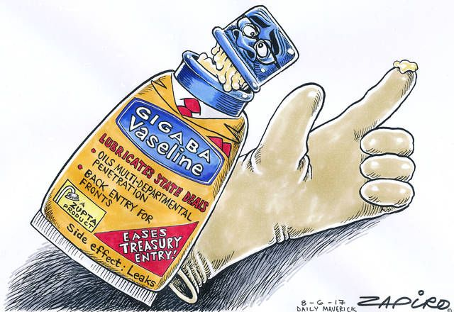
Positives
Remote geriatric care
  Telephone Consultation
  Concept makes sense – reduced burden to patient
  Fraught with issues
    Lack tech
    Hearing issues
  Personal case study

Slide 9

Positives
Remote geriatric care
  Telephone Consultation
Push toward home wards
  - Or even remote ward rounds
Martin et al. J Med Internet res 2020; Aug 14; 22 (8): e21486

Slide 10
5. NOF and covid-19
In general worse mortality
30 day mortality predicted around 30% in patients with NOF and COVID-19
Longer stay in hospital was associated in increase chance of developing
Positive result increased LOS
  Acutely unwell
  Reduced therapy
  Difficulty to discharge
  Increased non surgical management
Kayani et al. Bone Joint J 2020; 102-B(9)
Hall et al. Bone Joint J 2020; 102-B(9)

Slide 11
5. NOF and covid-19
‘stay at home’ message had significant impact
  People stayed indoors
  Less trauma
  Less NOFs ->10% reduction in cases (not massive as many occur at home in frail patients)
  Delayed presentation to 4.8 days from injury compared to 0.7 days (pre pandemic)
    Outcomes were not worse though
Serra-Torres et al. Adv in Ortho 2021

Slide 12
5. Impact hip fracture audit
833 patients (66% female)
17 centres
78 diagnoses with COVID during admission
lower rate of 30 day survival - adjusted = 3 times more
Likely half of the cases were caught in hospital
Unfortunately more than half of nosocomial were only identified in downstream facilities = caused worsening spread
Hall et al. The Bone and Joint Journal 2021; Jan 25

Slide 13
5. Impact hip fracture audit
Limitations
  When were they operated
    Delays associated with COVID-19
    We know delay to surgery has detrimental impact
      Lenzi et al (2021)
        Unchanged timing of operations of population
        But noted a reduction in admissions
      Williams & Kumar (2020)
Lenzi et al. Int J Health Policy Manag 2021; x(x)

Slide 14
6. Medically optimise
COVID Treatment
Orientation
Oxygen, steroids, novel
Pain
Delirium
Operation
Treat CAP, ACS, retention
Analgesia
Good holistic care
Early intervention + senior
MDT
Holistic
Other things...
Reduced moves

Slide 15
6. Medically optimise
AAGBI 2011: ‘Acceptable delay’
Hb < 80
Na < 120 or > 150 mmol or K+ < 2.8 or > 6.0 mmol
Uncontrolled diabetes
Acute left ventricular failure
Cardiac arrhythmia with a ventricular rate > 120
Chest infection with sepsis
Reversible coagulopathy
“surgery should be delayed only if the benefits of additional medical treatment outweigh the risks of delaying surgery”

Slide 16
6. Medically optimise
VTE
  Usual guidance is 6 weeks anticoagulation to prevent VTE
  COVID-19 increased risk state
Delirium
  Acute confusional state
  One of the commonest symptoms of COVID-19

Slide 17
7. Long covid
Growing evidence that major issue
Not much on geriatric long COVID
  EU-COGER study (Pan Eu Functional and medical recovery)
But in essence we see ‘long covid’ in the majority of frail patients post acute admission, post NOF, CAP
  Off functional baseline
  Sarcopaenia
  Cognitively worse
Avascular necrosis
  Likely related to use of steroids during acute course
Agarwala et al. BMJ Case Report 2021; May 23

Slide 18
In conclusion
COVID massively impacted our patient population
Many negative
Some positive impacts
NOF and COVID – even worse outcome
Medical optimisation relates to standard principles
Our population group are likely to suffer from ‘Long COVID’ type phenomena's more frequently
Access to rehab services are pivotal

Slide 19
Questions?
Dr Louis John Koizia
St Mary’s Hospital
l.koizia@nhs.net

