Slide 1
LISA SURGINOR
Ward Manager
MICHEÁL LYNCH
Falls Champion
Royal Victoria Hospital, Belfast

Slide 2
Background
Commenced Ward Manager post Jan 2021 (CCU background)
Inpatient cardiology ward – long stays, deconditioning
Major fall March 2021
Key Performance Indicator
Post fall review- falls coordinator

Slide 3
FIRE FIGHTING
High staff turnover
High use of agency staff
High numbers of junior staff
Staff shortages most shifts
Covid 19 challenges

Slide 4
Case study- 2nd Major Fall Jan 2022
75 year old male – baseline independently mobile with rollator
Mild cognitive impairment
Admitted with and treated for heart failure
Nearing MFFD status – Developed UTI and constipation causing fluctuating levels of consciousness for several days prior to fall
Nursed in side-room – used CPAP at night due to sleep apnoea
Patient had unwitnessed fall by staff in bathroom post enema administration
CTB – ?acute haemorrhage vs meningioma

Slide 5
Post fall review - actions
M&M meeting in March 2022 – Micheál Lynch
Update falls training – 3 months
Highlight at ward safety brief patients at risk of falls and those requiring 1:1 supervision
Encourage use of FallSafe signage
Encourage MDT approach by initiating falls prevention team
FallSafe ward –falls champions identified
Monthly FallSafe audits – PACE documentation, lying/standing, BP, urinalysis

Slide 6
Improving practice at ward level
Group supervision – dissemination of information regarding post fall review
Falls education board, falls resource file and FallSafe toolkit available to all staff on HUB
Falls Safe care bundle – call bell, urinalysis, history of falls, footwear etc.
Highlighted importance of early identification of those at risk – falls signage/ level of supervision required
Referral to MDT – appropriate walking aids
Risk assessments

Slide 7
Falls QI
Regular Datix audit
MDT approach – monthly falls prevention meetings – highlight trends, contributory factors and new ideas
M&M meeting – identifying lead falls consultants
Pharmacy communication book – medication review
Assistive falls technology – reduced falls to 1 in April (other contributing factors)
Falls stickers

Slide 8
Visual aid

Slide 10
Micheal Lynch – Falls Champion
Appointed falls link nurse for ward Feb 2021
What role meant for me
Update falls training and ensure other staff updated training
Organised FallSafe Coordinator to deliver face to face training after first major fall March 2021
Developed tick list proforma - management post falls

Slide 11
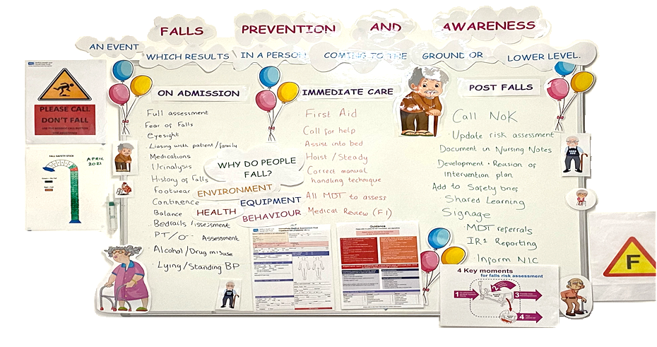
Focus of the month

Slide 12
Post fall review
Contributing factors to major fall became apparent
Importance of FallSafe Bundle
Accurate and detailed documentation
Not assigning blame – sharing the learning with the MDT
As relatively junior staff nurse can see importance of medical team having systematic approach to fall
Using post fall medical proforma

Slide 13
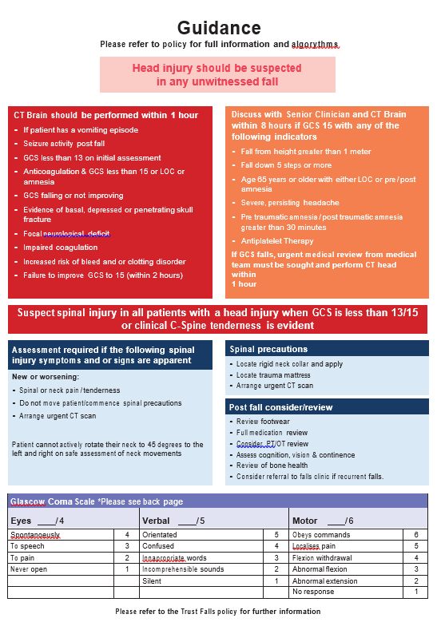
Medical performa

Slide 14
auditing
Monthly FallSafe audit
Reviewing datix with ward sister
Identify trends – reasons why patients fall in cardiology ward
Falls stick visual guide for staff and visitors displayed on ward

Slide 15
Closing remarks
Relatively new initiative (6 months)
Promising results - Significantly reducing number of falls – improving patient care
Drive within ward to become fallsafe ward/Inspire new staff to have passion for falls prevention
Aim is to get a green stick
Questions…

