Slide 1
Integrating prehabilitation into cancer care pathways
June Davis,
Allied Health Professional Advisor
Macmillan Cancer Support
Prehabilitation principles and practice
14th July 2022
1

Slide 2
National Context

Slide 3
Benefits of prehabilitation to patients and care givers
“Prehabilitation helps you pick, edit and contribute to your cancer story – so you have your own ownership and don’t just feel you are being ‘done to”.
Personal empowerment
• Physical and psychological resilience
Long-term health
“It makes you feel more in control of your treatment”.
“Takes your mind off it all – something to focus on”.
“Calmed the nerves and reassured me”.

Slide 4
The purpose of prehabilitation in cancer
enables people with cancer to prepare for treatment through promoting healthy behaviours and through individualised needs-based prescribing of exercise, nutrition and psychological interventions.
is part of a continuum to rehabilitation.
benefits can be seen in as little as 2 weeks.
empowers people with cancer to enhance their own physical and mental health and well-being and thereby supports them to live life as fully as they can.

Slide 5
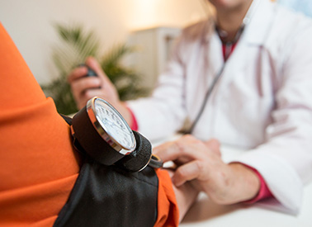
Impact of poor physical and mental health on outcomes

Slide 6
Prehabilitation for people with cancer can:

Slide 7
Prehabilitation principles
Notes:
1. Prehabilitation enables people with cancer to prepare for treatment by promoting healthy behaviours in order to maximise resilience to treatment and improve long-term health. Prehabilitation empowers people with cancer to enhance their own physical and mental health and well-being and thereby supports them to live life as fully as they can.
2. People are less vulnerable to the side effects of cancer treatment if they are as healthy as possible, physically and psychologically. People with cancer who have poor physical and/or mental health are known to have less treatment options available, to be more vulnerable to the adverse effects of cancer treatments, and to have poor long-term health prospects irrespective of cancer type and stage of disease.
3. Appropriately targeted interventions aimed at improving physical and/or mental health (exercise, nutrition and psychological interventions) along with behavioural change techniques are safe, accepted and welcomed by people with cancer and promote quality of life. A growing body of evidence suggests that they may also reduce side effects of treatment. Prehabilitation may, in some cases, allow people with cancer to access treatments that were not previously available to them.
4. Prehabilitation sits within a broader context of health improvement for people with cancer, including smoking and alcohol cessation, medication review, and management of long-term conditions, that we have not considered within the scope of this guidance.

Slide 8
Prehabilitation in the cancer care pathway
Personalised prehabilitation care plan (PPCP)
Overseen by cancer MDTs
Interventions should start as early as possible
Notes:
5. Prehabilitation, as a component of rehabilitation, should underpin the whole cancer pathway and is an approach we seek for all people with cancer through co-developing a personalised prehabilitation care plan (PPCP) as part of their overall care plan. Prehabilitation can optimise cancer treatment by promoting health and well-being as part of a continuum of preventative, restorative, supportive and palliative rehabilitation interventions. Prehabilitation, specifically including exercise, nutrition and psychological support, should be integral to the care of all people with a cancer diagnosis.
6. All cancer treatments are led through cancer multidisciplinary teams (MDT). The cancer MDT should have representation from those delivering prehabilitation therefore providing oversight of the prehabilitation needs of the person to ensure prehabilitation is taking place. Community hub MDTs also have an important role to play in supporting people with cancer with physical activity and exercise, nutrition and psychological support. This will be in collaboration with specialist, hospital based oncology teams.
7. Personalised prehabilitation care plans (PPCP), as part of a person’s care plan, should be a document that encompasses nutrition, physical and psychological screening for all people with cancer to identify need for more detailed assessment, individualised assessment according to need, and an individualised intervention prescription based on the screening and assessment process along with on-going support and evaluation to aid uptake and adherence.
8. Interventions targeted at improving physical and/or mental health should start as early as possible and in advance of any cancer treatment (not just the first cancer treatment).

Slide 9
Patient engagement
What information is provided to patients about the service (s)?
How do you involve and engage with patients and the public in the:
Planning and design of these services?
Evaluation of these services?
How does the service include/support/engage with family/friends/carers to enable interventions/plans to be implemented?
How do you ensure health inequalities are addressed in the planning, design and access to services?
How do you gather patient insight on the effectiveness of the service from their perspective?

Slide 10
Integrating prehabilitation into cancer pathways
Diagnosis
Prehabilitation begins at any point from diagnosis (and in some cases before a confirmed diagnosis)
Pre-treatment assessment
Screening for prehabilitation, assessment, care plan including a personalised prehabilitation care plan (PPCP)
Where a patients needs are identified above a prehabilitation programme would be prescribed.
Surgery

Slide 11
Recovery then follow up
Prescribed prehabilitation then rehabilitation programme.
Treatment preparation
Where need identified above prescribed prehabilitation programme
Screening, assessment, care plan including a personalised prehabilitation care plan (PPCP)
Systemic anti cancer therapy
Preceded or followed by….

Slide 12
During treatment
Prescribed prehabilitation programme continues
Preparation for recovery
Outcome assessment
Maintain benefits – into follow up and life beyond
Continue prehabilitation programme principles

Slide 14
Screening for prehabilitation
As early as possible
In advance of treatment
Use validated tools
Screening should be aligned to Holistic Needs Assessments
Include psychological risk factors, physical fitness and nutrition

Slide 15
Physical activity screening for prehabilitation
Screening tools
Physical activity screening tools: Self report physical activity – International physical activity questionnaire IPAQ Scottish physical activity screening questionnaire – SCOT-PASQ Godin Shephard Leisure Time Physical activity questionnaire – GSLTPAQ General Practice Physical Activity Questionnaire – GPPAQ Physical fitness screening tools: Duke Activity Status Index (DASI) Clinical Frailty Score 6 minute walk test Incremental shuffle walk test Timed Up and Go Test 30 second chair to stand test

Slide 16
Nutrition screening tools for prehabilitation
Screening tools
Malnutrition screening tool – MUST – Current weight, unplanned weight loss, BMI, acute disease effect subjective element Royal Marsden nutrition screening tool Malnutrition screening tool Patient Generated subjective Global assessment – PG-SGA Same tool to be used in all settings for a particular patient

Slide 17
Psychology and wellbeing screening tools
Psychology screening tools:
Patient health questionnaire – PHQ
Generalised Anxiety Disorder assessment – GAD-7
Hospital Anxiety and Depression Scale – HADS
Wellbeing screening tools:
EQ-5D
Fatigue – EORTC QLQ-FA12
General Self Efficacy Scale – GSE
Patient Activation Measures - PAMS

Slide 18
Assessment for prehabilitation
Physical fitness
Nutrition
Psychological support and emotional wellbeing
Notes:
10. Individualised assessment, when indicated, should encompass comprehensive evaluation of needs identified during screening using validated clinical measurement techniques. Assessments should inform the individualised prescription of exercise, nutrition and psychological interventions.

Slide 19
Physical fitness assessment
Brief Functional capacity measures
6 minute walk test
Fitter individuals
Step Test
Cardiorespiratory fitness assessment
CPET = Gold standard
Timed up and go test
30 second chair to stand test
Cooper Test
Need to know baseline functions of tissues

Slide 20
Nutrition assessment
Screening detects those people most at risk of disease related malnutrition
Nutritional assessment – process of collecting and interpreting information to help make decisions about nature and cause of nutrition related issues
Include diet history, assessment of eating habits, dietary impact factors, anthropometric measurements, body composition and muscle mass measurements

Slide 21
Psychological assessment
Patient health questionnaire – PHQ
Generalised Anxiety Disorder assessment – GAD-7
Hospital Anxiety and Depression Scale – HADS

Slide 23
Outcomes – Identify from the outset!
Emotional function as measured by EORTC-QLQ-C30
Health related quality of life (EQ-5D-5L)
Health economics analysis (EQ-5D-5L)
Patient Activation – Patient Activation Measure (PAM)
Self-reported physical activity (Godin Leisure Time Exercise Questionnaire)
Nutrition Assessment (Patient Generated –Subjective Global Assessment)
Self-efficacy for self-management of chronic disease
Distress as measured by the Emotion thermometers
Duke’s Activity Status Index (DASI)
Process evaluation – semi-structured interviews with participants and professionals to explore acceptability, usefulness and barriers to delivery/engagement
Holistic needs assessment

Slide 24
Workforce
Cancer MDT
Anaesthetists
Exercise physiologists
Lead cancer nurses & CNSs
GPs
Oncologists
Physicians
Public health teams
Psychologists
Support workers
Surgeons
AHPS
Fitness instructors
Notes:
16. Prehabilitation should be delivered by a multidisciplinary team working within a described framework (see below) using a combination of registered professionals (e.g. dietitians, occupational therapists, physiotherapists, psychologists) and unregistered professionals (e.g. rehabilitation/therapy support workers, healthcare assistants, fitness instructors) where there is scope to delegate some responsibilities (as well as care givers, family, wider support networks) according to agreed and documented local arrangements.

Slide 25
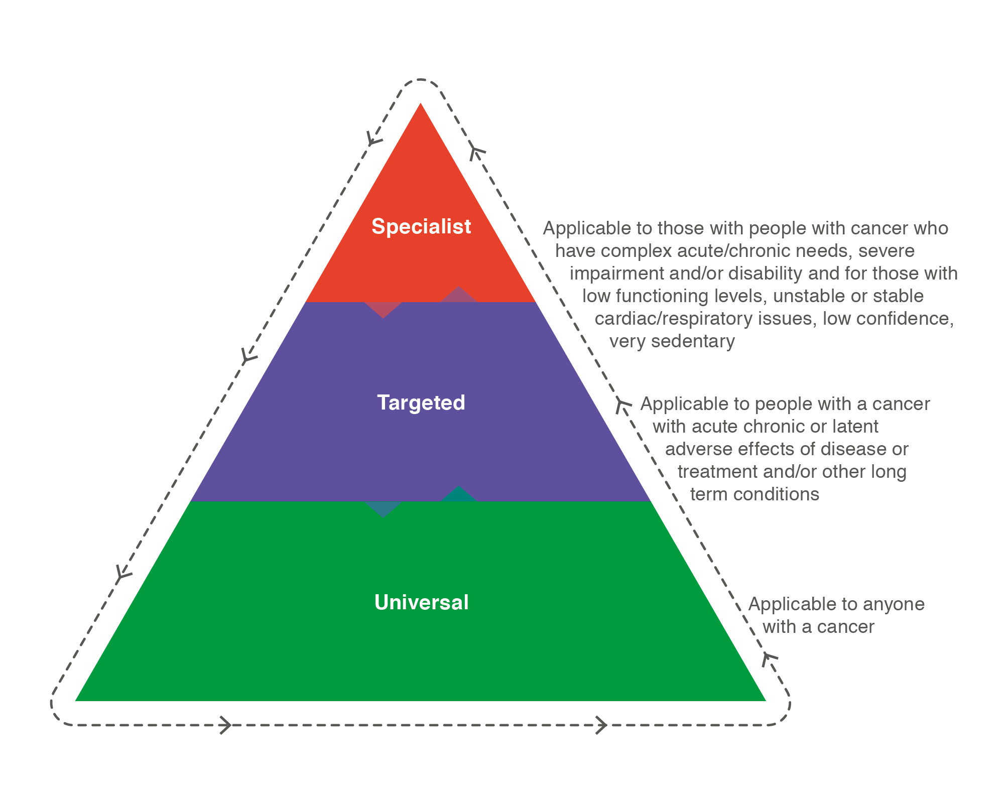
Prehabilitation interventions
Monitoring of interventions should be proportionate to need. Universal interventions should be self-monitored and recorded via the HNA or equivalent process. Targeted and specialist interventions should be monitored for adherence and effectiveness using appropriate validated measures.

Slide 26
Nutrition interventions | Description
Targeted | Dietetic Counselling Assess readiness to change Reasons and goals for nutritional recommendations Motivate the patient Therapeutic dietary advice
Specialist | Artificial Nutrition Support Enteral or parenteral nutrition

Slide 27
Exercise interventions | Description
Targeted | Referral/support for appropriate reconditioning and/or prehabilitation exercise programmes including Healthy Conversations. Group exercise or one-to-one support in local community gym setting run by cancer exercise specialists such as Move More106 –aiming to increase frequency, intensity and duration of exercise incrementally to get as near as possible to 150 minutes of moderate intensity. Interval training, supervised and structured exercise
Specialist | Fully supervised exercise intervention (aerobic/endurance/strength) for those very inactive/sedentary/co-morbidities, contemplative/low self-efficacy or treatment related indication (e.g. major surgery).

Slide 28
Psychological Support and Behaviour Change interventions | Description
Targeted | Psychological techniques such as problem solving. Counselling and specific psychological interventions such as anxiety management and solution-focused therapy, delivered according to an explicit theoretical framework.
Specialist | Specialist psychological and psychiatric interventions such as psychotherapy, including cognitive behavioural therapy (CBT).

Slide 29
A ‘how to guide’ is an interactive PDF encompassing designing, developing and funding personalised cancer prehabilitation and rehabilitation services in supporting people living with cancer
(https://www.e-lfh.org.uk/programmes/prosper/)
Designed for clinical and strategic leads and decision makers includes:
18 individual service case studies from across the UK focusing on cancer prehabilitation, rehabilitation or both.
Videos, data, outcomes, health economic framework and cost consequence calculator
Contributions from over 50 individual stakeholders and subject matter experts from across the UK

Slide 31
Health economic framework and cost consequence calculator:
The calculator is useful in several ways. It can:
Act as a checklist for understanding what measures to consider and the data to collect
Be used to help develop a business case to demonstrate potential or expected costs and impacts
Be used to consider benefits realisation when a project has been running for a period of time and data have been collected on costs and impacts
The calculator includes worked examples to demonstrate changes in the costs and the patient and other clinical outcomes, based on case study projects.
Users can use their own data in the calculator to carry out their own estimates and develop economic scenarios.
Patient videos
As part of the PRosPer project we made two videos which resulted from two patient engagement groups.
We wanted the films to illustrate, from a patient perspective, the importance of personalised care, specifically prehabilitation and rehabilitation, on their cancer journey. The films will complement and give context to the accompanying e-learning materials in the Persona 3 section of the PRosPer resources.
Clive, Martin, Chris: https://we.tl/t-Fn91vYMkzY
Valerie, Anna: https://we.tl/t-Hp75kwVz2C

Slide 32
What to consider when implementing prehabilitation at a local level
What is currently available locally to support health and wellbeing?
What is currently being delivered for rehabilitation?
What do your local cancer pathways look like?
How do they vary be speciality, tumour and treatment?
How might these pathways need to change to support prehabilitation and optimise patients for treatment?
For example: Information and support services
Social prescribing
Local health and wellbeing services

Slide 33
Capacity, effectiveness and service transformation
What is the current capacity to deliver prehabilitation and rehabilitation in current services?
How effective are the current services?
Is there a service which looks to improve patients’ health and wellbeing in advance of treatment whether surgery and/or chemotherapy and/or radiotherapy and/or immunotherapy?
A multidisciplinary team is required: who do you have? what are their skills, knowledge and expertise?
How could they support prehabilitation?
Does service transformation need to be considered and take place to enable incorporation of prehabilitation into the local cancer pathways?

Slide 34
Managing multiple prehabilitation interventions
How should multiple prehabilitation interventions be managed, supported and co-ordinated?
Prehabilitation should be delivered through a multidisciplinary approach with all members of the MDT understanding their role and their colleagues roles in supporting people living with cancer.

Slide 35
Components required for set up and sustaining a quality prehabilitation service
Senior sponsorship within the provider organisation and local leadership for the service transformation
Steering group to support and advise on the set up and monitoring of prehabilitation services.
Engage people with cancer from the outset
Collection of quantitative and qualitative outcomes from the outset i.e. baseline data before any change and then outcomes collected following changes. These should include quality of life metrics, changes in complications, length of stay data, range of clinical outcome data, health economic data, patient satisfaction and feedback.
Establish and agree changes to the pathway and staffing required to support delivery of the service and cost.
Establish which patients and tumour types to be targeted initially and later on.
Ensure there is a clear project plan with achievable milestones.

Slide 36
Idea
Create a multimodal programme together with patients and relevant stakeholders and ensure it fits your local situation.
Team
Create a multiprofessional team with believers and together design the patient journey
Business case
Value Based Healthcare principles / where are the savings realised / let management support.
Pilot
Decide on the most important outcomes to inform business cases and sustainable funding.
Test your prehabilitation design and numbers to convince others to scale up.
Implement
Decide on patient selection, accessibility to the programme, and sustainability.
5 steps to success!
From Theory to Practice: An International Approach to Establishing Prehabilitation Programmes - PubMed (nih.gov)

Slide 37
Breakout group questions
What components do you have in place to support local delivery of prehabilitation?
What are your next steps to progress with prehabilitation locally?
How can you promote sustainability of prehabilitation services locally?

Slide 38
Thank you for listening jfdavis@macmillan.org.uk @junedavis44

