Slide 1
TONY COLLIER BEM
Prostate Cancer UK Ambassador, awareness speaker and fundraiser
Prehab4Cancer & EMBRaCE-GM Patient Representative
Greater Manchester

Slide 2
My Story
Life changing event aged 45
Diet
Alcohol
Exercise
Running
Marathons
Ultra marathon
Running Into Cancer
Diagnosis
Prognosis

Slide 3
My Story
Choices post diagnosis
2 ways forward
Side effects of treatment
Loss of muscle mass
Weight gain
Hot flushes
Hot sweats
Fatigue
Loss of libido/sexual function
Mental health Impact
Anxiety
Depression
Counselling and psychosexual therapy
Impact on exercise
Exercise a vital part of maintaining my physical and mental well being
Taking control rather than being controlled (Exactly what Prehab does for cancer patients)

Slide 4
Prehab4Cancer & Recovery
Programme: Greater Manchester
@Prehab4Cancer
Notes:
Introduce myself + the service

Slide 5
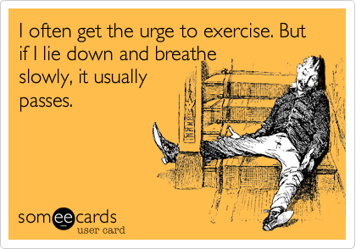
Notes:
ZM

Slide 7
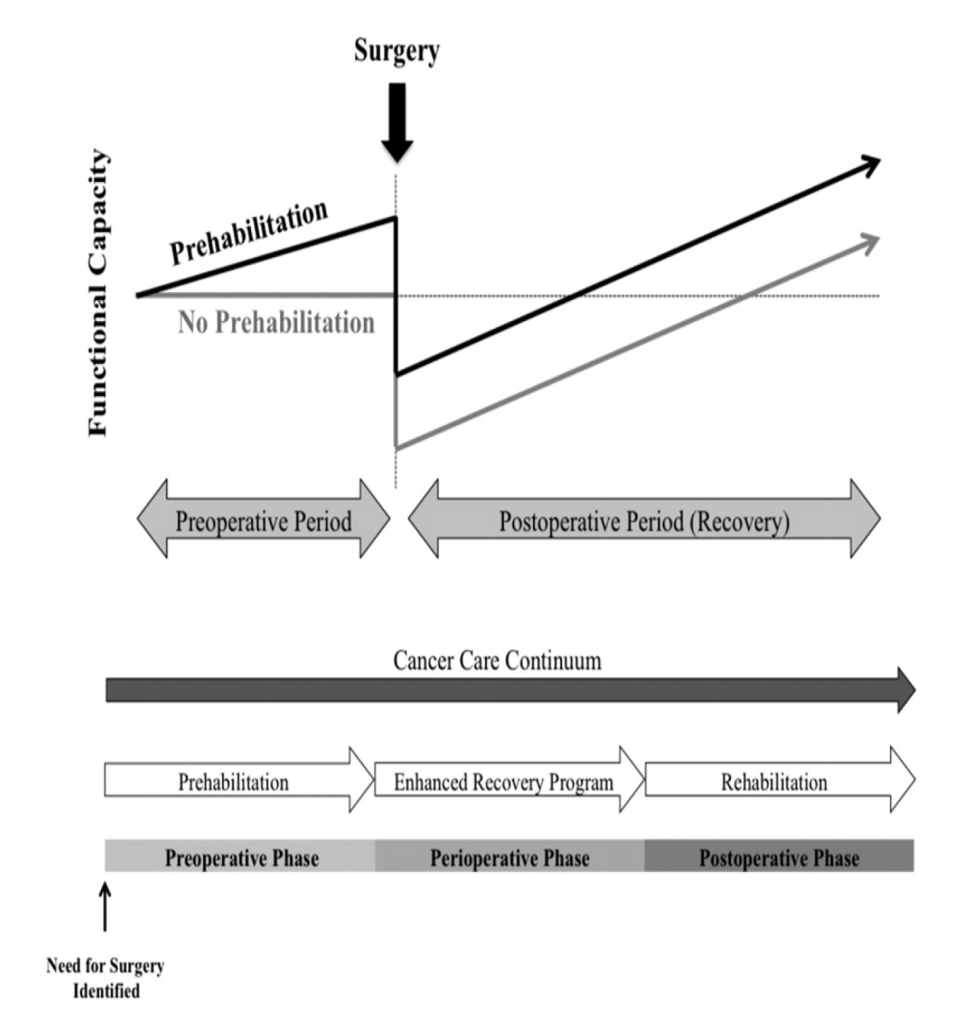
Prehab
Preparation for planned body stressor
MINNELLA ACTA ONCOLOGICA 2017
Notes:
Principles of Prehab….emerging evidence….

Slide 8
What is Prehabilitation?
The preparation for the physiological and psychological challenges of cancer treatment
Benefits:
Shortened recovery
Reduce treatment-related complications
Improve adherence & completion of treatment
Improve quality of life
Transition to lifelong habit of physical activity
Prehabilitation and rehabilitation are essential for reducing the future needs of people with cancer.
Independent Cancer Taskforce 2015 5-yr Strategy for cancer
Normal recovery
Complicated recovery
Reduces organ function
Accelerated atherosclerosis
Immune function altered
Treanor et al. Journal of Cancer Survivorship. Meta-analysis
Notes:
ZM

Slide 9
GM health is poorer than the UK average, with more people here suffering heart disease and cancer.
One in five people in Greater Manchester live in the one of country’s most disadvantaged areas.
More than two thirds of early deaths in our region are caused by smoking, alcohol dependency, poor diet and air pollution.
‘Invisible patients’ are more common in deprived areas and present as emergencies with advanced cancers
Notes:
ZM

Slide 10
Programme Model - Surgical
Prehab up to 12 weeks
Rehab 12 weeks
S U R
G E R Y
B R E A K
Supervised
3 monitored sessions per week
Intensity/Duration/Mode prescribed by specialist
Continuous
Steady State CV (40-70% Max Hr)
Progressing intensity based on HR & RPE
MSE combat sarcopenia
3x weekly sessions
Post Surgery update
Contact 4 – 6 weeks post
Establish plan of action for commencing rehab with Post Op Assessment
Patient centred Rehab
12 week pass to local gym
Prescribed exercise programme and supported sessions with specialist
Signposted to local community activities to promote long term exercise adherence and improvement of health
Positive exit strategy
ASSESSMENT
Universal
1-1 session with specialist to prescribe exercise programme
Weekly progress updates
Independent exercise at local leisure centre
Re-HIIT
Interval type exercise
Work : Active Recovery (60-80+ Max Hr)
RPE & HR monitoring
MSE combat sarcopenia
3x weekly sessions
Notes:
Walk Test results determine supervised or universal pathway 400+ metres universal along with medical status and overall picture of clients

Slide 11
Programme Model - Treatment
Pre-Treatment
During treatment
Rehab 12 weeks
Progressive/Continuous
Steady State CV (40-70% Max Hr)
Progressing intensity based on HR & RPE
MSE combat sarcopenia
3x weekly sessions
TREATMENT BEGINS
No expectation or target number of sessions
Patients receive support contact calls from specialists with advice and education around fatigue management
Offer of supporting patient to maintain some level of activity
Any pre prescribed programme is adjust for frequency, intensity & duration to accommodate treatment
Constantly adaptived programming throughout treatment
Post Treatment update
Establish plan of action for commencing rehab with Post treatment Assessment
Patient centred Rehab
12 week programme
Prescribed exercise programme and supported sessions with specialist
Progressive programme to help build patients functional capacity.
Focus on patients aims and goals
Motivational and behaviour change strategies used to build long-term adherence
Assessment
Re-HIIT
Interval type exercise
Work : Active Recovery (60-80+ Max Hr)
RPE & HR monitoring
MSE combat sarcopenia
3x weekly sessions

Slide 12
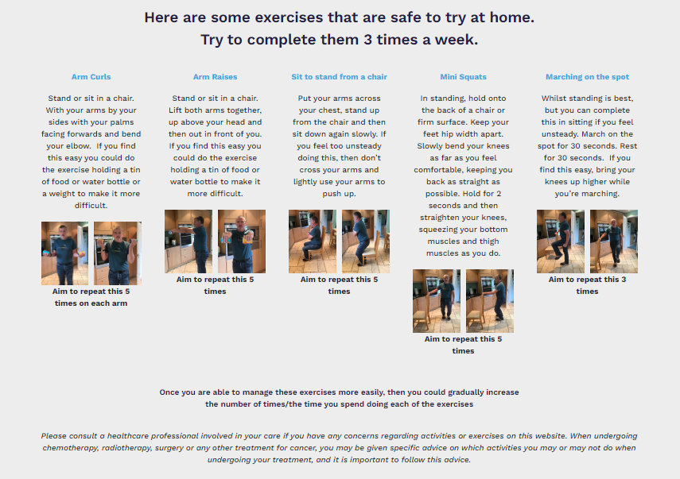
Prehab advice for non-eligible patients
Notes:
Website includes:
Advice on exercising
Exercises to try at home
Links to youtube channel with video demonstrations by exercise specialists
Nutritional advice and links to other resources
Wellbeing advice and links to other resources, including signposting for self referring to mental health services in Greater Manchester, and how to find local mental health services elsewhere.

Slide 13
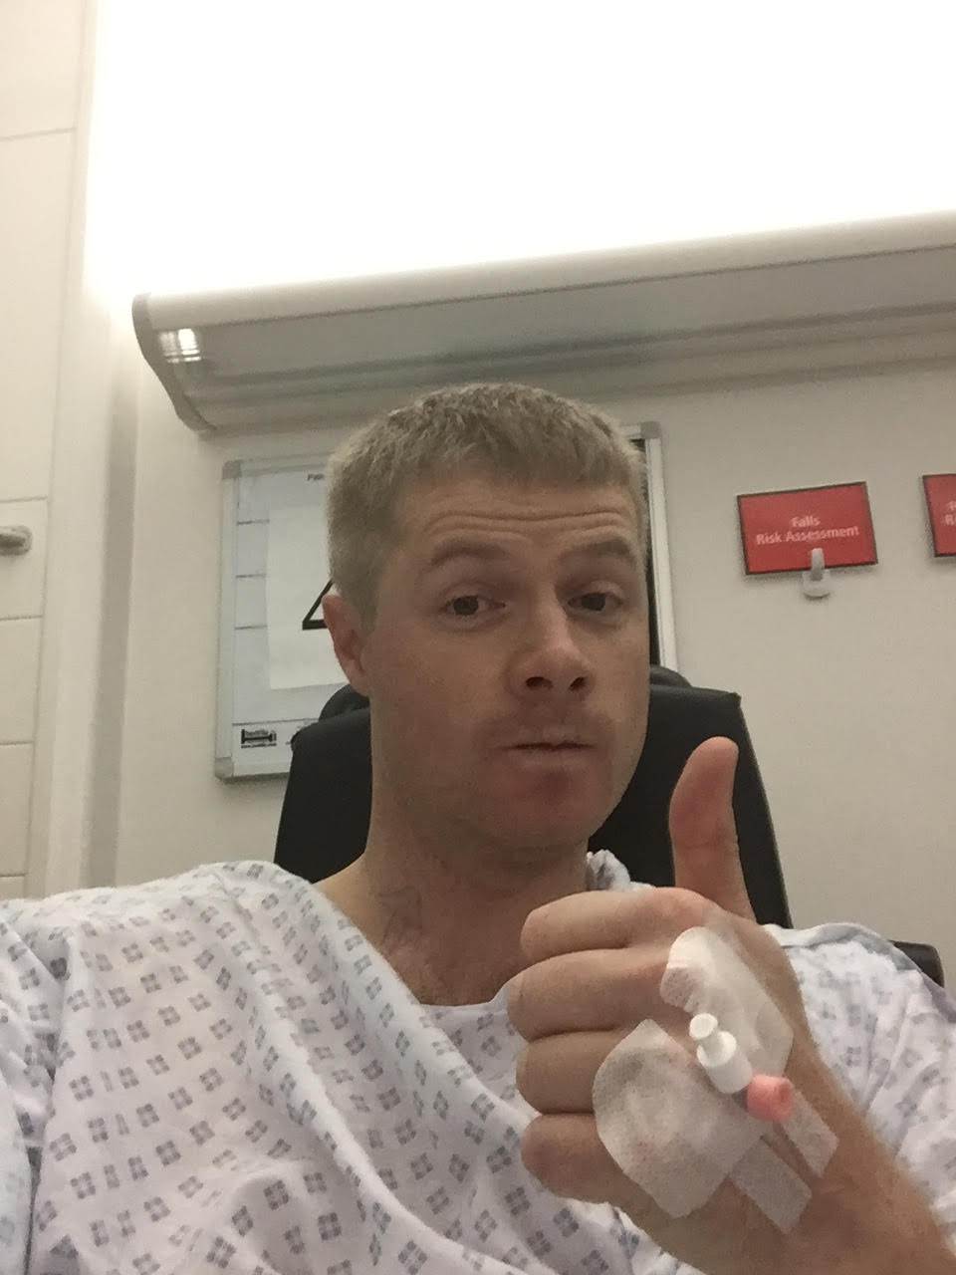
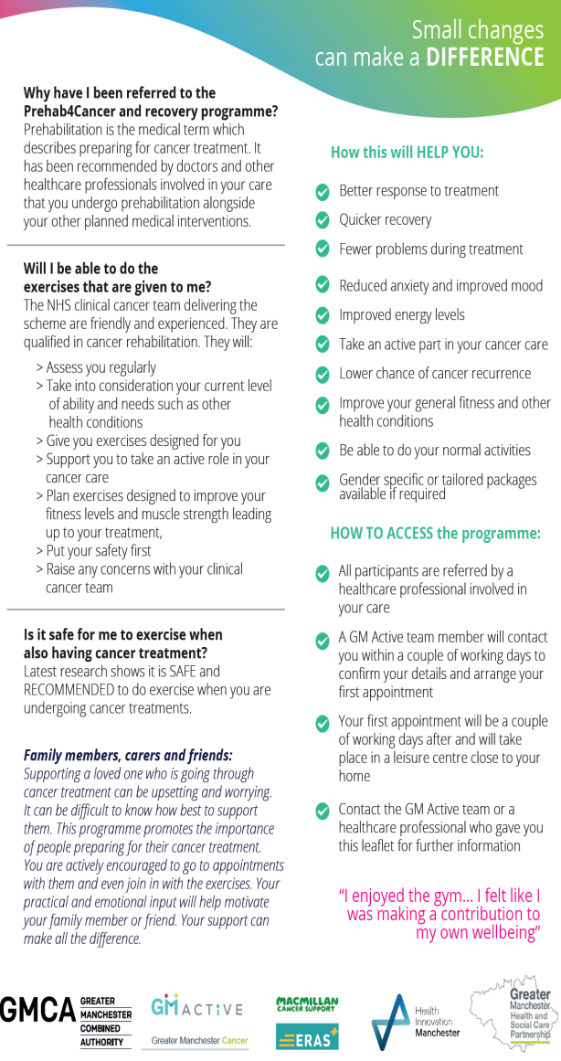
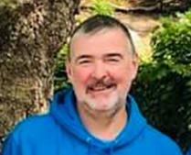
User Involvement: co-design & co-production
Notes:
Co-designed with people affected by cancer

Slide 14
Remote Service Delivery (COVID)
Referrals continued throughout lockdown. Referral form updated to include Blood Pressure, Resting Heart Rate and O2 Sats
Patients contacted >48 hours from referral, telephone/video call initial assessment
Personalised Home Exercise Pack sent via e-mail or post incl. resistance bands
2x a week tel/video call exercise sessions (Targeted 40%), 1x a week tel/video call exercise sessions (Universal 60%)
Intervention videos available via YouTube, Live exercise session timetable, Digital Heart Rate Monitors (MyZone) supporting assessment + adherence
1000 Patients have accessed the programme since the Pandemic began
Over 1500 attendances at online classes
85% Engagement Rate
***Co-design to plan for safe return to face to face assessment clinics & exercise sessions from May 2021

Slide 15
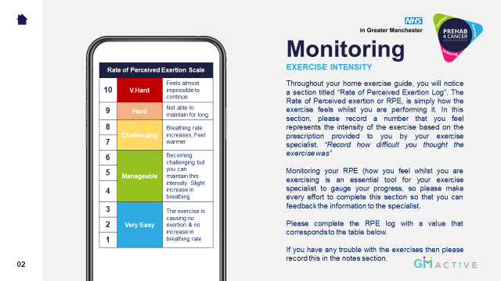
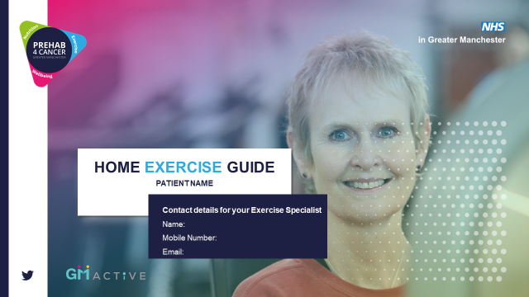
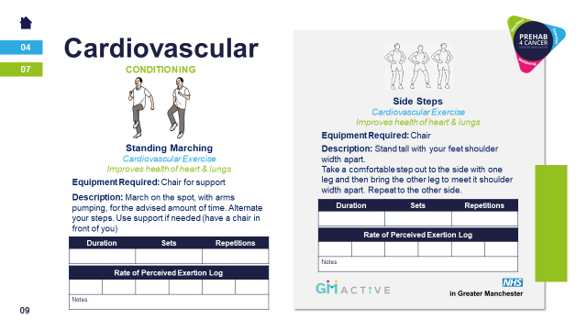
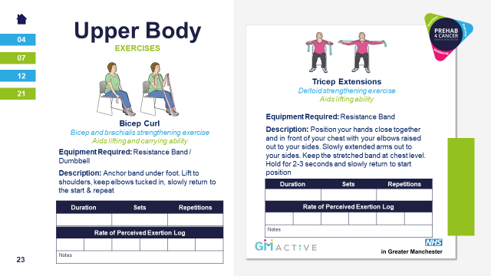

Slide 16
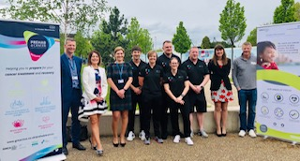
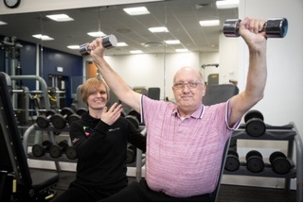
Launched April 2019….
Over 1000 patients referred in first year
80% participation rate
94% uptake rate from initial assessment
100% patients accessing service locally
Participants are showing clinical significant improvement in fitness during prehab phase & improved recovery post-surgery. Nutritional status is maintained.
Participants demonstrate improved confidence, motivation, sense of control & overall patient experience *anecdotal from HCPs across GM & through participant focus groups

Slide 17
Overview Figures
Outcome Measures:
Clinically significant CV Function improvement - >50m on 6MWT and >65m on Incremental walk test
Stabilised weight & BMI across all 3 tumour groups
Significant improvement for lower body strength (+5 on Sit to Stand test)
Increased sense of Wellbeing and Quality of life measured on validated tools
Patients returning for Post Op assessment and showing fitness was better than their baseline
Full programme evaluation and our data has now been matched with hospital data to produce:
Length of Stay and Length of stay on critical or high care
Number of readmissions in 30 + 90 days post discharge
Mortality: patient survival at 30 days, 90 days, 1 year and 2 years post-surgery.
Independent assessment of programme now completed (https://www.scwcsu.nhs.uk/case-studies/evaluating-the-success-of-the-prehab4cancer-programme )
Notes:
IMPACT

Slide 18
Colorectal | Baseline | Preop | Post Op | Completion
Weight (kg) | 83.3 | 84.6 | 77.8 | 77.4
Leg Strength | 24 | 31 | 27 | 39
Self Efficacy | 67.6 | 75.8 | 73.5 | 75.2
WHODDAS | 3.5 | 2.7 | 3.6 | 1.9
Upper GI | Baseline | Preop | Post Op
Weight (kg) | 80.2 | 76.5 | 67.1
Leg Strength | 27 | 28 | 22
Self Efficacy | 70.2 | 74 | 68.5
WHODDAS | 3.9 | 2.1 | 6.5
.
Lung | Baseline | Preop | Post Op | Completion
Weight (kg) | 72.8 | 71.5 | 70.8 | 74.8
Leg Strength | 22 | 27 | 20 | 26
Self Efficacy | 67.5 | 73.3 | 69.4 | 70.4
WHODDAS | 5.5 | 4.0 | 6.2 | 2.6
@GM_Cancer I #VCW2021

Slide 19
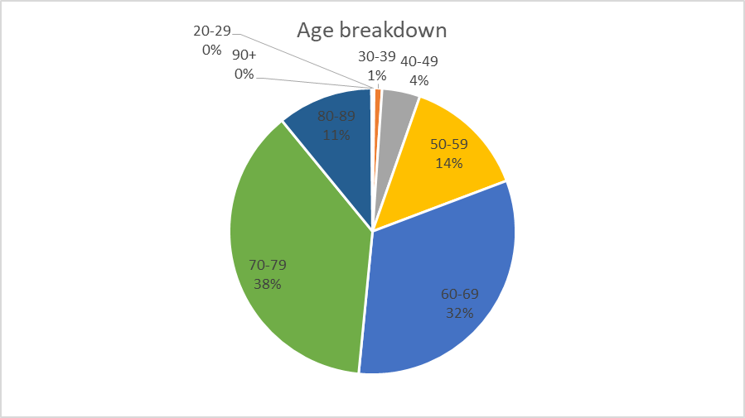
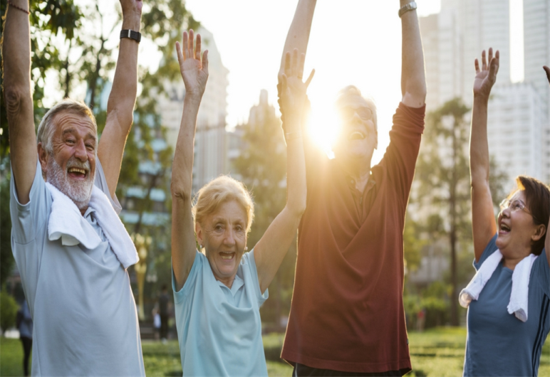
Prehab4Cancer participants (by age)
Age SHOULD NOT be a BARRIER to exercise…

Slide 20
Physiological assessments (walk tests)
Six Minute Walk Test (6MWT) – frail, older patients or those contraindicated for the ISWT.
Incremental Shuttle Walk Test (ISWT) – standard ax. within lung pathway, bleep test
Notes:
KRG

Slide 21
P4C Patient Quote 1
Patient improved Sit to stand from 28 to 40 in 3 weeks. Patient quote 'I knew I had people checking on me so had to do my exercises, also I wanted to go into surgery knowing I'd done everything I could - no regrets'

Slide 22
P4C Patient Quote 2
Patient has just improved Sit to Stand from 0-12 in 3 weeks of home exercise. Patient quote 'I was scared of the operation & felt like I HAD to do the exercises. Now I feel ready for the operation & WANT to do my exercises'

Slide 23
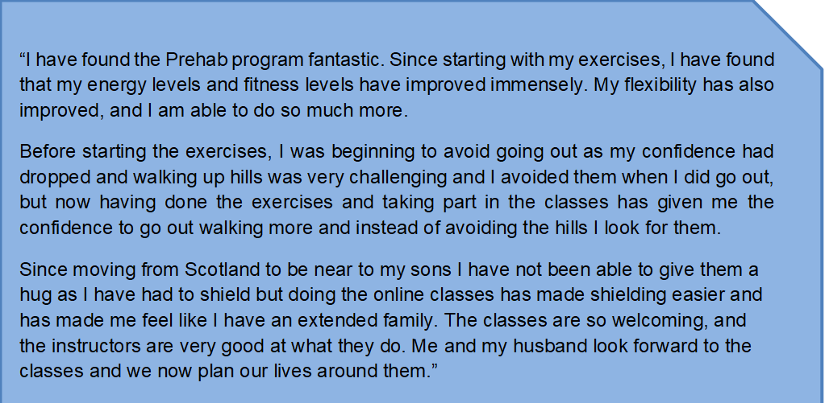
.

Slide 24
SUMMARY
Patient Level Data and qualitative interviews/focus groups shows:
Participants are showing clinical significant improvement in fitness during prehab phase & improved recovery post-surgery. Nutritional status is maintained.
Participants demonstrate improved confidence, motivation, sense of control & overall patient experience.
Participants maintaining healthy lifestyle behaviours beyond engagement in service provision, at 1 year follow up.
Notes:
ZM Conclusion

Slide 25
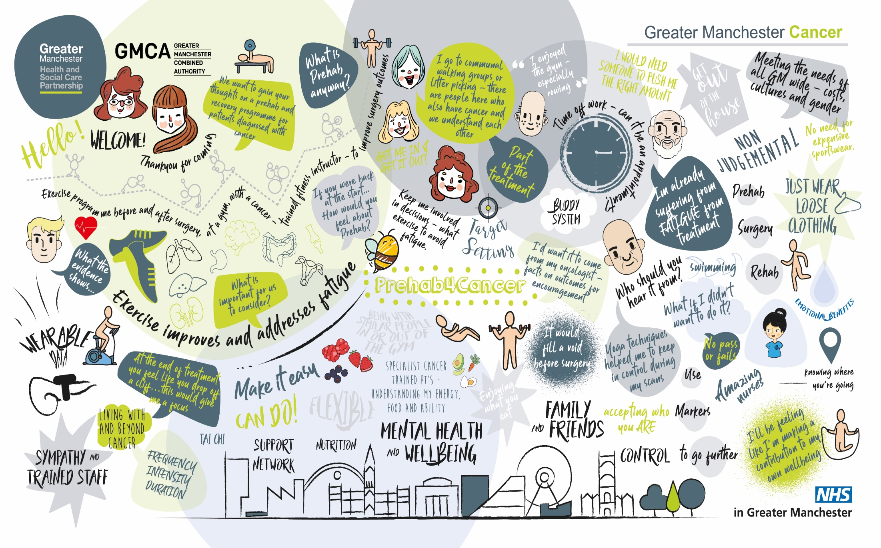
Notes:
ZM SALIENT POINTS FROM THIS GROUP – Patients perspective:
Consistent info – from oncologist/surgeon – part of treatment – need an appt letter,
Falling off a cliff
CONTROL
Fatigue
Therapeutic rapport – people involved
Personalised care!!

Slide 26
Notes:
Patient focus groups October

Slide 27
Where are we now?
Recurrent funding agreed
Approximately 1,000 patients per annum (despite covid)
Plans to increase cohorts to include more tumour groups
Ultimate aim to jump from 1,000 to 10,000 patients
Constraints
Finance
People resource
Independent Assessment confirms VFM
Award Winning

Slide 28
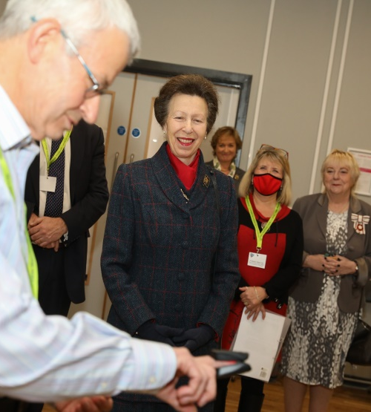
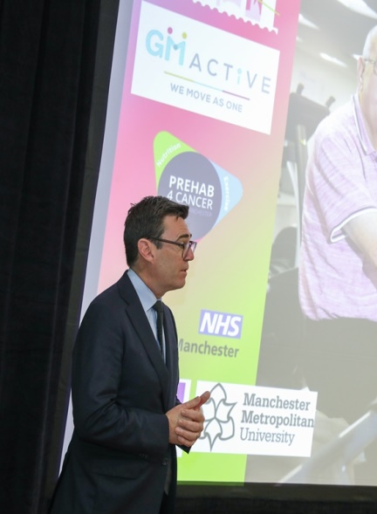
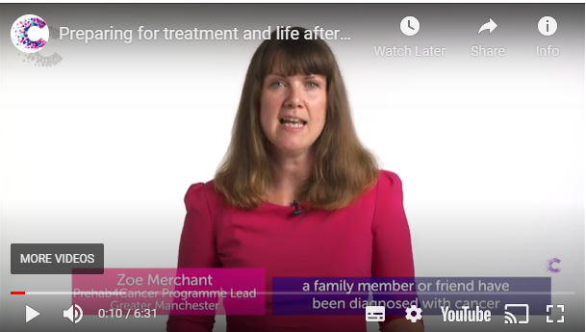
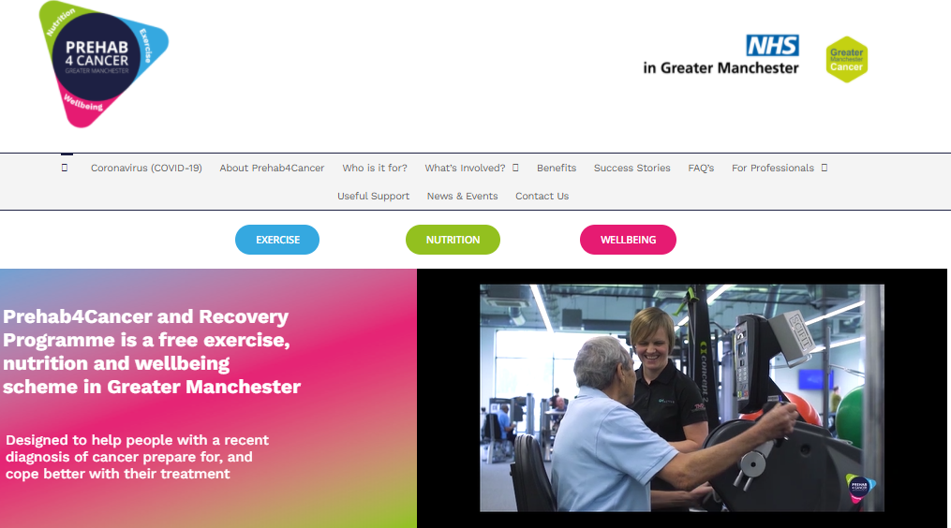
Greater Manchester Mayor Andy Burnham
Royal visit from HRH Princess Anne
Cancer Research UK, 2021 Prehabilitation resources
GM Active Training Academy
70,000 hits on P4C website
HSJ Partnership Award Winners 2022
Notes:
KRG
HRH: RCOT Patron
CRUK Resources easily accessible to Persons affected by cancer and professionals
GM Mayor – huge support and advocator of the programme. Winner of the GM commitment to moving

Slide 30
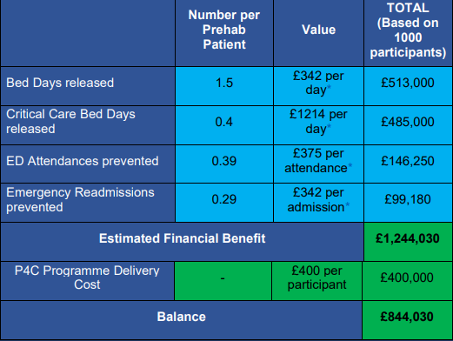
Health Care Resource Use & Associated Savings (ROI)
Reduced Length of Stay by 2 days = 381 bed days saved
Reduced 30 & 90 emergency readmissions = 35 bed days saved
Reduced Emergency Department attendances = 6 bed days saved
£400 cost per participant to deliver
£1,244 provider efficiencies per patient
Notes:
KRG: Link to less complicated recovery – benefit to patient and system proficiencies
Covid – Commissioning has changed but we needed to show effiencies using bed days as a proxy

Slide 31
Enhanced Monitoring for Better Recovery and Cancer Experience in Greater Manchester
© Copyright. All rights reserved 2021

Slide 32
The Enhanced Monitoring for Better Recovery and Cancer Experience in Greater Manchester
The challenge:
“There was a massive gap between GP and hospital care.”
EMBRaCE-GM PPI, Oct 2020
We need real-world data:
Sleep
Vital signs
HRV
Symptoms
Activity levels
Digital phenotypes of recovery
Data to stratify interventions
Support development of digital cancer care tools
Inform drugs and therapeutics trials
© Copyright. All rights reserved 2021

Slide 33
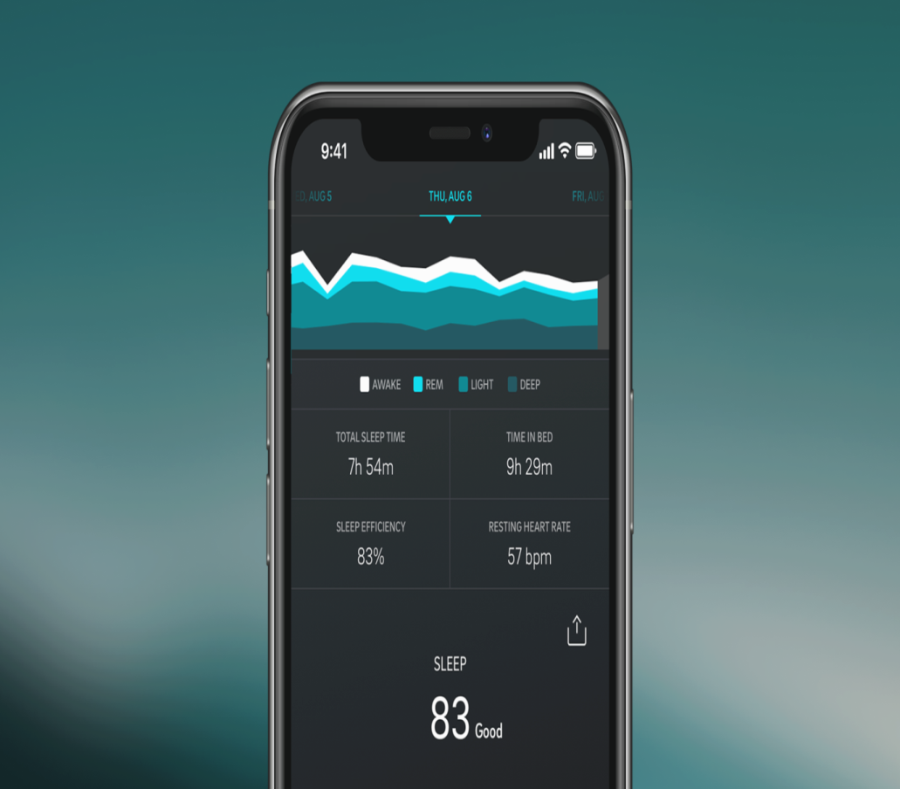
The solution
Commercial wearable vital signs monitoring…
OURA RING
Sleep
Fatigue
Physical Activity
Mindfulness
Relaxation
Heart Rate
Temperature
Mental Health
Objective, patient generated. With PROMs from mobile devices.

Slide 34
Aims
Can wearable vital signs monitors provide useful data during cancer treatment?
Are such devices acceptable to patients?
What could we achieve with the data obtained?
What do health care professionals think of this data?
Different patients, different treatments and different devices…
…are the answers the same?
© Copyright. All rights reserved 2021

Slide 35
There are lots of questions to answer…
How do activity levels reflect recovery?
How does cancer treatment affect patients’ sleep and fatigue levels?
Can heart rate variation predict a good recovery? Or identify problems?
Can we get computers to analyse the data to predict problems in advance?

Slide 36
Conclusion
Patient involvement in co-design vital
Patient driven and led
Patients front and centre
Evidence that exercise is important for cancer patients now overwhelming
VFM now proved
Walking the walk as well as talking the talk

