Slide 1
An Overview of the NHSE Pt Safety Incident Response Framework
Prof Helen Young
Chief Nurse /SRO NHS111 Covid Response Services
NHS South Central Amb Service

Slide 2
Content
What it is?
What are the differences between old and new systems?
How to Prepare?
When will it be implemented?

Slide 3

What is the PSIRF
Part of the National Safety Strategy
Patient Safety Incident Response Framework
NHSE based and available to see with resources on NHSE website

Slide 4
What is the PSIRF?
Part of the national NHSE Patient Safety Strategy
The PSIRF will replace the Serious Incident Framework (SIF)
Broader scope:- PSIRF moves away from reactive and hard-to-define thresholds for ‘Serious Incident’ investigation and moves towards a proactive approach to learning from incidents.
Promotes a range of proportionate safety management responses.
Investigation approach: safety investigation is now tightly defined.
Quality of investigation is the priority with the selection of incidents for safety investigation based on opportunity for learning and need to cover the range of incident outcomes.
Experience for those affected critical - expectations are clearly set for informing, engaging and supporting patients, families, carers and staff involved in patient safety incidents and investigations.
Orgs must implement Just Culture approach where staff involved in incidents are treated with equity and fairness.

Slide 5
Patient Safety Investigations in future:
Investigator must have expertise, experience, time and authority.
PSIRF clarifies investigations must be led by those trained and experienced in patient safety incident investigation (PSII), with the authority to act autonomously and with dedicated time and resource.
Investigation timeframe are more flexible and set in consultation with the patient and/or family. They should average three months and never exceed six.
Terminology - ‘systems-based PSII’ replaces the term root cause analysis (RCA).
Governance and oversight is strengthened, with commissioners and local system leaders assuring plans and co-ordinating investigations spanning multiple settings. Provider boards now sign off PSII quality and safety improvements.

Slide 6
Differences between old and new systems.
Moves away from reactive and hard-to-define thresholds for Serious Incident investigation and towards a proactive approach to safety and learning investigations.
Selects incidents for PSII based on the opportunity for learning.
Selects PSIIs for learning to ensure the wide range of outcome severities is covered.
Introduces local provider patient safety incident response plans (PSIRPs) to be agreed with commissioners.
Highlights alternative, proportionate and effective responses to incidents (eg case note review, timeline mapping, ‘being open’ conversations, after action review, audit, to better describe common review activities and address queries.
Prioritises the quality of PSII to support and focus on safety improvement.
Supports more balanced allocation of resources to develop improvements and equity of care from PSII findings

Slide 7
Differences between old and new systems.
PSII to be led by those with PSII training
experience of conducting quality PSIIs
Authority to act autonomously
Dedicated time and resource to conduct a good quality PSII.
PSII methodology
‘Systems-based PSII’ or a ‘systems approach to investigation’ replaces the term ‘root cause analysis’ (RCA).
PSII relates only to ‘comprehensive’ and ‘independent’ investigations.
Replaces previously termed ‘concise investigations’ with techniques such as audits and reviews.
Discontinues use of the ‘5 Whys’ technique as it is inadequate when used literally, in a linear fashion or as the sole analysis technique.
Promotes analysis techniques that facilitate a systems approach to identification of the interconnected contributory, human and causal factors.
Moves from over-reliance on documentation and statements to increased use of listening, interviews, discussion and observation.
Identifies system strengths as well as problems (together with their associated mitigating and contributory factors)

Slide 8
How to Prepare – the introductory model is out for review and used by Early Adopters.
It has 3 parts
Prepare for Incidents (4 steps)
1. Establish behaviours or reporting, learning and a culture of quality improvement
2. Develop your Strategic Safety Plan based on your organisation incident history
Design your system to support the needs of those affected by the incidents you are seeing
4. Prepare, test and retest your response to incidents to identify and improve on any weaknesses

Slide 9
How to Prepare – the introductory model is out for review and used by Early Adopters.
It has 3 parts
Respond to Incidents (4 steps)
1.Take immediate remedial action when the need is identified
2. Select and undertake investigations into the appropriate incidents based of your strategic safety plan
3. Provide support for all those affected (staff and patients)
4. Develop, implement and monitor all improvements made using the QI cycle

Slide 10
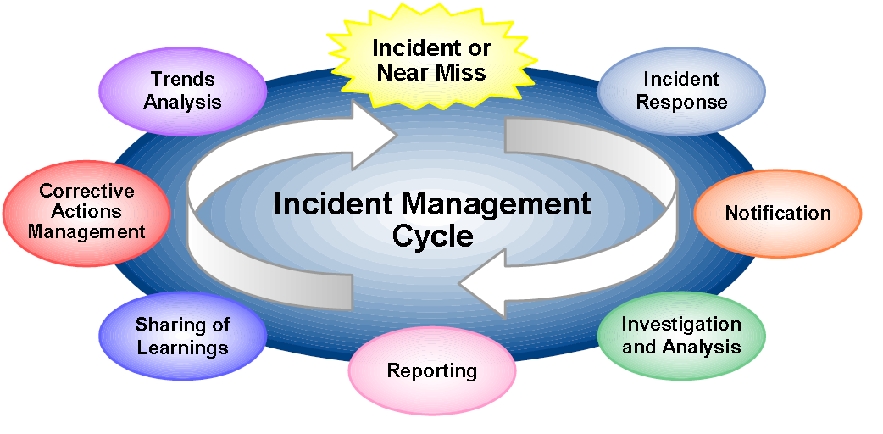
How to Prepare – the introductory model is out for review and used by Early Adopters.
It has 3 parts
Oversight of Incident Management
Design your system wide governance and risk share arraignments with commissioners providers and partners
Designate specific roles and ensure all appropriate experience and training of those involved

Slide 11
When?
Early Adopters working with it now from each area/sector
Delayed a little due to Covid
Early 2022 all expected to start engaging so be ready!

Slide 12
Thank you ☺
Helen.young@scas.nhs.uk

