Slide 1
PSIRF
Early Adopter
Experience and Learning
Marcia Meaning
Head of Nursing Patient Safety
Isle of Wight NHS Trust

Slide 2
Introduction
Our experience as an early adopter
Leading the way on the PSIRF and how the Trust has implemented the pilot scheme
Challenges and barriers to implementation
Early successes
Learning from incidents

Slide 3
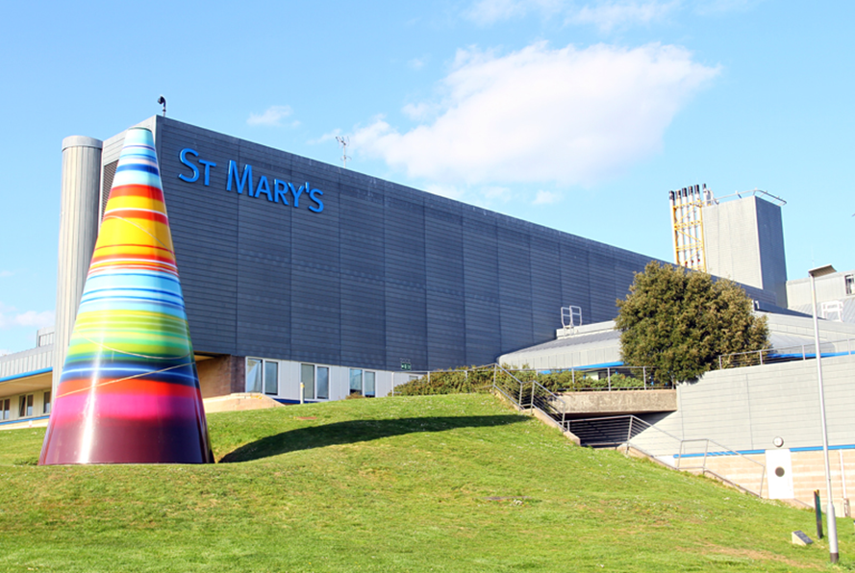
Local Context
Single Trust serving a resident population of 140,000 that increases significantly in Summer
Unique organisation - Isle of Wight NHS Trust combined Acute, Ambulance, Community & Mental Health provider
One commissioner
Datix

Slide 4
First things first..
Identified a project lead for implementation
Identified dedicated staffing resource
Project Group
Data Collection and Analysis- consider your sources
NHS I/E Patient Safety Incident response plan template

Slide 5

Preparing for PSIRF
Engaged our executive team
Engagement meetings with key stake holders to explain PSIRF and PSIRP
Discussed priorities and narrowed down categories
Shared the plan to Trust Board

Slide 6

Preparing for PSIRF
Shared the plan with NHS I/E
Incident Response and Serious Incident review and Oversite meetings
Involved our commissioners
Staff engagement

Slide 7

Preparing for PSIRF
Briefed the Communications Team
Managed the transition
Agreed transition date
Go Live

Slide 8

Challenges and Barriers
Initial introduction to PSIRF provided by NHS I/E
Root cause analysis very well embedded
Existing investigators did not have systems learning approach
Changing mind set- Serious outcome does not mean PSII

Slide 9

Initially no Patient Safety Lead or Patient Safety Specialist
Coroner
External investigators
Ockenden Report

Slide 10

Early successes
Introducing the incident response and serious incident review and oversite meetings before we started PSIRF
Professional respect and challenge in the meetings
Increased focus on Duty of Candour and Being Open conversations
Introduction of alternative response techniques reduced the number of formal investigations reducing burden on Investigation Leads
Monitoring actions

Slide 11

Ongoing success
Number of incidents being reported increasing
Number of low harm/no harm incidents high, incidents with moderate harm and above low
Principles of just culture embedding
Staff engagement
Support from Commissioners and Regional NHS I/E team

Slide 12
Introducing a learning culture
NHS culture has changed over the last decade
Previously
  Reactive and bureaucratic
  Poor methodology focused on outcomes and severity rather than process
  Resulted in non-engagement, defensiveness behaviour and blame
As a Trust we are working towards
  Focus on learning as part of fair and just culture
  Concentrating on potential improvements rather than the investigation
  Embracing robust patient safety systems
  Shared learning with a focus on systems and process
  Supporting staff and particularly the ‘second victim’ of serious incidents

Slide 13
Characteristics of learning culture
Responsive to incidents, errors and complaints
Individuals who willing to report and co-operate
Respond positively to national reports and guidance
Feel empowered to address patient safety concerns
Confidence in communicating and sharing information
Willingness to learn from mistakes and near misses
Responsive to the need for change

Slide 14
Essential components of a learning culture
1
Build Trust
2
Encourage reflection
6
Formalise learning as a process
3
5
4
Demonstrate learning values
Enable knowledge sharing
Empower employees

Slide 15
Learning from incidents
Extensive time and resources committed to investigations
Most incident reporting systems are used for alerting, logging and managing incidents
Historic focus on the most serious outcome rather than opportunity for learning
Reporting is becoming more thematic than quantative
Action plans are being prioritised and other processes are supporting monitoring

Slide 16
Sharing the learning our story so far
Need to share learning from both incidents and near misses, as well as learning from what went well
Needs to be timely – the sooner the better
Learning should be shared repeatedly at every opportunity
  Individual patient and patient feedback
  Cluster reviews
  Themed newsletters
  Presentation to services and divisions
  Annual reports
  Scenario based learning

Slide 17
Embedding the learning
Embedding learning can be a challenge
Sadly, repeated incidents of similar nature have occurred
‘Rome wasn’t built in a day’
To embed learning
  Strong strategic and operational leadership
  Adequate time and resource
  Co-production and staff engagement
When does failure to learn become a conduct and capability issue?

Slide 18
Next steps
Increase patient and carer engagement
Appoint a Patient Safety Partner
Early implementer of the Learning from Patient Safety Events (LfPSE) system
Promoting and embedding Just Culture
Evaluate patient, carer and staff experience of PSIRF

Slide 19

Questions

