Slide 1
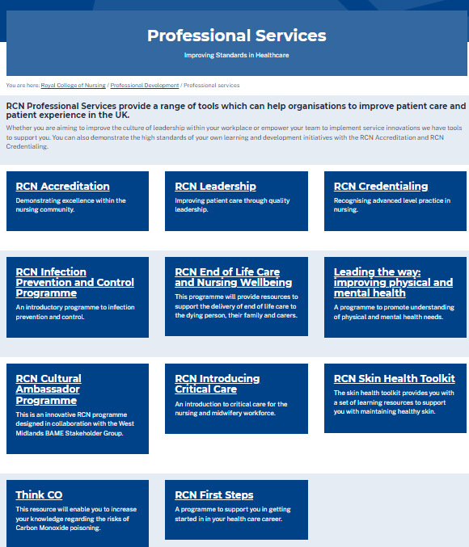
https://www.rcn.org.uk/professional-development/professional-services
@wendypresto
Ward Manager Conference
Wendy Preston RN MSc
RCN Head of Nursing Practice
Honorary Respiratory Consultant Nurse
Advanced Nurse Practitioner - OOH

Slide 2
Ward Manager – what hat’s do you wear?

Slide 3
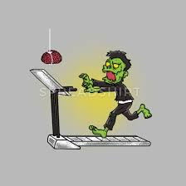

Slide 4
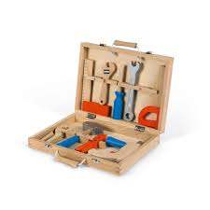
What tools do you need in your toolbox?

Slide 5
Staffing for safe and effective care?
Are you always supervisory?
…..or in the numbers often?

Slide 6
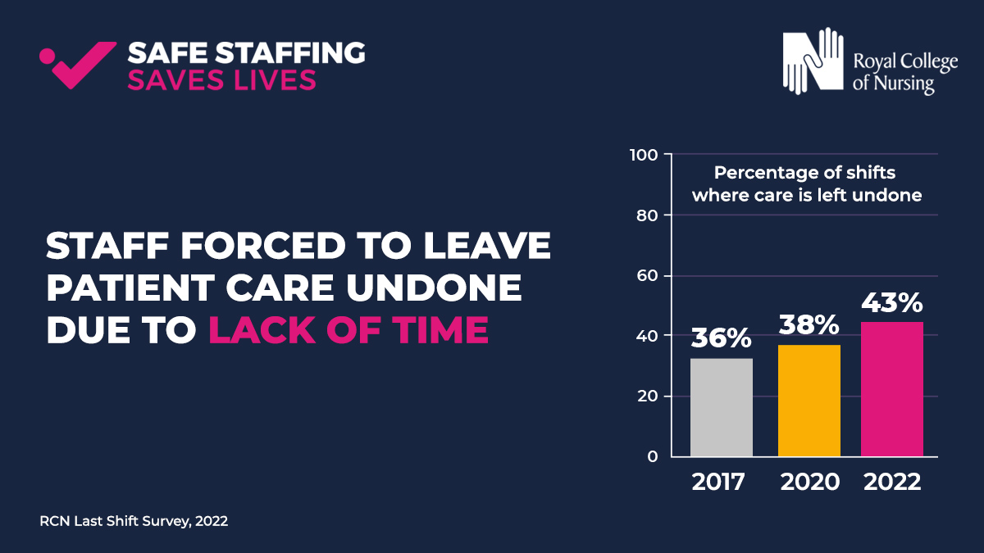
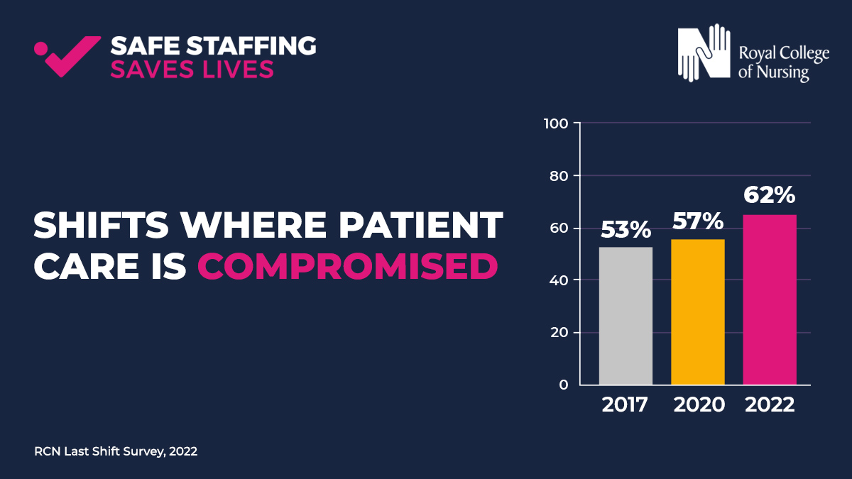
Last Shift survey report 2022
Notes:
Last Shift survey report - In March 2022, we invited nursing and midwifery staff from across the UK to tell us about their experiences of the last time they were at work. The survey provides valuable insight into the realities of staffing levels across the UK, and the impact on our members and the people they are caring for.
The questions address a number of issues, including adherence to the RCN Nursing Workforce Standards, planned and actual staffing levels and how these staffing levels affected patient care and the wellbeing of nursing staff.
TOP LEFT image - 83% of shifts lacked enough nursing staff to meet patient need, up from 73% in 2020.
TOP RIGHT image - Unreasonable pressures -nursing staff forced to leave patient care undone and this situation is worsening. NB Jane Ball's work
BOTTOM LEFT: 62% of 2022 respondents said patient care was compromised on their last shift – an increase from 2020, and 2017
BOTTOM RIGHT: Members said almost 70% of shifts lack the right skill mix needed to deliver safe and effective patient care (ref Standards 7, 10)

Slide 7
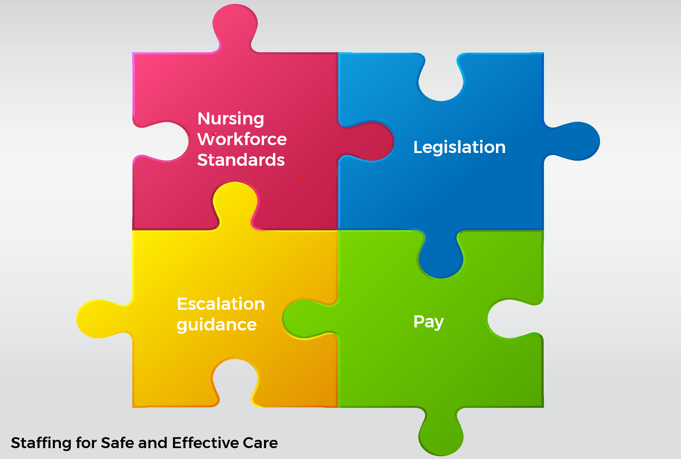
A new tool for your tool box…….
https://www.rcn.org.uk/professional-development/nursing-workforce-standards

Slide 8
About the Standards
The Standards apply across all areas of nursing and all sectors within the United Kingdom.
The Standards were co-created with expert consensus by the nursing professional body and the largest trade union for nurses.
The Standards are designed to support a safe and effective nursing workforce alongside each nation’s legislation. The 14 Standards are grouped into 3 key themes:
Responsibility and Accountability – 4 standards
Clinical Leadership and Safety - 6 standards
Health, Safety and Wellbeing - 4 standards

Slide 9
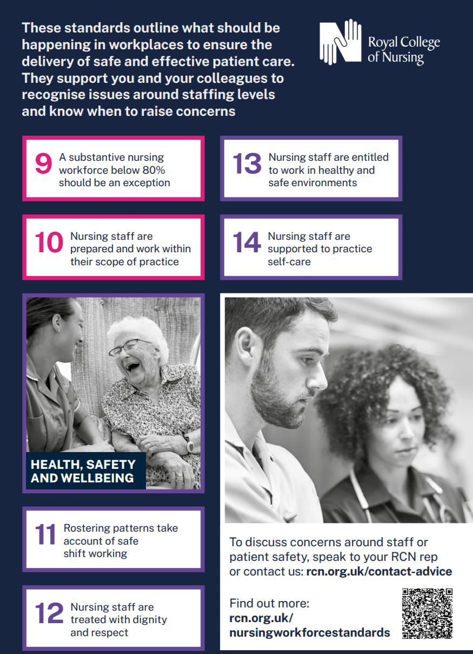

Slide 10
Registered Nurse Leadership
Standard
5
Standard
6
Examples
Registered Nurse Lead
Time & Resources to Lead
5a - Each team & service (e.g. Ward/ Community team/ Nursing Home) should have a registered nurse lead.
5b –If it is a wider MDT team and not managed by a RN then there must be a clear line to nursing leadership.
6a – Should be 100% supervisory (i.e. not planned to be in the numbers) – if not needs to be a documented exception and reported to board.
6b – list of what this resource and time is for.
6c – Role within leadership team needs to be included in job descriptions.
Notes:
DoN example

Slide 11
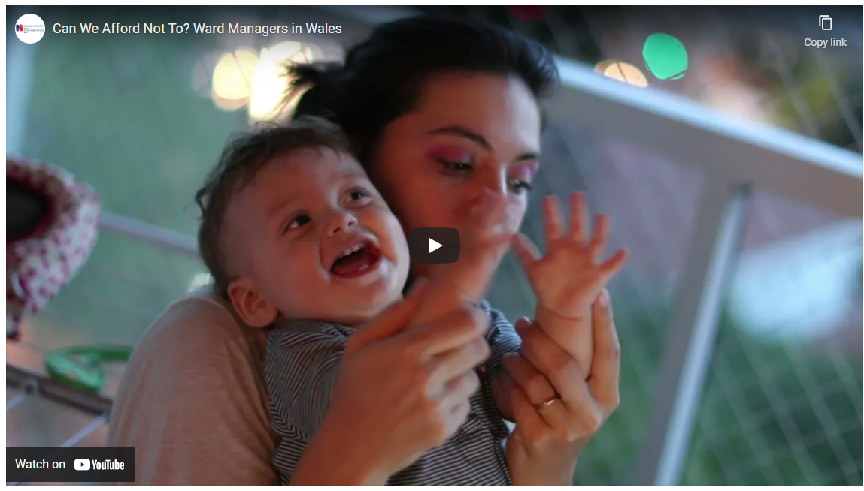
Ward Managers: The Importance of Being Supernumerary
We're excited to launch our new report and short film on ward managers in Wales: the issues they currently face, but also the impact great leadership brings in improving patient care and reducing adverse incidents.
Often responsible for around 30 patients and teams of around 40, ward managers need protected time when they aren't required to care directly for patients and can focus on managing and leading their teams. This is called being supernumerary, and it benefits both staff and patients.
This work was made possible by RCN members. Over 100 ward managers from across NHS Wales participated in three focus groups, interviews and an online survey. Their experiences and views formed the basis of our recommendations.
Full reports available at:
https://www.rcn.org.uk/wales/Get-Involved/Safe-and-Effective-Care
Video - https://youtu.be/CA7I8NcGslM

Slide 12
The standards complement RCN guidance published in November 2020: Raising and Escalating Concerns
View the publication
https://www.rcn.org.uk/professional-development/publications/rcn-raising-and-escalating-concerns-uk-pub-009425

Slide 13
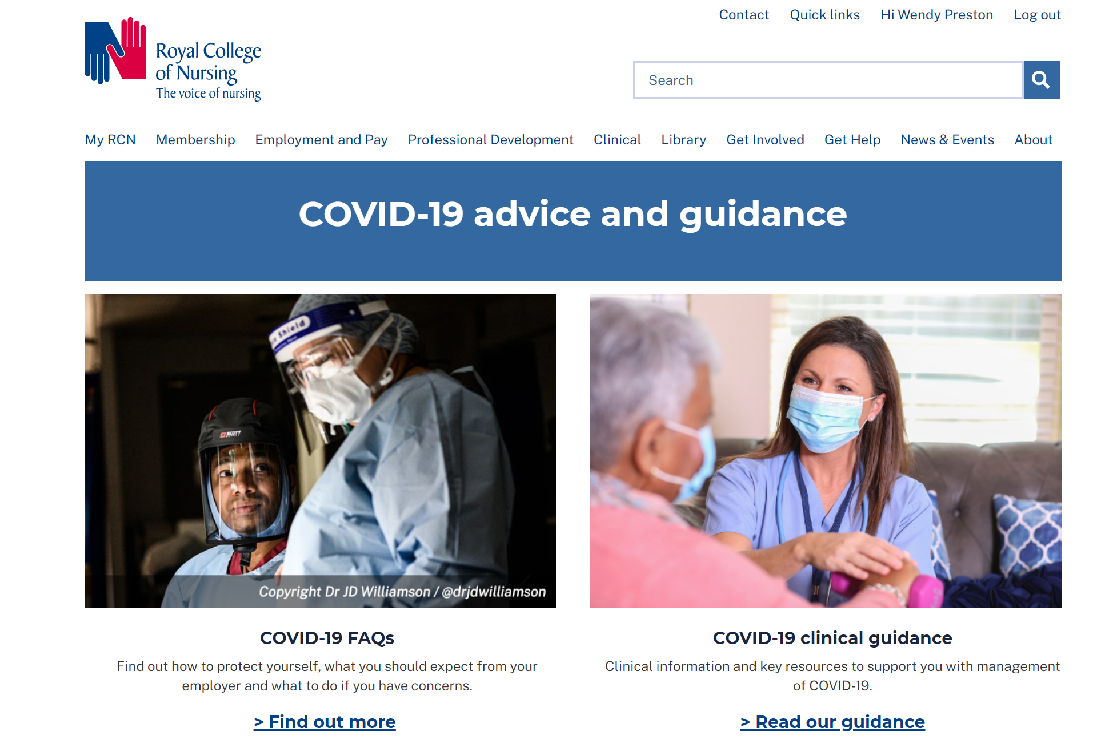
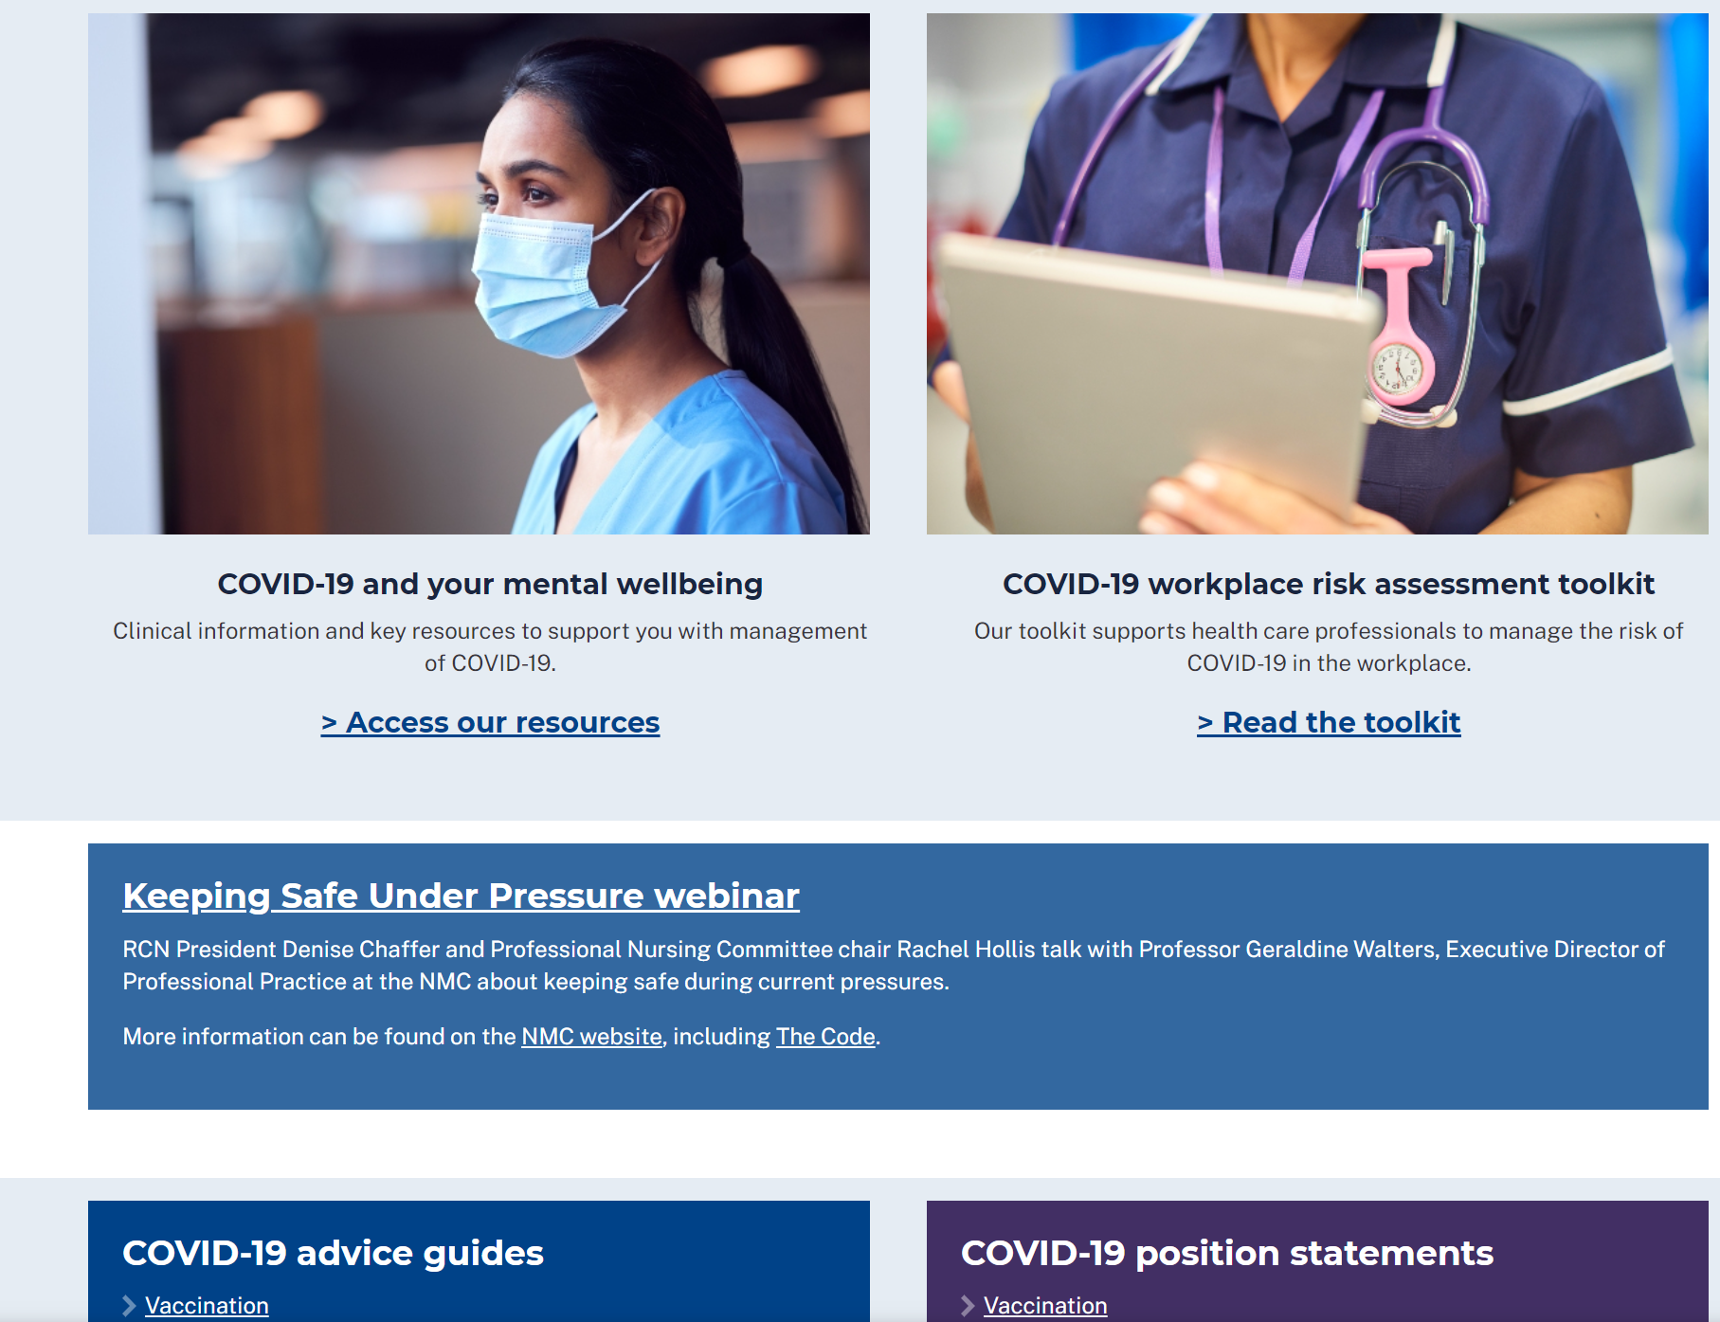
Covid-19 resources:
www.rcn.org.uk/covid-19

Slide 14
Today……..for your tool box
Exciting agenda
Becoming a Ward Manager: A Lived Experience – Leah Callighan
Developing your Ward leadership skills – Sally Bassett
Supporting Ward Manager to Lead through Covid-19
Driving Pride on the Wards: Delivering Ward Accreditation – Vicky Dunne
Safe Staffing at Ward Level: Real time monitoring & Red Flags – Rebecca Herring
Supporting Nurses in difficulty & managing performance – Sarah Freeman
Leading a ward through difficult & challenging times – Prof Helen Young
Last but definitely not least is finance and budgets – David Bailey
Enjoy…..

