Slide 1
The Parliamentary and Health Service Ombudsman
The new NHS Complaint Standards
Jo Power – Liaison Officer
Cat Bulger Dispute Resolution Caseworker 19 August 2022

Slide 2
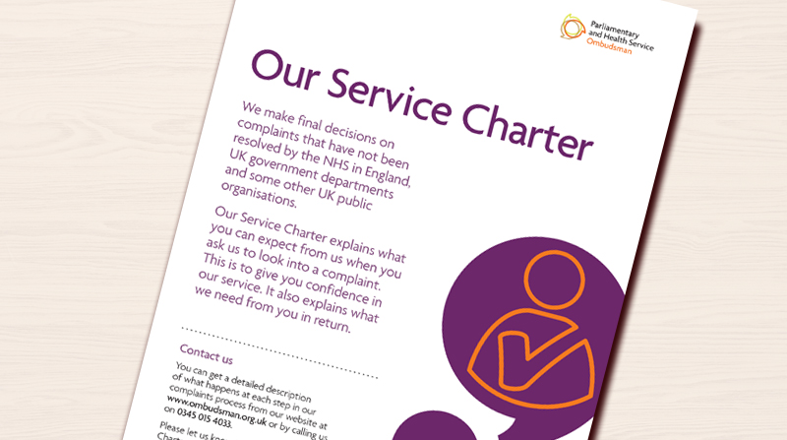
Overview
              The Ombudsman – a reminder
              Supporting and improving frontline complaint handling
              Implementing the NHS Complaint Standards
              Mediation – our dispute resolution service

Slide 3


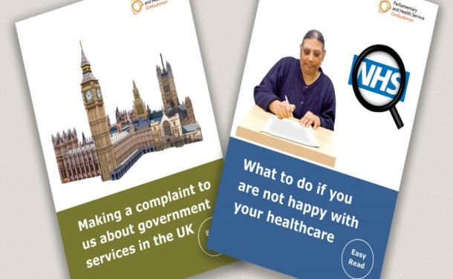
Our role
Parliamentary Commissioner Act 1967
Health Service Commissioners Act 1993
18%
82%
Complaints about UK government departments and public organisations
Complaints about the NHS in England

Slide 4

NHS complaints second and final stage - Ombudsman
Under Regulation 14(2)(c) and Regulation 14(2)(d), the local response must tell the complainant of their right to take the complaint to the Ombudsman
The Local Authority Social Services and National Health Service Complaints (England) Regulations 2009

Slide 5


The numbers – 2021-22
122,367 enquiries received
26,043 complaints were not ready for us
36,614 decisions were made, including:
  29,213 decided after initial checks
  29 cases resolved through mediation
  6,760 decided at primary investigation
  612 decided after detailed investigation

Slide 6
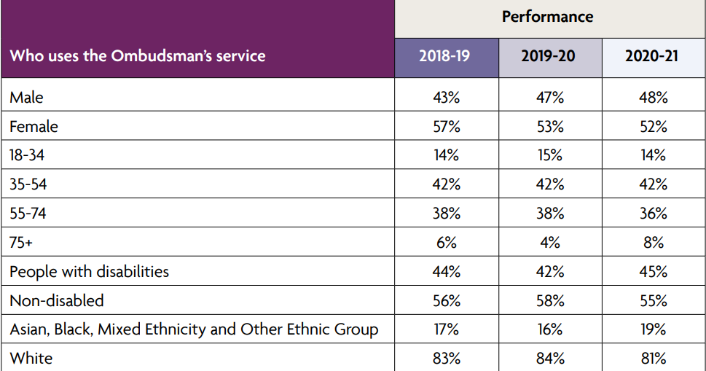
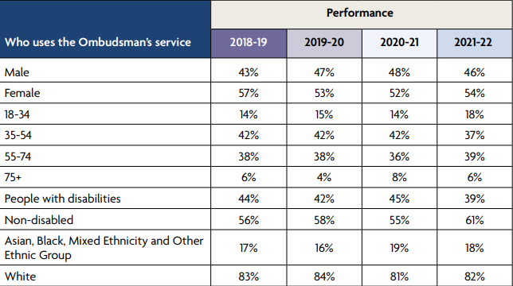
Our customers

Slide 7
Recommendations in 2021-22
We recommended 361 apologies | We made 294 service improvement recommendations
We recommended 85 other actions to put things right | Financial remedy recommendations totalled £265,656

Slide 8

Our casework process
Investigation
Our approach
We look to see if what happened was in keeping with relevant regulations, standards, policies and published guidance.
Our decision
If it wasn’t, we look to see how significant the shortfall is and what impact it has had and, if it has caused hardship or injustice, has that already been remedied by the organisation.

Slide 9

The NHS
Complaint Standards

Slide 10

Research found three core issues:
No consistency
No core training/support
Complaints not valued

Slide 11
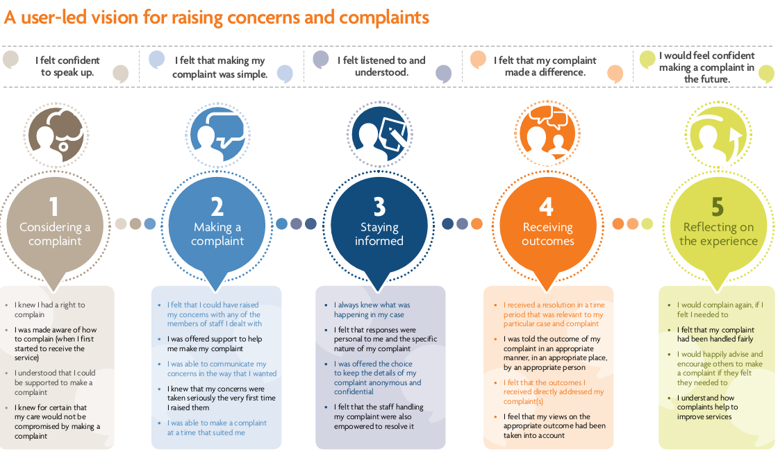
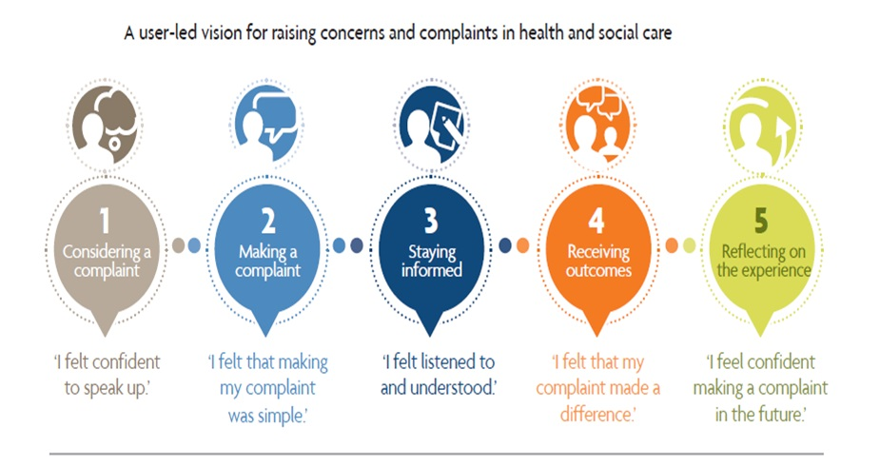
My Expectations

Slide 12

Do not reinvent the wheel
Based on existing guidance and good practice and draw this together into a single vision for all
Ensure you meet the requirements of the NHS Complaint Regulations

Slide 13
The Complaint Standards:
Set out a single set of expectations for NHS staff to follow when they handle a complaint
Support staff to deliver what people expect when they raise a complaint
Describe how NHS organisations can be ‘just and learning’ cultures by:
- taking responsibility when things go wrong
- celebrating positive feedback

Slide 14

The Complaint Standards

Slide 15


The launch – 30 March 2021

Slide 16

Pilot and Early Adopter phase
…. leading the way

Slide 17
Community of practice
Share experiences with other early adopter organisations
To join, email Liaisonmanagers@ombudsman.org.uk

Slide 18

www.ombudsman.org.uk/complaint-standards

Slide 19
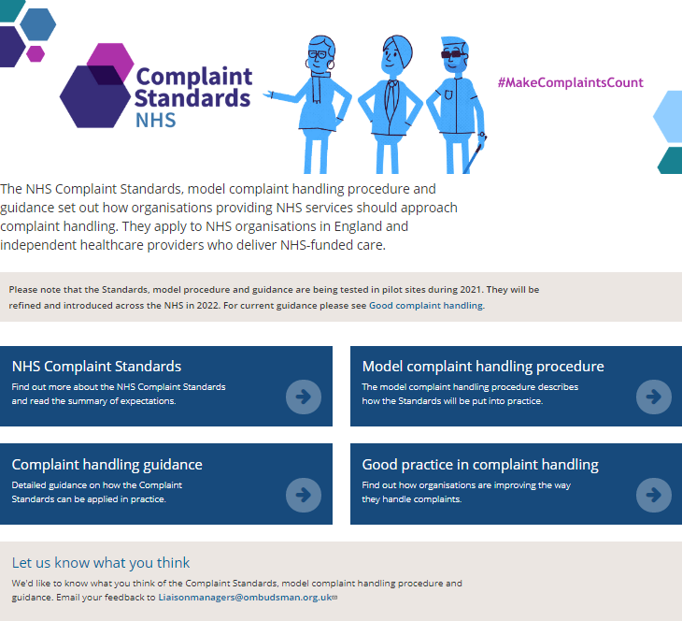
The Complaint Procedure and the Guidance is available on our website
www.ombudsman.org.uk/complaint-standards

Slide 20

Three Steps
How to work with your team and resolve complaints early where you can
If needed, how to carry out a full and fair investigation
If something has gone wrong, how to put things right and ensure learning is captured, embedded and services improve

Slide 21
There is a focus on early resolution of complaints and supporting people to do this

Slide 22
Quality responses and realistic timescales are important to build trust.
Keeping people updated and involved throughout may make the initial process longer but will reduce ‘comebacks’.

Slide 23

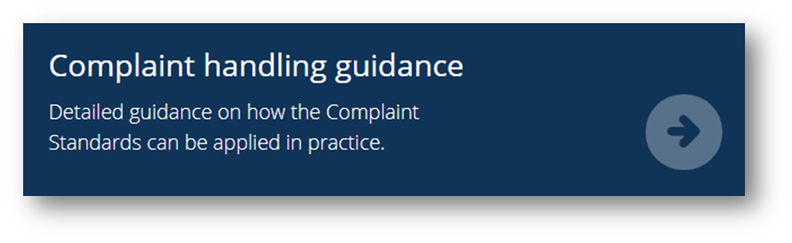
Make sure you share your feedback and suggestions on the model Complaint Handling Procedure and Guidance Modules
liaisonmanagers@ombudsman.org.uk

Slide 24
Next Steps
Refine & tailor materials
NHS Standards
Finalise end 2022
Consult & design
Engage, Refine, Tailor
UKCG Standards
Launch Sep 22
Finalise end 2022
Design, engage & begin using
Embed in casework
From Q1 23-24
Engage, training
Advanced training
Continue to embed
Jan 2023
23-24
24-25
Report on Progress

Slide 25
2023 – Launch to the wider NHS
PHSO will start to use the Complaint Standards to assess complaint handling at NHS organisations from spring 2023
PHSO worked with regulators from across the health sector when we developed the Complaint Standards and they will also use them in their complaint handling assessments.

Slide 26

Mediation at PHSO
Cat Bulger – Dispute Resolution Caseworker

Slide 27
What is Dispute Resolution?
We facilitate meetings between complainants and organisations to help them work together to come to a resolution to the complaint
We hold individual meetings first, followed by joint meetings where both parties attend
Our DR caseworkers are trained and accredited mediators. They make sure parties feel safe, understood and that those involved have time to explore their interests and needs.
We remain impartial and give no view on the complaint – parties get to decide how to resolve their complaint.

Slide 28
Why mediate instead of investigating?
Better outcome - what does the complainant want to achieve?​
Reduces communication issues – (as far as to diffuse conflict)​
Rebuild relationships​
Outcome is not dictated by us​
Can be a faster process than investigation​
Gives the opportunity for both sides to speak and be heard​
Apologising is not an admission of liability

Slide 29
Key facts and figures
Since starting using DR in 2019, we have now facilitated over 80 joint sessions.
2021/22 – We facilitated 29 joint sessions. In almost all of these, parties have confirmed the complaint has been resolved.
We have facilitated 26 joint sessions to date in this current business year with over 90% being resolved through this process. We are aiming to complete 100 sessions by the end of the business year and our three-year Strategy aims to have a fully developed mediation service.
We currently have 4 permanent DR caseworkers. 8 more caseworkers have recently been accredited.

Slide 30

Feedback on the DR process
…the meeting was a great experience for me, reinforcing the importance of listening to the service user and the feedback of the care they felt they received.
It’s a good way to get a grievance out there. As a rule, the process is good. Thinking about face to face or the phone, you can see their expression if it’s face to face so you know they are genuine. It’s a good thing to do to get it resolved
Operations Manager,
Healthcare Provider
October 2021
A complainant March 2022

Slide 31




Thank you
Website
www.ombudsman.org.uk
@PHSOmbudsman
Helpline
0345 015 4033
8.30 - 5.00 Monday to Thursday
8:30 –12:00 Friday
Parliamentary and Health Service Ombudsman
Email
liaisonmanagers@ombudsman.org.uk
Radio Ombudsman Podcast

