Slide 1
Supporting older people to live well with frailty
Dr Lis Boulton
19th August 2022

Slide 2
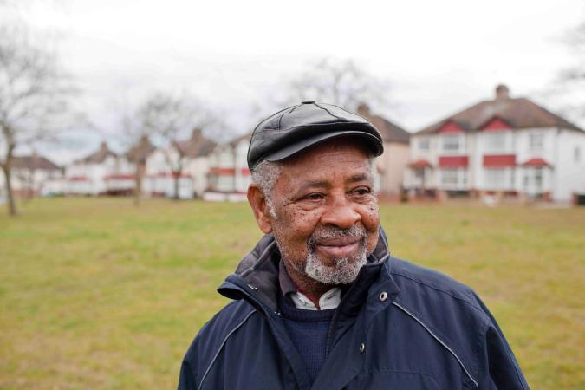
Age UK
Local, national and international charity working for and with older people.
135 Network partners across the four nations, delivering diverse services and activities.
Age UK - nationally - is involved in service development, research, campaigning and public policy
Information and advice services with around 6 million+ contacts pa.

Slide 3
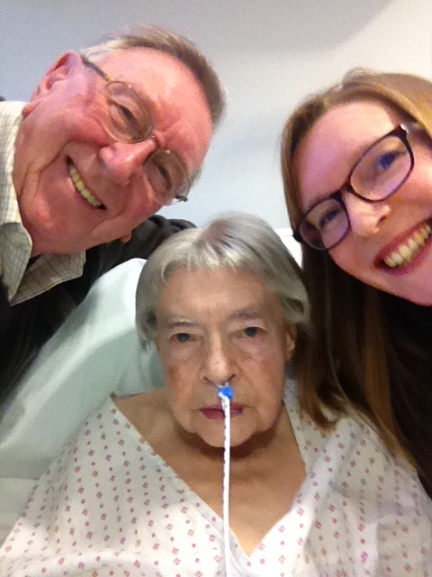
Frailty as a lived experience

Slide 4
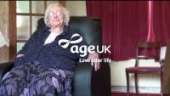
Older people’s perspectives on frailty
https://www.youtube.com/watch?v=VOAogfrv2A0

Slide 5
Language and perceptions
Frailty is a distinctive health state related to the ageing process in which multiple body systems gradually lose their in-built reserves. Around 10 per cent of people aged over 65 years have frailty, rising to between a quarter and a half of those aged over 85 (BGS).
We use frailty to describe something a person lives with, not what they are.
‘Frailty’ captures a range of needs, typically underscored by reduced, or reducing physical capacity.
Also indicates proximity to risk – a shock or crisis could have severe consequences for health and wellbeing.
People living with frailty might find it difficult to ’bounce back’ from relatively minor health of life events.
We see it as a collection of modifiable health and social needs, rather than an irreversible state. People can move in and out of living with frailty, as their health and circumstances change.

Slide 6
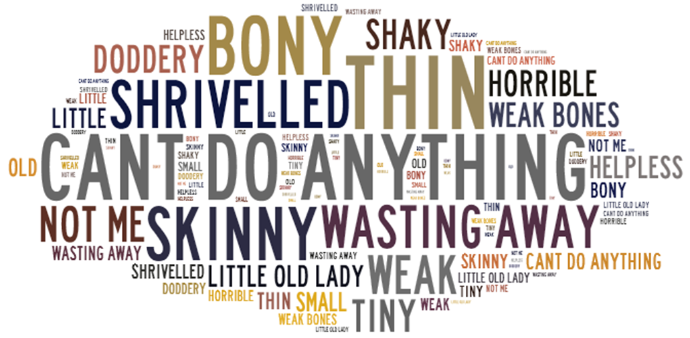
Language and perceptions
Older people don’t see themselves as frail; they don’t want that negative association.
But they talk about loss – of independence, of good health, of opportunities, of freedom.

Slide 7
Understanding the lives of older people living with frailty
Living with frailty
Independence and control
Support and assets
Adapting to life changes
Loneliness and isolation

Slide 8
Concepts of frailty
Biomedical | Lived experience
Risk | Change/transition
Deficits | Fear [of implications] and loss
“Unsuccessful” ageing | Loneliness
Compliance | Adaptation
Outcome of unhealthy behaviours | Resilience
Notes:
I

Slide 9
The impact of Covid on older people’s physical and mental health
Four waves of research – representative polling and free text surveys.
August 2020, February 2021, September 2021, March 2022
Online survey promoted through Age UK networks (March 2022)
    15,334 responders (1,250 answering on behalf of another person)
    100,675 individual free text responses
    Answering on behalf of another person
    94% aged 65+ and 74% aged 75+
  Representative online poll older people (Kantar, March 2022)
    All respondents aged 60+ with 16% 75+
    52% female; 40% from more disadvantaged groups
    13.5% from Black Asian Minority Ethnic communities

Slide 10
Covid restrictions had negative impact on physical activity
Being less physically active has made mobility and health conditions worse.
26% older people less fit; 28% can’t walk as far; 21% less steady.
16-19% finding climbing stairs, walking short distances and cleaning / tidying more difficult.
Significantly more people from less advantaged groups (21%) are finding walking short distances outside more difficult, compared to those from more advantaged groups (14%).
Older people from ethnic minority communities (21%) are less able to to stay fit than white older people (28%).
My wife’s general health declined a lot in the last two years plus waiting for hip replacement, in the end she could hardly walk, confined to a chair for most of the time.
Two years of keeping away from most people and not going out has certainly affected his physical and mental health.
I have severe osteoarthritis. It’s in my knees, hands and feet. My mobility is getting so much worse. I am stressed more than I was, as unable to function properly.
I lost a lot of mobility and confidence. I still have not been able to go out by myself for a walk.

Slide 11
Older people are living with more pain
24% older people living with more pain.
Significantly more women than men are living with more pain (27% vs. 19%), and 19% are finding it more difficult to go up and down stairs.
27% older people from less advantaged groups are living with more pain (vs. 19%), and 51% are not confident that their health will improve.
46% people with long term conditions are living with more pain and 52% say they can’t walk as far.
31% carers are living with more pain, and 22% are finding walking short distances outside more difficult.
Arthritic pain has made walking harder/more painful and thus my weight has increased with the added health problems.
Knock on effects [of] waiting so long made pre-existing spinal condition worse. Chronic pain, Cannot plan life… now finding it harder to think straight.
I wasn’t able to go out during the pandemic, my mobility deteriorated as the severe chronic back pain escalated.
Back and hip pain has worsened. Depression has also worsened.

Slide 12
Impact on people with long term conditions
Older people with long term conditions have not had access to their usual appointments to help manage their conditions.
37% respondents have long term conditions that affect their ability to carry out activities of daily living (ADLs).
23% said it was harder to look after themselves.
People with long term conditions found it significantly more difficult to perform all ADLs.
Significantly more concerned about their ability to access services, to stay fit and independent.
Significantly less confident that their ability and health would improve.
No face-to-face appointments for two years; I have two chronic health conditions.
His mobility has declined, and pain greatly increased, and the frustration of not being able to meet and discuss his condition or get answers to his situation has led to his becoming very depressed.
They suffer from five ailments, all of which have no cures. Her treatment is on going but is, simply put, firefighting. Her condition will continue to deteriorate and little or nothing can be done other than treat the symptoms, which will continue.

Slide 13
The loss of social contact continues to affect older people
Many older people are still feeling isolated, as previous activities and opportunities to meet people have not resumed.
43% are spending less time with friends; 32% spending less time with family.
Some older people are still not leaving their homes and are lonelier than ever.
40% are lonely and 6% don’t have anyone they could ask for help.
Lack of confidence in large groups, or indoor settings is widespread and is preventing social contact.
A big reduction in social activities and socialising, this is mainly by choice as the virus is still very much with us.
I feel the pandemic has robbed me of 2 years of my life where I should have been enjoying what time I have left.
Because of 12 different diagnoses, I remained totally isolated for over 2 years. I missed things like church, even seeing my daughter, felt hopeless and depressed.
Although fully vaccinated, I am less confident in going into crowded places.
Feel apprehensive when I go out especially as people and places seem to have stopped precautions. Don’t see family and friends very much.
Notes:
The worry for us is that many more older people are now living with frailty and reduced resilience, as a result of the pandemic.

Slide 14
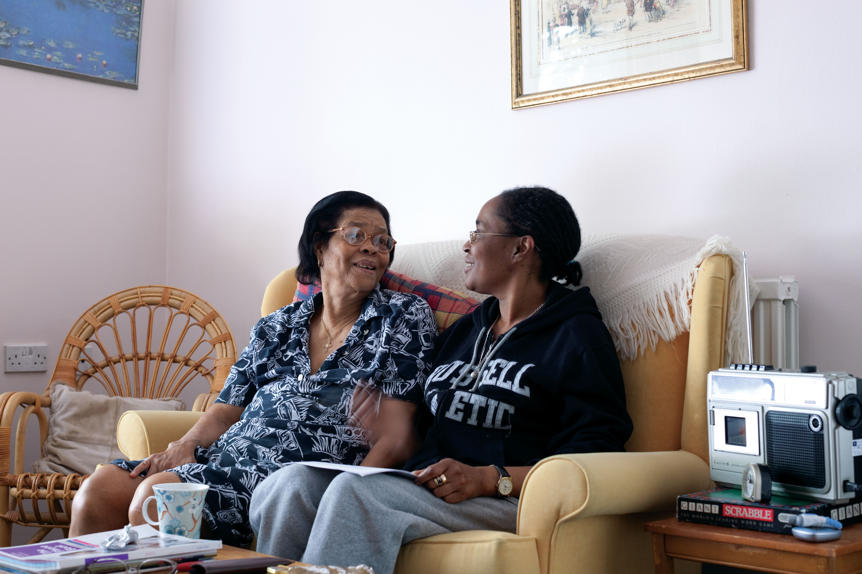
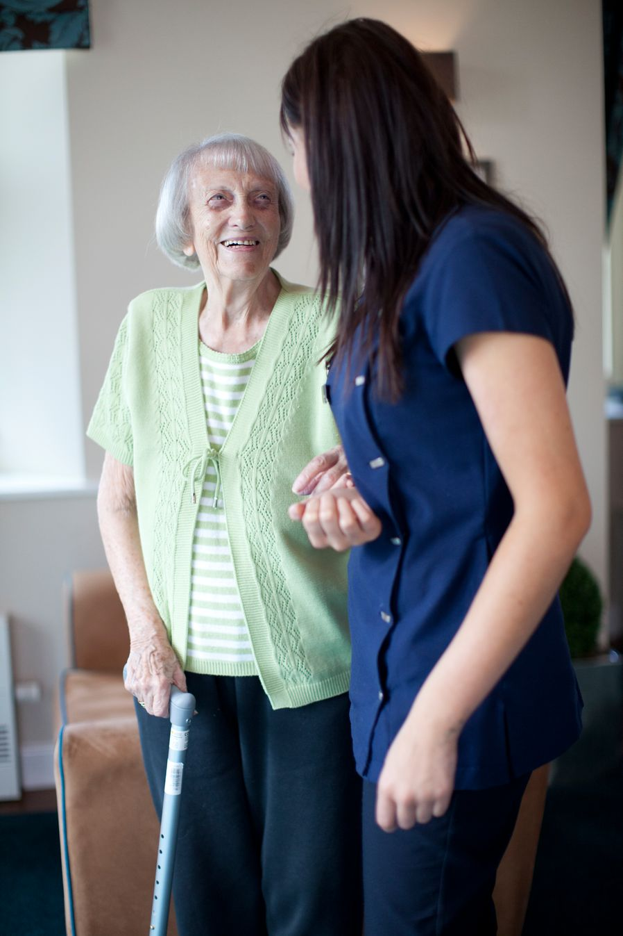
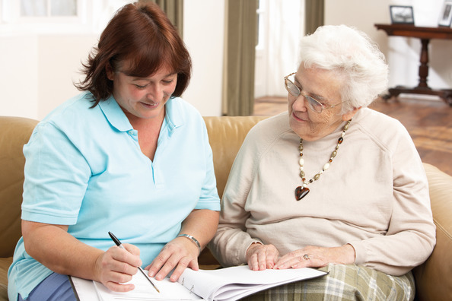
What can Age UK do to help you?
Support and information
Sounding board
Access to large Network of local Age UKs
Home from Hospital
Discharge Lounges
Transport to hospitals and clinics
Small repairs and adaptations
Information and Advice
Support with assessments
…

Slide 15
Useful resources and contact details
Age UK’s website
Age UK’s Health and Wellbeing Research
Understanding the lives of older people living with frailty Ipsos MORI for Age UK
Doddery but dear? Examining age related stereotypes (Centre for Ageing Better)
Patiently Waiting. Older people’s experiences of waiting for surgery (Independent Age)
email: healthinfluencing@ageuk.org.uk

