Slide 1
Analysis of safeguarding adult reviews: April 2017 – March 2019: Findings for Sector-Led Improvement Healthcare UK 30th September 2022

Slide 2
Safeguarding Adult Reviews
Care Act 2014
SAB duty to conduct a SAR
Where an adult with care and support needs has died, or has experienced serious abuse or neglect, and
The Board knows or suspects that the death resulted from abuse or neglect, and
There is reasonable case for concern about how the Board, its members or others worked together to safeguard the adult
SAB power to conduct a SAR in any other case
Purpose:
To identify lessons learnt and apply to future cases
To improve how agencies work, singly and together, to safeguard adults

Slide 3
A growing body of evidence
Year | SARs (n)
2021-22 | 300
2020-21 | 245
2019-20 | 250
2018-19 | 135
2017-18 | 110
2016-17 | 110
2015-16 | 90
Not all SABs undertake a SAR in any one year, though the number who do so has been steadily rising
Please use the chat box to tell us about your own experience of SARs:
As a SAB member commissioning a SAR?
As a SAR independent reviewer?
As a practitioner involved in a case that has been reviewed?
As a manager reviewing your agency’s actions in order to submit information to a SAR?
NHS Digital (2022) https://digital.nhs.uk/data-and-information/publications/statistical/safeguarding-adults

Slide 4
The first national analysis of SARs 2020
Commissioned by CHIP - the sector-led Care and Health Improvement Programme co-produced and delivered by the Local Government Association and the Association of Directors of Adult Social Services in England
Authors: Michael Preston-Shoot, Suzy Braye, Oli Preston, Karen Allen and Kate Spreadbury
https://www.local.gov.uk/analysis-safeguarding-adult-reviews-april-2017-march-2019
Project Oversight: Adi Cooper, CHIP

Slide 5
Methodology
Reviews completed 1/4/17-31/3/19
Request to all SABs
National repository
The sample
231 SARs
Analysis
Quantitative analysis
Qualitative analysis
Websites trawl
129/132 (98%)
Thematic framework
Data collection tool completed for each SAR: structured & unstructured data

Slide 6
The analytic framework: five domains
The organisations around the team
The interagency team
Direct work with the adult
Legal and policy context
SAB governance

Slide 7
Two key sets of findings
1. SAB governance of SARs
How SABs implement powers and duties:
Care Act 2014 + statutory guidance
Key pointers for SABs in meeting quality standards in the commissioning and conduct of SARs
2. Learning from the 231 cases
Types of abuse and neglect
Demographics
Themes within the 5 domains of the analytic framework

Slide 8
SAB governance: Key questions
for SABs & SAR authors
1. Clarity of authority
2. Timeliness of decision-making
3. Types of abuse and/or neglect
4. Rationale for chosen methodology
5. Rationale for information-seeking methods
6. Positive/negative reasons for delay
7. Co-operation of services and agencies
8. Subject and family involvement
9. Annual reports
10. Quality assurance
11. Monitoring implementation
12. Recording of decisions at all stages

Slide 9
The 231 cases: demographics
263 subjects, 80% deceased
129 male, 109 female
Average age 55
Little information about sexuality or ethnicity
Range of health concerns and complex interplay
Physical comorbidities
Physical and mental ill-health + significant life events
Living situations:
Living alone (36%)
Group care (33%)
Location of abuse
Own home (48%)
Residential/nursing care (18%)
Perpetrator
Self (48%)
Care providers (30%)
Concluded prosecution = 16.2%

Slide 10
The 231 cases: types of abuse/neglect
Type of abuse/neglect | Reviews n | %
Self-neglect | 104 | 45.02%
Neglect/omission | 85 | 36.80%
Physical abuse | 45 | 19.48%
Organisational abuse | 33 | 14.29%
Financial abuse | 30 | 12.99%
Domestic abuse | 22 | 9.52%
Psychological abuse | 19 | 8.23%
Sexual abuse | 12 | 5.19%
Sexual exploitation | 5 | 2.16%
Modern slavery | 2 | 0.87%
Discriminatory abuse | 2 | 0.87%
Other | 11 | 4.76%
Not specified | 29 | 12.55%
Modern slavery/sexual abuse/ sexual exploitation more prevalent in younger subjects
Neglect/abuse by omission more prevalent in older subjects
Psychological/emotional abuse and modern slavery more prevalent for females
Financial, physical abuse and self-neglect are (slightly) more prevalent for males
No correlation with types of abuse/neglect subject to s.42 enquiries
Some types of abuse/neglect positively correlated with each other (e.g. domestic, financial, physical and emotional abuse); some appear unrelated to other types (self-neglect, neglect/omission)

Slide 11
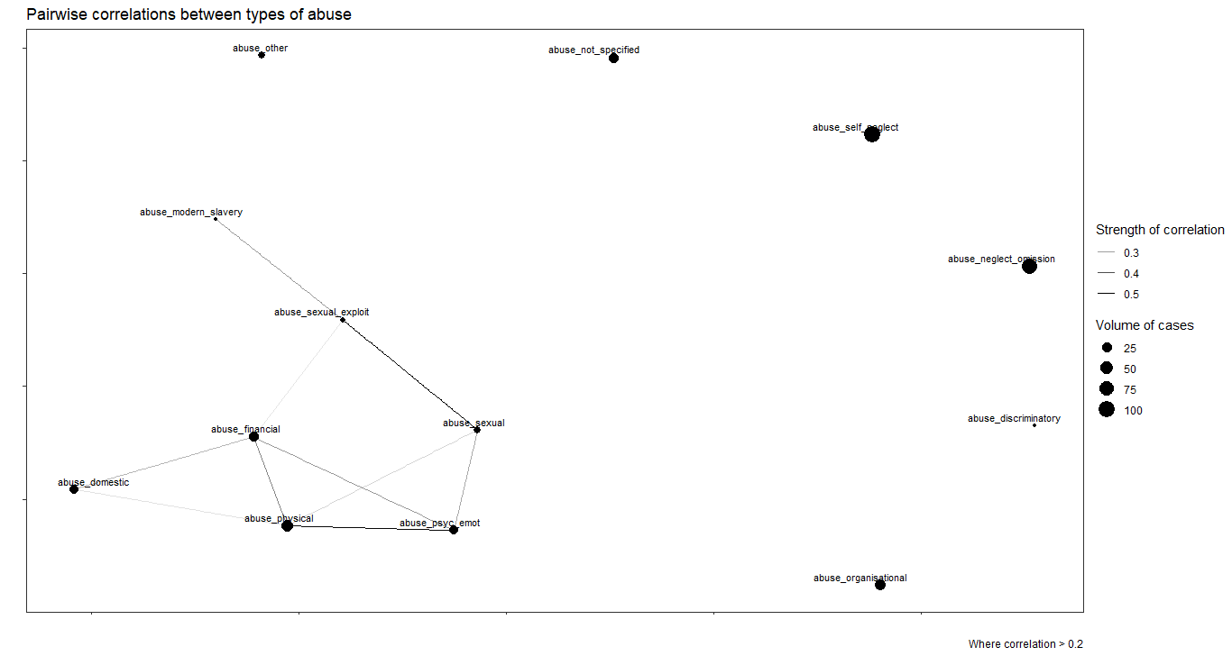
Correlations between types of abuse and neglect

Slide 12
Good practice across the domains
Direct work
Health (24%)
Inter- agency
Information- sharing (23%)
Organisational
Management oversight (4%)
SAB governance
SAR management (1%)
Personalisation (23%)
Continuity (16%)
Care/support (16%)
Case coordination (19%)
Safeguarding (16%)
Commissioning (3%)
SAB policy/ procedures (<1%)
Safeguarding (14%)
Mental capacity (14%)

Slide 13
Poor practice across the domains
Direct work
Mental capacity (60%)
Inter- agency
Case coordination (73%)
Organisational
Staffing/workloads (28%)
SAB governance
Self-neglect policy (6%)
Risk assessment (58%)
Safeguarding (50%)
Caregivers (48%)
Care/support (48%)
Health (43%)
Information-sharing (70%)
Safeguarding (50%)
Procedures (23%
Legal literacy (19%)
Management oversight (27%)
Training (23%)
Resources (21%)
Commissioning (21%)
Escalation policy (6%)
Risk assessment policy (4%)
Mental capacity policy (3%)
SAR management (4%)

Slide 14
Mental capacity failings in SARs
Failure to undertake assessment
Reliance on
- The assumption principle
- The judgement of a third party
- ‘Lifestyle choice’
- Failure to recognise impact of deteriorating health or changing circumstances
- Uncertainty about responsibility
Assessment undertaken but …
- Inadequate evidence of ‘understand, retain, use or weigh’
- Not repeated in changing circumstances
- Missing key information
- Professional hierarchies
- No ‘real world observation’
- Failure to recognise implications for intervention – the ‘capacity paradox’

Slide 15
Recommendations across the domains
Direct work
Risk assessment (31%)
Inter- agency
Case coordination (55%)
Organisational
Training (40%)
SAB governance
Dissemination of
Caregivers (27%)
Care/support (24%)
Personalisation (20%)
Information-sharing (42%)
Safeguarding (33%)
Procedures (23%)
Record-sharing (12%)
Commissioning (28%)
Quality assurance (21%)
Policy/procedures (18%)
Records/recording (16%)
Mental capacity (28%)
Health (19%)
learning (32%)
Quality assurance (22%)
Training (17%)
Self-neglect policy (15%)
Other [policy/procedures (14%)

Slide 16
The national context – 24% of SARs
Notable issues |  | Target bodies
Impact of austerity |  | Department of Health & Social Care
Legal rules |  | Ministry of Justice
Recognition of impact on victims |  | Department for Work & Pensions
Regulation of services |  | Home Office
Statutory guidance |  | Crown Prosecution Service
Coordination of parallel review systems |  | Care Quality Commission
National commissioning shortfalls |  | NHS England
 |  | Local Government Association
 |  | Health & Safety Executive
 |  | National Probation Service
 |  | Prison Service
Do SARs give sufficient attention to the legal, policy and financial context in which safeguarding practice takes place?

Slide 17
Sector-led improvement priorities
SAB commissioning and conduct of SARs
Support for sector-wide learning from SARs
Support for adult safeguarding practice improvement
Revisions to national policy / guidance
Further research to develop the good practice evidence base

Slide 18
Going forward
Briefings for specific sector groupings – SAB chairs & managers, reviewers, practitioners, strategic leads
Database archive
Report launch December 2020: report and webinar
CHIP: local and national initiatives on improvement priorities
Presentations to national groups, SABs, conferences
Further analysis for specific sectors
LGA webinar series:
https://lgaevents.local.gov.uk/lga/frontend/reg/thome.csp?pageID=482432&eventID=1402

Slide 19
Professor Suzy Braye
Emerita Professor of Social Work, University of Sussex
Independent Adult Safeguarding Consultant s.braye@sussex.ac.uk
Professor Michael Preston-Shoot
Professor Emeritus of Social Work, University of Bedfordshire;
Independent Adult Safeguarding Consultant; Independent Chair, Brent Safeguarding Adults Board and Lewisham Safeguarding Adults Board
michael.preston-shoot@beds.ac.uk

Slide 20
Questions for discussion
What are the local improvements that you would like to see prioritised?
What works well and what works not so well in safeguarding in your own locality?

