Slide 1
Using data to drive day surgery performance
Dr Mary Stocker
Consultant Anaesthetist, Torbay
Past-President BADS

Slide 2
Data
Invaluable or..
A tedious necessity

Slide 3
Who Cares?
Chief Exec
Managers
Consultants
All of us??

Slide 4
Who Contributes?
Who should be proud
Who should be congratulated
Who should want to drive improvement?

Slide 5
Surgeons
Anaesthetists
Managers

Slide 6
Cleaners
Booking Staff
Receptionists
Theatre Teams
Ward Staff
All of Us – we are the team who make it happen
Yes YOU!

Slide 7
I think its invaluable
To drive change
To congratulate and motivate teams
Healthy competition
To identify areas for improvement

Slide 8
Local Data Options

Slide 9
National Data Sources
NHS Choices Indicators
https://previewer.digital.nhs.uk/choices/
Model Hospital
https://model.nhs.uk/

Slide 10
NHS Digital Clinical Indicators
Data is average of previous 12 months data
6 months in arrears (so you may have got better!)
Signed off by medical director/director of performance
Some one looks at it and takes note

Slide 11
Day Case Procedures
Bunions
Knee arthroscopies
Conservative breast cancer surgery
Hysteroscopy
Inguinal hernia repair
Umbilical hernia repair
Dupuytren’s contracture

Slide 13
Day Case Procedures
Bunions
Knee arthroscopies
Conservative breast cancer surgery
Hysteroscopy
Inguinal hernia repair
Umbilical hernia repair
Dupuytren’s contracture

Slide 14
Breast Cancer Day Surgery Rates

Slide 15
Mastectomies and Wide Local Excision

Slide 16
Breast Cancer Day Case Rates

Slide 17
Directory and Dataset

Slide 18
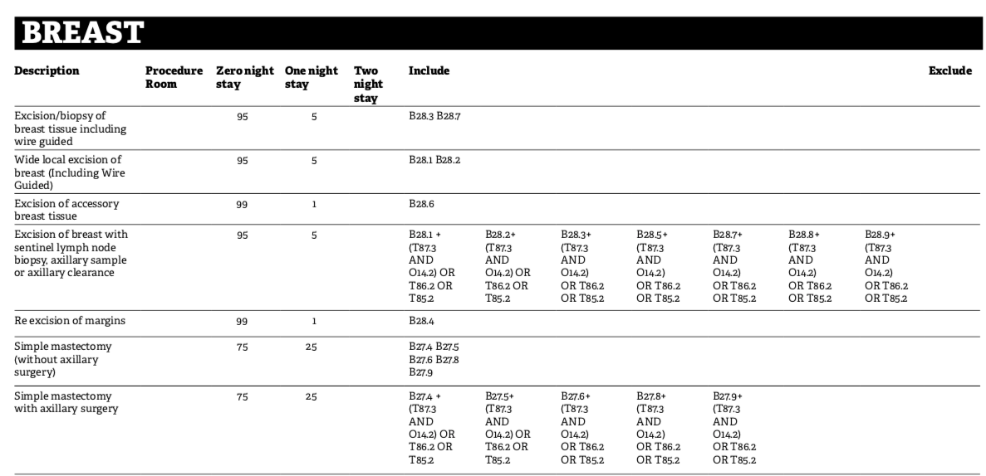
Directory

Slide 19
Dataset

Slide 20
Model Hospital
All 220 Procedures in BADS Directory
Over all day case rates
Rates by specialty
Rates by individual procedure

Slide 21
Model Hospital
Shows national benchmark (from BADS Directory)
Benchmarks against peers
Trends over 2 years
Displays individuals trusts
Identifies top performers

Slide 22
Day Case Rates
Overall
By Specialty
By Procedure

Slide 23
Unplanned admission rates
By specialty
By procedure
Overall
Also potential bed days saved

Slide 24
Day Case Rates
 | ENT | H&N | Gen | Gynae | Urol | Vasc | Eyes | Breast | Ortho
Trust 1 | 85% | 78% | 47% | 77% | 85% | 85% | 95% | 71% | 89%
Trust 2 | 61% | 78% | 64% | 63% | 61% | 75% | 99% | 73% | 88%
Trust 3 | 58% | 100% | 64% | 89% | 58% | 100% | 92% | 68% | 93%
Trust 4 | 79% | 82% | 69% | 91% | 79% | 89% | 94% | 86% | 92%
Trust 5 | 66% | 84% | 67% | 82% | 66% | 92% | 99% | 77% | 91%
Trust 6 | 62% | 97% | 69% | 52% | 62% | 91% | 98% | 58% | 83%
Variation | 27% | 22% | 22% | 39% | 27% | 25% | 7% | 28% | 10%

Slide 25
Bed Savings
 | Bed Savings
Trust 1 | 324
Trust 2 | 427
Trust 3 | 107
Trust 4 | 117
Trust 5 | 276
Trust 6 | 452

Slide 26
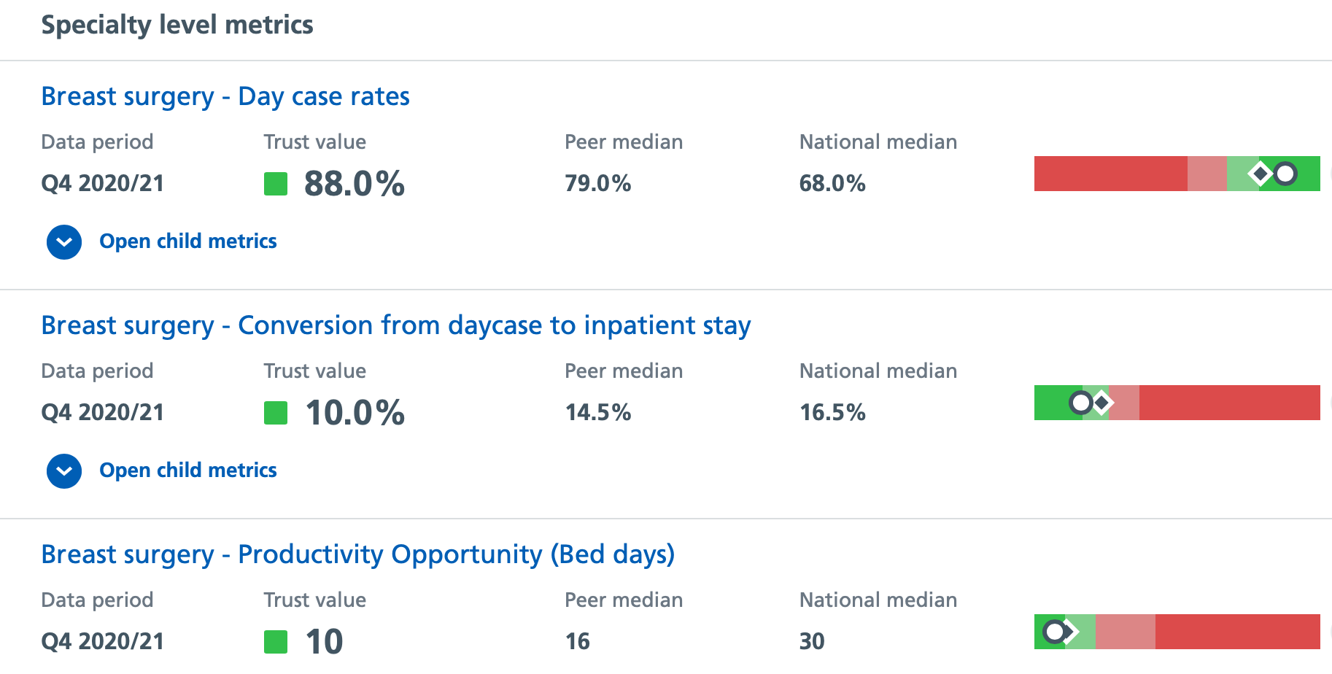
Model Hospital Metrics – Breast Surgery

Slide 27
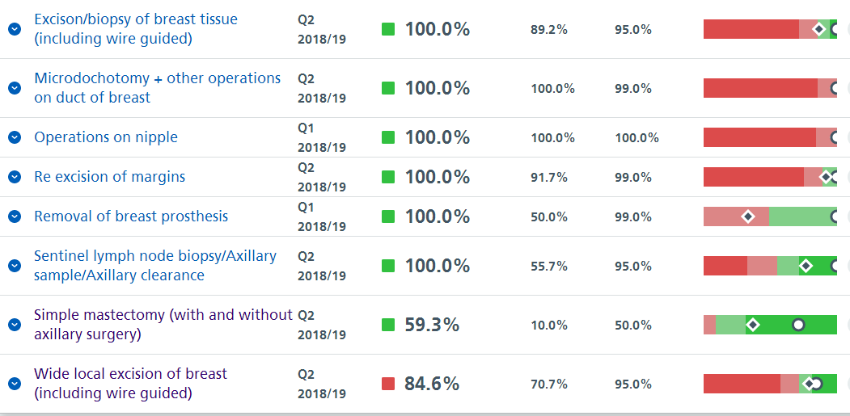
Day Case Rates – Breast Surgery

Slide 28
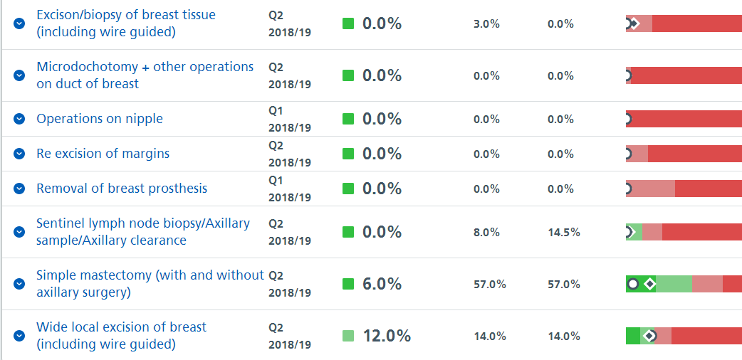
Unplanned Admission Rates

Slide 29
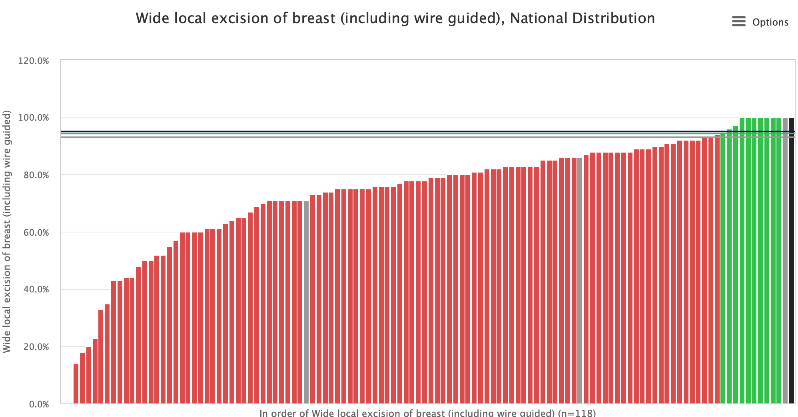
Wide Local Excision Current Performance

Slide 30
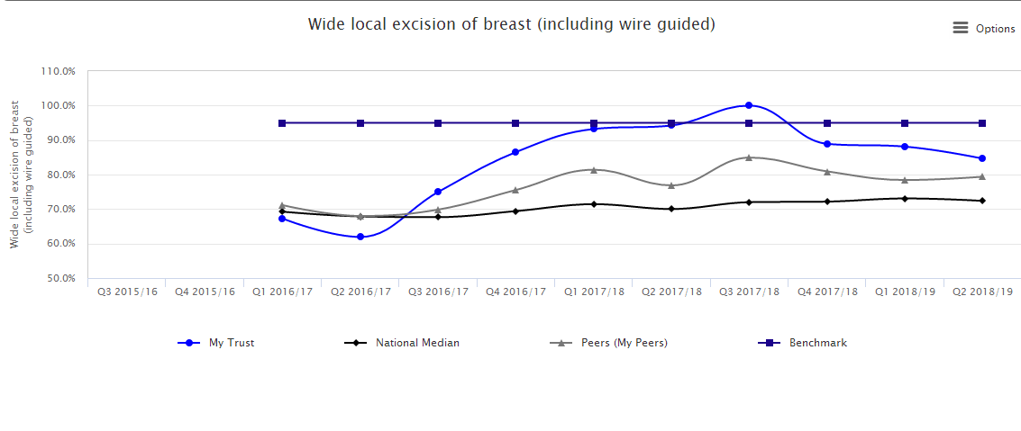
Wide Local Excision - Trends

Slide 31
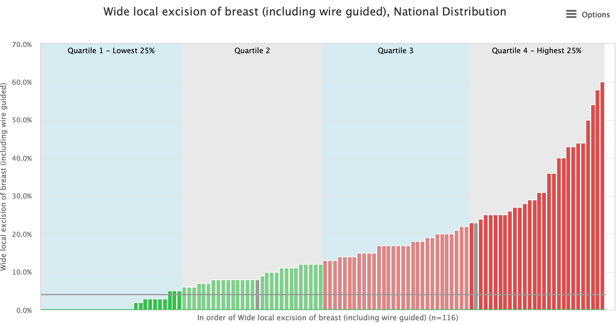
WLE Unplanned Admission Rates

Slide 32
WLE Unplanned Admission Rates Trends

Slide 33
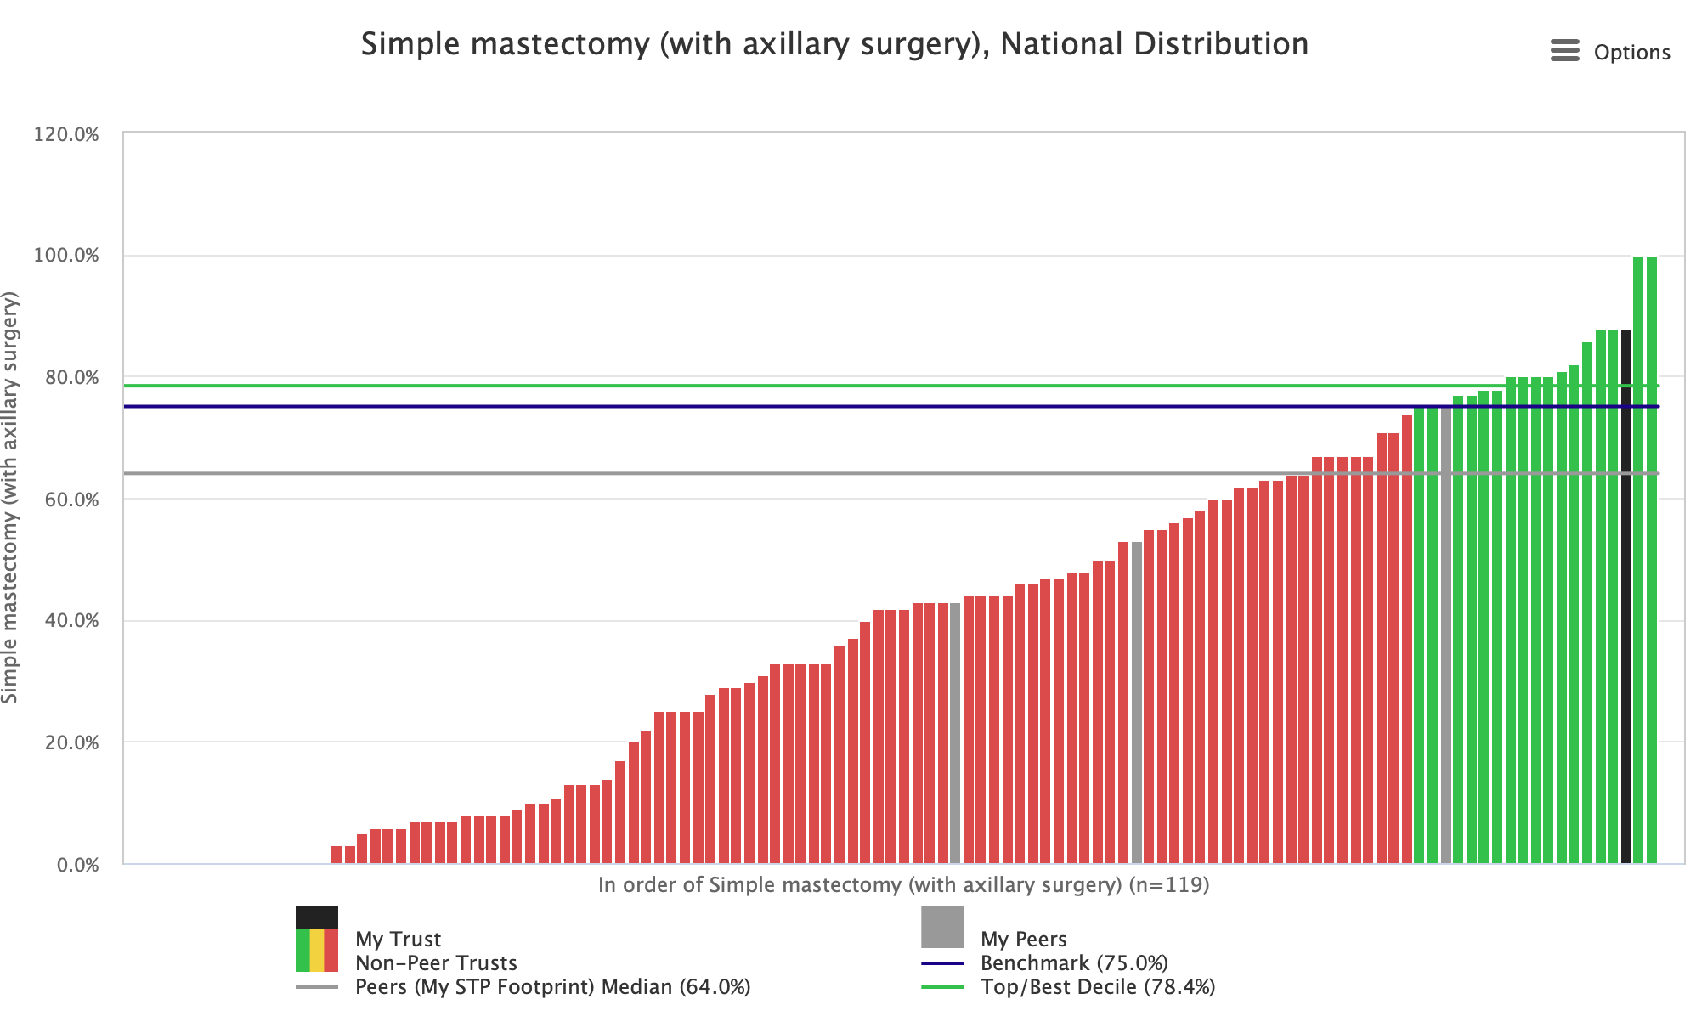
Mastectomy – Current Performance

Slide 34
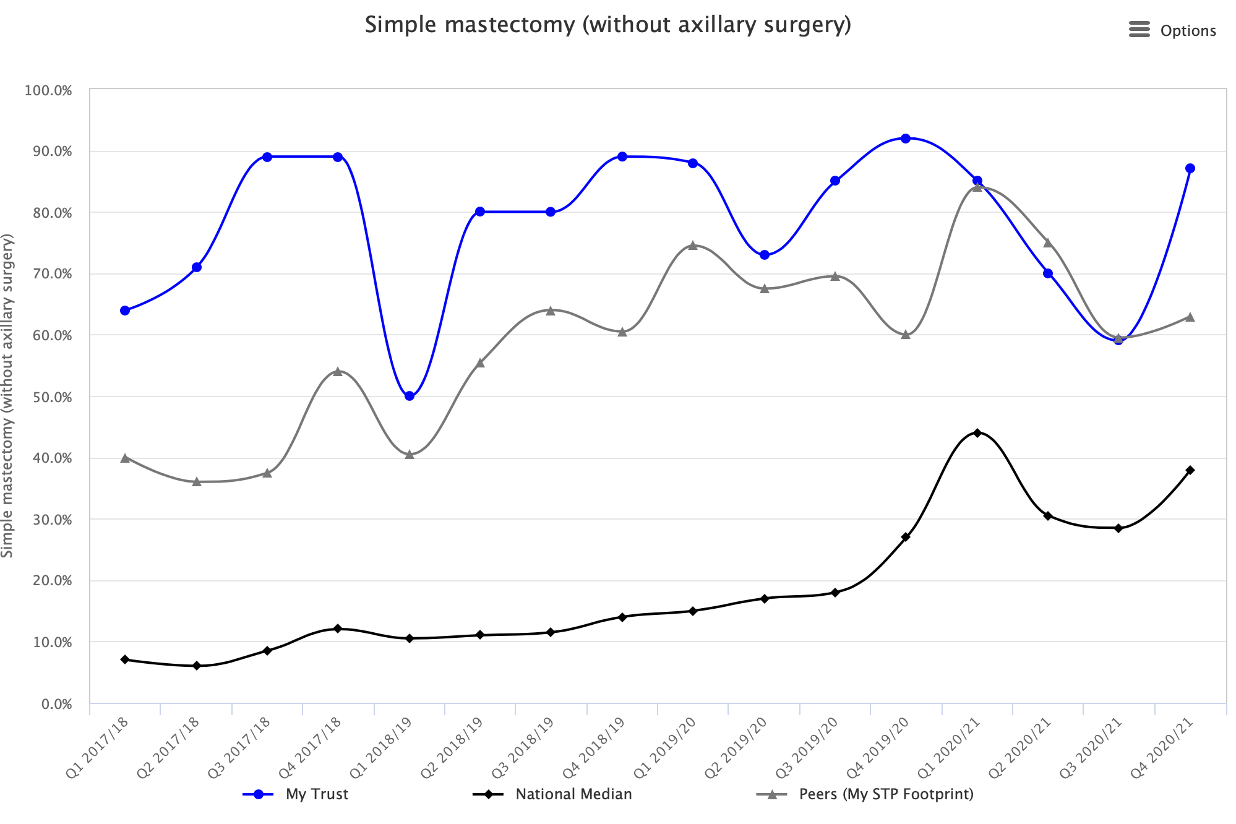
Mastectomy Trends

Slide 35
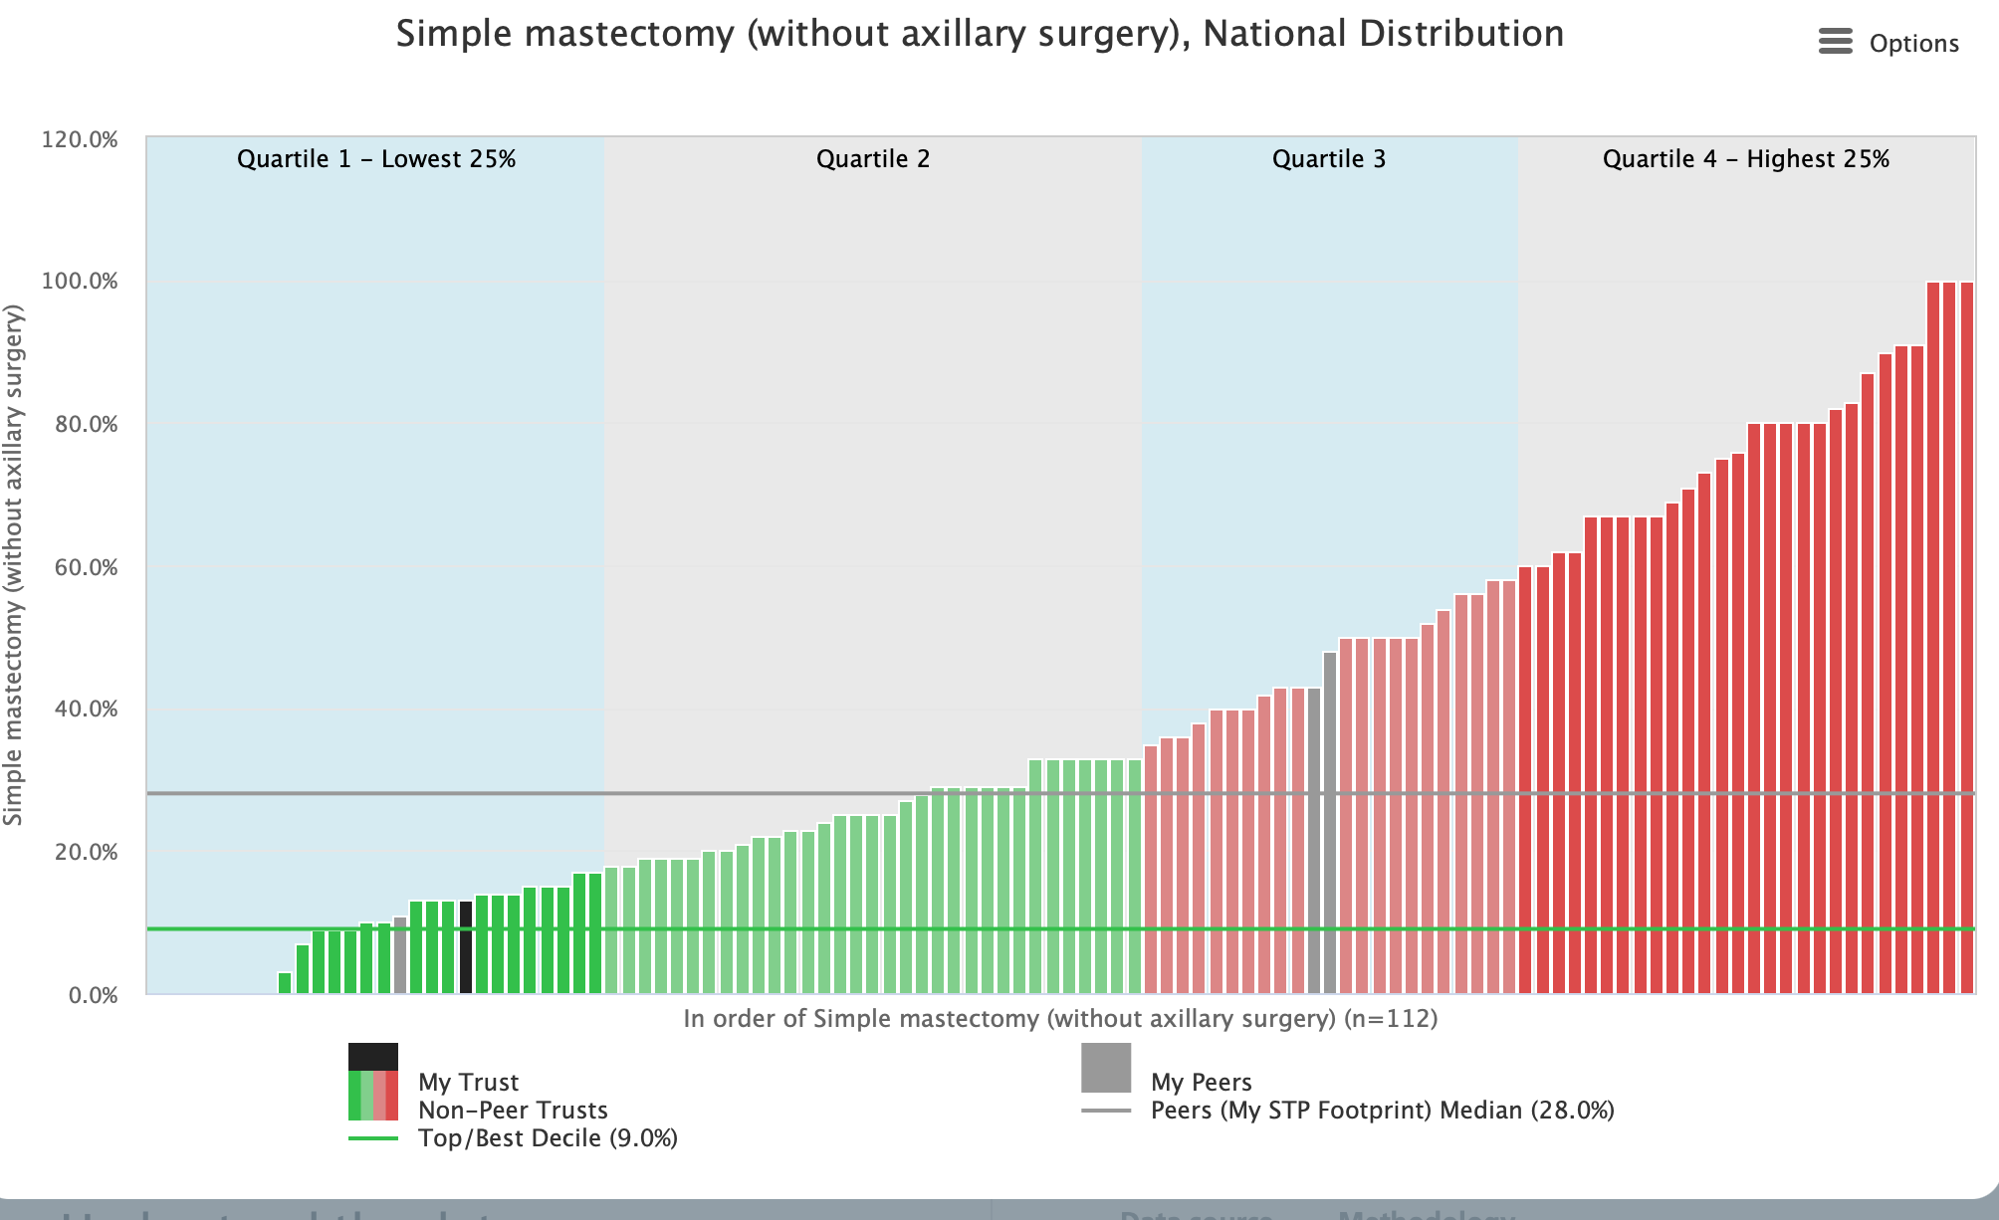
Mastectomy Unplanned Admissions

Slide 36
Difficulties with Data
Our Actual Day Case Rate = 15%
Pathways:
Discharged – admitted 24-48hrs later
Are they coded as emergency or elective?
Pulled down from surgical ward, operated upon and discharged
Are they coded as inpatient

Slide 37
Summary
Data is invaluable to drive performance and improve outcomes for our patients and our trust
We all should own it and care about it
If it doesn’t look right find out why
Use it to identify areas requiring improvement
Put graphs up in your unit
Use it to celebrate success

