Slide 1
Improving mental health services for children and young people during Covid 19. Transforming mental health services for children and young adults
Dr Harriet Stewart
Oxford University Hospitals September 2022

Slide 2
Transformation and innovation post-pandemic
Improving mental health services for children and young people
Early intervention and accessibility to CAMHS
Workforce development
Role of data and outcome measures

Slide 3
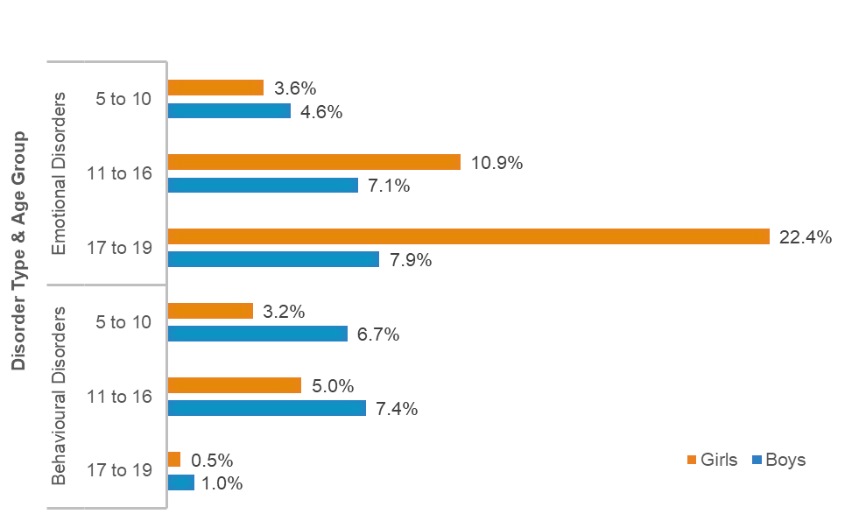
Proportion of children with emotional and behavioural disorders by age gender and disorder TypE (Census 2017)

Slide 4
Pre-pandemic
Boys were more likely to have a disorder among younger age groups, and girls among older age groups. 1 in 4 young women aged 17-19 had a disorder with emotional disorders (particularly anxiety) being the most commonly reported.
Worryingly 52.7% of the young women with a disorder had self-harmed or attempted suicide.

Slide 5
Statistics (or what happened March 2019-2022)
Reduction in F2F patient care (Ougrin and Wong et al Pub 7 Mar 2022)
Initial drop in referrals by over 50%
Patients not attending A&E or GP surgeries
Fear of catching covid or their parents catching covid
Reduction in self-harm. More support at home/less anxiety re school and social life
Similar pattern in USA (Penner et al 2021) and UK Chen et al 2020)

Slide 6
Then in Sept 2020
Sharp upturn in referrals- peak of 180% in Nov 2020 compared to previous years
Ongoing demand has remained extremely high
Huge environmental change for children

Slide 7
What are we seeing now?
Increase in eating disorders and severity of presentation- eg requiring re-feeding in hospital:loss of control; loss of routine; pressure to exercise and social isolation.
Increase in self-harm after the initial decrease seen in Mar 2021
Increase in anxiety across the board (initially some children said they felt less anxious in lockdown 2020). Now more OCD perhaps because of reduced exposure and avoidance during lockdown. It was the children without pre-existing MH problems and those with SEND who were found to have suffered most (gov.com).
Conversion disorder is back.Tics (Heyman et al 2021)
Increase in referrals of highly complex patients who are presenting extreme challenges within their home setting.

Slide 8
Problems
Waiting lists are getting longer
Lack of early identification and diagnosis
Lack of effective specialist support
Children and families having brief assessment and intervention that is too superficial to meet their complex needs
At the same time CAMHS clinicians and managers are also affected by the pandemic and suffering from exhaustion and burn-out

Slide 9
Clinical examples
‘Beth’ with tics
‘Hayley’ with self-harm and autism

Slide 10
Online working
Positives:
Saving time for patients and clinicians
Meetings
Negatives
Brain fog from online meetings
Unable to see the whole patient
Confidentiality

Slide 11
Leadership training
Systems overhaul
Clinic coordinators to improve admin around appointments eg for NDT clinics so that they are one-stop as all the information has been gathered and discussed beforehand
Senior assessment and allocation to treatment
Inspiration with a common purpose and modelling to clinicians and CAMHS staff
Research and QI projects and the ability to make a difference and make things work.

Slide 12
Role of Data/Outcome Measurement
National Data-Mental Health Service Data Set from Jan 2016
New ways of measuring- 5 year data plan
Prevalence/incidence; access; quality; outcomes; prevention and spend
Grouping CYP according to need-CCG Improvement and Assessment Framework
Intervention codes and outcome tools-ratings RCADS; SDQ;CGAS;GOMS;DAWBA
Annual updates-KPI’s and payment outcomes- capitated and episodic ‘year of care’ payment models

Slide 13
Workforce
Mental/physical health initiatives for staff with locally agreed uptake rates.
Tackling bullying in the workplace.
Line manager training in stress management
Joy in work initiatives
Headspace/mindfulness
NHS health checks

Slide 14
Adapting CAMHS and meeting demand
A more flexible attitude to work
People moving in and out of the workplace and being able to change roles more easily
Supporting workers to do their jobs rather than expecting them to meet targets
Being healthy together- strength in teams
Gratitude and helping others- vocational

Slide 15
References
1. Ougrin D, Wong BH, Vaezinejad M, Plener PL, Mehdi T, Romaniuk L, et al.Pandemic-related emergency psychiatric presentations for self-harm of children and adolescents in 10 countries (PREP-kids): a retrospective international cohort study. Eur Child Adolesc Psychiatry [Epub ahead of print] 7 Mar. Available from: 10.1007/s00787-021-01741-6. [PMC free article] [PubMed] [CrossRef] [Google Scholar]
2. McNicholas F, Kelleher I, Hedderman E, Lynch F, Healy E, Thornton T, et al.Referral patterns for specialist child and adolescent mental health services in the Republic of Ireland during the COVID-19 pandemic compared with 2019 and 2018. BJPsych Open 2021; 7: e91. [PMC free article] [PubMed] [Google Scholar]
3. Chen S, Jones PB, Underwood BR, Moore A, Bullmore ET, Banerjee S, et al.The early impact of COVID-19 on mental health and community physical health services and their patients’ mortality in Cambridgeshire and Peterborough, UK. J Psychiatr Res 2020; 131: 244–54. [PMC free article] [PubMed] [Google Scholar]
4. Penner F, Hernandez Ortiz J, Sharp C. Change in youth mental health during the COVID-19 pandemic in a majority hispanic/latinx US sample. J Am Acad Child Adolesc Psychiatry 2021; 60: 513–23. [PubMed] [Google Scholar]
5. Zhou SJ, Zhang LG, Wang LL, Guo ZC, Wang JQ, Chen JC, et al.Prevalence and socio-demographic correlates of psychological health problems in Chinese adolescents during the outbreak of COVID-19. Eur Child Adolesc Psychiatry 2020; 29: 749–58. [PMC free article] [PubMed] [Google Scholar]

Slide 16
Refs 2
6. Hawes MT, Szenczy AK, Klein DN, Hajcak G, Nelson BD. Increases in depression and anxiety symptoms in adolescents and young adults during the COVID-19 pandemic. Psychol Med [Epub ahead of print] 13 Jan 2021. Available from: 10.1017/s0033291720005358. [PMC free article] [PubMed] [CrossRef] [Google Scholar]
7. Khan AN, Bilek E, Tomlinson RC, Becker-Haimes EM. Treating social anxiety in an era of social distancing: adapting exposure therapy for youth during COVID-19. Cogn Behav Pract [Epub ahead of print] 5 Feb 2021. Available from: 10.1016/j.cbpra.2020.12.002. [PMC free article]
8. Odd D, Sleap V, Appleby L, Gunnell D, Luyt, K.Child Suicide Rates during the COVID-19 Pandemic in England: Real-time Surveillance. Healthcare Quality Improvement Partnership (HQIP), July 2020.
9. Branley-Bell D, Talbot CV. Exploring the impact of the COVID-19 pandemic and UK lockdown on individuals with experience of eating disorders. J Eat Disord 2020; 8: 44. [PMC free article] [PubMed] [Google Scholar]
10. Nissen JB, Højgaard D, Thomsen PH. The immediate effect of COVID-19 pandemic on children and adolescents with obsessive compulsive disorder. BMC Psychiatry 2020; 20: 511. [PMC free article] [PubMed] [Google Scholar]
11. Schwartz-Lifshitz M, Basel D, Lang C, Hertz-Palmor N, Dekel I, Zohar J, et al.Obsessive -compulsive symptoms severity among children and adolescents during COVID-19 first wave in Israel. J Obsessive Compuls Relat Disord 2021; 28: 100610. [PMC free article] [PubMed] [Google Scholar]
12. Heyman I, Liang H, Hedderly T. COVID-19 related increase in childhood tics and tic-like attacks. Arch Dis Child 2021; 106: 420–1. [PubMed] [Google Scholar]
13. Skripkauskaite S, Shum A, Pearcy S, McCall A, Waite P, Cresswell C. Report 11: changes in children’s mental health symptoms from March 2020 to June 2021.
14. Dept of Education. The State of the Nation 2021: Children and Young People’s Wellbeing 2022
15. ImpactEd. Lockdown Lessons Pupil Learning and Wellbeing during the Covid 19 Pandemic. (60000 pupils in England).

Slide 17
Thank you for listening

