Slide 1
Optimising the period of learning in practice (PLP)
Dr. Qun Wang
Trust Lead for NMP
Nurse Consultant Geriatrics

Slide 2
Objectives
Optimising the PLP for NMPs in training, working with academic partners, to ensure the quality and safety of future non-medical prescribers
Assessment to ensure trainees have met the necessary learning outcomes and acquired competencies

Slide 3
Optimising PLP to ensure quality and safety of future NMPs
A competency framework for Designated Prescribing Practitioners (DPP) states “PLP enables the trainee to put theory into practice, to develop and demonstrate competence as a prescriber under the supervision of experienced DPPs”. (RPS, 2019).
Trainee NMPs must complete over 90 hrs prescribing practice under the supervision/assessment in clinical areas.

Slide 4
Optimising PLP to ensure quality and safety of future NMPs
Key stakeholders:
DPP
Named Practice Supervisor
Practice Assessor
Practice Educator
Academic partners: prescribing module leader, relevant academia/lecturers.

Slide 5
Optimising PLP to ensure quality and safety of future NMP
Clinical environment focused:
Right learning environment with appropriate NMP governance
Right DPP/supervisor
Right Trainee

Slide 6
Optimising PLP to ensure quality and safety of future NMPs
The DPP requirement:
1 Personal characteristics
2 Professional skills and knowledge
3 Teaching and training skills
Delivering the role
4 Working in partnership
5 Prioritising patient care
6 Developing in the role
Learning environment and governance
7 Learning environment
8 Governance

Slide 7
Assessment to ensure trainees have met the necessary learning outcomes and acquired competencies
Local NMP governance:
Trust NMP committee
Choose the right trainee: eligibility criteria used in our Trust
Support provided during the training period
Support provided upon qualify
Support provided post qualify

Slide 8
Choose the right trainees-Trust eligibility criteria
> 3 years as Registered Nurses/ Allied Healthcare Professionals (AHPs)
Band 7 above, minimal 2 years working experience (Pharmacist)
> 1 year working experience in specialty areas
Prescribing is service requirement not personal interest
Must have division support for study time and allocation of Designated Prescribing Practitioner (DPP)
Capable of undertaking level 6 or course or above
Must have Physical Examination or OSCE module qualification prior to application

Slide 9
Non-Medical Prescribing training eligibility check list

Slide 10
Support provided during the prescribing training
Adequate Study leave for university attendance, self-learning time can be negotiated with individual division
DPPs ( clinical supervisor and clinical assessor for each trainee)
Protected 12 sessions supervision ( 2 hour per session)
Assessing competency in conjunction with university assessment contents

Slide 11
Support provided during the prescribing training
Key assessment areas in practice:
Knowledge and skills within individual trainee’s scope of practice
Assessing 10 elements in line with The Competency Framework for all Prescribers (RPS,2021)

Slide 12
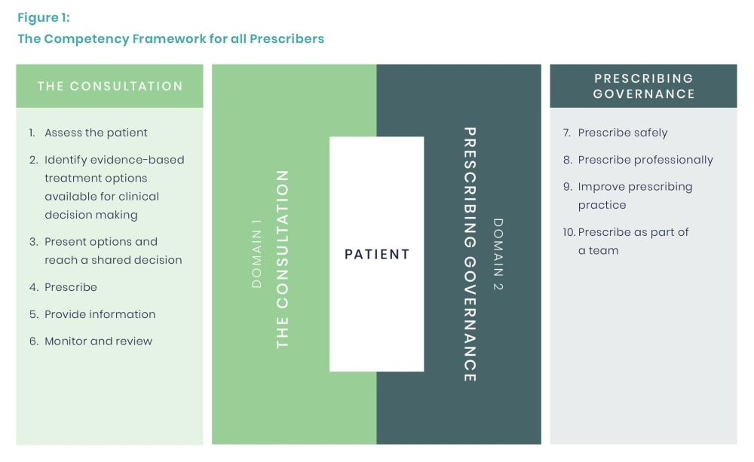
Support provided during the prescribing training-competency framework

Slide 13
Support provided during the prescribing training
Engage with key stakeholders throughout the training period:
DPP
Named Practice Supervisor
Practice Assessor
Practice Educator

Slide 14
Support upon qualify
Notify the Trust NMP Lead for your registration-Trust Notice of Practice (NoP) form
Outline Scope of Practice signed by clinical supervisor and Line manager
Continue work with clinical supervisor for the prescribing role
Encourage team support, CPD support

Slide 15
Support upon qualify-(NoP form)

Slide 16
Support upon qualify-(NoP form)

Slide 17
Support upon qualify-(NoP form)

Slide 18
Support post qualify
Join Trust NMP forum
Bi-monthly Trust wide NMP training
Annual declaration of prescribing competency
Annual NMP audit
Annual NMP report
Prescribing relevant CPD

Slide 19
Reference
Royal Pharmaceutical Society (2019). A Competency Framework for Designated Prescribing Practitioner.
Royal Pharmaceutical Society (2021). The Competency Framework for all Prescribers.
Local NMP Policy

