Slide 1



Slide 2


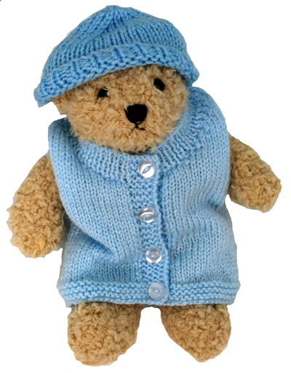

Aidan
Aidan James Eldridge was stillborn in 2009 weighing 5lb 4oz
His death is marked as unexplained on the post-mortem
Was told his death was ‘just one of those things’
- I later understood Aidan was growth restricted
I wish I was empowered with symptoms to look out for as I did
not know I had a high risk pregnancy due to diabetes
Never get over the shock and devastation of loosing a child
- Many missed milestones throughout my life
Aidan’s Ted
Notes:
2
2

Slide 3

If only...
I had been told to monitor Aidan's movements. I may have noticed a
reduction and been assessed
My Trust had customised growth charts. This would have detected
Aidan's lack of growth
I had been empowered with information and thought to call my midwife
the day before he died to report a sharp pain under my ribs
Notes:
3
3

Slide 4
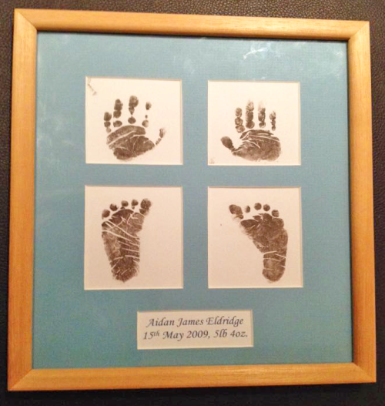

Stillbirth & Neonatal Deaths
The UK still has one of the worst stillbirth rates in the
whole of the developed world
Over 4500 babies die in the UK every year, 13 every day
2597 babies were stillborn in 2021, compared to 2371
in 2020. An increase of 3.8 to 4.1 per 1,000
The majority of stillbirths are preventable
Every one of us can play a part in helping to half the
number of stillbirths by 2025 as part of the governments
national ambition
Notes:
4
4

Slide 5


Empowering....
Notes:
5

Slide 6
Every Encounter Counts
It's ok to discuss complications with women in context
Talk about chances of problems, not risks (more positive)
Choose clear and concise language
Ask parents to relay back to check they've understood
Be specific – how will they know if they are “concerned”
Need to grasp importance of reporting RFM
Notes:
6
6

Slide 7
Every Encounter Counts
Ensure parents know who to call and where to go
Make parents feel comfortable in calling for advice
Informed choice is knowing ALL options (personalised care)
Correct colleagues giving out of date advice
Take time to read reports and reviews to learn from
Know about situational awareness & perfect handovers
Notes:
7
7

Slide 8
Current Parents Needs
To access maternity services
- Registration taking too long
To understand what number to call to speak to a midwife
- For the phones to be fully manned
Accessibility needs including language translation
More midwives!
Notes:
8
8

Slide 9
Bereaved Parents Needs
To avoid repeating their story – notice stickers on notes
Individual & bespoke care
A clear plan to make them feel more in control
Extra appointments & scans around significant dates
Ongoing postnatal support
Empathy and understanding
Notes:
9
9

Slide 10
Rainbow Pregnancy Helpline
To compliment the work of Tommy’s Rainbow Clinics
To provide support and counselling in between antenatal appointments
Assist with mental health, anxieties and an opportunity to talk about their baby
Empowerment and reassurance and mindfulness activities
Advice on attending the hospital to be assessed if needed
Peer support via a fully monitored Facebook group as well as the option
of swapping details with other parents at a similar stage
Notes:
10
10

Slide 11
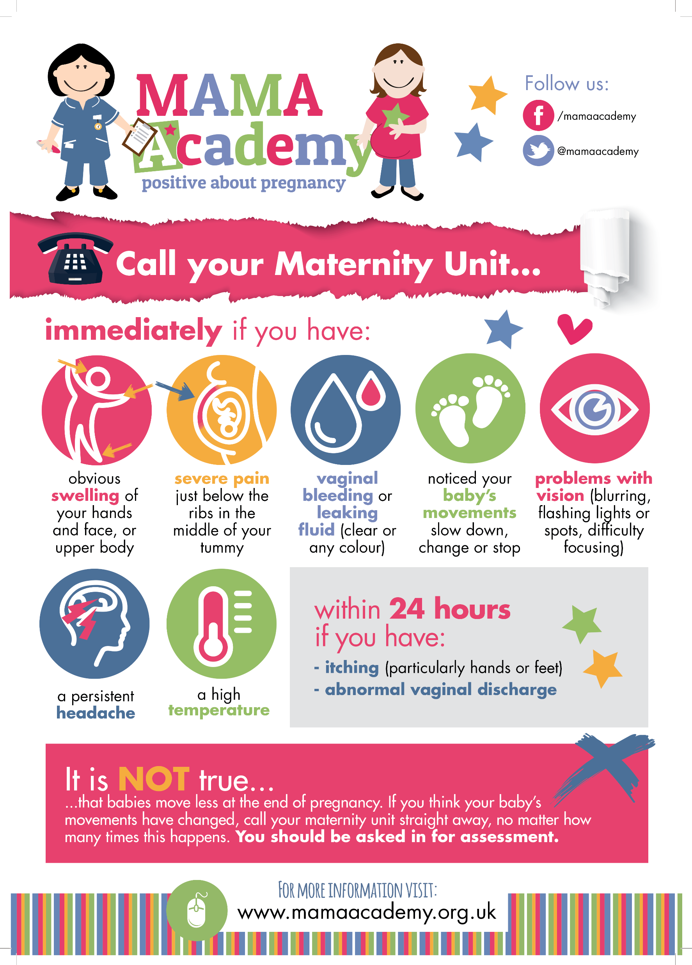
MAMA Poster
Pictorial poster on symptoms to report
Ideal for illiterate parents and
non-English speaking women
Free for you to display in all antenatal areas
Notes:
11
11

Slide 12
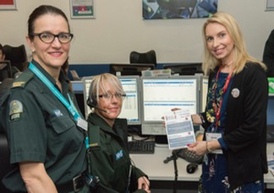
Ambulance Call Cards
Working with The London Ambulance
Service
Cards improve response times at home
births and stand alone centres.
Available for free for all London Trusts
and independent midwives
Notes:
12

Slide 13
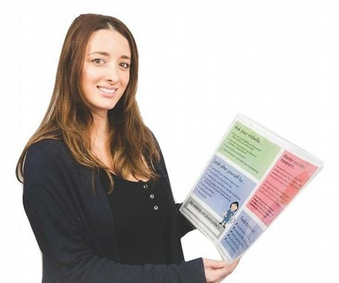
Wellbeing Wallets
All 15 initial pilot trusts reported significant
decrease in stillbirth numbers
Currently distributed within
TWO THIRDS of NHS Trusts nationwide
Assisting midwives with time constraints
Just 75p each inc. delivery
-Email me for a sample
Notes:
13

Slide 14

Wellbeing Wallets
Given to mothers by their midwife at booking
Assists midwives in discussing sensitive topics
such as smoking, symptoms to report without
delay and monitoring movements
Gives parents permission to call with any concerns
Advises parents of expected care when reporting RFM
Notes:
14

Slide 15
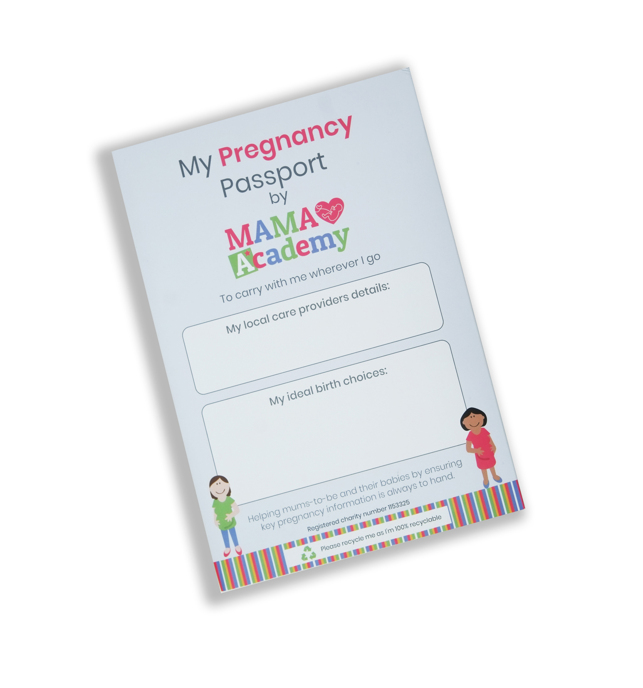
Pregnancy Passports
Maternity DMA report showed that parents
still require handheld as well as digital info
Contains risk factors if the digital
record can’t be accessed
Folder clip and pouch to secure
growth charts and scan pictures
100% recyclable
Notes:
15

Slide 16
Accessibility
Variety of languages via QR code on Passport
Awareness video’s with BSL
Audio version of our passport for visually impaired
Pregnancy Passport available in braille
Designing poster for GP surgeries on how to access service
Notes:
16
16

Slide 17
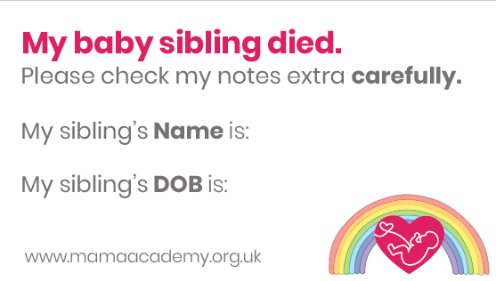
Stickers
Previous loss
Smoking CO readings
Pronouns
And more!
Notes:
17

Slide 18
The Future
Stillbirth rates declined year after year since 2012…
In 2011 there were 3811 stillbirths
In 2012 there were 3558 stillbirths
In 2020 there were 2371 stillbirths
In 2021 there were 2597 stillbirths
By working together and sharing best practice, we can get back on track
in continuing to save babies lives
Notes:
18

Slide 19


Get in touch
www.mamaacademy.org.uk
/mamaacademy
@mamaacademy
heidi@mamaacademy.org.uk
Notes:
19

