Slide 1
Ward accreditation as an assurance tool for quality
Michelle Hope, Deputy Chief Nurse
West Hertfordshire Hospitals NHS Trust

Slide 2
Introduction
Ward accreditation explained
Encouraging ownership of continuous quality improvement at ward level
Engaging and empowering staff to improve the basic standards and quality of care at ward level and reduce variation in standards between wards & clinical departments
Sharing best practice across wards & clinical departments
Increasing staff pride within their areas

Slide 3




My experience of devising and delivering ward accreditation

Slide 4
Ward accreditation explained
The Chief Nursing Officer for England identifies ward accreditation as having potential to enable nursing and midwifery to lead on improvement and sharing of learning and good practice
Ward accreditation is a framework that enables a comprehensive assessment of the quality of care delivered at ward level
_____________________________________________________________
Wards & Clinical Departments
Accredited Clinical Environment ACE
Going for silver

Slide 5
Data
Data collection
Test Your Care
Ward Score Card
Matrons Quality Checks
Patient Experience Questionnaire
Infection Prevention Control Dashboard
Trust reports incl. workforce data, training records
Observation audit of patient records and clinical environment

Slide 6
9 Standards
Person Centred Care
Nutrition & Hydration
Dignity & Respect
Leadership & Professionalism
Safe Care & Treatment
Safeguarding
Consent
Clinical Governance
Infection Control

Slide 7
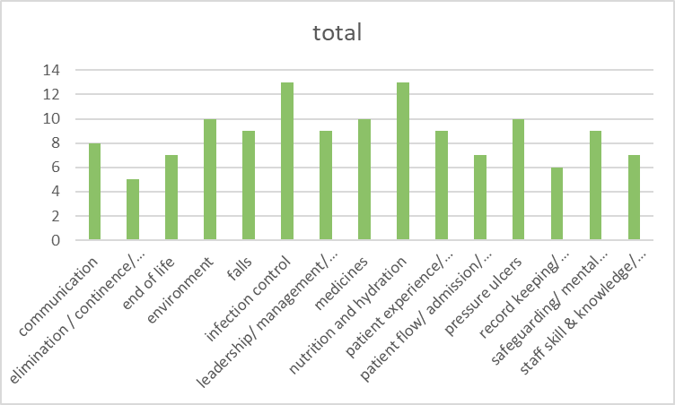
How to choose your metrics
To determine which factors, contribute to a successful ward accreditation programme I needed to review the scoring criteria. To comply with secondary research ethics approval I utilised professional networks within the NHS to request copies of their scoring tools for analysis. An email was sent to 28 contacts whose Trust had been identified in the public domain as having a ward accreditation programme in place, the response rate was 15. The standards used in the ward accreditation of these 15 NHS Trusts was compiled in a spreadsheet; the number of standards varied from 5 to 39 with a mean of 14.8. There was a total of 68 different standards identified with some of these merged by the author, for example elimination/ continence & catheter care were grouped into 1 theme.
A variety of themes and standards are available with some key themes emerging as consistently used in scoring criteria. In line with the mean of 14.8 themes or standards there were 15 which appeared in more than a third of the responses.

Slide 8
16 standards
The 15 most frequently occurring standards were checked against the CQC fundamental standards and there were 2 exceptions that were not reflected in the final 15: are complaints and clinical governance, complaints were one of the themes merged by the author into the overarching theme of clinical governance and 26% of NHS Trusts had this in their standards however it was excluded from the list of 15 as it was below the 30% used to identify the most frequently used standards and as such was not included in the final 15. For this reason, I added this standard to have a final set of 16 standards.
Additionally, the display of CQC rating is one of the CQC fundamental standards which is not included in the final 16 ward accreditation standards.

Slide 9



MBA findings
As an output from the accreditation process Wards and departments are awarded a rating based on their success in meeting these standards and these ratings varied between colours such as red, amber, green or gold, silver, bronze to identify the outcome of the assessment. There were also references to white, requires improvement, satisfactory and foundation to identify those wards which are under performing. The medal colours were most often used with bronze 47%, silver 47%, gold 40% & platinum 33%.

Slide 10

Encouraging ownership of continuous quality improvement at ward level
Gap analysis
Going for silver
During the pause of impact assessment due to the EPR rollout a gap analysis was undertaken to review current progress on the following criteria: preparation, undertaking, feedback, outcomes

Slide 11
Engaging and empowering staff to improve the basic standards and quality of care at ward level and reduce variation in standards between wards
Peer review
With not to
Not punitive we want you to succeed and share successes

Slide 12
The areas for improvement are grouped into 5 themes: assessment/inspection, ratings/ standards, reward, sharing learning & feedback.
Relaunch under the working title of ‘going for silver’ to support all clinical areas to aspire towards improved ratings.
The ratings should also be re-evaluated Gold will replace platinum as the highest rating with a new level white added for those who haven’t received bronze during an assessment. All wards will start with a bronze rating in recognition of the 2020 impact analysis rating with the ambition being that in 12 months’ time all wards will achieve silver rating.

Slide 13
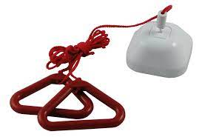
Sharing best practice across wards
Peer review

Slide 14

Increasing staff pride within their areas
Going for Gold……..

Slide 15


Thank you

