Slide 1
Tony Bonser
tbonser@aol.com
North West Regional Strategic EoLC Leadership meeting
Vice-chair of trustees – St Catherine’s Hospice
Fund-raiser for Macmillan Cancer Support
Local Hospital Trust Patient/carer groups
Chair of Hospice Patients/carers sub-committee
Notes:
What I do. Status with a group of professionals.

Slide 2
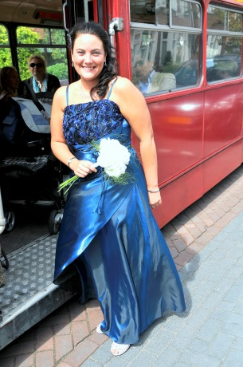
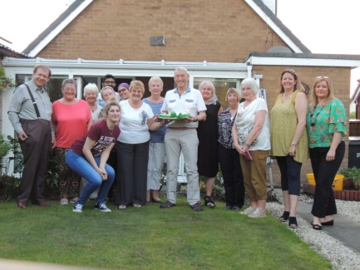
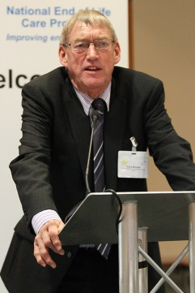
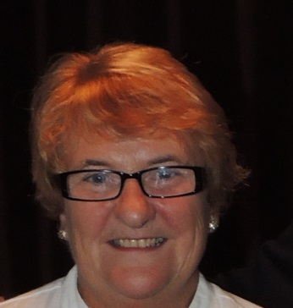
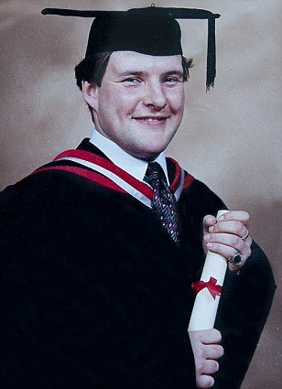
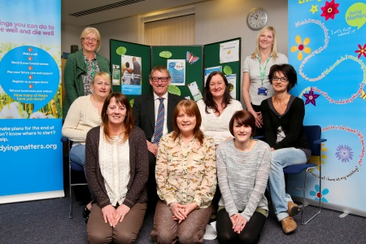
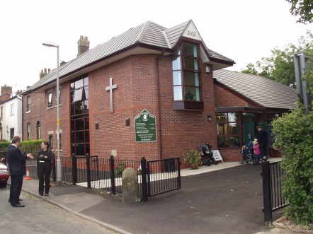
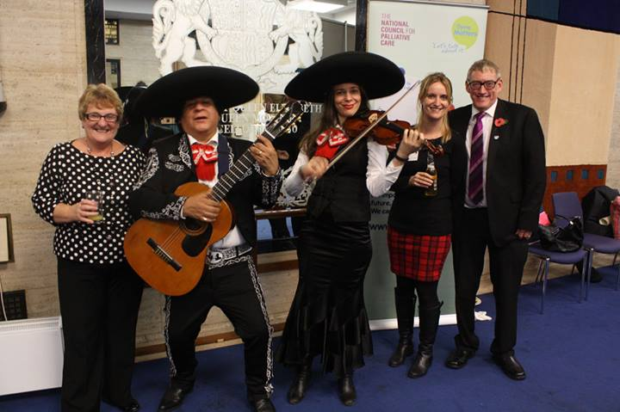
But this is who I am…..
Notes:
Connected to range of networks. Common factor, my late son Neil. What happened to him affects me, and thus everyone in all the networks – and always will, for good or bad. You are never dealing with just the patient.

Slide 3
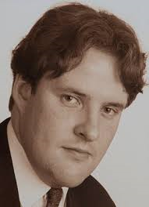

Slide 4
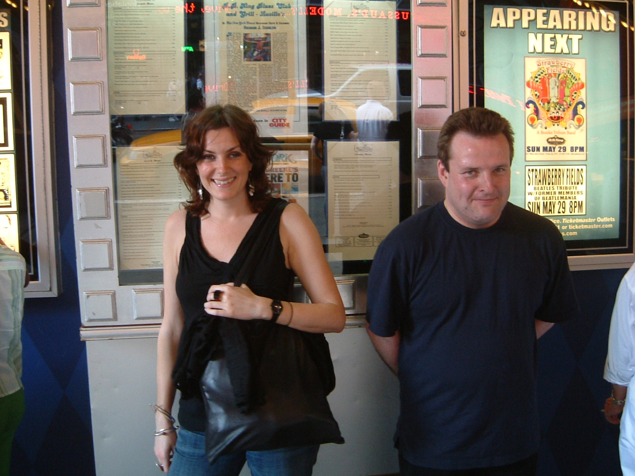
What do you want?
Notes:
Our son Neil – 1973-2009. Diagnosed with a Sarcoma in 2004. Operated on We though it was all over. Asked, “What do you want?” To go to New York. He met a friend, Alison. Enjoyed themselves.Good memories for us as we fulfilled his dream.
Our son, Neil, 1973-2009. Diagnosed with a Sarcoma in 2004. Operated on. We asked, “What do you want?” “To go to New York.” We took him. Met Alison, a friend. They enjoyed themselves. We have good memories. Asked what he wanted and made it happen. Heart of Patient-centred philosophy.

Slide 5
The duty to share information can be as important as the duty to protect patient confidentiality.

Slide 6
It’s all about communication

Slide 7

….and what do YOU want, Neil?
Notes:
2009. Neil in hospital. Nurse asks same question. To go home (his flat in Preston.) She makes it possible. He died next day – but good death. Where he wanted. Good memories.

Slide 8
......... but we don’t always speak the same language

Slide 9
YOU HAVE A 50% CHANCE.
Notes:
Neil. Initial diagnosis. 50% chance of surviving for 5 years. We didn't understand. Would he be alive or dead? Non-medical friend said his actual chance was either 0% or 100%. Statistics are valuable to professionals but don't work for individual patients. Empower, don't confuse.

Slide 10
IT’S NOT LOOKING TOO GOOD
Notes:
Euphemisms. My GP ( and Neil’s) to me about Neil. I heard, “We haven't found cure yet, but we will.” You know what you’ve said but not what I’ve heard. He was trying to tell me Neil was dying.

Slide 11
WE WON’T RESUSCITATE
Notes:
DNACPR. Said to us at Neil's bedside. Don't know if discussed with him, or if he heard. Never will now. Still causes us immense pain.

Slide 12


Slide 13
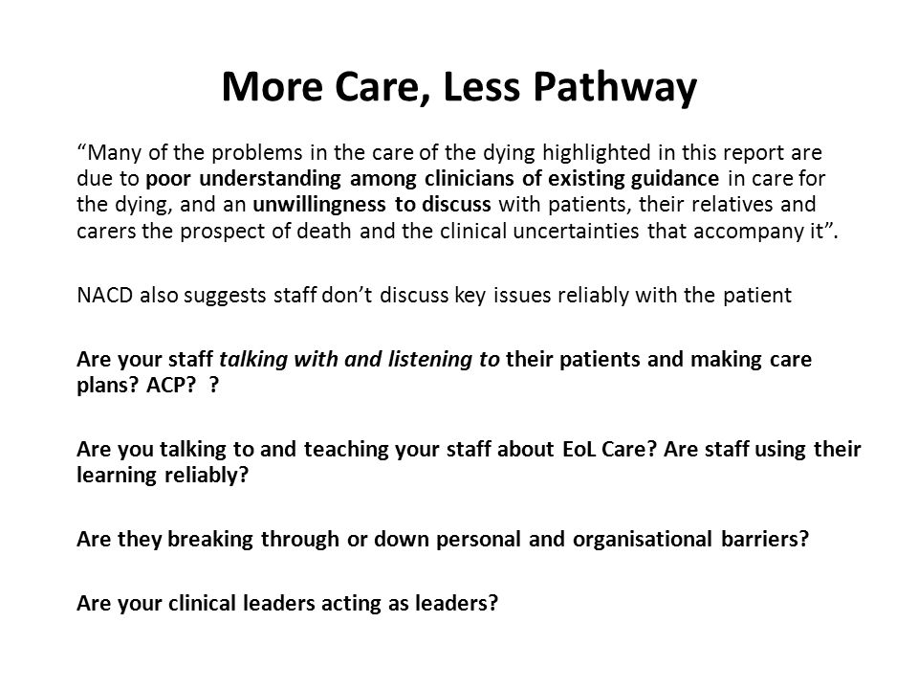

Slide 14
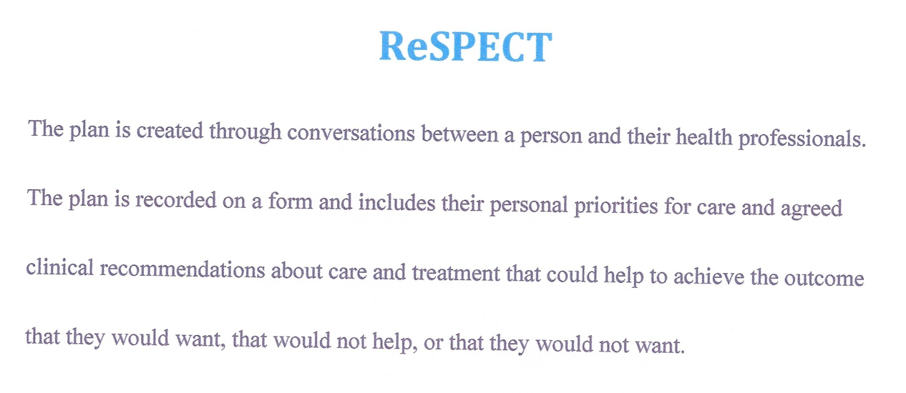
We can do so much better.

Slide 15
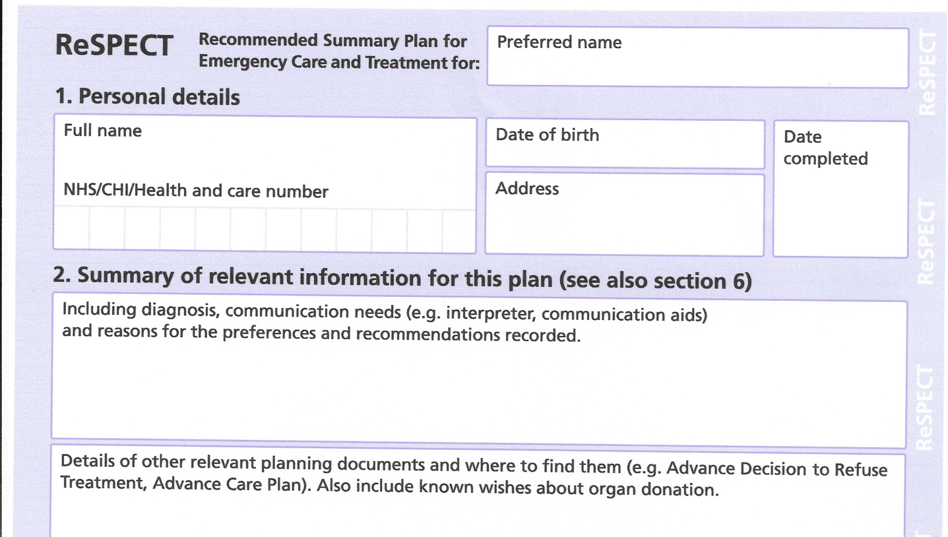

Slide 16
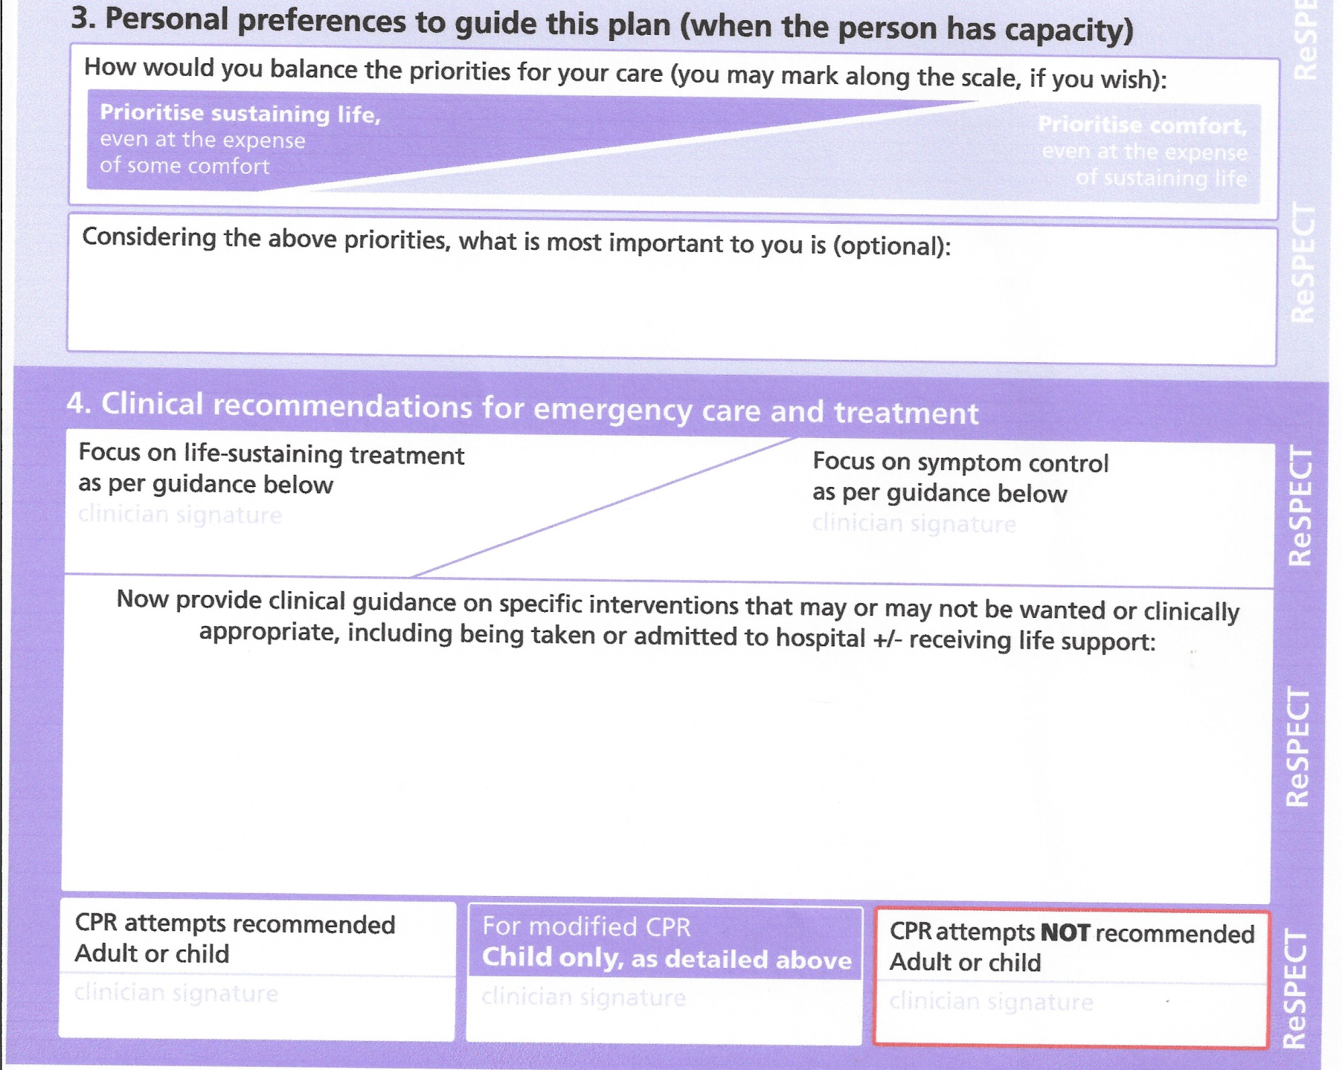

Slide 17
Tell us once
Part of What to do when someone dies: step by step
Tell Us Once
Tell Us Once is a service that lets you report a death to most government organisations in one go.
When you register the death the registrar will:
let you know if the service is available in your area
give you the phone number
give you a unique reference number to use the Tell Us Once service online or by phone

Slide 18
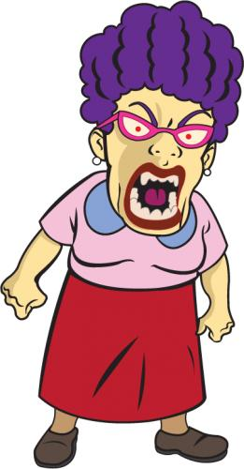

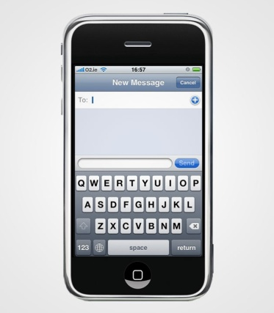

But when we don’t communicate ......
There is sometimes so much anger within relationships that communication breaks down.

Slide 19

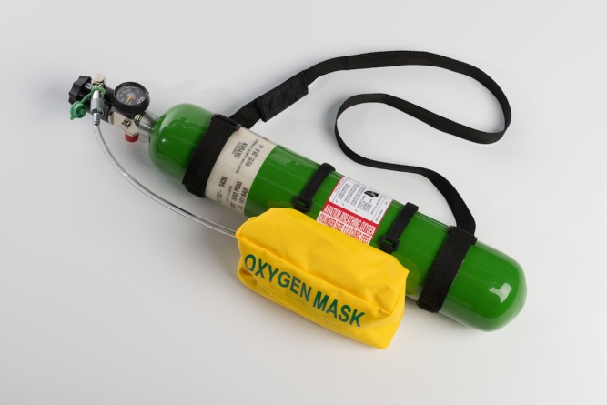
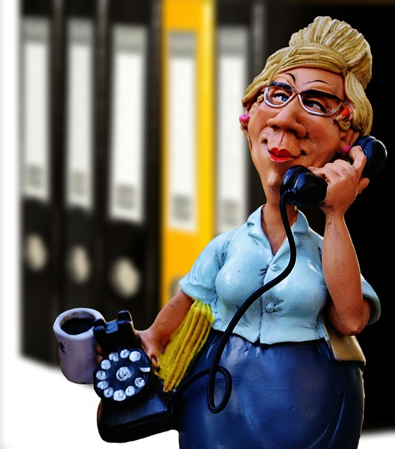
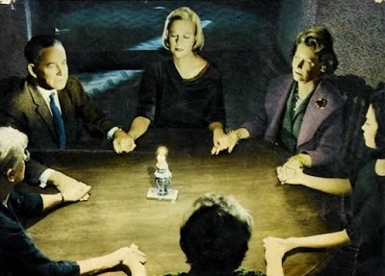

Professionals sometimes don’t communicate.

Slide 20
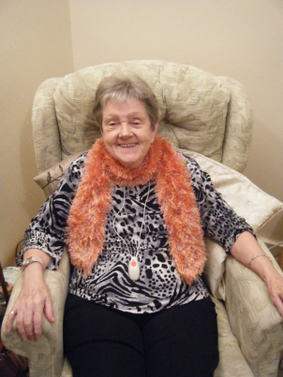
But when it goes right it can change people’s lives and deaths.
GET ME HOME!

Slide 21
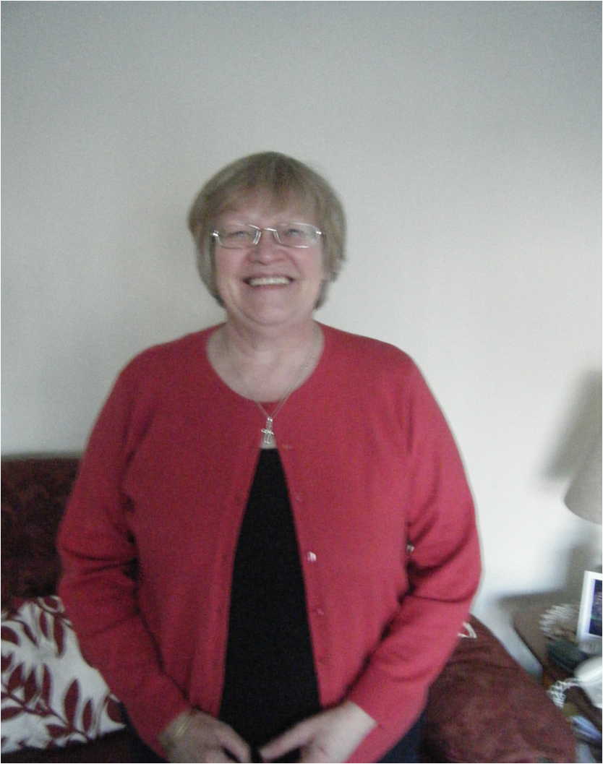

Slide 22
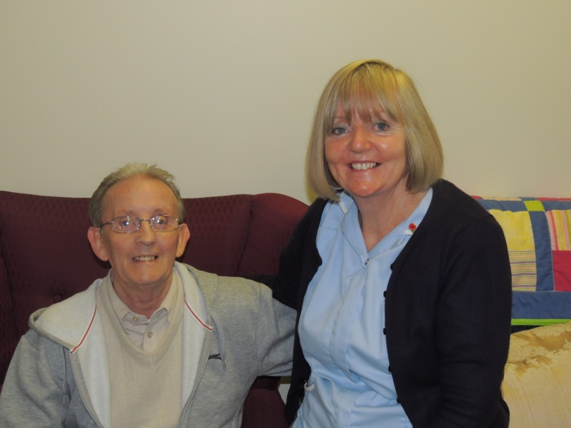
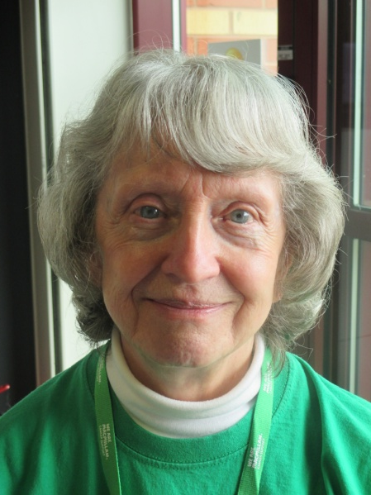
Communication is about passing it on
And making sure the right people have the right information to make the right decisions.

Slide 23
“Medicine can do so much now. What we see in hospital is more and more interventions are done, but it's no longer as thoughtful as it could be, and the essential conversations of what matters to people are not taking place. It is the understanding that we are mortal and have a finite time on this planet that needs to be revisited in medicine.”
Ros Taylor
The Lancet
“Don’t just do something. Sit there!”

Slide 24
It’s not just about safeguarding.
It’s not just about good practice.
It’s about people, and relationships, and lasting memories, and peace of mind.

Slide 25
How people die remains in the memory of those who live on
Cicely Saunders
We owe it to the dead and the living to get it right.

