Slide 1

Digital and Interoperable Medicines Programme
Shahzad Ali / Paul Brown, Clinical Leads, NHS Digital
Digital and Interoperable Medicines Programme - NHS Digital
Notes:
Paul
Programme of work funded up to March 2024 to deliver 3 key components

Slide 2


Vision
“Safer, more joined up care through the seamless, digital flow of patient medicines information across health and care; improving patient experience, reducing burden for health and care staff and increasing opportunities for research.”
Medicines Interoperability
Electronic Prescription Service (EPS) Next Generation
Medicines Data
(for secondary uses)
Notes:
Paul
Overarching Digital Medicines vision – encapsulating the full NHS(x) Programme components

Slide 3
What are the benefits
Medicines Interoperability
Adoption of standards enables the seamless, digital flow of medicines information. Reducing manual transcription.
Fewer medicines related clinical incidents and harm
Quality
Patient experience (reduced burden)
Quality
Electronic Prescription Service (EPS) - Next Generation
Hospital outpatient prescriptions can be sent electronically to the patients nominated community pharmacy, supporting remote appointments.
The service is enhanced - such as the ability for patients to track their prescriptions via NHS App.
March 2024
Clinician experience
Quality
Clinical and administration time saving and reduced burden.
Non Cash Releasing
Medicines Data for Secondary Uses
Provision of secondary care medicines data an enabler for research and population health management
Improved health outcomes
Quality
Notes:
Paul
Clear benefits to the aims of each of the components of the programme
(EPS – fewer medicines related harms??? - arguably)

Slide 4
What are the problems
Electronic
Prescription
Service (EPS)
(Next Generation)
Patient experience is suboptimal and there is avoidable work for healthcare professionals as the current EPS technology restricts the ability to enhance the service or extend it across all settings and prescription types.
Notes:
Paul
(Briefly) – describe the EPS work
Established in primary care – GP to Community Pharmacy
But ……..

Slide 5
What are the outcomes
EPS (Next Generation)
EPS is enhanced and aligned to national interoperability standards and is available for use by all NHS care settings including hospital outpatients, improving patient experience and reducing burden for staff.
March 2024
Notes:
Paul

Slide 6
What are the problems
Medicines Interoperability
There is avoidable work for healthcare professionals and an increased risk to patient safety due to patient medication and allergy/intolerance information not being interoperable between the systems used within and across care settings.
Notes:
Paul
What:
Whilst over time we have moved information quicker, it is not currently
interoperable so that it can be moved effectively from one system to another, hence
reducing transcription
Found upon admission a patient was deemed to not be allergic to any medication,
however mentioned during an outpatient appointment they had stated they were
allergic to ramipril
Recently was speaking to a patient who was Stage 5 kidney disease, who had
been admitted to hospital

Slide 7
Medicines safety and efficiency challenges
237 million medication errors annually | 6.5% hospital admissions caused by adverse effects Increasing to 20% in over 65 age group | Two thirds of hospital admissions considered preventable
5 deaths every day due to errors in prescribing, dispensing or monitoring | Overprescribing Taking 10 or medicines a day means 300% more likely to be admitted to hospital due to an adverse drug reaction | Estimated 167 million manual transcriptions of patient medicine information each year 1.2 million hours of staff time
Notes:
Paul
Why it is important? What it means in the real world-Burden
Part of the overprescribing recommendation
As you can see there are a substantial number of reasons as to why medicines
information needs to be shared.
Each year there are 237million medication errors, there may be more as not all of
them are reported. A sizeable number of patients are readmitted into hospital as a
result of adverse events, 6.5% for a lower age bracket, and when you are over 65 it
increases to 20%.
Furthermore a significant number of occasions where patients are readmitted to
hospital, these admissions could have been prevented.
The figures show 5 deaths occur on a daily basis due to an error related to
prescribing, dispensing or monitoring.
Also we have received evidence, and these are based on conservative figures, that
nationally there are potentially 167 million manual transcriptions occurring each
year, this equates to, again conservative numbers, upwards of 1.2million hours of
staff time.

Slide 8






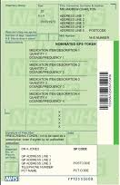




















The ambition for interoperable medicines…
“To create fully interoperable, computable medication and prescription information across the NHS enabling seamless transfer of care and ultimately a patient centred consolidated medication record.”
General Practice
Patients
111 and
Remote Consult
UEC
Treatment Centre
Pharmacy
Patient centered Consolidated Medication Record
Optometry
Secondary care
Outpatient & A&E
Dentistry
Secondary care Inpatient
Ambulance
Private & other
Care at Home
Care Home
Drug and
Alcohol
Mental Health
Social care
Notes:
Shahzad
Bring information together to allow staff to………????
Ambition is to create fully interoperable systems

Slide 9
What are the outcomes
Medicines Interoperability
The definition and adoption of interoperable medicine standards is supporting safer, more joined up patient care, contributing to reduced risks to patient safety and burden on staff, and laying the foundations for a single consolidated patient medication record.
March 2024
Notes:
Shahzad

Slide 10
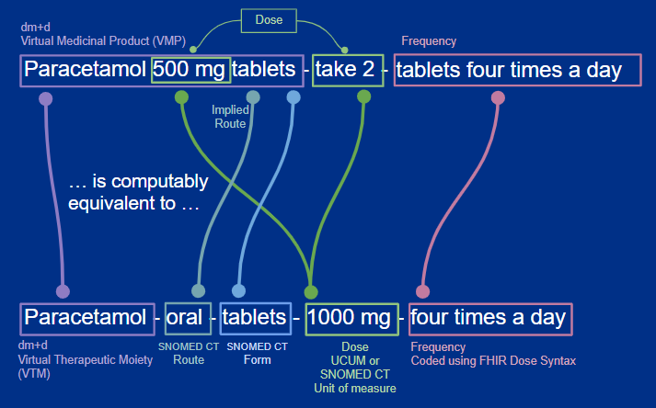
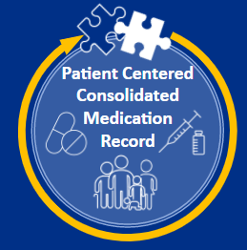

Structured Dose syntax
What do the standards enable
Primary care dm+d adoption
100%
Primary care systems: Product based prescribing. Specific for dispensers and clear for patients to understand / take.
Primary care
Systems
Product based Prescribing...
… Dose based Prescribing
Secondary care systems: Dose based prescribing. Flexible dispensing and options for administration e.g. Form
Secondary care
Systems
Secondary care ePMA dm+d adoption
average 60% - 70%
Notes:
Structured dose syntax is the combination of a number of terminology standards to produce a vocabulary that is brought together in a consistent structure. The dm+d is used to identify the medicine or active ingredient, SNOMED-CT provides routes / forms / sites etc, and is supplemented by UCUM for units of measure. The HL7 FHIR Standard provides the syntax around these terminologies to ensure a consistent message structure.
This is the heart of the challenge.
Typically, primary and secondary care clinicians and systems describe medication in different ways. Today, such instructions are held as text strings and an almost infinite variety of text strings. For example there are numerous ways to describe something as simple as “take 2 tablets four times a day”.
The adoption of the HL7 FHIR, dm+d and SNOMED standards provide a way to describe medication instructions as coded, computable statements.
This allows the programmatic conversion between the different ways primary and secondary care describe medication, giving us interoperability between these systems and within shared record implementations.

Slide 11







What have we done so far
Nov 2018
October 2019
August 2021
31st March 2023
Dose syntax guidance published
Implementation guidance published ePMA to stock control
UK Core FHIR clinical & technical assurance
NHS Compliance Interoperable Medicines Standard
PRSB Digital Medication Information Final Report
First of Type - ePMA to stock control (Derby)
Interoperable medicines standard published
(DAPB 4013)
April 2019
October 2020
1st October 2021
Notes:
Shahzad
Where we are up to-FHIR Standards
As a programme engaging further with UCD work, make ourselves a service

Slide 12
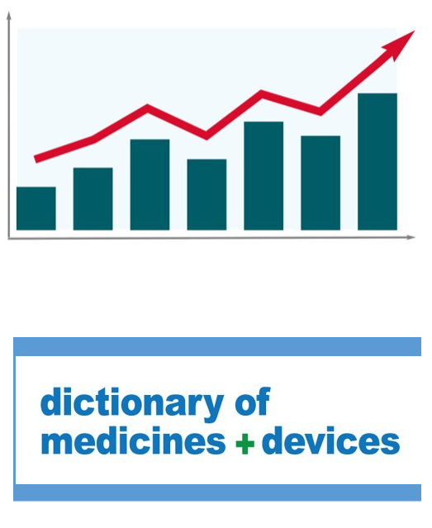
dm+d adoption in ePMA is improving
Trusts providing English ePMA data nationally:
average dm+d coverage increased from 60% to 70%
>95% dm+d coverage increased from 3 Trusts to 6​
Two implemented dm+d support (both now have >95%)
Use of up to date code for over 95% increased from 0 to 11​
Scotland average dm+d coverage for February 97.11% vs England 70.16%
England uses the most up to date dm+d codes 93.86% while Scotland is at 84.3%
Notes:
Shahzad
NB: will briefly cover collection of ePMA data for secondary uses later

Slide 13
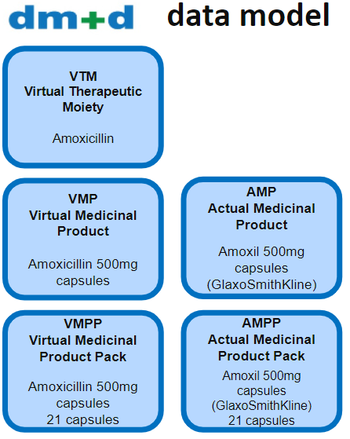



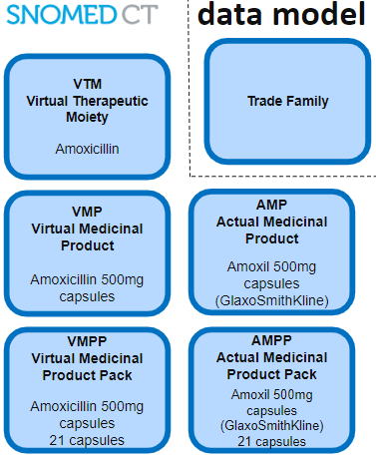
Alignment Challenges
Data / Tooling / Time
Weekly release…
1, 2, 3, 4
UK Drug Extension
Circa 1.5 weeks lag between publications
Release cycle…
dm+d 1, 2, 3, 4 plus 10 days
Data models are similar but not the same
Update schedules are different
File release formats are different
Notes:
Shazad

Slide 14
What we’ve done
2021
Sept 2021
Nov 21- Mar 22
Jun / Jul 2022
DHSC / NHSE commission Discovery
Report / Recommendation issued
Working groups commence deep dives
Papers to steering groups
Consultation across stakeholders
Steering group formed
Options and/or recommendations formed
2021
Oct 2021
Mar - Jul 2022
Notes:
Shahzad
Dm+d Snomed work for medicines terminology

Slide 15
How can the progamme help?
Website and Bulletin
Business cases
Benefits toolkit
Strategic drivers
Case for change
Education &
Awareness Campaign
eLearning
Talking Heads
Animations
Enhanced Technical guidance
Rendering of Meds' in shared care records
Early adopter blueprints
Weekly working group
Service Transformation
Trust & Provider Engagement
https://digital.nhs.uk/services/interoperable-medicines
Standards Adoption
Notes:
Shahzad
FCI information to come
More technical guidance - clinical trials for example
…,?

Slide 16


Recent engagement
18 – 19 October 22
Medicines Interoperability Hackathon
# MEDSHack22
Interoperability
Benefits Questionnaire ​
​
Research into
interoperability
benefits (harms)
dm+d & SNOMED CT UK drug extension enhancements
ePRASE
Risk & Safety Evaluation
Dose syntax update
FHIR R4 UKCore
PRSB
Diabetes Standard
Trust and
User Engagement ​
​
Medicines Optimisation DLN Community of Practice
Medicines Interoperability Learnathon 05 October 22
Standards Adoption
Notes:
Shahzad

Slide 17
What are the problems
Medicines Data for Secondary Uses
Research and analysis to improve health outcomes by reducing harm and avoidable deaths is hampered by a lack of comprehensive comparable and timely data for medicines prescribed, administered and supplied to patients in hospital settings.
Notes:
Paul
COVID collection
Data landed for COVID collection (27 “CareFlow Medicines Management Systems” Trusts with another 5 planned)
Any new ePMA systems implemented up to October 2022 will be included in this collection
Prescriptions 67,202,673 Administrations 330,894,243
Historical data from 1st Jan 2019
99% of all Historical data
Data will continue to flow until autumn 2023

Slide 18
Why are we proposing to collect National ePMA data - Benefits to the NHS
providing information that informs
safety, effectiveness, planning and policy
First Do No Harm - The report of the Independent Medicines and Medical Devices Safety Review
make prescribing safer for patients such as improve our understanding of why some people experience complications or side effects caused by the taking a mixture of medicines
provide more evidence of the effectiveness of medicines at treating specific illnesses such as improving our knowledge of the benefits and risks of new medicines
provide information that informs future healthcare plans
support national strategies relating to medicines use, improving the health outcomes of patients such as improving our understanding of how antibiotics are used and why some conditions are becoming resistant to them
broaden our understanding of the impact of medicines on the health and care of patients through linkage to other health data
Monitoring the use of medicines in the restraint of patients
Monitoring of antidepressants being prescribed to under 18’s
Understand how future standards could be applied to ePMA systems with minimal burden to trusts
Overprescribing report – good for you, good for us, good for everybody
World Health Organisation
Medication Without harm
UK 5-year action plan for antimicrobial resistance 2019 to 2024
NHS Long Term Plan
Deliver value from the £16 billion we spend on medicines
Notes:
Paul
Proposing a national collection from Trusts that have implemented ePMA system(s)
Primary system initially
Ackmnowldge not full coverage nationally nor within each Trust
The ePMA collection meets both strategic and local use cases.
There are a number of strategies this collection will support
The dataset is the first time we have collected ePMA data – we anticipate developing standards off the back of the data ensuring we don’t burden trusts – an iterative process
significant interest from:
MHRA , UKHSA (UK Health Security Agency) - PHE, NHS England missed or delayed doses AND looking at health demographics (deprivation)

Slide 19
What are the outcomes
Medicines Data for Secondary Uses
Patient medicines data from secondary care is available to NHS organisations and health bodies for secondary uses, increasing opportunities for research and analyses in the drive to improve health outcomes
March 2024
Notes:
Paul
Proposed!!! Subject to timelines etc

Slide 20
When are we proposing to collect – What trusts would need to do
2022/23
2023/24
Oct 22 | Nov 22 | Dec 22 | Jan 22 | Feb 22 | Mar 23 | Apr 23 | May 23 | Jun 23 | Jul 23 | Aug 23 | Sep 23 | Oct 23 | Nov 23
ISN Published
ISN Compliance
ePMA suppliers develop extract functionality working with Trusts
Trusts to ensure patients are informed about the ePMA data collection
Trusts have a signed Data Processing Agreement (DPA) or agree to manage Legally restricted medicines themselves prior to sending data
Trusts to implement the data extract working with their ePMA Suppliers
Trusts must send their ePMA data to NHS Digital

Slide 21
Key achievements 21/22
Q1
Medicines Data
ePMA data available to support COVID research
Q2
Medicines Interoperability
Medicines Interoperability
Medicines Data
EPS
Baseline maturity data gathered from Trusts
Standards and guidance published
dm+d adoption feedback for Trusts part of COVID collection
EPS available for secondary care system suppliers to start development
Q3
Medicines Interoperability
Medicines Interoperability
dm+d ‘hearts and minds’ campaign underway (including e-learning)
Medicines Interoperability
dm+d available in the NHS Digital Terminology Server
Learnathon and Hackathon collaboration with suppliers and NHS
Medicines Interoperability
Medicines Interoperability
Test tool available to support system supplier adoption of standards
Information Standards Notice published
Q4
Medicines Interoperability
Medicines Interoperability
Medicines Data
Discovery and prototype for UK Medicines Terminology Product Enhancement
Structured dose prototype for GP systems (EMIS)
Development of tool to translate medicines collection descriptions to dm+d
Medicines Data
EPS
EPS
EPS
Specification for national ePMA collection published
EPS assurance tool to support system supplier adoption
First of type for secondary care access to EPS
Roadmap defined for EPS ‘Next Generation’
Notes:
Paul
In summary
Achieved a lot / a lot still to be achieved.

Slide 22
Notes:
Paul

