Slide 1
Medication error litigation claims
Michelle Stafford - Safety and Learning, South
NHS Resolution
@NHSResolution
Advise / Resolve / Learn
1

Slide 2
Maternity medication error claims agenda
Claims data related to medication errors
The key ambitions of the National Medication Safety Programme
The most common medications involved in claims
Improving the safe use of anticoagulants
Understanding of learning organisation principles and relationship to organisational culture
Identify ways to improve policies, procedures or practice to support learning
www.resolution.nhs.uk
@NHSResolution
nhsr.safetyandlearningenquiries@nhs.net
Advise / Resolve / Learn
Advise / Resolve / Learn ²

Slide 3
NHS Resolution
Our purpose is to provide expertise to the NHS to resolve concerns fairly, share
learning for improvement and to preserve resources for patient care.
Strategic aims…
Resolution
Resolve concerns and disputes fairly.
Intelligence
Provide analysis and expert knowledge to drive improvement.
Intervention
Deliver interventions that improve safety and save money.
Fit for purpose
Develop people, relationship and infrastructure.
Advise / Resolve / Learn
3

Slide 4
Strategy overview
Strategic priorities:
Priority 1.
Deliver fair resolution
Priority 2.
Share data and insights
as a catalyst for improvement
Priority 3
Collaborate to improve maternity outcomes
Priority 4
Invest in our people
and systems to transform our business
All of our services will focus on achieving fair and timely resolution, wherever possible keeping patients and healthcare staff out of formal processes to minimise distress and cost.
Bringing together key parties to determine what further improvements can be made within our areas of expertise to support the government’s maternity safety ambition.
Ensuring that our unique datasets help derive usable insights that benefit patients and the healthcare and justice systems.
Develop our people, systems and services so that we can continue to deliver best value for public funds.
4
Advise / Resolve / Learn
Advise / Resolve / Learn ⁴

Slide 5
Role of the Safety and Learning team
Faculty of Learning
Products for learning
National and regional events
Support incentive schemes
Safety and Learning
Member facing
Collaborative working

Slide 6
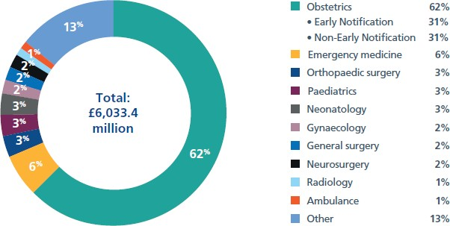
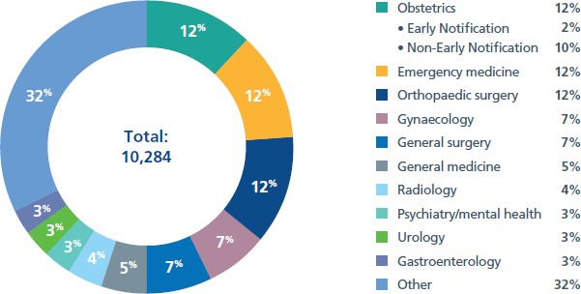
The percentage of clinical negligence claims reported in 2021/22 by specialty, with a breakdown by volume and by value

Slide 7
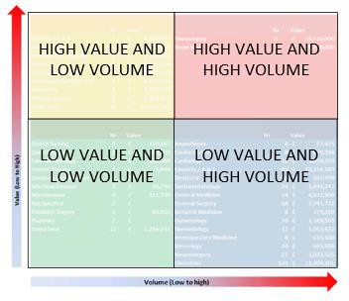
Scorecards

Slide 8
Claims: just the tip of the iceberg
Claims
Serious Untoward Incidents (SUIs)
The opportunity to reduce harm and improve safety is the way that the near miss and no harm incidents are handled.
Incident reports
Mistakes leading to harm
Near misses/no harm

Slide 9
Medication errors: learning from claims
Medication errors are any Patient Safety Incidents (PSI) where there has been an error in the process of prescribing, preparing, dispensing, administering and monitoring or providing advice on medicines.
nhsr.safetyandlearningenquiries@nhs.net
9

Slide 10
The NHS Patient Safety Strategy
The NHS Patient Safety Strategy has a strategic focus on medication errors, with the
Medicines Safety Improvement Programme addressing the most important causes of severe harm associated with medicines.
The programme aims to reduce severe avoidable medication-related harm by 50% by March 2024.

Slide 11
Key ambitions are:
to improve the safe use of anticoagulants.
to reduce harm from opioid medicines used for chronic pain.
to reduce avoidable readmissions by increasing uptake of the Discharge Medicines Service
(Medicines Safety Improvement Programme)

Slide 12
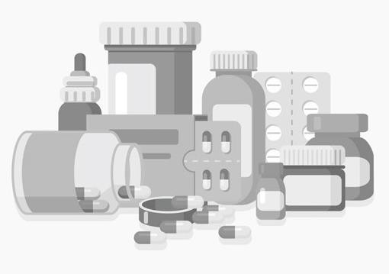
Did you know? Medication errors
Click on any of the pictures to read the full leaflet.
You can find other some of our other products for learning via our website here.
Did you know? Insights into medication errors
Did you know? Anti-
infective medication errors
Did you know? Heparin
and anticoagulants
Did you know? General Practice Medication Errors
Did you know? Maternity Medication Errors
Did you know? Extravasation

Slide 13
Overall medication error claims in England (5yrs)
Total number of claims = 1420
Open claims = 495
Total cost of closed claims = £19,324,495
Unsuccessful claims = 438
Successful claims = 487
Total damages paid = £10,419,356

Slide 14
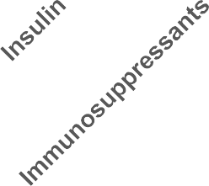
Overall medication error closed claims by type of medication
England
140
131
120
104
100
80
65
60
40
37
29
21
20
18
15
20
13
12
12
10
0

Slide 15
Overall medication error claims by specialism
70
60
50
40
30
20
10
0
General Medicine
Anaesthesia
Orthopaedic Surgery
Emergency Medicine
General Surgery
Obstetrics
Cardiology
Pharmacy
Psychiatry/ HM Prison Mental Health Medical/dental
Renal Medicine

Slide 16
Medication error claims - what are the common types of medication errors?
Prescribing
Omission
Wrong time
Improper dose
Wrong dose prescription/wrong dose preparation
Administration errors including the incorrect route of administration, extra dose or wrong rate.

Slide 17
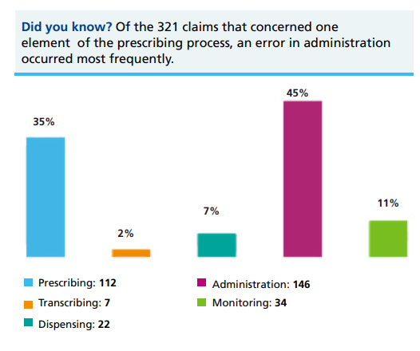
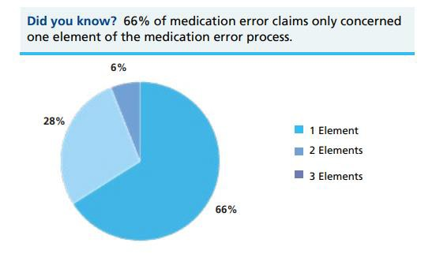
Themes within medication error claims

Slide 18
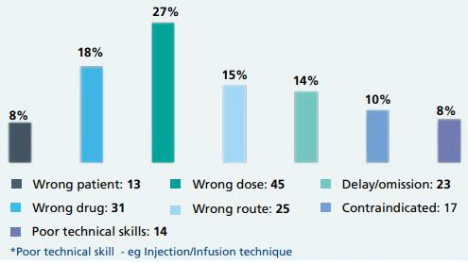
Themes within medication error claims

Slide 19
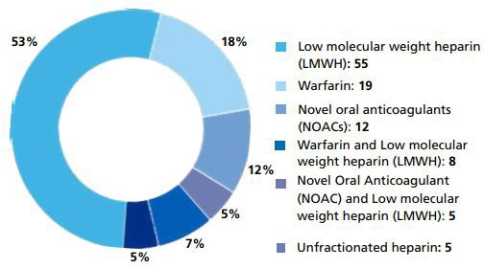
Anticoagulant medication error claims
Types of anticoagulant involved in claims
Total claims = 373
Open = 155
Unmeritorious claims = 114
Successful claims = 104
Value of closed claims = £8,189,129

Slide 20
Heparin and anticoagulant claims result in significant patient harm.
Types of patient harm identified within heparin and anticoagulant claims:
Death: 36
Venous thromboembolism: 34
Other: 26
Stroke: 8

Slide 21
Did you Know?
Key causes for low molecular weight heparin (LMWH) medication error claims:
Incorrect dose or course length was prescribed
Delay or an omission with unknown reason
Failure to ensure a sufficient course of LMWH was supplied at discharge from hospital

Slide 22
Did you Know?
Key causes for warfarin medication error claims:
Failure to stop or reverse warfarin when indicated
Failure to provide bridging therapy when warfarin was stopped pre-procedure
Failure to restart warfarin post-procedure
Stopping warfarin when not indicated
The wrong drug had been given to the patient

Slide 23
Did you Know?
Key causes for novel oral anticoagulant (NOAC) medication error claims:
Failure to stop the NOAC when indicated
Delay or an omission with unknown reason
Stopping a NOAC when not indicated

Slide 24
What can you do?
Ensure protocols concerning the prevention of venous thromboembolism (VTE) in patients include LMWH dose calculations and course lengths
Communicate the importance of ensuring the timely prescription of LMWH where risk assessments have identified it is indicated
Communicate the importance of avoiding delays in the administration of LMWH

Slide 25
What can you do?
Ensure robust policies and procedures exist around pre and postoperative management of anticoagulated patients including bridging therapy
Ensure protocols are in place which detail when anticoagulant reversal is indicated / should be considered
Ensure that anticoagulant treatment plans are effectively and accurately communicated to providers of primary care

Slide 26
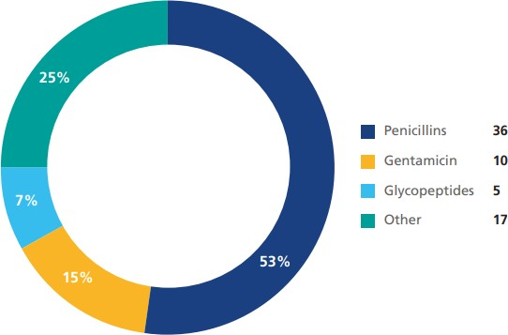
Anti-infective medication error claims
Types of anti-infective involved in claims
Total claims = 172
Open = 53
Unmeritorious claims = 51
Successful claims = 68
Total value of closed claims = £2,612,667

Slide 27
Maternity medication error claims
1 April 2015 – 31 March 2020*
Claims notified
55
Claims settled with damages paid
22
Total cost of settled claims
£460,728
Opioid: 5
Anti-infective: 5
22%
32%
Hormone: 5
Other: 7
23%
23%
*All NHSR notified claims related to extravasation 1April 2015-31 March 2020

Slide 28
Examples of maternity medication error claims
Anticoagulant (LMWH) – Thrombosis/Embolism: failure to provide coagulant
prophylaxis to mother following birth which resulted in DVT.
Total cost of claim £10K
Anticoagulant - Thrombosis/Embolism – mother discharged without any anticoagulant medication following vaginal birth resulting in multiple pulmonary emboli.
Total cost of claim £35K
Opioid – Psychiatric/psychological injury: Administration of incorrect dosage of morphine – prior to C-section. Higher does of intrathecal morphine given as part of epidural anaesthetic.
Total cost of claim £50K

Slide 29
What can you do?
Ensure staff follow local guidance and appropriately risk assess each patient. If in doubt don’t give the medication and escalate it for advice.
Reducing avoidable readmissions through improving discharge medication review
Provide education to ensure staff are aware of the risk of medication errors and what they need to do if one occurs. Review your organisation’s reporting procedure for medication errors and ensure learning after incidents is shared with all staff.

Slide 30
What can you do?
Have a standing agenda item on your medicines management board to ensure incidents and near misses are robustly reported and investigation and action plans are implemented and embedded.
Ensure a designated person reviews the Medicine and healthcare products regulatory agency (MHRA) medication safety updates and cascades and actions accordingly to encourage learning across the wider organisation and Local Maternity Neonatal Systems and Integrated Care System.
Review patient information resources to include manufacturers guidance, evidence based practices and patient support organisations.

Slide 31
What can you do?
Support a culture of openness and learning by sharing good practice case stories.

Slide 32
The ambition for the NHS to be
the largest learning organisation in the world
Create an environment that maximises learning
Learning organisation principles
Major in near misses and anticipatory factors
Partnership with patients , carers and staff/utilising the experiences and views of families during the investigation
Establishing a learning culture rather than a blame culture
Supporting staff to disclose information and during investigations

Slide 33
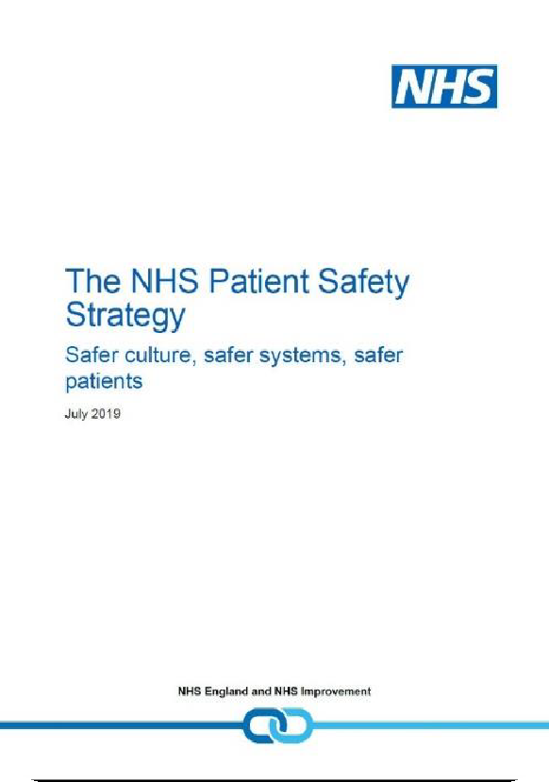
https://engage.improvement.nhs.uk/policy-strategy-and-delivery- management/patient-safety-strategy/user_uploads/developing-a-patient- safety-strategy-for-the-nhs-14-dec-2018-v2.pdf
Chaffer, D., Kline, R. and Woodward, S.
https://resolution.nhs.uk/resources/being-fair/

Slide 34
Being fair: supporting a just and learning culture for staff and patients following incidents in the NHS
A just and learning culture is the balance of fairness, justice, learning – and taking responsibility for actions. It is not about seeking to blame the individuals involved when care in the NHS goes wrong. It is also not about an absence of responsibility and accountability.
All actions should be understood
Staff should be supported to learn from their actions
Chaffer, D., Kline, R. and Woodward, S.

Slide 35
Three aims of Being Fair
To help the NHS prioritise learning about how to minimise the conditions and behaviours that can underpin or lead to things not going as planned rather than apportion individual blame
Help the NHS build a consistent approach for all staff, no matter what profession or background
Help the NHS to avoid, wherever possible, suspension, exclusion and disciplinary action unless there is wilful intent

Slide 36
Saying Sorry

Slide 37
Duty of Candour animation

Slide 38
Summary
Duty of candour is always the right thing to do.
Listen to patients, relatives and carers
Follow local and manufacturer’s guidance
Staff may need updates and training including patient stories and learning from claims, incidents and complaints

Slide 39
Did you know? Medication errors
Click on any of the pictures to read the full leaflet.
You can find other some of our other products for learning via our website here.
Did you know? Insights into medication errors
Did you know? Anti-
infective medication errors
Did you know? Heparin
and anticoagulants
Did you know? General Practice Medication Errors
Did you know? Maternity Medication Errors
Did you know? Extravasation

Slide 40
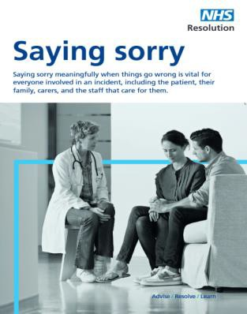
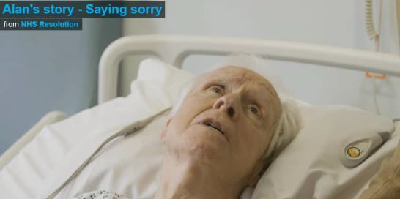
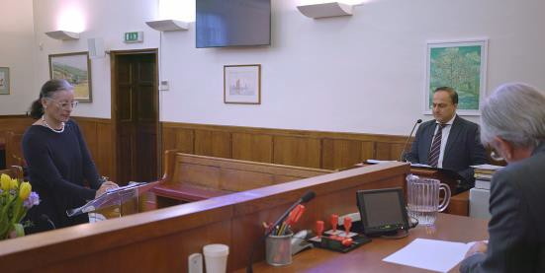
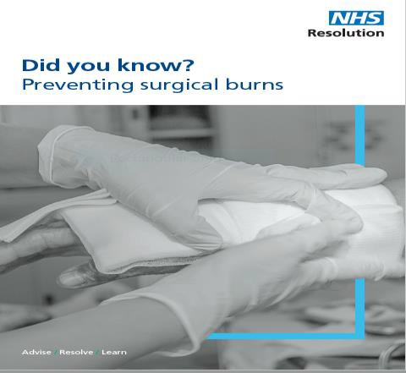
A range of products for learning
https://resolution.nhs.uk/resources/

Slide 41
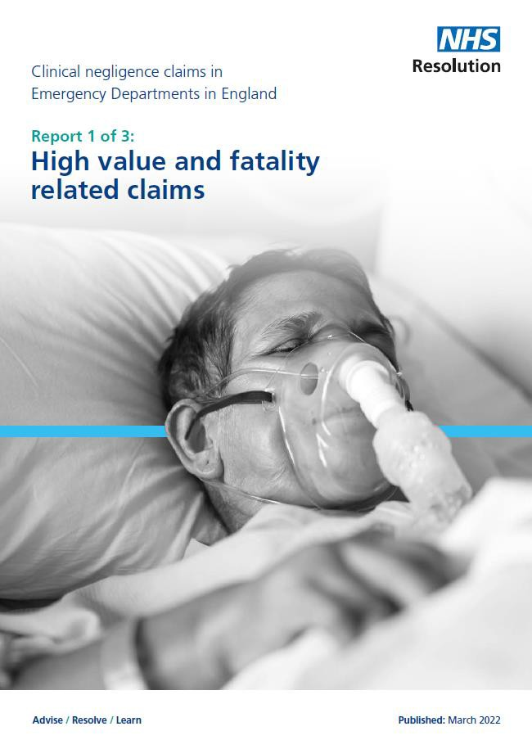
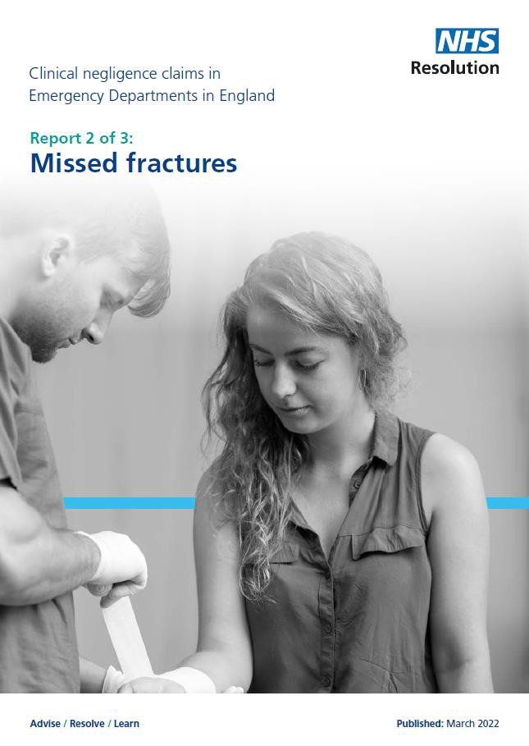
Emergency medicine reports

Slide 42
Thank you for your time
www.resolution.nhs.uk @NHSResolution
Further queries or information please contact our team:
nhsr.safetyandlearningenquiries@nhs.net

