Slide 1
Prescribing for late effects and in cancer survivorship: opportunities for the non-medical prescriber
Dr Christopher D Scrase MA MB FRCP FRCR
Suffolk and NE Essex Integrated Care System Macmillan Clinical Lead for Cancer
Macmillan Consultant Clinical Oncologist
Ipswich Hospital
East Suffolk and North Essex NHS FT

Slide 2
Agenda
Cancer as a long term condition
Personalised care
Tools to understand those needs
Needs of people living with cancer
Scope of services for managing consequences and its treatment including late effects
Social and pharmacological prescribing opportunities
Summing up

Slide 3
Cancer as a long term condition

Slide 4
Cancer as a long term condition

Slide 5
Personalised care

Slide 6
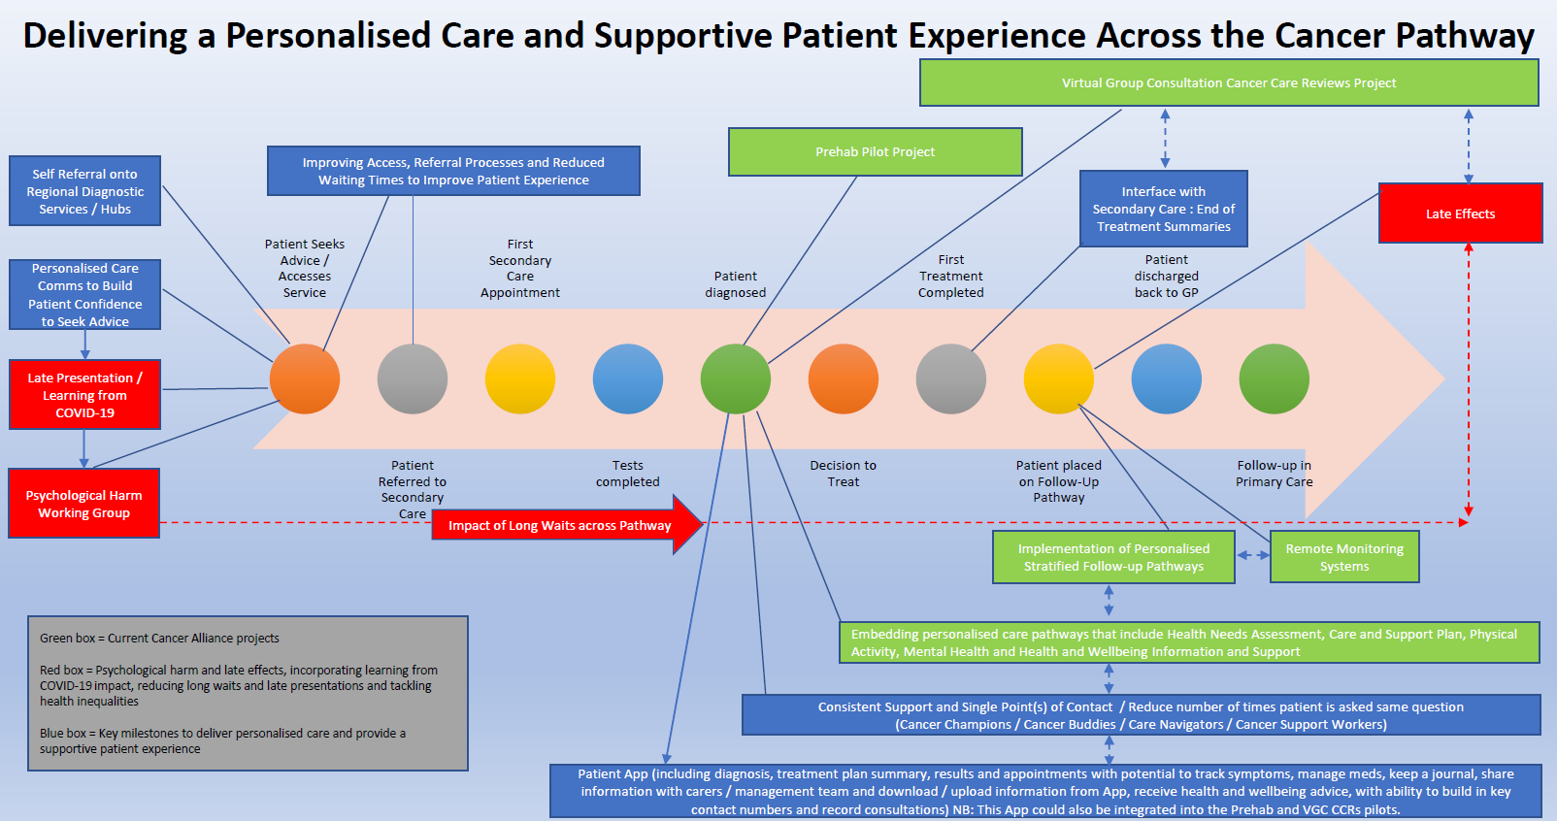
The breadth of personalised care across the cancer journey [courtesy EoE CA]

Slide 7
Personalised Care for people living with cancer
Relevant throughout the whole cancer pathway
Needs have to be identified before they can be addressed and people may require support in identifying their needs
The needs of a person living with cancer will change as they progress through their experience with cancer so should to be regularly assessed
Personalised care is the responsibility of everyone supporting a person living with cancer and is best provided by multiple different professionals
Supported self-management is core to personalised care

Slide 8
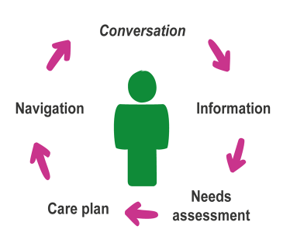
Elements of personalised care
Supportive conversations – facilitated by holistic needs assessment, treatment summary and cancer care review interactions
Provision of information – during conversations, digitally, including health and wellbeing information and support via various channels
Holistic assessments to identify needs – facilitated by HNA delivered in all settings
Personalised care and support planning to address needs – facilitated by HNA, care and support planning, delivered in all settings
Navigation to services to meet areas of physical and psychosocial needs – including health and wellbeing support, community services and digital tool/channels

Slide 9
Personalised care interventions
Personalised Care and Support Plan based on HNA
Ensures people’s physical, practical, emotional, social needs are met and that resources are targeted to those who need them most.
End of Treatment Summary
Completed by secondary care and given to the patient and GP. Provides detailed summary of treatment, potential side effects, signs and symptoms of recurrence and contact details to address any concerns.
Health & Wellbeing Information & Support
Information and support to patients/their family before, during and after cancer treatment. This may include: how to support management of side effects, community support groups, financial support, how to get back to work, diet and lifestyle.
Cancer Care Review
Discussion between patient and GP / Nurse about their cancer journey. Helps patient understand what information and support is available.

Slide 10
Tools to evaluate ‘needs’

Slide 11
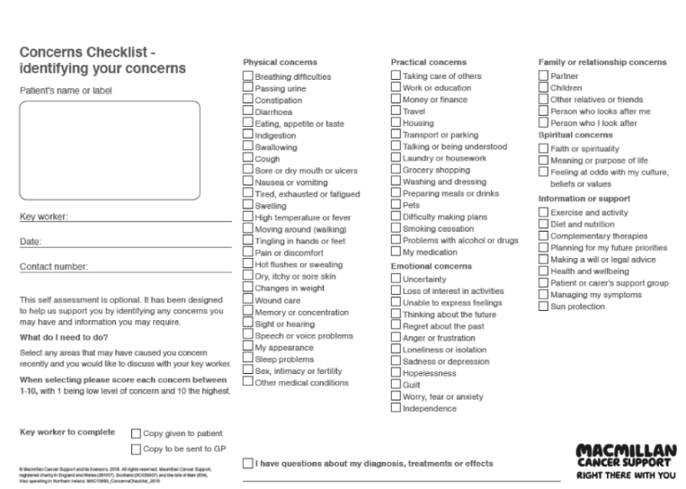
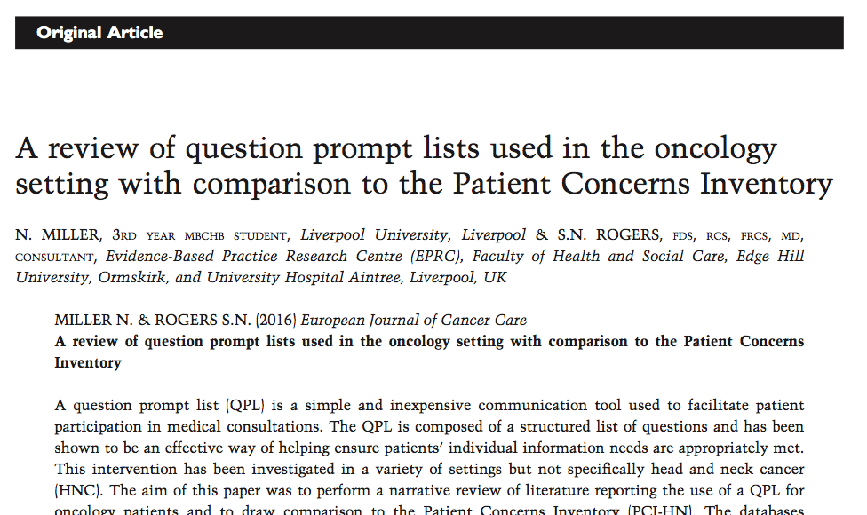
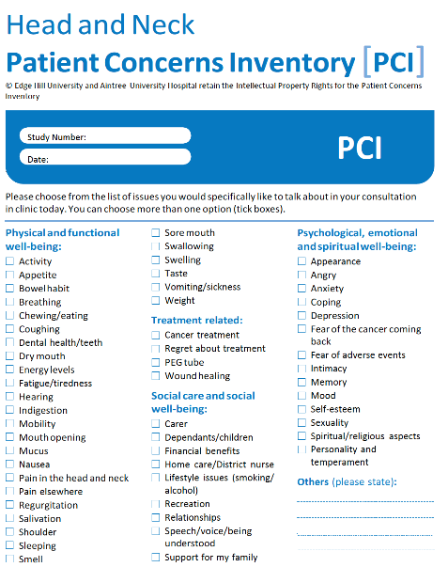
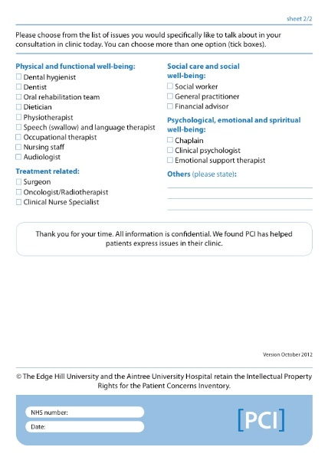
Holistic needs assessments & Personal concerns inventories
HNAs
PCI [Courtesy Simon Rogers]

Slide 12
What are the needs identified by patients?

Slide 13
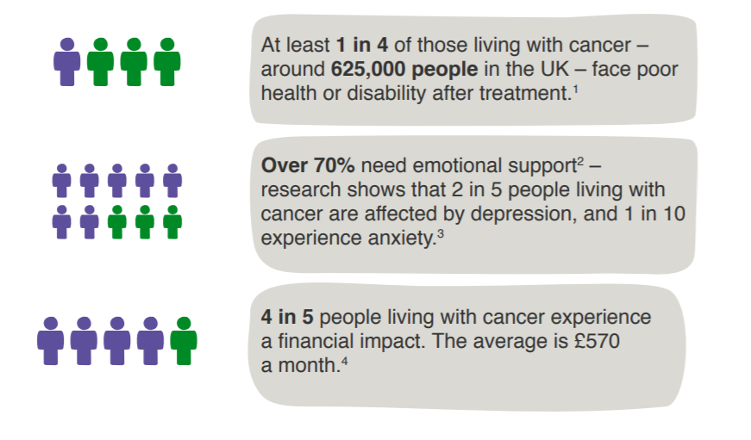
Needs of People Living with Cancer
1 Macmillan Cancer Support. Throwing light on the consequences of cancer and its treatment. 2013 (1 in 4 people using estimated prevalence of 2.5 million)
2 Macmillan Cancer Support. Hidden at Home – The Social Care Need of People Living with Cancer. 2015.
3 Pitman A, et al. Depression and anxiety in patients with cancer. BMJ 2018; 361:1415.
4 Macmillan Cancer Support. No Small Change: Time to act on the financial impact of cancer. 2012.

Slide 14
Late effects, long-term problems, and unmet needs of cancer survivors (1)
Martina Schmidt ESMO 2021
The most frequently reported problems rated with at least moderate burden were:
loss of physical capacity (40.7%),
fatigue (38.5%)
sleep problems (36.6%)
sexual problems (35.4%)
arthralgia (33.4%)
anxiety (33.2%)
neuropathy (28.9%)
Cardiac disorders (15.6%)
Osteoporosis (11.9%) ……..of survivors
Extreme burden was most frequently rated for sexual problems (10.1%), mainly in men with prostate cancer.

Slide 15
Late effects, long-term problems, and unmet needs of cancer survivors (2)
Highest proportion of dissatisfaction with received support related to those with patients with sexual problems (44.7% of affected survivors rated support as poor);
Support for fatigue was rated as poor by 37.7% and as good only by 29.5% of affected survivors;
Support was also reported as poor for neuropathy (35.9%), cognitive problems (35.3%), weight gain (34.7%), or hot flashes/night sweats (33.7%);
In contrast, support in case of pain was rated as good by a majority (51.3%).

Slide 16
Late effects, long-term problems, and unmet needs of cancer survivors (3)
Clinical aspects and implications:

Slide 17
How to we integrate identification and management of late effects into follow up?

Slide 18
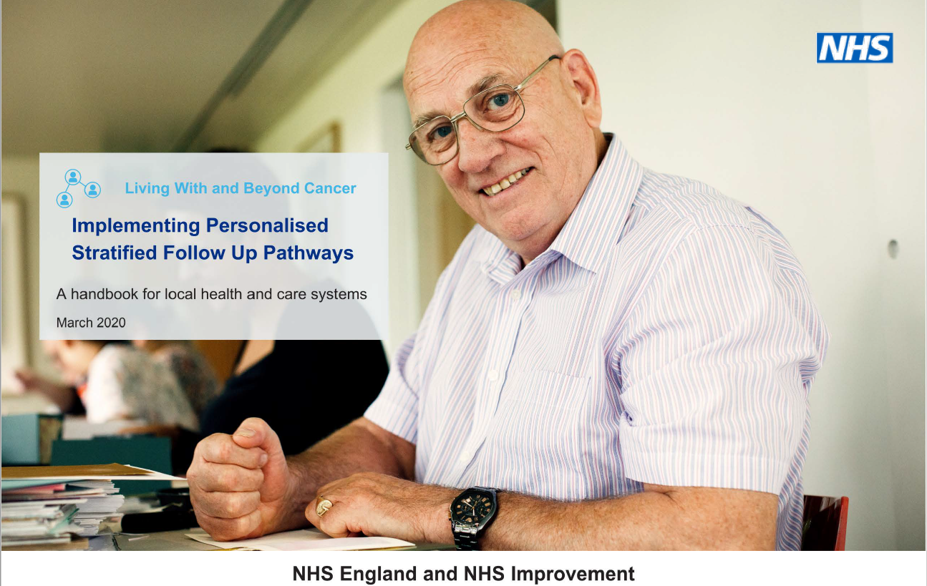
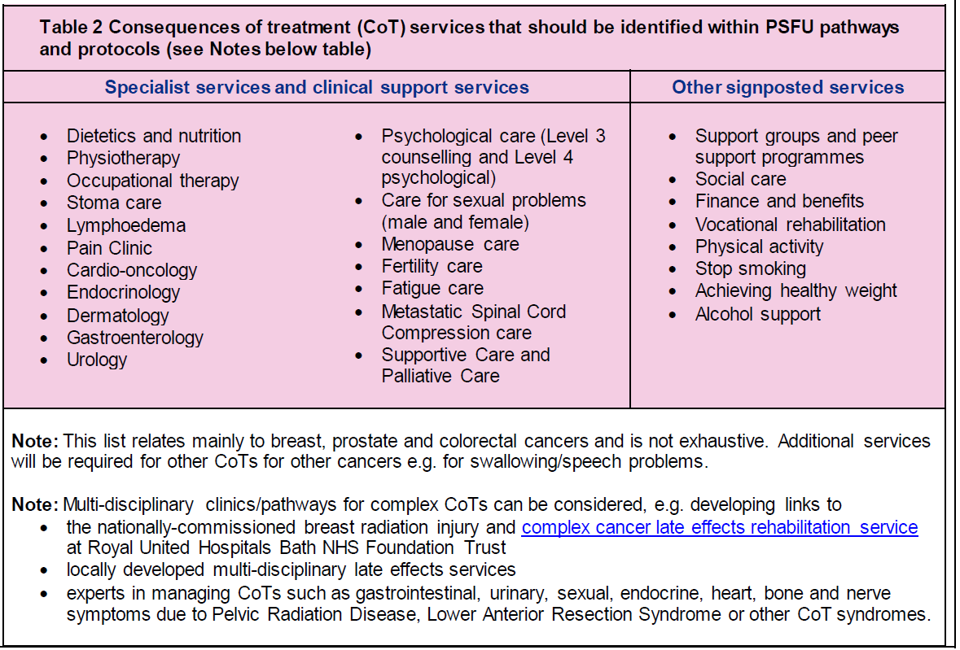
Consequences of cancer and its treatment including late effects
Pathway/referral routes for the monitoring, diagnosis, care, treatment and rehabilitation of consequences of cancer and its treatment should be clearly identified and made integral to all PCFU/PSFU protocols

Slide 19
Let’s consider then the cancer management offered…..

Slide 20
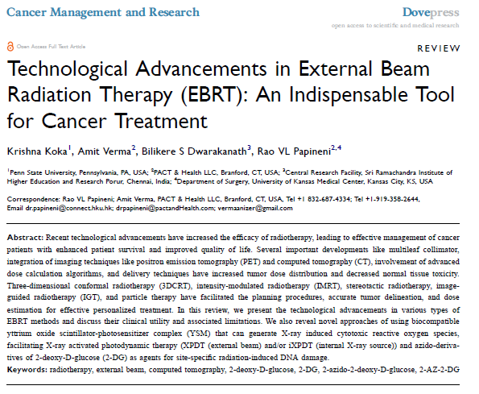
Radiotherapy (and strategies to reduce CoT)
Prevention: High quality radiotherapy. Appropriate patient selection. Some elements of prehab and ongoing support during treatment
Mitigation: Early intervention for minimisation of sequelae – cancer rehab;
Management: Intervention to address physical and psychological harm.

Slide 21

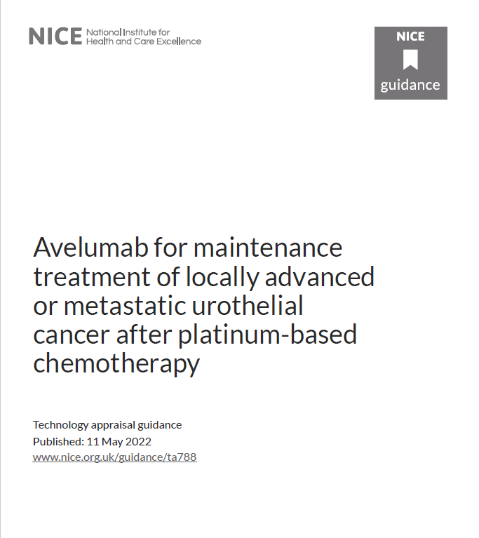
Chemotherapy and the changing world of drug types and approaches
A plethora of new agents
Targeted and ‘personalised’
‘New’ side effects
Increasingly offering maintenance therapies..

Slide 22
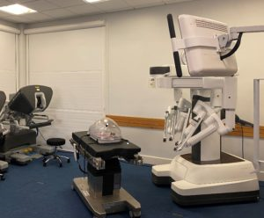
Surgery is also becoming increasingly technology-driven
‘The technology allows surgeons to complete these complex operations by keyhole surgery, which in turn has resulted in reduced conversion to open surgery, less post-operative pain and earlier discharge from hospital’
ESNEFT surgical team
However patients still have the consequences of the (part) organ removed..

Slide 23
Scope of services for managing consequences of cancer and its treatment including late effects and prescribing opportunities

Slide 24

Enhanced supportive care
Enhanced Supportive Care is led by the Specialist Palliative Care Team, but delivered by the whole of the Supportive Care Team;
This might include talking through any troublesome symptoms, and formulating a plan, which may include changing or building on existing medicines, to help alleviate symptoms.

Slide 25


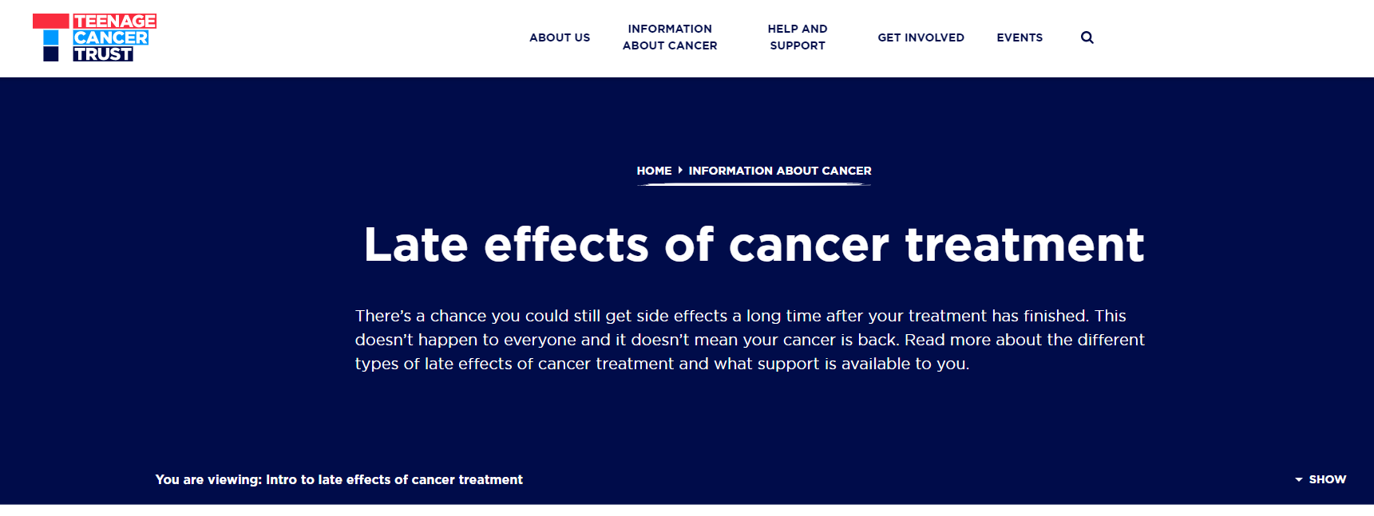
Children & TYA specialist services
Endocrine issues which will require specialist oversight
Cardiac issues which similarly will require specialist oversight
Bone health optimisation
Long term risk of second cancer and surveillance (‘enhanced screening’)

Slide 26
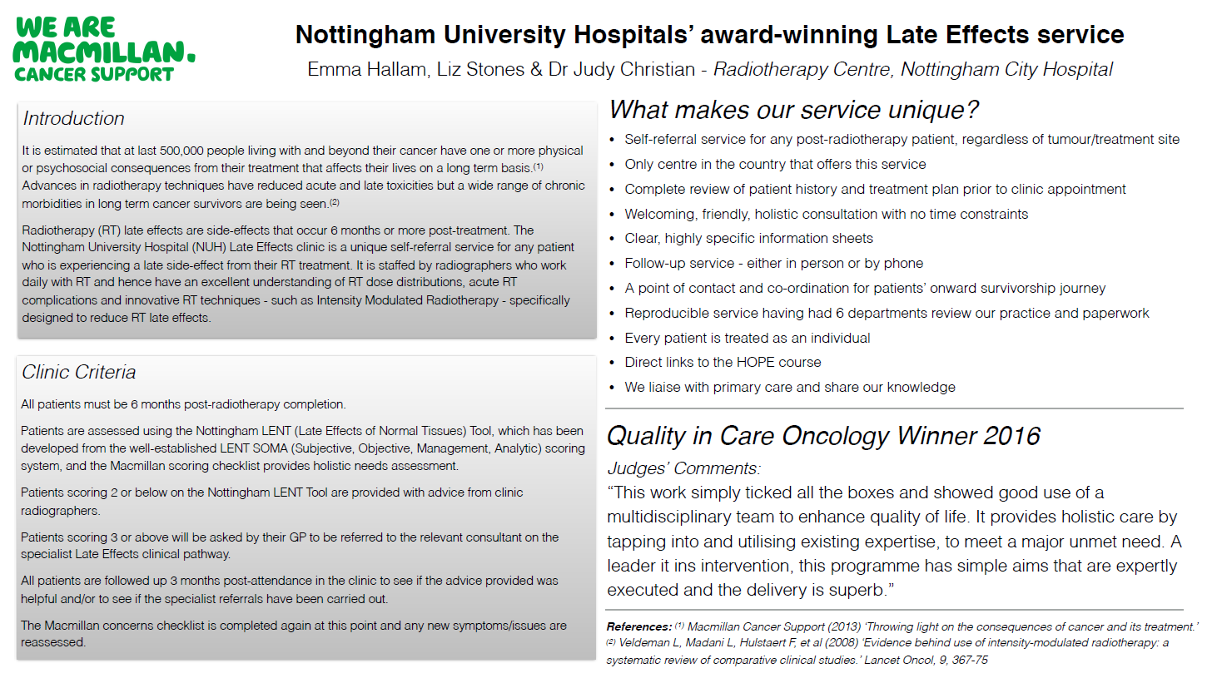
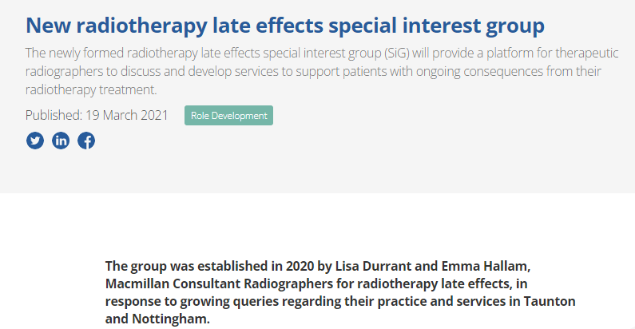
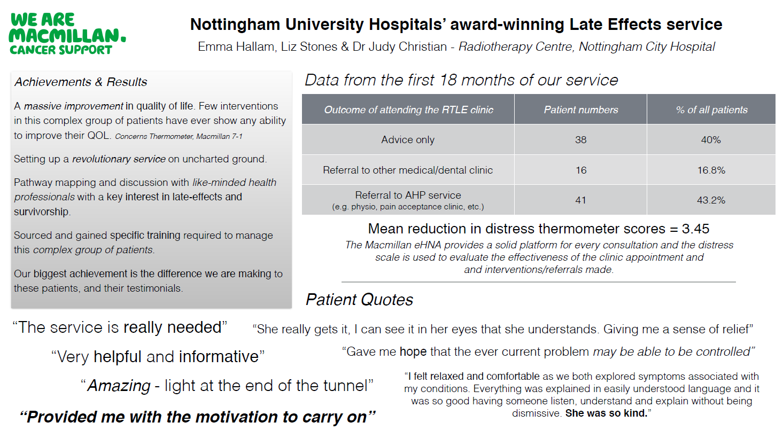
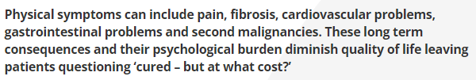
Radiotherapy late effects services

Slide 27
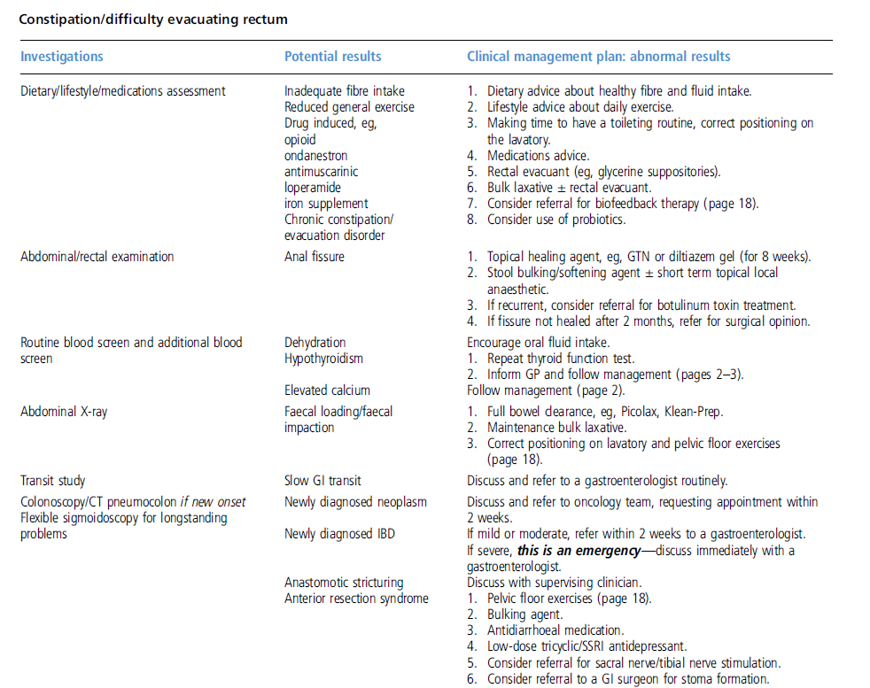

Pelvic radiation disease (1)

Slide 28
Pelvic radiation disease (2)
www.prda.org.uk

Slide 29
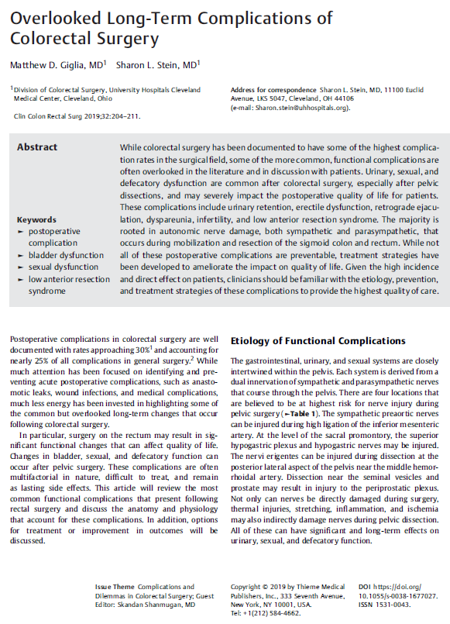
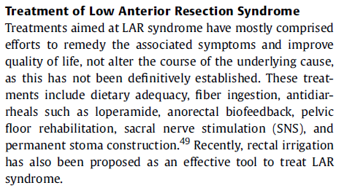
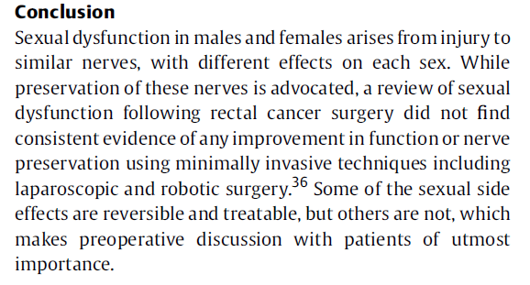
Colorectal surgery late effects and services to address these
Example 1
Example 2

Slide 30
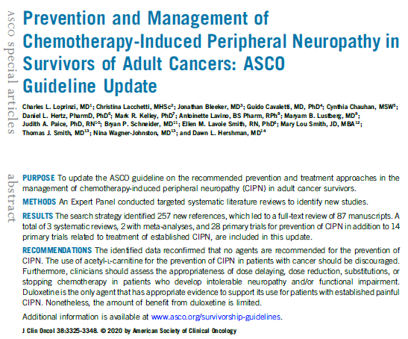
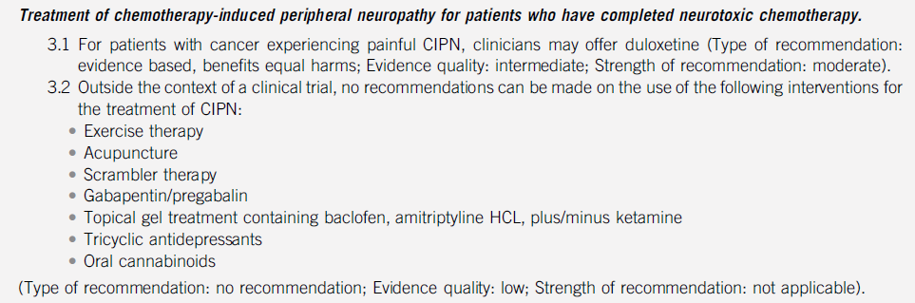
Chemotherapy induced late effects (using CIPN as an example) and services to address these

Slide 31


Social prescribing

Slide 32

The future?
Long term sequelae are not to be under-estimated.
Services to address the long term consequences of cancer and its treatment need to be embraced.

Slide 33
The role of the NMP?
Will be part of a multi-disciplinary team.
Knowing how to have supportive conversations with your patients and how to advise or signpost is key.
Prescribing medication may be part of our armamentarium in helping these patients with specific sequelae.

Slide 34
Agenda
Cancer as a long term condition √
Personalised care √
Tools to understand those needs √
Needs of people living with cancer √
Scope of services for managing consequences and its treatment including late effects √
Social and pharmacological prescribing opportunities √
Summing up √

Slide 35

Thank you for listening! christopher.scrase@esneft.nhs.uk

