Slide 1

Delivering Compassionate Leadership in Nursing and Midwifery
Dr Sarah McGloin Head of Grants and Impact

Slide 2

The RCN Foundation
Set up in 2010 as an independent charity and grant maker with the purpose to support and strengthen nursing and midwifery to improve the health an wellbeing of the population.
The Foundation supports all nurses, midwives and HCSW you do not need to be a member of the RCN to receive support.

Slide 3
Strategic Aims
Supporting the nursing community in times of need and improving their health and wellbeing.
Investing in the future of nursing through our programme of education grants and scholarships.
Developing nursing-led projects that improve patient care, health and wellbeing.
Increasing the visibility, profile and public understanding of the role and contribution of nursing to maintaining and improving the nation’s health.

Slide 4
Mental health and emotional wellbeing
Mental health and emotional wellbeing of nursing and midwifery staff is a key priority for the Foundation heightened by the pandemic.
Early into the Pandemic, we commissioned the Kings Fund to undertake a piece of work to explore the effect of working through the pandemic on the mental health and emotional wellbeing of nurses, midwives, HCSW and student nurses

Slide 5
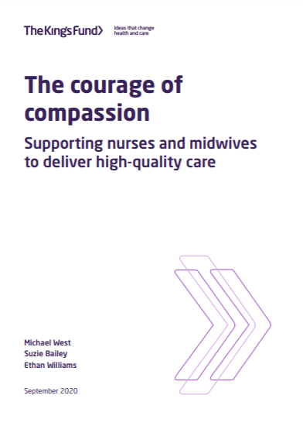
The Courage of Compassion – supporting nurse and midwives to deliver high quality care (Kings Fund, 2020)
This review investigated how to transform nurses’ and midwives’ workplaces so that they can thrive and flourish and are better able to provide the compassionate, high-quality care that they wish to offer.

Slide 6

The ABC of nurses’ and midwives’ core needs
Autonomy/Control – The need to have control over our work lives, and to be able to act consistently with our values
Belonging – The need to be connected to, cared for by, and caring of those around us in the workplace, and to feel valued, respected and supported.
Competence/Effectiveness - The need to experience effectiveness in what we do and deliver valued outcomes like high-quality care.

Slide 7
Compassionate Leadership
“Compassionate leadership involves a focus on relationships through careful listening to, understanding, empathising with and supporting other people, enabling those we lead to feel valued, respected and cared for, so they can reach their potential and do their best work. There is clear evidence that compassionate leadership results in more engaged and motivated staff with high levels of wellbeing, which in turn results in high-quality care “(West 2021).

Slide 8
How do compassionate leaders behave?
Empathise with their colleagues
Seek to understand the challenges they face
Committed to supporting others to cope with and respond successfully to work challenges
Focused on enabling those they lead to be effective and thrive in their work.

Slide 9
Four behaviours of Compassionate leadership
Attending and listening take time to listen to the challenges, obstacles, frustrations and harms colleagues experience as well as listening to accounts of their successes and joys (West 2021)
Empathising mirroring and feeling colleagues’ distress, frustration, joy, etc, without being overwhelmed by the emotion and becoming unable to help (Gilbert, 2017)
Understanding taking time to properly explore and understand the situations people are struggling with. It implies valuing and exploring conflicting perspectives (Gallo,2017)
Helping taking thoughtful and intelligent action to support individuals and teams. Removing obstacles that get in the way of people doing their work (e.g., chronic excessive workloads, conflicts between departments) and providing the resources people and services need (McCauley and Fick-Cooper, 2020)

Slide 10
Courage of Compassion recommendations
1: Authority, empowerment and influence
Introduce mechanisms for nursing and midwifery staff to shape the cultures and processes of their organisations and influence decisions about how care is structured and delivered.
2: Justice and fairness
Nurture and sustain just, fair and psychologically safe cultures and ensure equity, proactive and positive approaches to diversity and universal inclusion.
3: Work conditions and working schedules
minimum standards for facilities and working conditions for nursing and midwifery staff in all health and care organisations.

Slide 11
Courage of Compassion recommendations
4: Teamworking Develop and support effective multidisciplinary teamworking for all nursing and midwifery staff across health and care services.
5: Culture and leadership
Ensure health and care environments have compassionate leadership and nurturing cultures that enable both care and staff support to be high-quality, continually improving and compassionate.
6: Workload
Tackle chronic excessive work demands in nursing and midwifery, which exceed the capacity of nurses and midwives to sustainably lead and deliver safe, high-quality care and which damage their health and wellbeing.

Slide 12
Courage of Compassion recommendations
7. Management and supervision
Ensure all nursing and midwifery staff have the effective support, professional reflection, mentorship and supervision needed to thrive in their roles.
8. Learning, education and development
Ensure the right systems, frameworks and processes are in place for nurses’ and midwives’ learning, education and development throughout their careers. These must also promote fair and equitable outcomes.

Slide 13
Courage of Compassion: Where are we now?
Free online open access course at the Kings Fund:
An introduction to leading with kindness and compassion in health and social care.
RCNF funded Queen Margaret University, HeaLiN study
An introduction to leading with kindness and compassion in health and social care

Slide 14
References
Gallo, A. 2017 Dealing with Conflict; Harvard Business School; Harvard.
Gilbert, P. 2017 Compassion: Concepts, research and applications. Routledge. Oxford.
McCauley, C. and Fick-Cooper, L. 2020. Direction, alignment, commitment: Achieving better results through leadership CCL Press. North Carolina
West, M. 2021 Compassionate Leadership; Swirling Leaf Press; London

