Slide 1
Day Surgery Pathway
Dr Kim Russon
Consultant Anaesthetist, The Rotherham NHS FT
Immediate President, British Association of Day Surgery (BADS)
BADS / HCC Day case Foot and Ankle Conference
8th November 2022
Disclosures
Represent BADS on advisory boards with the following companies: Depuy & Sintetica

Slide 2
Benefits of Day Surgery
Patient benefits
  Reduced infections
  Reduced risk of VTE
  Patient preference
Benefits for the hospital
  Release inpatient beds
Enabled elective surgery to continue running efficiently during COVID pandemic
Help recover the huge elective waiting lists

Slide 3
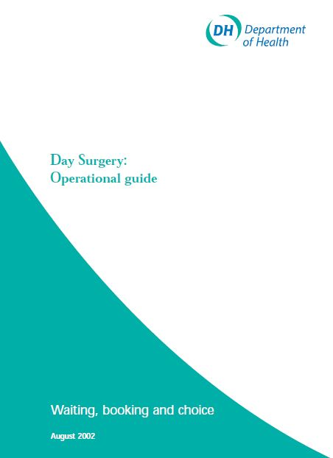
Definition of Day Surgery
“Day surgery is the admission of selected patients to a hospital for a planned surgical procedure, returning home on the same day”
Admitted
Operated on
Go home
On the same calendar day
It is not a 23-hour stay (ambulatory), which involves overnight admission
Day Surgery: Operational Guide
DoH London 2002

Slide 4
2004

Slide 5

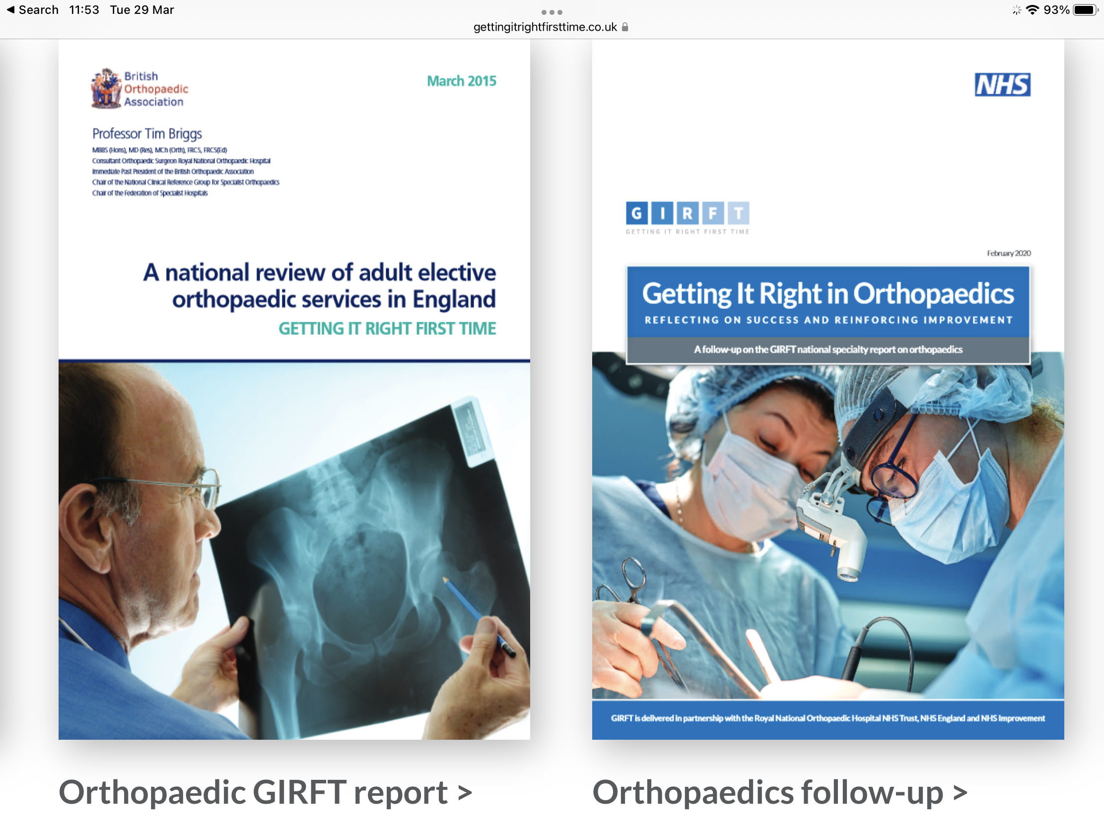
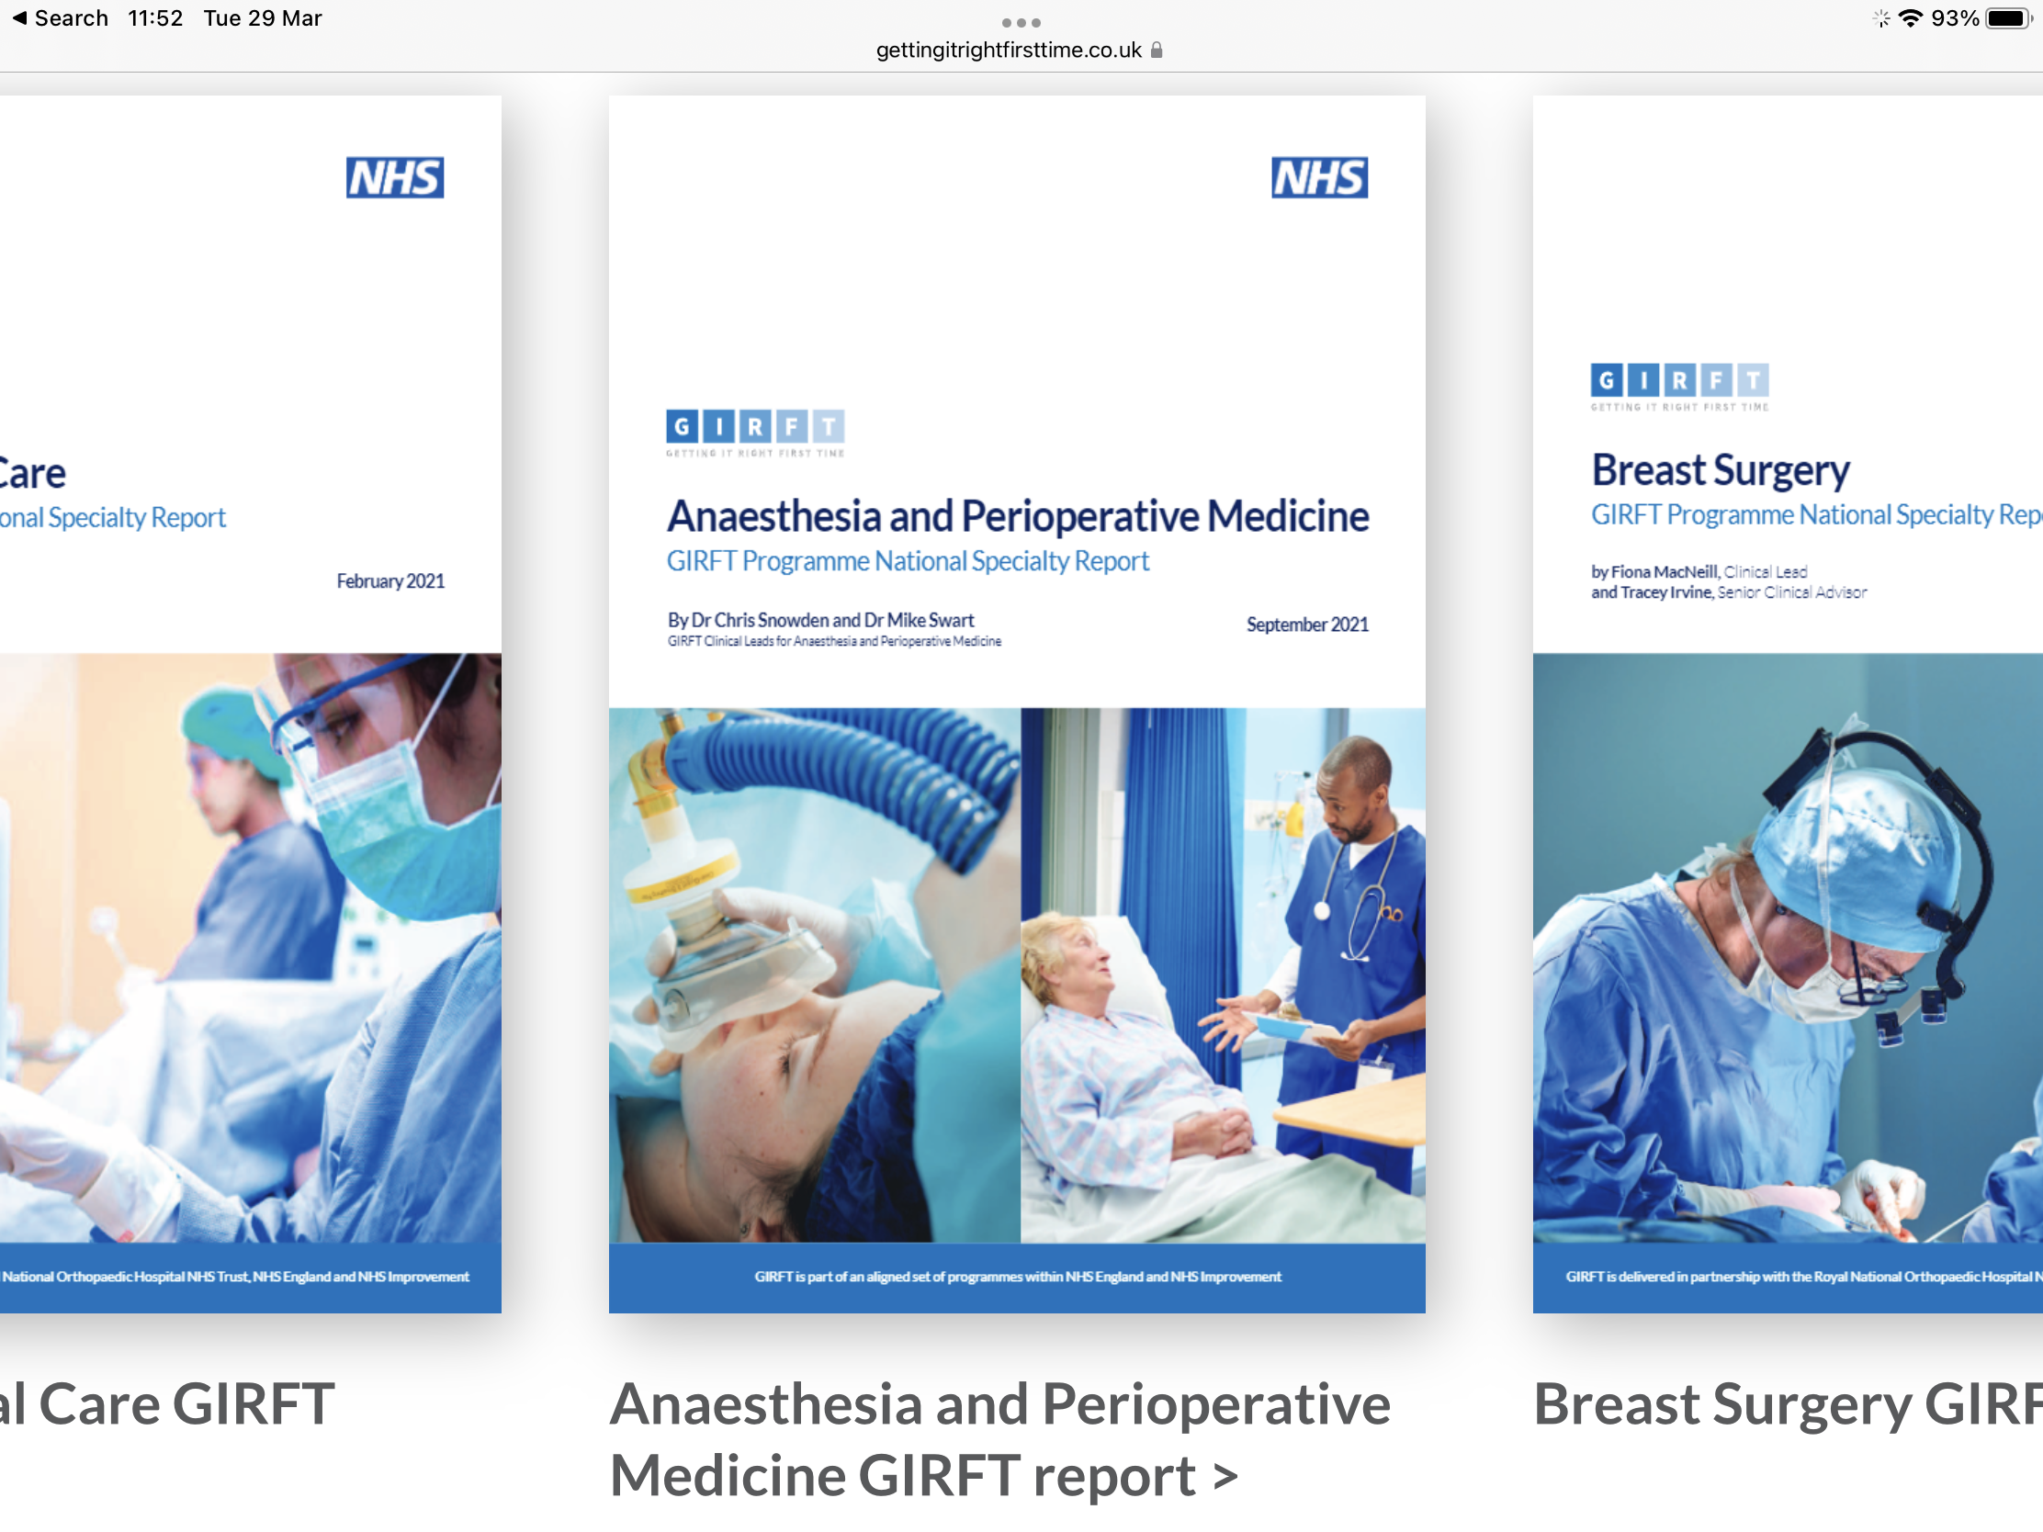

Slide 6
ENGLISH NHS TRUST DAY SURGERY PERFORMANCE (2020) International Association of Ambulatory Surgery and GIRFT index day case procedures (data courtesy of CHKS)

Slide 7
Key to Successful Day Surgery
  High quality pathway
  Treat day surgery as the “norm”
  Consistent day surgery message
  Make Day Surgery the priority
  Support at Trust Board level
  Appropriate resource
    Equipment
    Senior experienced staff /Clinical expertise
Benchmark, Review service, Drive change

Slide 8
High Quality Day Surgery Pathway
GP referral for procedure
Surgical OPA / Trauma meeting
Patient selection
Pre-op assessment
Booking & Scheduling
Admission
Surgery & Anaesthesia
Discharge
Recovery at home
Champions
Key Enablers

Slide 9
GP Referral
Do our primary care colleagues know what can be done as day case?
Do they know which patients are appropriate?
Do they start the day surgery message?
Do they ensure patients are "fit" for surgery?

Slide 10
Surgical Outpatients
Key enablers
Start/continue the day surgery message
Promote that procedures should be done as a day case
Reassure patients about to be day case

Slide 11
Surgical Outpatients
Default suitable surgical procedures to day case
  Book as planned day case
  Intended management day case
Remember if not fit for day surgery probably not fit for elective surgery
Consider starting optimisation
Can surgery be delayed until optimised
Patients should be considered NOT just on a waiting list but an optimisation list

Slide 12
Which procedures?

Slide 13
Surgical criteria
Low risk of significant immediate post-operative complications (eg catastrophic bleeding or airway compromise)
Post-operative pain managed by oral analgesia supplemented by regional anaesthetic techniques
Manage oral nutrition post-operatively
Patient able to mobilise with / without aid post-operatively

Slide 14
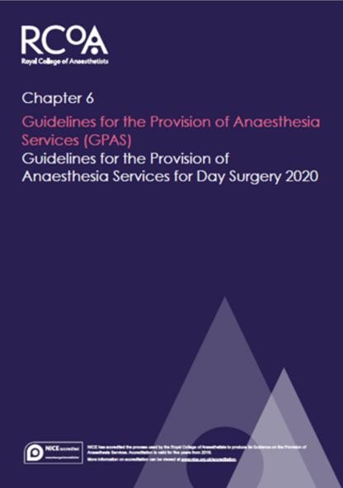
Operating times
Surgical procedures lasting 3 to 4 hours (and longer!) are now routinely performed on a day case basis

Slide 15

Basket of Procedures
2001
Cataract Extraction
Excision Breast Lump
Carpal Tunnel Decompression
Bat Ears
R/O Metalwork
Bunion Operations
Laparoscopy
Tonsillectomy
TURBT
Squint Correction
Orchidopexy
Anal Fissure
D&C / Hysteroscopy
Nasal Fractures
Myringotomy
Laparoscopic Cholecystectomy
Excision of Ganglion
Hernia Repair
Varicose Veins
Dupuytren’s Contracture
Haemorrhoidectomy
Circumcision
Arthroscopy
SMR
Termination of pregnancy
Notes:
15

Slide 16
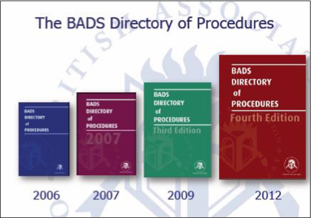
Nearly ALL surgery should be day or very short stay
2016

Slide 17
Nearly ALL surgery should be day or very short stay
Over 200 procedures listed as suitable as a day case
Hysterectomy
Mastectomy
Tonsillectomies
Shoulder surgery
ACL reconstruction
Arthroplasty
some emergencies
Bunion operations
ORIF ankle
2019

Slide 18
Ambulatory Emergency Surgery
Should not be excluded
Unselected
Unplanned
Day or Night
Many can be considered / performed as a day case
Key is to plan it as a day case

Slide 19

Plan as a Day case
Pre- assessment
Peri-operative care
Post –operative care
Selection criteria
Pre-assessment
Admission
Operation
Day surgery unit
Same- day discharge

Slide 20
High Quality Pathways
  “Standardise”
  Agreed Booking/scheduling
  Agreed Anaesthetic & Surgical practice
  Guidelines for PONV, Analgesia, TTOs
  Informed and well prepared patient
Dedicated multidisciplinary day surgery team
Champions and Key enablers
Dedicated facilities (wherever possible)
All focused on successful day surgery

Slide 21
Which patients?
Can the operation be done as a day case?
Would this patient’s risks be increased in any way by treating them as a day case?
NO then treat as a day case
What management would be different if he/she were admitted as an inpatient?
NOTHING then treat as a day case
How can we facilitate this patient to be a day case?

Slide 22

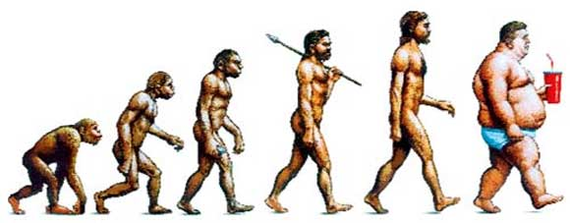
Patient Selection for Day Case
Patient Factors:
Patient Preference
Cardio-respiratory disease
Elderly
Obesity
GORD
Reduced risk thromboembolism
Reduced PONV
Covid risk

Slide 23
Elderly
Usually better managed in their own environment

Slide 24
National Audit Office 2019
The average 67 year old admitted to hospital.....
  5% loss of muscle strength per day
  After 10 days
    12% reduction in lung capacity
    14% reduction in hip/knee muscle strength
    Reduced life expectancy of 10 years

Slide 25

Obesity
“even morbidly obese patients can be safely managed in expert hands, with appropriate resources.”
“obese patients benefit from the short duration anaesthetic techniques and early
mobilisation associated with day surgery”
Day case and short stay surgery: 3
Association of Anaesthetists of Great Britain and Ireland
British Association of Day Surgery 2019

Slide 27
Obesity
Problems occur early (induction/ primary recovery)
Ensure common co-morbidities identified and address DM/ OSA
Be mindful everything can be more difficult and take longer (anaesthesia/ surgery/ positioning)
Senior staff required
Appropriate equipment (table, side extensions, instruments, oxford pillow etc)

Slide 28
Obesity
May not be appropriate for surgery in an isolated site but could still be a day case through a main hospital facility
Once they are through primary / first stage recovery no increased risk of complications from overnight stay
Day Surgery can reduce risk of DVT/HAI

Slide 29
AAGBI Guidelines management peri-operative diabetes 2015
“Glycaemic control should be checked at the time of referral for surgery “
HbA1c should be < 69 mmol.mol 1 in the previous three months.
If HbA1c ≥ 69 mmol.mol 1, elective surgery should be delayed while control is improved then proceed with day surgery
Diabetics are usually better at managing their own diabetes than we are!

Slide 30
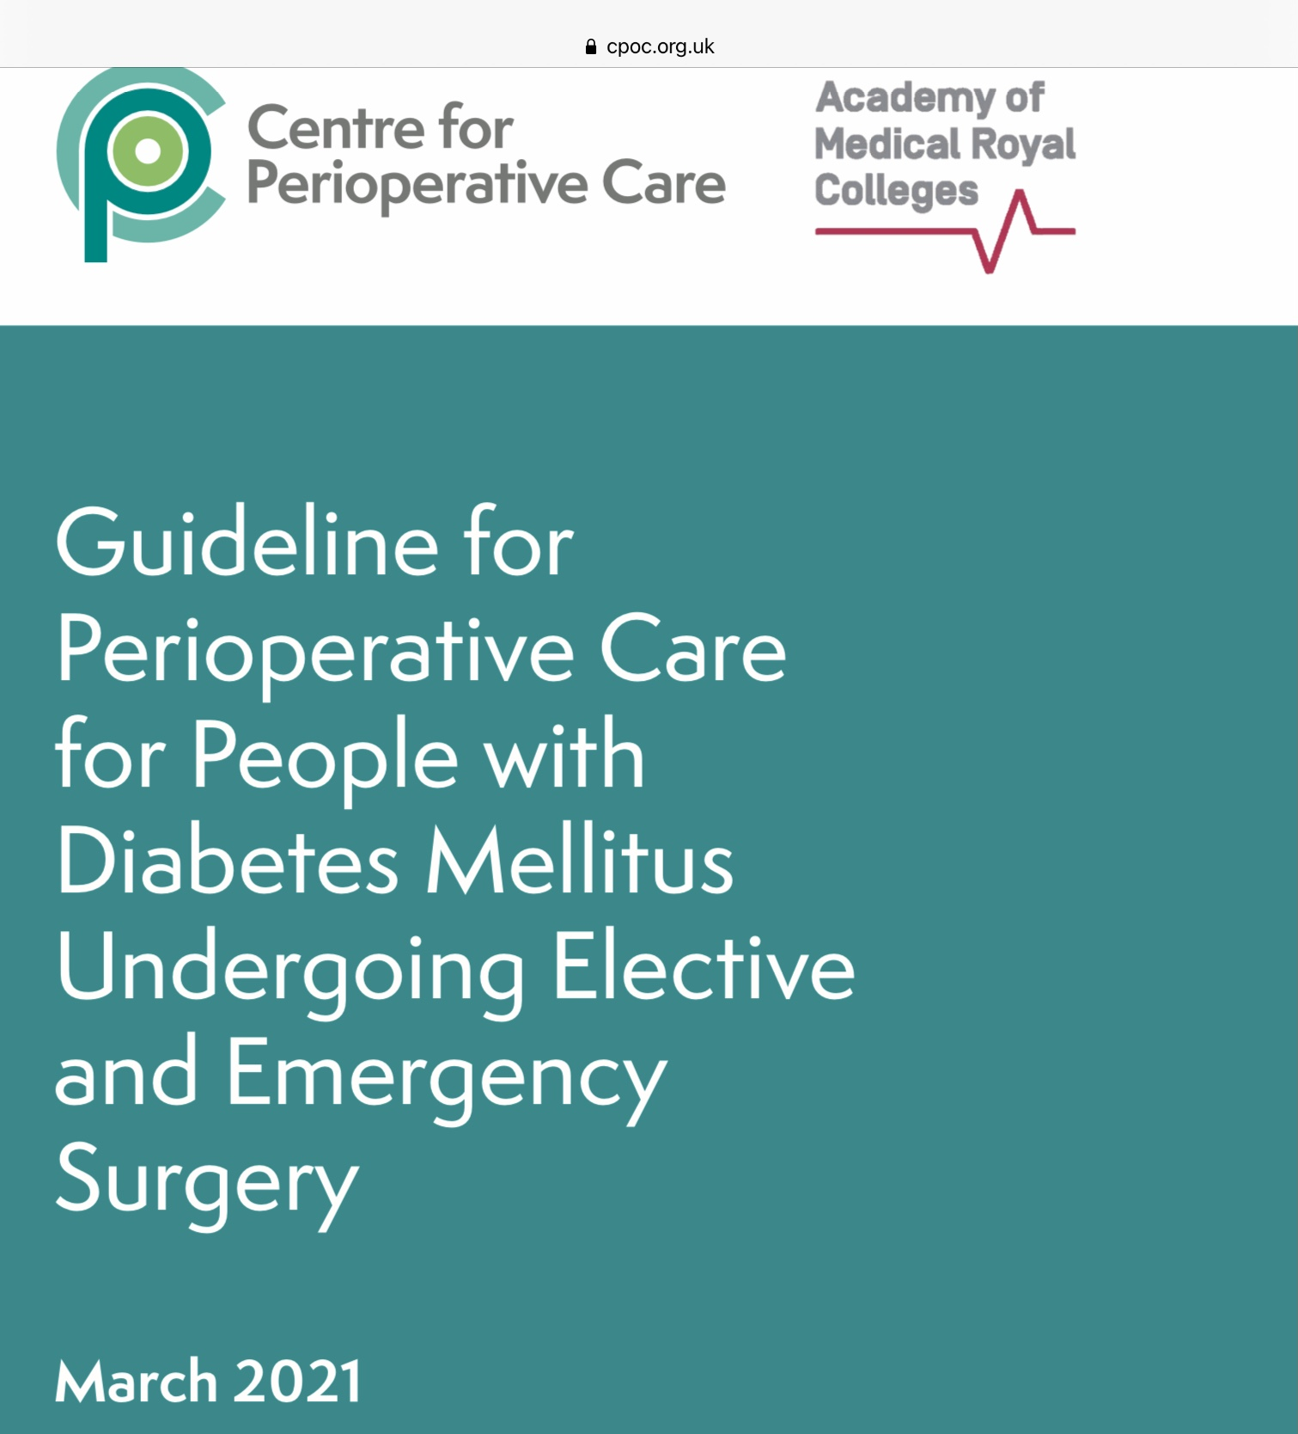
Building upon the recommendations contained within the NCEPOD report into perioperative diabetes (Highs and Lows, 2018)
CPOC has published a guideline on the care of surgical patients with diabetes that encompasses the whole perioperative pathway

Slide 31
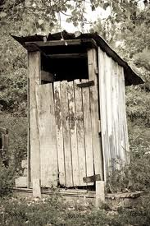
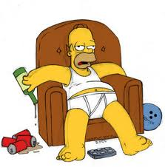
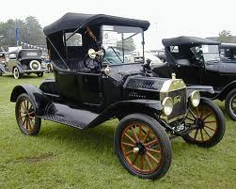
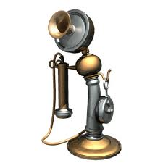
Social Factors
Responsible adult
Maximum 1 hours drive
Adequate housing
conditions
-inside toilet
-telephone access
-heating
-stairs
The vast majority of patients will meet the criteria for social factors
or
can be enabled to do so with proactive management

Slide 32
Distance from Hospital
Rarely a problem
Even in rural areas
Remember it is 1 hour from a hospital that can treat the condition and not necessarily the operating hospital

Slide 33
Possible Solutions
Torbay model: provide carers into patient’s home
Norwich model: allow some patients home without carers after certain procedures
Escort vs 24 hour Care
Retief J, Morris R, Stocker M. The postoperative carer: A global view and local perspectives. Journal of One Day Surgery. March 2018.

Slide 34
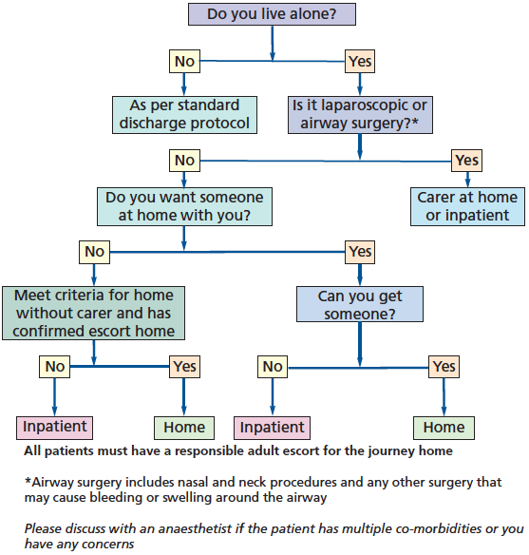
Norwich Home Alone Protocol

Slide 35
Both pathways have been in place for a number of years now
Excellent patient satisfaction
No adverse outcomes
QIP in the Day Surgery chapter Royal College of Anaesthetists
https://rcoa.ac.uk/sites/default/files/documents/2020-08/21075%20RCoA%20Audit%20Recipe%20Book_14%20Section%20B.5_p189-208_AW.pdf

Slide 36
Pre operative assessment
Well Prepared Patient
Good pre-assessment
  Nurse led
  Guidelines
  Inclusion rather than exclusion
  Make day surgery the norm
If not “fit” then optimise and make fit for day case

Slide 37
Pre operative assessment
  Patient preparation for day surgery
    Confirm day surgery intention
    Discuss arrangements from admission to discharge home
  Identification of medical concerns and address early
    Medication
    BP/Hb/AF etc
  Optimisation of patient
  Patients should be considered NOT just on a waiting list but an optimisation list

Slide 38
Day Surgery Facilities
A dedicated day surgery unit (DSU) with its own admission ward, operating theatres, recovery and postoperative discharge ward
  On hospital grounds
  Geographically distant or remote from their associated hospital
    These are limited with respect to patient eligibility and the range of surgeries offered
No stand-alone DSU but adapting inpatient wards and theatres
All should be equipped to the same standard as any inpatient operating theatres
Ideally, use operating trolleys to reduce transfer delays, manual handling risks and bed take-over by medical and surgical inpatients

Slide 39
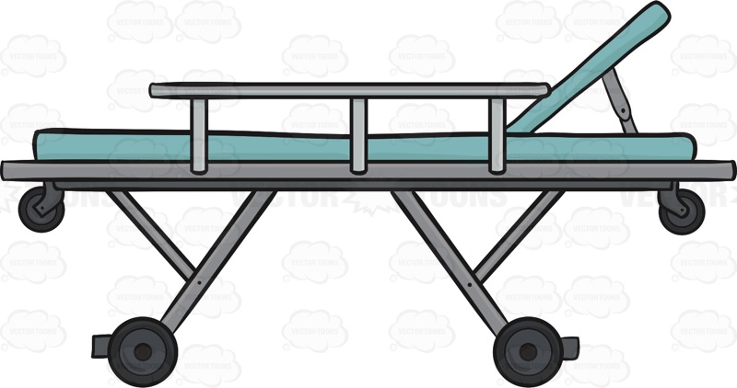
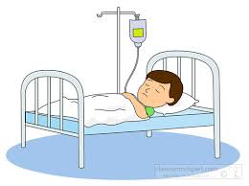
Admission
Should have....
  No beds
  No showers
  Only simple catering facilities
  No capacity to accept
  an inpatient
Dedicated Facilities
For entire pathway if possible
Protected from inpatient sabotage
Day surgery nursing expertise
Not distracted by sick inpatients
Protected “green pathways”
Team all focused on successful high quality day surgery

Slide 40
Why dedicated facilities?
Patient experience
Separation from inpatient activity
  Beds, Pajamas , “the sick role”
  Everyone else is going home so I will too
Activity can continue even during times of bed pressures
  Fewer cancellations
Higher chance of successful day surgery discharge
Higher quality outcomes

Slide 41
Why dedicated facilities?
Nursing expertise
Nurses with expertise in day surgery pathway
Nurses not distracted by higher acuity patients
Whole team are committed to high quality day surgery outcomes

Slide 42
Surgery and anaesthesia
Appropriate list planning

Slide 43
List Efficiency
"Smart" list order
  Consider recovery times
    Medical – Diabetes/Obesity/ Elderly
    Surgical – THR/UKR/ Tonsillectomy / Difficult lap chole
  Consider pre-surgery preparation
    Guidewire insertion (start with a mastectomy)
    Xray / Bloods

Slide 44
Surgery and anaesthesia
Appropriate list planning
Usual operation and done well
Appropriate surgical and anaesthetic technique for rapid recovery
  Short acting GAs
  Regional anaesthesia
  Multimodal analgesia
  Anti-emesis
Experienced staff
Required equipment
Any specific discharge criteria specified
Documentation, TTOS completed in Theatre to avoid delays to discharge

Slide 45
Recovery
Agreed protocols for pain and PONV management
Criteria led discharge to second stage
(Bypass second stage with awake anaesthesia - LAs/Blocks/Spinals)

Slide 46
Patient discharge
Nurse led discharge
  Specify criteria
  Not time specific (except for certain ops eg tonsillectomy)
  "When street fit"
TTOs in packs on DSU ward
KEY:
Well prepared patient
Expecting to go home the same day

Slide 47
Patient support after surgery
Transport home
Carer afterwards
  Depends on surgery and risk of complications
  Patient circumstances
  Virtual wards
24hour telephone access to skilled advice
  Not ED or GP
Post-op phone call the next day
  Provides support
  Collects audit data to enable pathway refinement

Slide 48
Monitor Outcomes
Day case rates
Cancellations on the day
Unplanned admissions
Postoperative symptoms
Patient satisfaction

Slide 49

Benchmarking
Understanding your outcomes
Continuous service improvement
Learn from others
Desire for change
Push boundaries

Slide 50
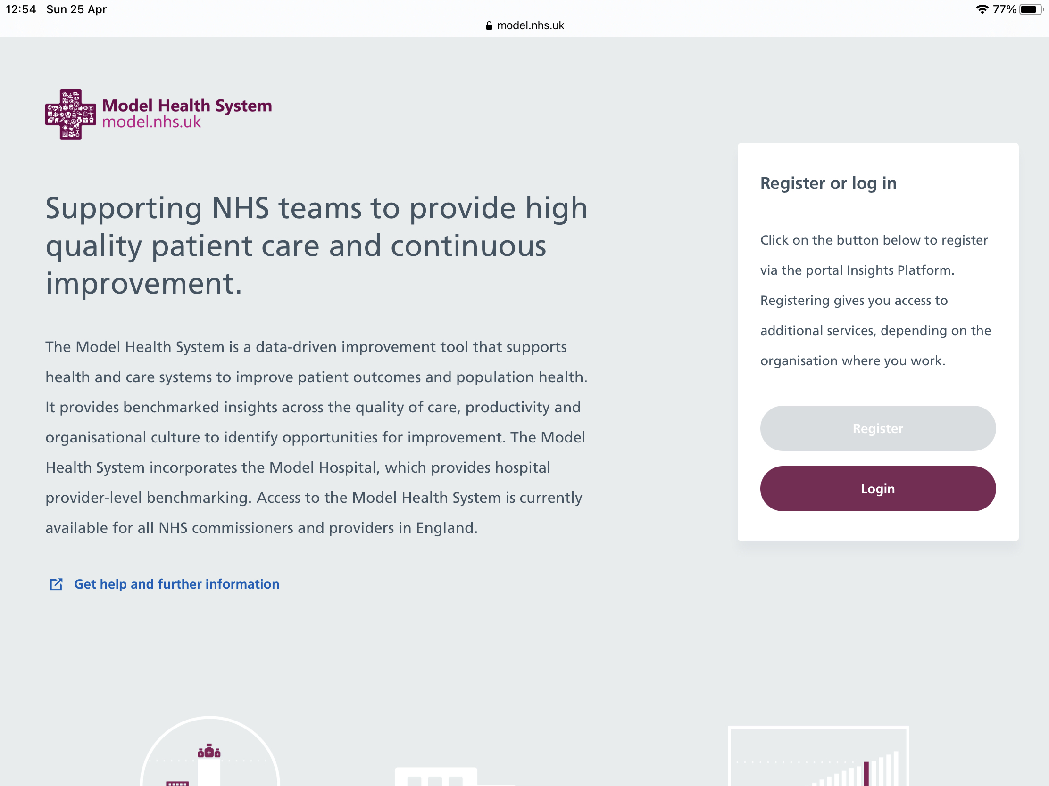

Slide 51
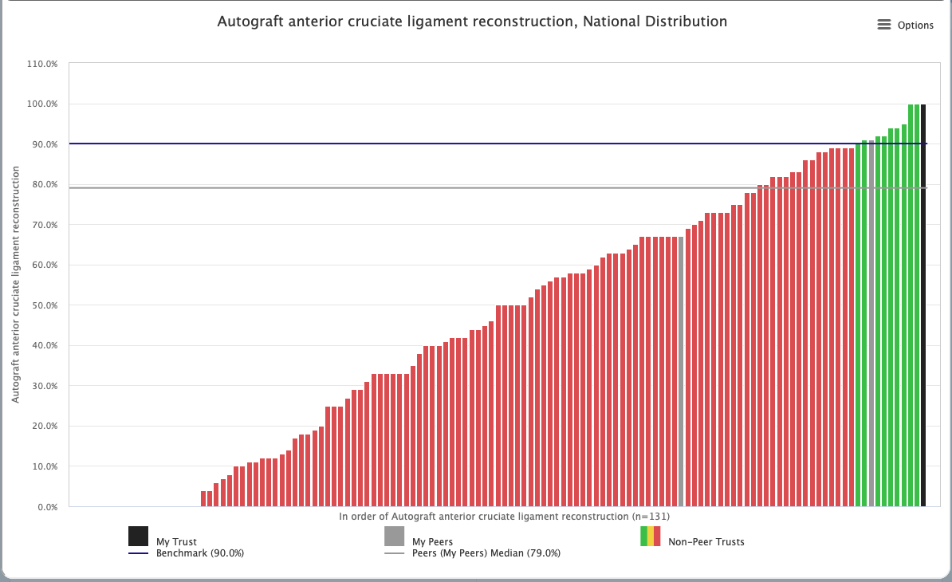
Model Health System
(Model Hospital)

Slide 52
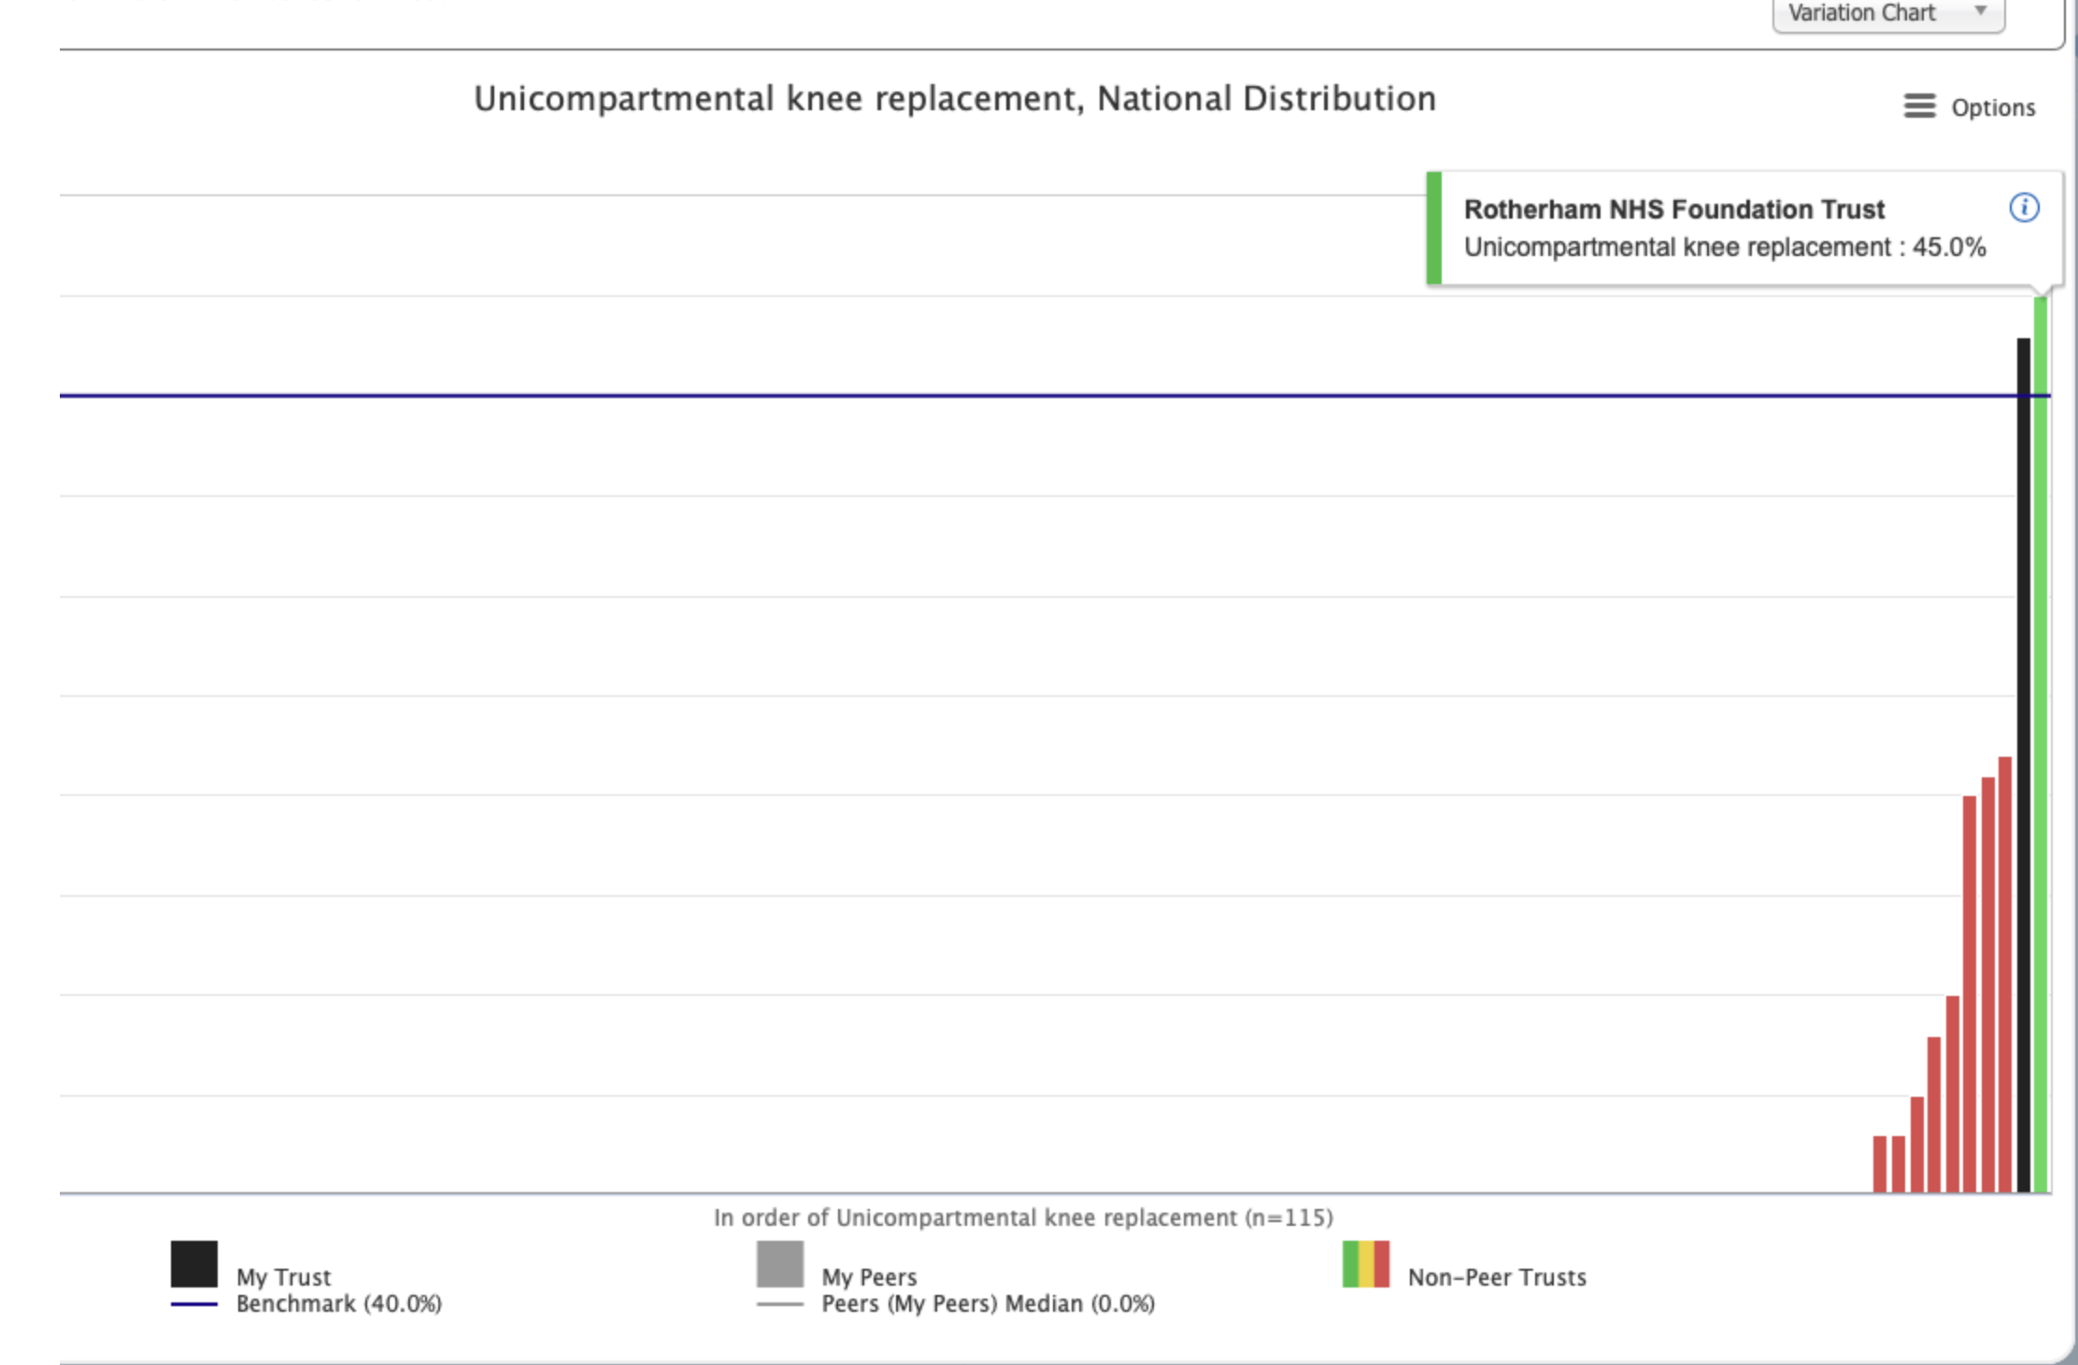
Model Hospital
BADS Benchmark 40%
Peer median0%
67% (Q4 2019 /20)
We are still working on getting our coding correct
(A year ago it showed as zero on Model Hospital)

Slide 53
Developing new pathways
What changes are needed in your pathway for you to move this procedure to day case?
Who are the key players?
How can you implement this?

Slide 55
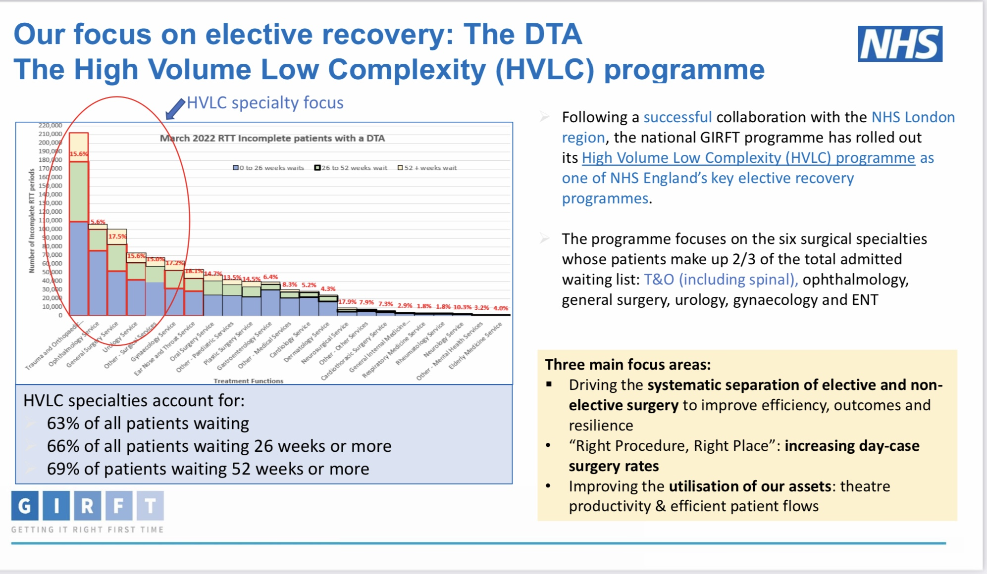

Slide 56
HVLC
29 surgical procedures “High volume, low complexity” across 6 surgical specialities
A suggestion of which cases should be day case as default and their suitability for regional anaesthetic
Specialty | Procedure | Day case probable | BADS expected DC rate | Likely anaesthetic | Spinal anaesthesia opportunity | Possibility of non-airway management | Comments
General surgery | Inguinal Hernia | Yes | 75% | GA | No | No | Those rates will go up over 80%
 | Paraumbilical Hernia | Yes | 90% | GA | No/Yes | Yes | Can be undertaken under spinal
Gynaecology | Diagnostic laparoscopy | Yes | 100% | GA/Spinal | No/Yes | No/Yes
 | Endometrial ablation | Yes/OPC | 95% | GA/LA | Yes | Yes | >50% done under LA in OPC
 | Hysteroscopy | Yes/OPC | 100% | GA/LA | Yes | Yes | 90% done under LA in OPC
 | Vaginal hysterectomy | Yes | 60% | GA/Regional | Yes | Yes | Day case rates will rise to 80%
Orthopaedics | Anterior Cruciate Ligament Reconstruction | Yes | 90% | GA/Spinal | Yes | Yes/No
 | Total Hip Replacement | Yes 10-20% | 20% | Neuroaxial | Yes | Yes
 | Total Knee Replacement | Yes 10-20% | 20% | Neuroaxial | Yes | Yes
 | Uni knee replacement | Yes 40% | 40% | Neuroaxial | Yes | Yes
 | Bunions | Yes | 95% | Regional | Yes | Yes
Urology | Bladder outflow obstruction | Yes | 50-100% | GA/Neuroaxial | Yes | Yes
 | Bladder tumour resection pathway | Yes | 60% | GA/Neuroaxial | Yes | Yes
 | Cystoscopy plus | Yes | 80% | GA | Yes | Yes
 | Minor peno-scrotal surgery | Yes | 100% | GA/LA | Yes | Yes
 | Ureteroscopy and stent management | Yes | 80-90% | GA/Spinal | Yes | Yes
Acknowledgment: Dr Chris Snowden & Dr Mike Swart & GIRFT London Elective Recovery & Transformation Programme

Slide 57
Introduction of a High Quality Day Surgery Process
Elective Surgery Recovery & Transformation Programme
Engagement of clinicians
Identify day case procedures
Mapped out pathway
Default to day surgery
Agreed surgical / anaesthetic processes
Standardise pre-operative preparation
Standardise admission process
Streamline discharge process
Expect nurse led discharge as per BADS guidance

Slide 58
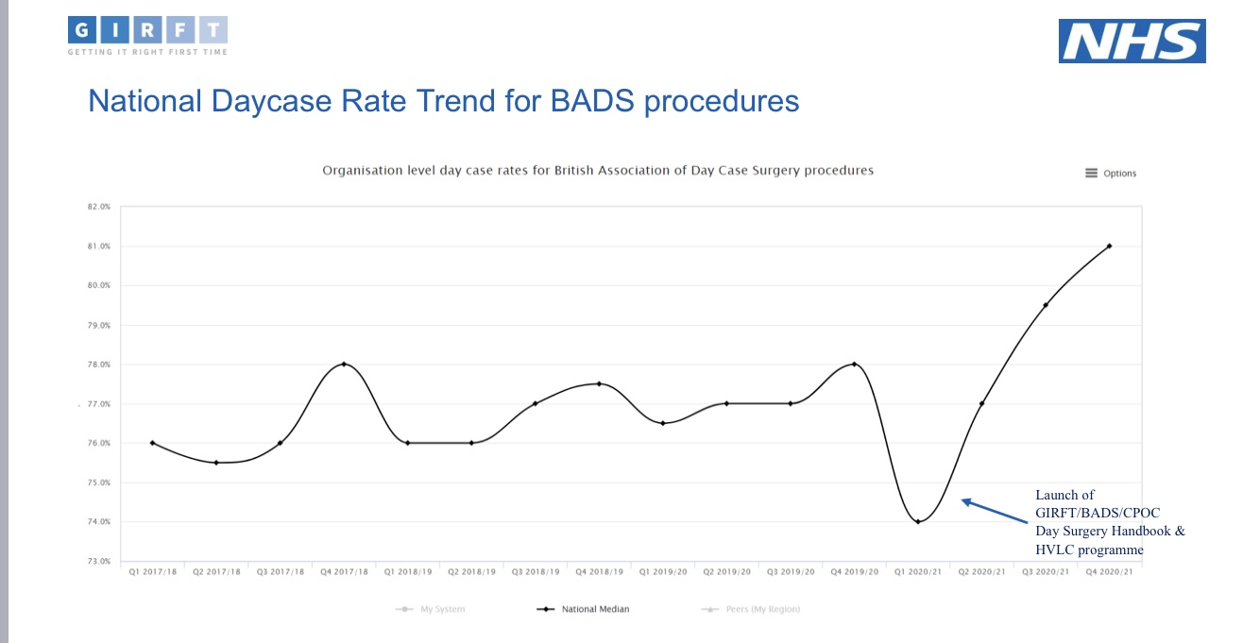

Slide 59
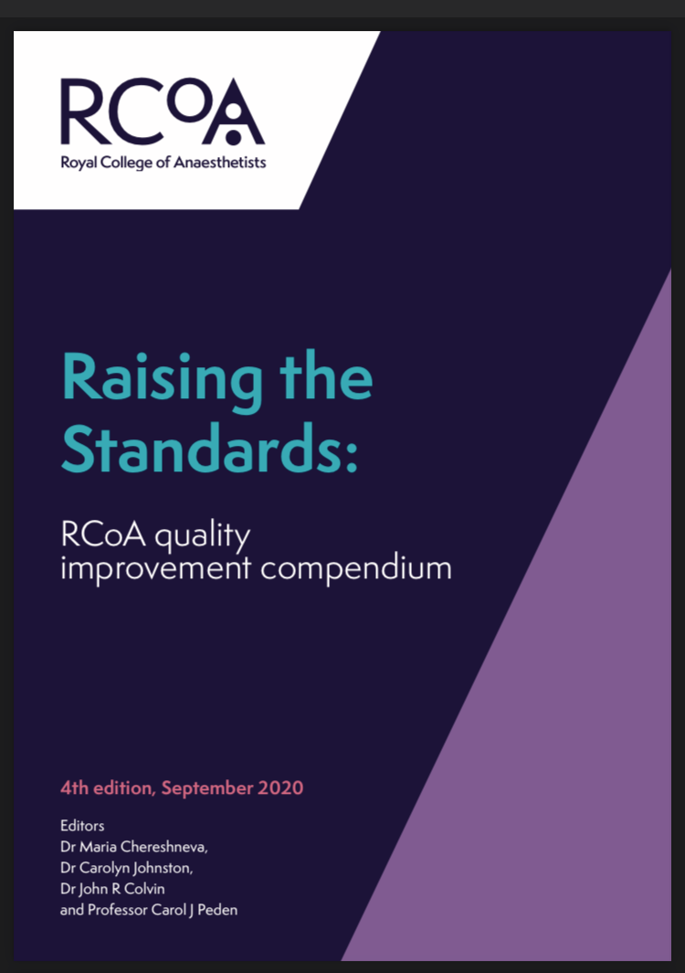
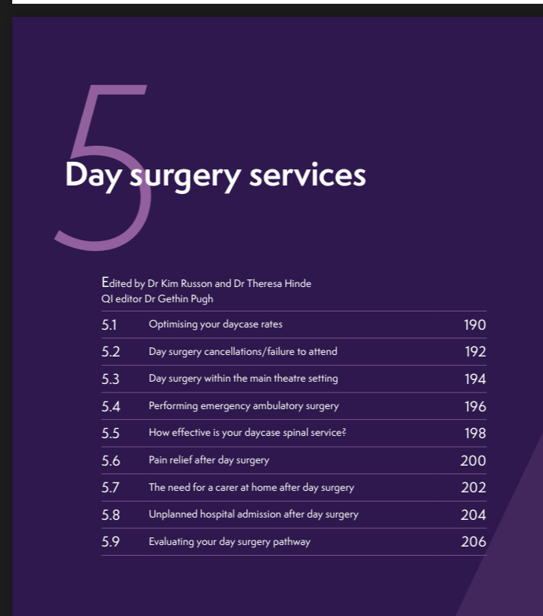

Slide 60
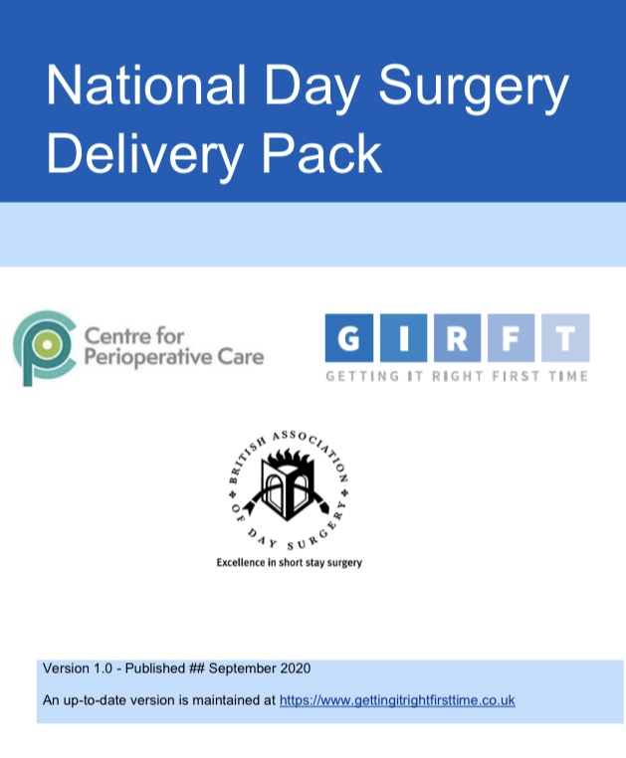
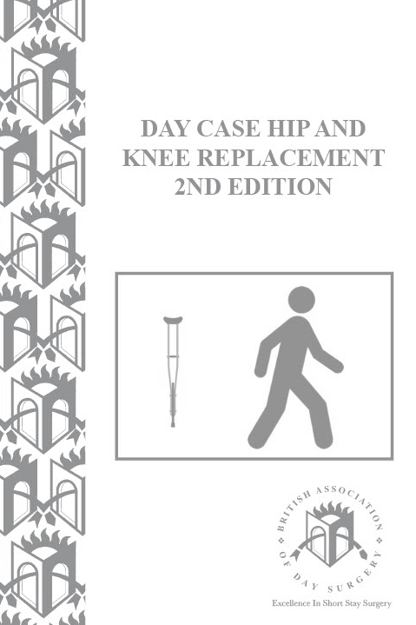
BADS Website
Free access to BADS Handbooks for
BADS members
Links to events
Day Surgery Unit Directory

Slide 61
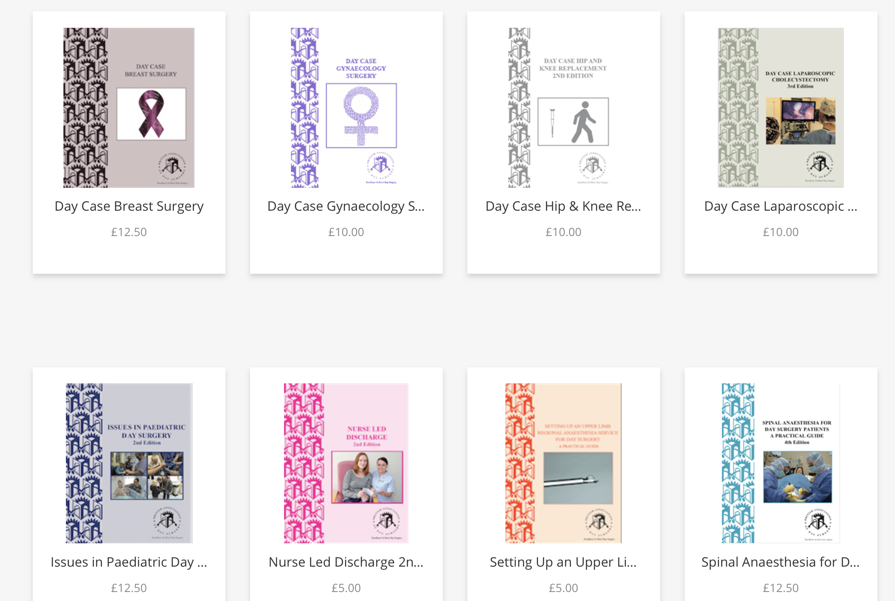
BADS Website
Links to events
Day Surgery Unit Directory

Slide 62



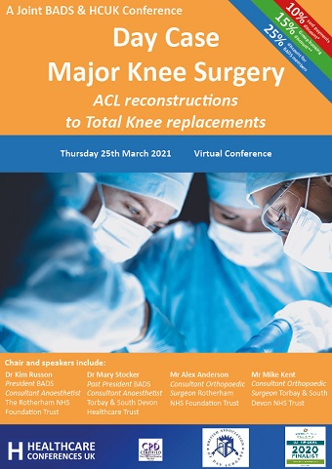
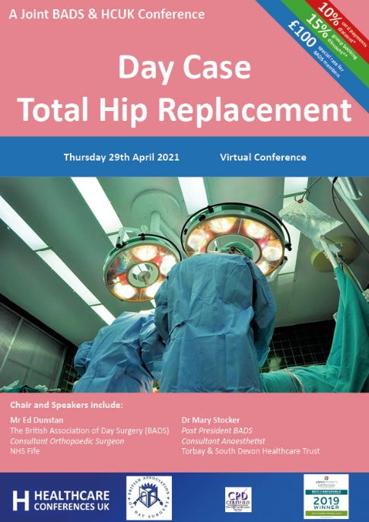
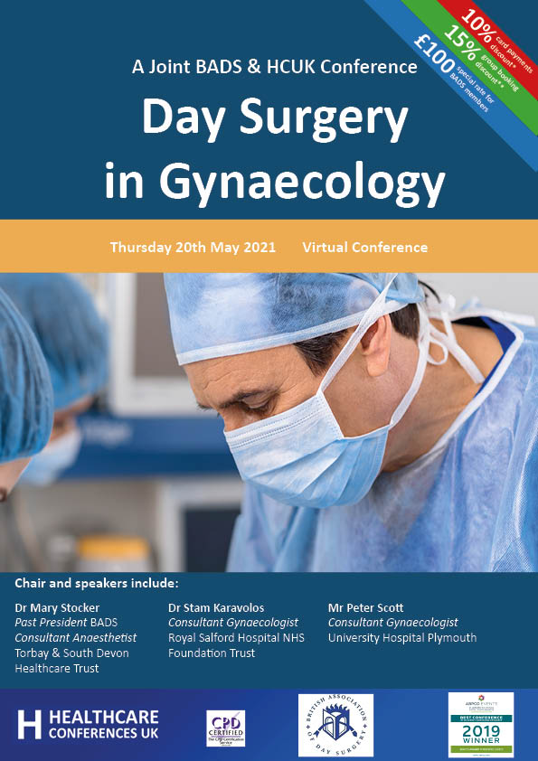
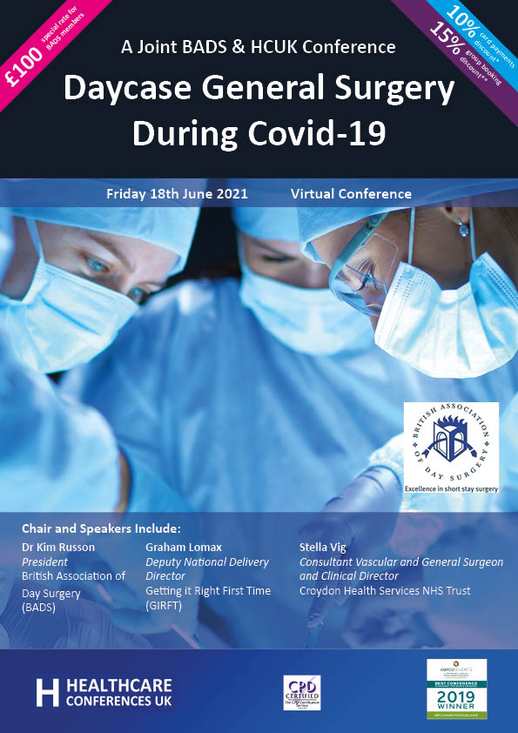

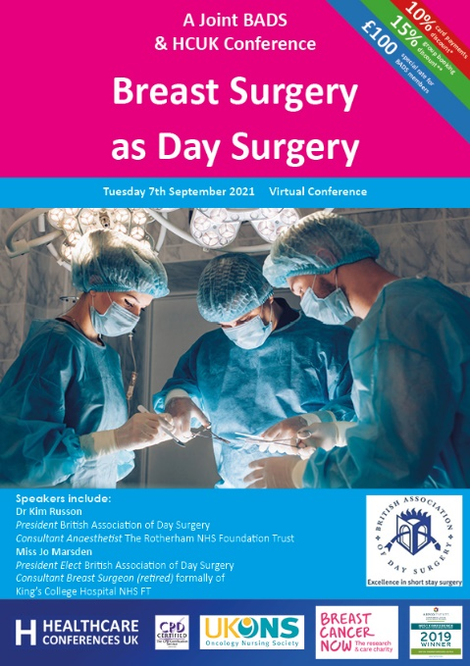

Slide 63
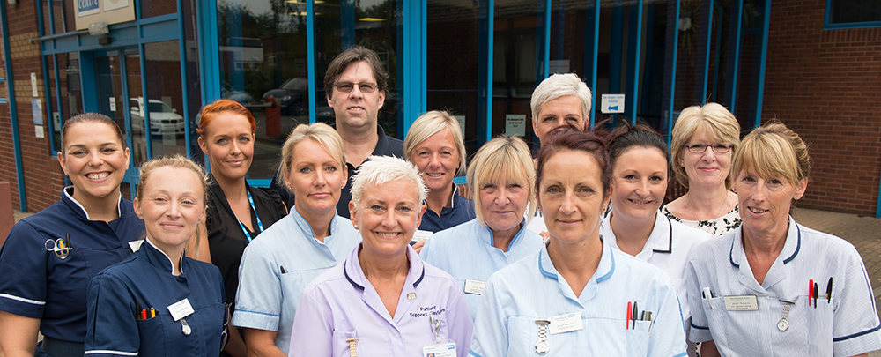
Sucessful Day Surgery
  High quality pathway
  Treat day surgery as the “norm”
  Appropriate resource
  Teamwork

Slide 64
Think Day Surgery
Can this procedure be done as a day case?
Would this patient’s risks be increased in any way by treating them as a day case?
What management would be different if he/she were admitted as an inpatient?
How can facilitate to make this patient a day case?

Slide 65
Plan as Day Surgery
GP referral for procedure
Surgical OPA / Trauma meeting
Patient selection
Pre-op assessment
Booking & Scheduling
Admission
Surgery & Anaesthesia
Discharge
Recovery at home
Ensure all appropriate patients are managed as day cases
  Social care rarely an issue
  Optimised medical issues rarely an issue
  Procedures – embrace the BADS directory

Slide 66
Thank you! Questions?

