Slide 1
The Caldicott Guardian in Primary Care
Legal issues
Andrew Latham
Partner
November 2022

Slide 2
What we will be discussing
The duty of candour and the Caldicott Guardian
Caldicott decision making
The role of Primary Care Network Agreements
Current issues in General Practice

Slide 3
A bit of a health warning
Lawyers love producing text-heavy, unexciting slides

Slide 4
The duty of candour

Slide 5
What is candour?
“The volunteering of all relevant information to persons who have or may have been harmed by the provision of services, whether or not information has been requested and whether or not a complaint or a report of that provision has been made”
Robert Francis QC
“The quality of being open and honest; frankness.”

Slide 6
The duty of candour: what is it?
Key set of recommendations from Francis report
Statutory duty on organisations – Health and Social Care Act 2008 (Regulated Activities) Regulations 2014, regulation 20
Applies to individuals through professional obligations and guidance
Provision of an explanation – not an admission of liability

Slide 7
A reminder of the key ingredients
Two statutory duties created:
General duty to be open – all cases
Formal duty of candour - only if NSI/harm threshold met
Q1 – Has there been an ‘unintended or unexpected incident’? If yes, then..
Q2 - In the reasonable opinion of a health care professional, could the unintended or unexpected incident result in, or has it resulted in:
The death of the patient, or
Severe harm, moderate harm or prolonged psychological harm
If yes to any parts of Q2 then specific DoC duty applies.
Notes:
Note – the death must be must be linked directly to the incident rather than the natural course of the illness or condition

Slide 8
Notifiable safety incidents Other registered persons (GPs etc)
An unintended or unexpected incident that occurred in respect of a service user during the provision of a regulated activity that In reasonable opinion of healthcare professional, incident appears to have resulted in—
(a) (i) the death of the service user, where the death relates directly to the incident rather than to the natural course of the service user's illness or underlying condition,
(ii) an impairment of the sensory, motor or intellectual functions of the service user which has lasted, or is likely to last, for a continuous period of at least 28 days,
(iii) changes to the structure of the service user's body,
(iv) the service user experiencing prolonged pain or prolonged psychological harm [28 days +], or
(v) the shortening of the life expectancy of the service user; or
requires treatment by a health care professional in order to prevent—
the death of the service user, or
any injury to the service user which, if left untreated, would lead to one or more of the outcomes mentioned in sub-paragraph (a).

Slide 9
How do you comply with the specific duty?
As soon as reasonably practicable after becoming aware of a ‘NSI’ the provider must:
Notify the relevant person that the incident has occurred, and
Provide reasonable support to the relevant person
The notification (face to face)
Inform them that the incident has occurred
Provide a true account of all facts
Advise what further enquiries will be made
Apologise
A written record of the notification must be kept
The notification must be followed up in writing (covering all of the above)
Notes:
NHS Standard Contract – within 10 working days of the incident being reported to local systems, and sooner where possible.

Slide 10
Who needs to be told?
The "relevant person" means the service user or, in the following circumstances, a person lawfully acting on their behalf—
(a) on the death of the service user,
(b) where the service user is under 16 and not competent to make a decision in relation to their care or treatment, or
(c) where the service user is 16 or over and lacks capacity in relation to the matter.

Slide 11
How do you comply with the specific duty?
Practical points:
Apology = expression of sorrow or regret – see NHSLA (NHSR) guidance
Who should provide the notification?
consider seniority, relationship to patient, experience and expertise in the type of incident that has occurred
What about recognised risks of procedures and matters discussed during the consent process?
What if the patient doesn’t want to know?
Mixed information: staff, third party information
Notes:
NHS Standard Contract – within 10 working days of the incident being reported to local systems, and sooner where possible.

Slide 12
Things to think about and train staff on
Where should the initial conversation take place?
Tone, language, sensitivity, time
What support should be available to the patient during the conversation and afterwards?
Who will be the single point of contact following the discussion with the patient?
Who will capture the discussion in writing and where will that documented account be held?
If the patient is unable to hold the discussion who should be involved on their behalf?
What if other relatives want to know/complex family dynamics?

Slide 13
Is the duty of candour engaged?
Sunita is a heavy smoker. She presents to her GP with a persistent cough and is referred to the local hospital for a chest x-ray. A lesion is reported and the results sent to the GP.
The GP messages the practice reception to arrange an urgent appointment with Sunita, although there is no answer on her phone as she is away. A letter inviting her to the practice is lost in the post, and the message to follow up is missed. Several months later Sunita presents at hospital with shortness of breath and haemoptysis. She is admitted and is diagnosed with lung cancer.

Slide 14
Candour case study
Is the duty of candour engaged?
If Sam lacks capacity, who should you tell?

Slide 15
Legal issues – making sustainable disclosure decisions

Slide 16
Scott v LGBT Foundation
S sought therapeutic support from L
Forms S had previously signed made clear information may be disclosed in those circumstances.
S told L about mental health issues and substance misuse. L assessed S as being of ‘intermediate risk’ of self-harm. L specifically informed S that, due to serious concerns regarding his welfare, L would have to discuss assessment with his GP in order to help get S some support.
L also said that there was no need for Scott to consent to this given the nature of the concerns L had about his welfare. At this point, S did not raise any objections.

Slide 17
Scott v LGBT foundation
L provided details to S’s GP over the phone
S alleged the disclosure breached the DPA and his confidentiality
Was this a breach of confidence?

Slide 18
Scott v LGBT Foundation
DPA is concerned with a specific scheme based around records and processing. There are other areas of law (in particular, the law of confidentiality) which are the appropriate vehicle for verbal disclosures
The disclosure could have been justified under the DPA in any event by reference to legitimising conditions
General duty of confidence had been qualified by what had been said by L to S and the forms
In any event the disclosure could have been justified in the public interest

Slide 19
Things to think about
What legal issues are engaged?
Data Protection Law
Confidentiality
Anything else/more specific (AHRA)
What (else) should I take into account as part of my decision making?

Slide 20
Things to think about (2)
What guidance is out there?
GMC, MDUs, NHS England (or other national guidance)
How much time have I got?
What’s my need for certainty?
Who can I ask for help?
DPO, LMC, Practice Manager, other Caldicott Guardians

Slide 21
Things to think about (3)
What guidance are you following?
Can you justify why you are doing what you are doing?
Can you explain why you are not doing something else?
What is your audit trail like?
Is there an information sharing agreement?

Slide 22
Things to think about (4)
Who are the points of contact?
What format is the information being provided in?
All at once or in phases?
Do people know what they are looking for?
How can the organisations involved assist one another (this may be more than/different to providing ‘just the information requested’)?

Slide 23
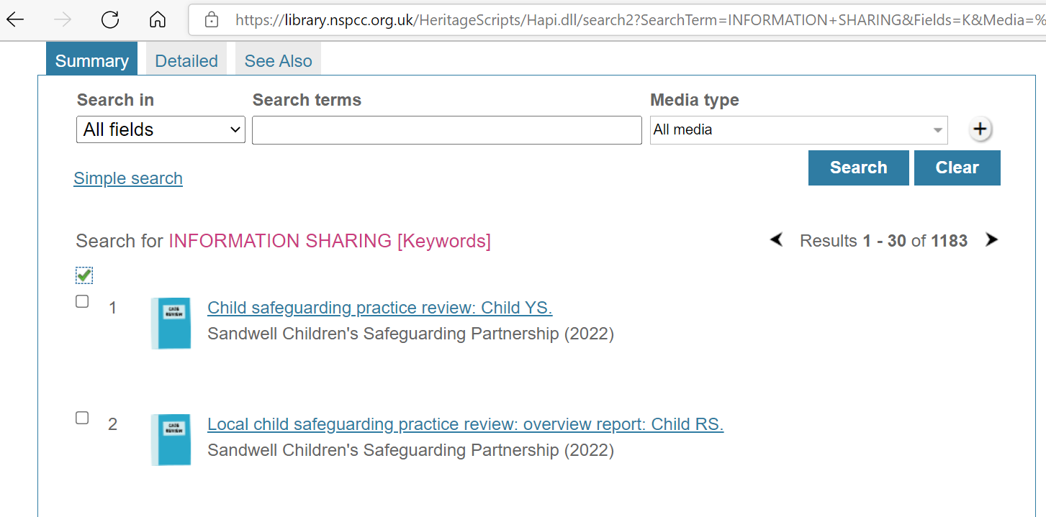
What are the risks?
Data protection, human rights, breach of confidence, misuse of private information claims
Regulatory complaints
Complaints regulations complaints
Adverse (social) media interactions

Slide 24
Coco v AN Clark – ingredients for confidentiality claims…
To bring a claim
the information has “the necessary degree of confidence about it”;
the information was provided in circumstances importing an obligation of confidence; and
there was an unauthorised use or disclosure of that information (and some kind of risk of damage which potentially could be distress)
Plus…
Proportionality, reasonable expectations (objective/specific)

Slide 25
… and defences
No misuse (i.e. the use was in the reasonable expectations of the individual)
The disclosure or use was justified:
Because of the consent of the individual
Because of a legal authority (for instance a court order or statutory provision which permits or requires the disclosure/use)
COPI notices/s. 251 approval
Because disclosure can be justified in the public interest
So big questions are WHO do you want to share information about, WHETHER/WHAT information are you sharing, WHY you want to share it, with WHOM you want to share it
What are the implications of (not) sharing?

Slide 26
A few things to bear in mind
Even if you aren’t seeking consent, what are you doing to involve the patient? If not, why not?
Risk appetite and your need for certainty, time pressure
Documentation/audit-trail
Consent will almost never be your GDPR legal basis, even if you are thinking about it re confidentiality
Legal obligation, vital interests, public interest/exercise of official authority, legitimate interests
Remember consent can be express/implied, but it needs to be freely given and informed.

Slide 27
Decision trees
https://ico.org.uk/for-organisations/data-sharing-information-hub/can-i-share-personal-data-with-a-law-enforcement-authority/data-sharing-stage-one/
NHS Confidentiality Code of Practice
GMC guidance

Slide 28
Record keeping, process documentation and litigation Ahmed v BBC
“We recognise that those decisions were made long ago and that some of the personnel involved in them may no longer be employed by [the BBC]. However, those difficulties are easily surmountable if an organisation has transparent pay structures or processes for determining pay and for recording the rationale of its decisions about levels of pay. The BBC found itself in difficulties in this case because it did not (and, to an extent, still does not) have a transparent and consistent process for evaluating and determining pay for its on-air talent. It has no records (or, if it has them, it has not produced them) of how the pay levels for [Samira Ahmed] and Jeremy Vine were determined. “

Slide 29
Primary care network agreements

Slide 30
Data sharing agreements
Having a data sharing agreement does not itself make data sharing lawful
Nor does the absence of an agreement make it unlawful
So you still need to think about who/what/where/when/why/how you are sharing
Legal issues as above
An agreement is a way of documenting roles and responsibilities
Controllers (GP practices generally, possibly third parties you are sharing information with)
Processors (someone who crunches data on your behalf)

Slide 31
Template agreements
There are non-mandatory template agreements produced by NHSE and the BMA for data sharing and data processing
Populate as relevant for your PCN
Do people working with the agreement understand it (have they read it?)
You can also draft something bespoke

Slide 32
Choice of contractor: Business critical suppliers

Slide 33
Choice of contractor: Specificity in contracts

Slide 34
What else?
Privacy information for patients
Patient engagement?
Doing data protection impact assessments
Implied consent for direct care
More caution needed for sharing information for secondary purposes

Slide 35
Current issues in general practice

Slide 36
National programmes
An update from NHS England on Accelerating Citizen Access to GP Data (1 November 2022) - NHS Digital
NB 4pm deadline on 4 November 2022 to contact TPP/EMIS
General practice readiness checklist - NHS Digital
Patient access to their records (rcgp.org.uk)
General Practice Data for Planning and Research (GPDPR) - NHS Digital
NHS Data Saves Lives / Goldacre review

Slide 37
Recent cases/points to be aware of: substantive – deletion/correction of records
R (AB) v NHSFT [2020] EWHC 2287 – no requirement to delete ‘inaccurate’ information from medical records: it was legal for the information to be retained (provided there are adequate notes of correction to any inaccuracies)
YZ v South Wales Police [2022] EWCA Civ 683 – Police not required to delete information about individual suspected of, but not charged with, serious offences/return to a ‘blank slate’.

Slide 38
Recent cases/points to be aware of: substantive – security
Underwood v Bounty and Hampshire Hospitals [2022] EWHC 888 – Hospital not vicariously liable for suspected data breach by contractor, security arrangements by Trust were adequate.
Ali v Luton Borough Council [2022] EWHC 132 - a council (which was justified in allowing access to its child protection/social work systems to an employee who went rogue) was not vicariously liable for her then doing so.

Slide 39
Q+A and thank you!
Andrew Latham Partner | Clinical Law Capsticks Solicitors LLP
T: 020 8780 4674
M:07912 563 029
E: andrew.latham@capsticks.com
@ajlhealthlaw

