Slide 1
The Value of National Clinical Audit
Sam McIntyre, Associate Director of Quality and Policy
Royal College of Emergency Medicine

Slide 2
Contents
My dream
A focus on quality and high standards
Priority setting
4-nation engagement
Supporting trainees' engagement
Real-time data-driven approach

Slide 3
My dream
Research is great, but expensive and slow…
I believed in clinical audit before I knew what it was

Slide 4
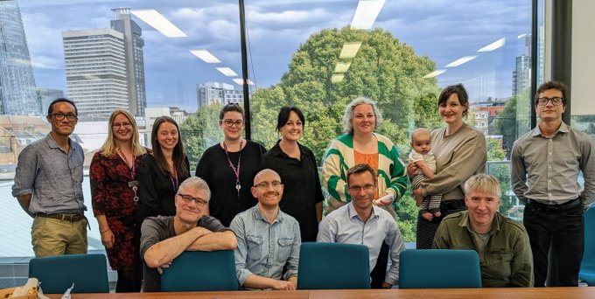
A focus on quality and high standards
National quality professionals
Local quality professionals
Clinical lead
Topic experts
Multidisciplinary consultants

Slide 5
Priority setting
Intelligence gathered from:
Standard and guidance publication
Community requests
Known quality issues
Safety incident trends
Ongoing research

Slide 6
4-nation engagement
Standardising quality across the whole UK
Benchmarking
Wider learning

Slide 7
Supporting trainees' engagement
Supporting trainees' engagement with audit/QI via well-designed projects they can plug into for experiential learning events

Slide 8
Real-time data-driven approach
Near real-time data-driven approach to improving service provision

Slide 9
Thank you, questions?
@blackmoonsam

