Slide 1



Complaints Resolution & Learning from Claims
Naomi Assame
Safety and Learning Lead (North)
NHS Complaints Summit
3rd November 2022
@NHSresolution

Slide 2
By the end of session
The work of NHS resolution
What does resolution mean to a complainant?
Learning from complaints that turn into claims

Slide 3
The genesis NHS Resolution
Formerly called the NHS Litigation Authority (NHS LA) –joined by the National Clinical Assessment Service and the Family Health Services Appeal Unit, functions brought together by successive arm’s length body reviews
Established in 1995 to bring expertise and economies of scale to the management of compensation claims against the NHS in England and to pool the risk of such claims
Changed our name in 2017 to better reflect all core functions under a shared purpose and our five-year strategy.

Slide 4
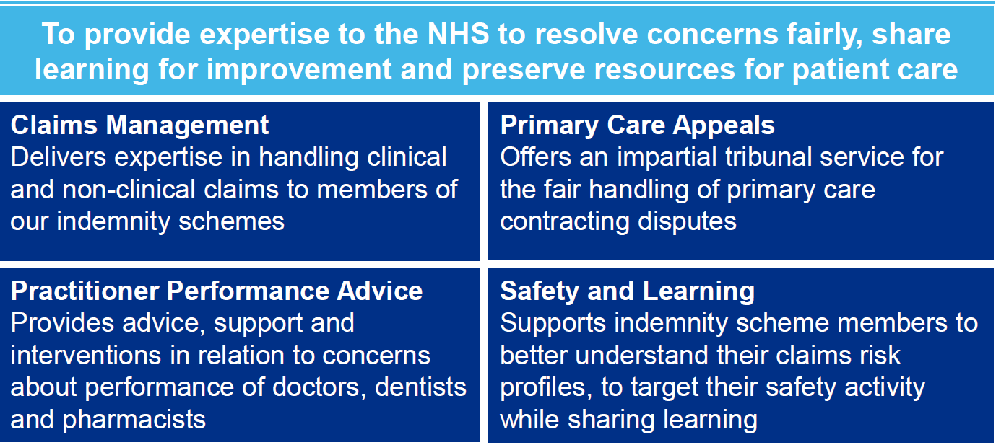
Our Vision

Slide 5





Strategy overview
Priority 1.
Deliver fair resolution
Priority 2.
Share data and insights
as a catalyst for improvement
Priority 3
Collaborate to improve maternity outcomes
Priority 4
Invest in our people
and systems to transform our business
All of our services will focus on achieving fair and timely resolution, wherever possible keeping patients and healthcare staff out of formal processes to minimise distress and cost.
Bringing together key parties to determine what further improvements can be made within our areas of expertise to support the government’s maternity safety ambition.
Ensuring that our unique datasets help derive usable insights that benefit patients and the healthcare and justice systems.
Develop our people, systems and services so that we can continue to deliver best value for public funds.
2

Slide 6






Year in review - claims
A record 77% of claims were settled in 2021/22 without court proceedings, up from 75% last year
16,484 clinical and non-clinical claims were settled in 2021/22 compared with 15,712 in 2020/21
77%
Nearly £2.5 billion was paid out on 17,539 closed clinical and non-clinical claims in 2021/22
12,623 claims were settled without proceedings in 2021/22, compared with 11,738 in 2020/21
The volume of clinical negligence claims and reported incidents received in-year increased from 13,351 to 15,078
This year the ‘annual cost of harm’ is £13.3 billion across CNST
£13.3bn

Slide 7
Maternity overview
38% of total clinical negligence payments (£2.4 billion). Slightly reduced from 40% last year
60% of the total clinical negligence cost of harm (£13.3 billion)
38%
60%
70% of the total clinical negligence provision (£128.2 billion). Slightly increased from 68% last year
62% of claims by value (£ 6 billion) notified to us in 2021/22
62%
70%

Slide 8
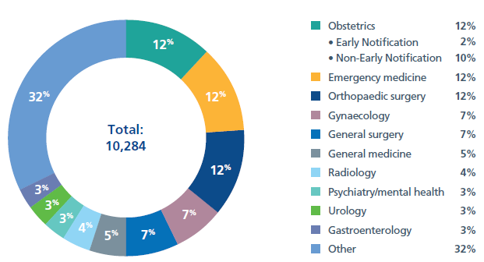
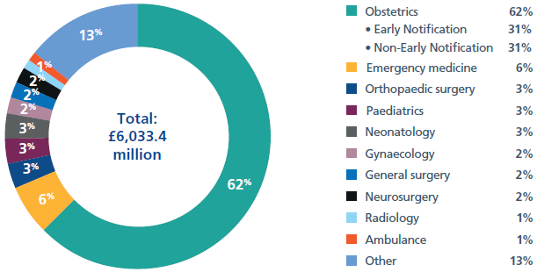
The percentage of clinical negligence claims reported in 2021/22 by specialty, with a breakdown by volume and by value

Slide 9

Why we need to learn from harm
“To err is human, to cover up is unforgivable, and to fail to learn is inexcusable”
Sir Liam Donaldson
“It requires insight into personal and organisational deficiencies and the welcoming of constructive criticism. Above all, it requires a determination to put right what has gone wrong, not only for any who have suffered as a result, but to protect future patients from a repetition of wrong-doing. It requires a willingness to learn and be challenged.”
Francis (2013) Vol 3, p1488

Slide 10
Why learn from claims?
Harm
Financial cost
Human Cost
Clinical Governance
Reduce harm & claims

Slide 11
Role of the Safety and Learning team
Safety and Learning
Member facing
Faculty of Learning
Collaborative working
National and regional events
Products for learning
Support incentive schemes

Slide 12
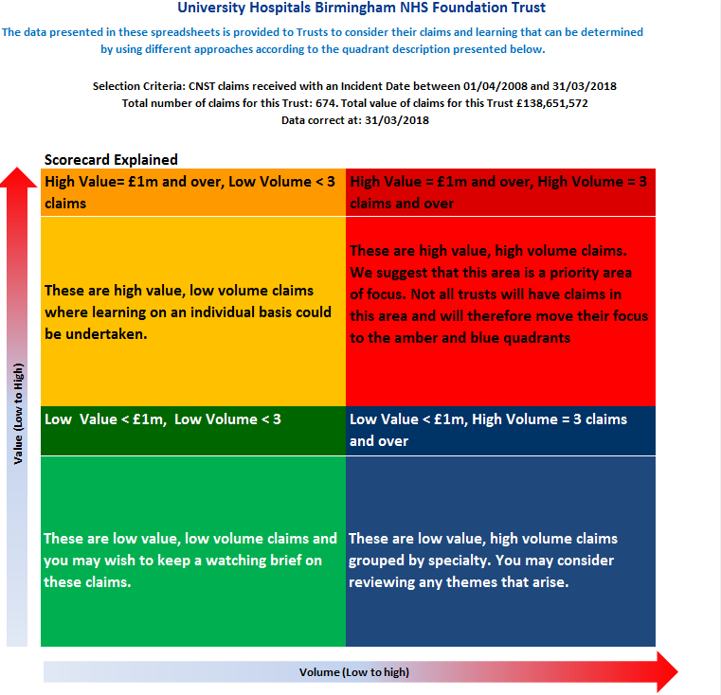
What is a Scorecard?
Quality improvement tool
Ten years of claims data
Open and closed claims
Updated annually
Supports thematic analysis
Scorecard animation
Notes:
Scorecards contain claims data for the last 10 years and claims are listed by incident date. You can filter your scorecard data in several ways including cause, injury and cost. How to do this will be demonstrated later on in the session.
Scorecards are not a live tool. This means that that the status of open and closed claims and their costs are subject to change.
The scorecard is populated by data from NHS Resolution's Claim Management System – also known as CMS. This data is entered by both trusts and NHS Resolution’s claims managers.
Early Notification cases should not appear on the scorecard unless they have progressed to a claim.

Slide 13
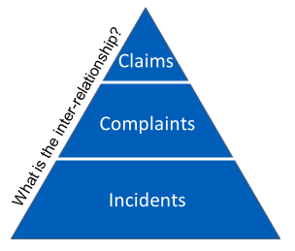
Approaches to learning from claims
Triangulating data from incidents, complaints

Slide 14
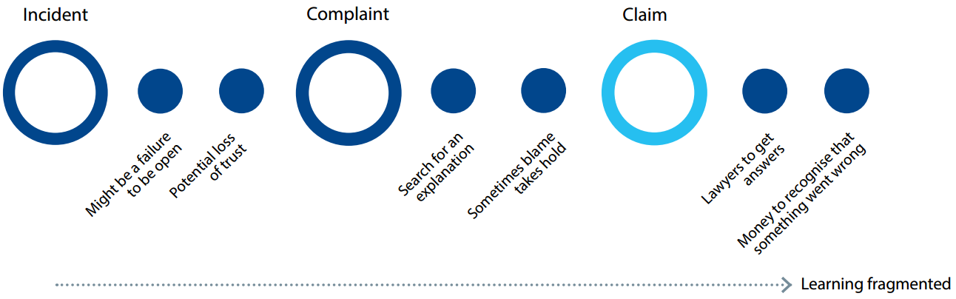
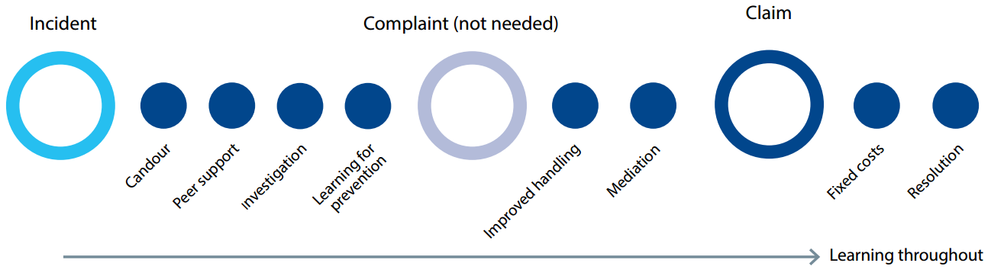
Our role – moving upstream
Current (worst case scenario)
Future (best case scenario)

Slide 15
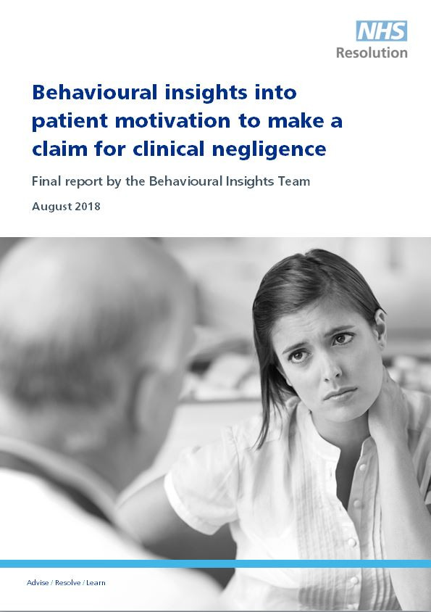
Why do people claim?
NHS Resolution’s research into behavioural insights August 2018
10,000 former claimants approached. 728 responded and in depth interviews undertaken with a sample
Key conclusions:
NHS staff reactions generally considered inadequate
Majority not satisfied with the NHS complaints handling process
Suggestion from NHS staff major motivation to claim

Slide 16
What do people expect?
What do patients and families want?
  An apology
  To prevent it happening to someone else
  To understand what went wrong
  To have answers and be heard
  Compassion, understanding and support
  Signposting to support where appropriate
What do staff want?
  Help to say sorry
  To prevent it happening to someone else
  To understand what went wrong
  To have answers and be heard
  Compassion, understanding and support
  Signposting to support where appropriate

Slide 17
Supporting patients and their family following an incident
After an incident the following actions are not only statutory, regulatory and professional requirements, but also the right and fair way to support staff, patients and their families
  Making a meaningful apology as soon possible
  Communicating openly and clearly with patients and their families
  Keeping patients, families and staff informed throughout an incident and investigation

Slide 18

Saying sorry
Saying sorry meaningfully when things go wrong is vital for everyone involved in an incident, including the patient, their family, carers, and the staff that care for them.
Saying sorry is:
  always the right thing to do
  not an admission of liability
  acknowledges something could have gone better
  the first step to learning from what happened and preventing it recurring

Slide 19
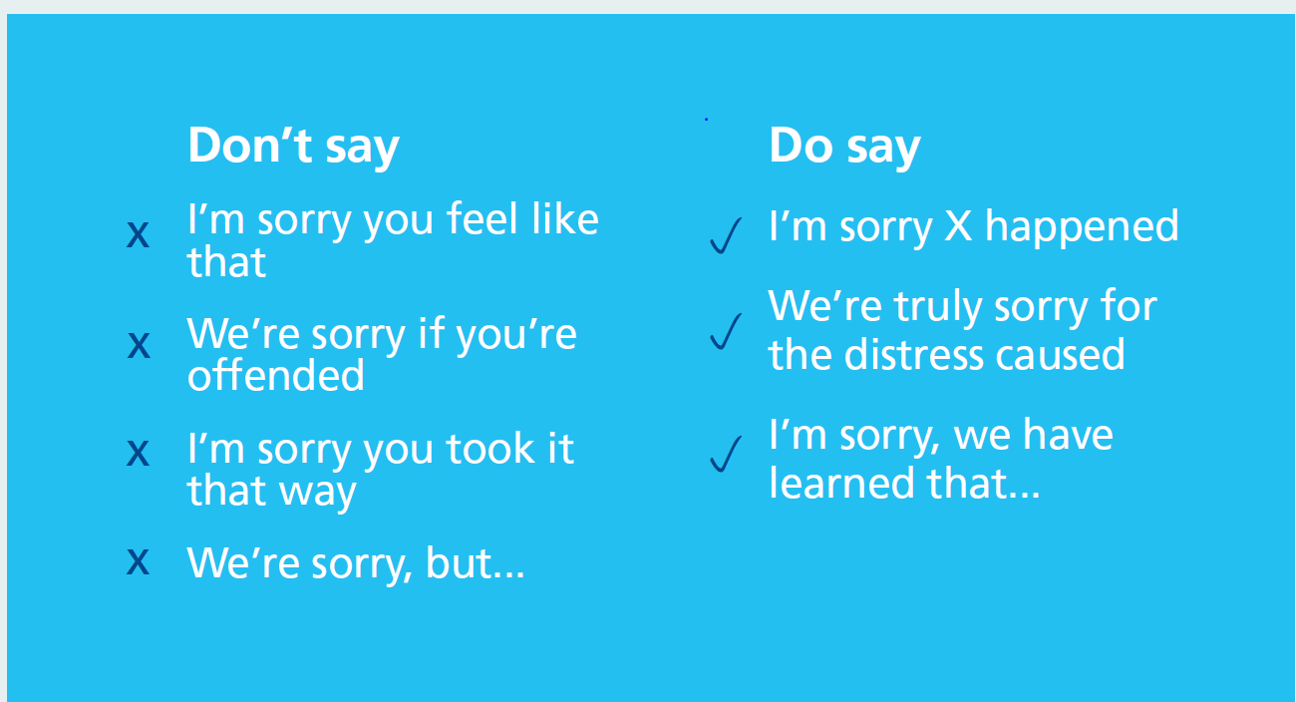
Saying Sorry

Slide 20

Example of Saying Sorry
You may also need to say sorry in writing where significant harm has been caused or in response to a written complaint. An example of this could be:
“I wish to assure you that I am deeply sorry for the poor care you have been given and that we are all truly committed to learning from what happened. I apologise unreservedly for the distress this has caused you and your family”

Slide 21

Duty of Candour animation

Slide 22

Saying Sorry

Slide 23
Factors that discourage candour
Fear of litigation and regulators
Blame culture
Being criticised or judged by your colleagues
Being isolated from your colleagues
Annoying senior colleagues
Time

Slide 24

Being fair: supporting a just and learning culture for staff and patients following incidents in the NHS
A just and learning culture is the balance of fairness, justice, learning – and taking responsibility for actions. It is not about seeking to blame the individuals involved when care in the NHS goes wrong. It is also not about an absence of responsibility and accountability.
All actions should be understood
Staff should be supported to learn from their actions
Chaffer, D., Kline, R. and Woodward, S.

Slide 25
Three aims of Being Fair
To help the NHS prioritise learning about how to minimise the conditions and behaviours that can underpin or lead to things not going as planned rather than apportion individual blame
Help the NHS build a consistent approach for all staff, no matter what profession or background
Help the NHS to avoid, wherever possible, suspension, exclusion and disciplinary action unless there is wilful intent

Slide 26


Conclusions
A just and learning culture is for all: staff, patients and organisations. It is not only about safety; it is about how we treat each other, every day
When things do not go as planned, patients’ physical and mental health, and wellbeing will always be of paramount concern to healthcare staff
At the heart of this are the rights of patients and their families to an apology, an explanation and to be involved in any subsequent reviews or investigations
They also have the right to seek assurances and / or financial compensation where appropriate
Full report and leaflet available online

Slide 27

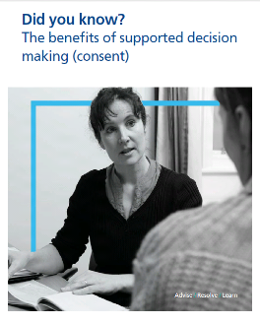
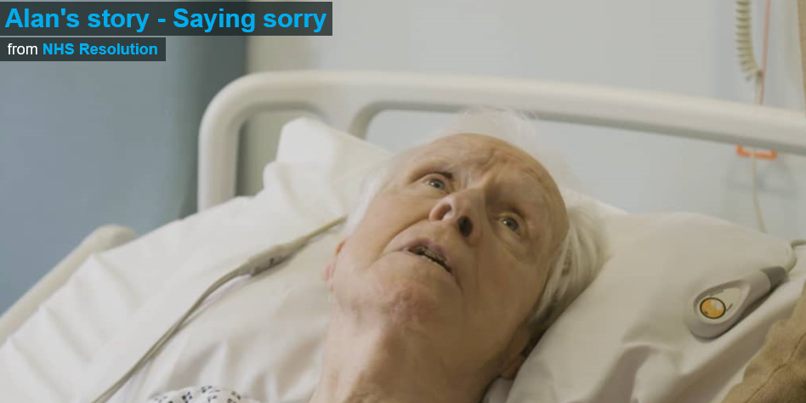
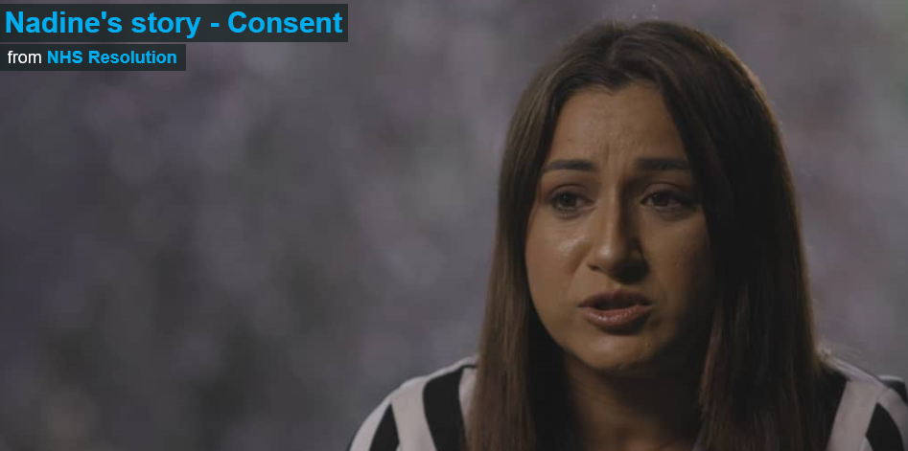


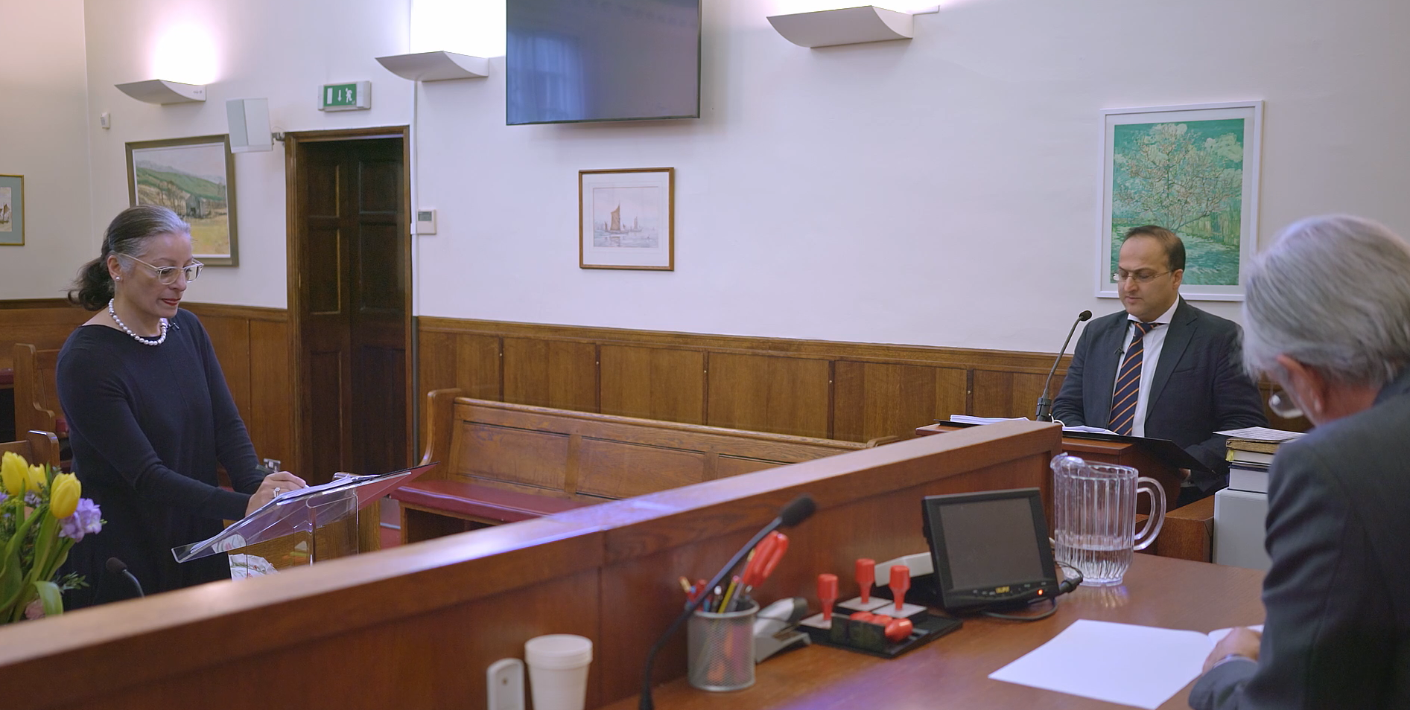





Resources
https://resolution.nhs.uk/resources/

Slide 28

Thank you

Slide 29
Contact NHS Resolution
NHS Resolution
8th Floor,
10 South Colonnade,
Canary Wharf,
London, E14 4PU
or
Arena Point, Merrion Way, Leeds, LS2 8PA
London 020 7811 2700
Leeds 0203 928 2000
generalenquiries@resolution.nhs.uk
Safety and Learning team:
@NHSResolution
020 7811 2700
Safety@resolution.nhs.uk
https://resolution.nhs.uk

