Slide 1
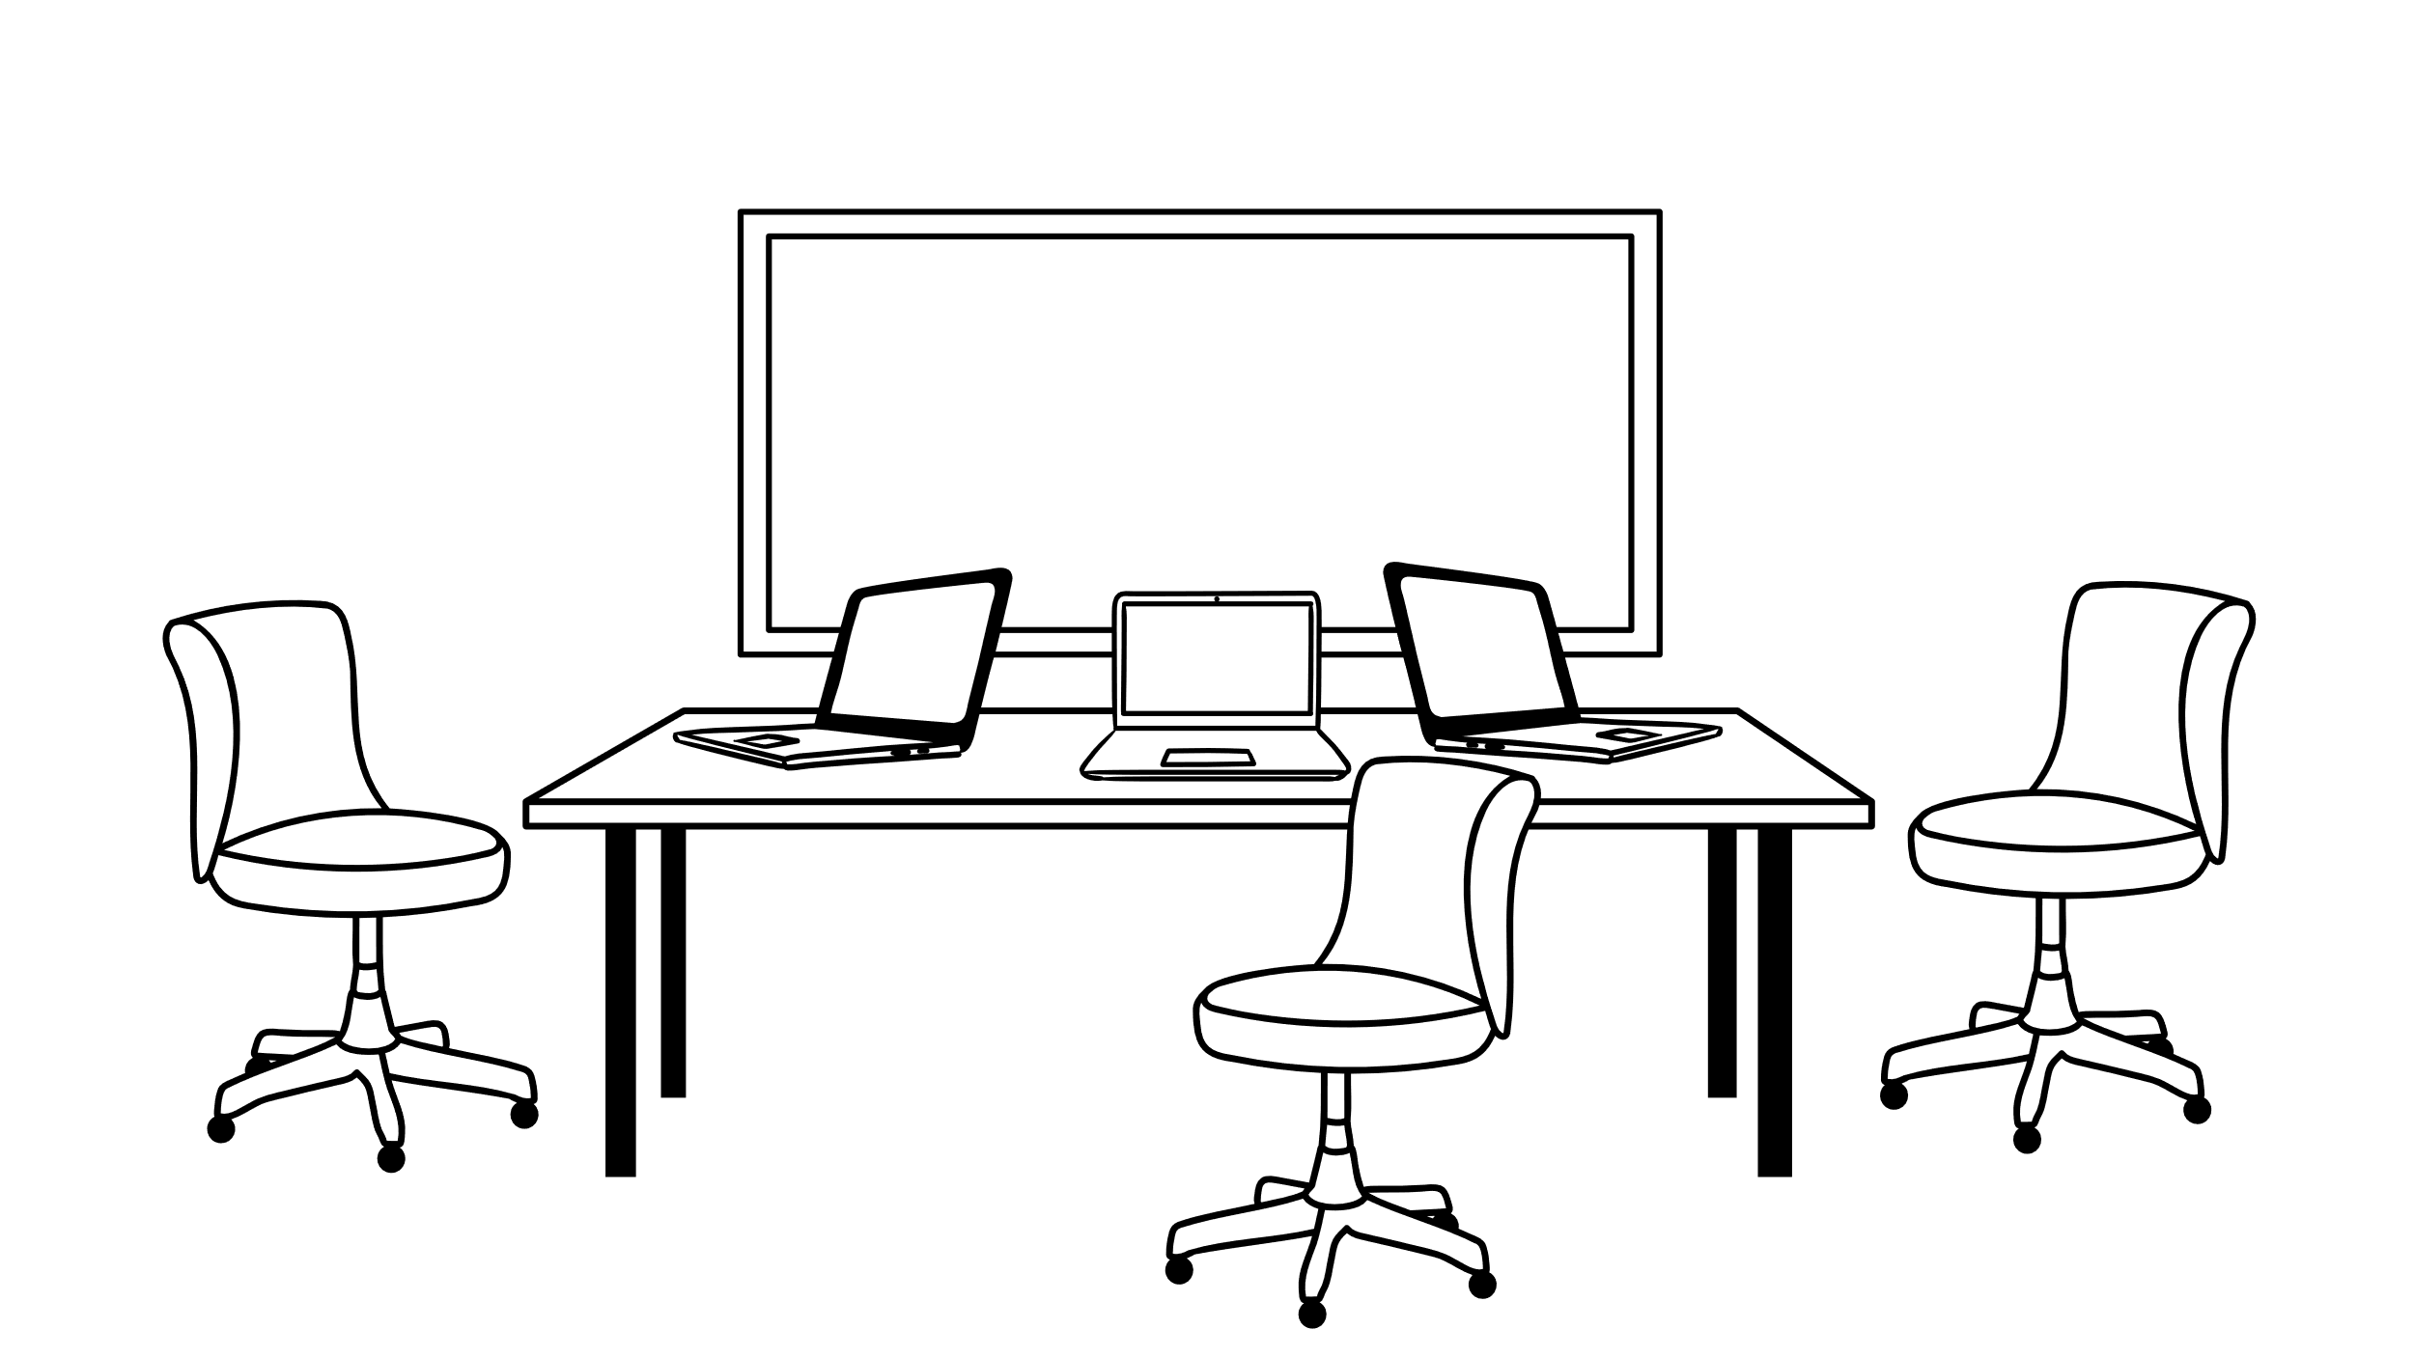
DELIRIUM
Notes:
Intro. Delirium pathway.

Slide 2
DELIRIUM
Dr Eleni Fixter MRCPsych
Consultant in Old Age Psychiatry
Trust Doctor Tutor
Delirium Pathway Lead
TEWV NHS Foundation Trust
Dr M S Krishnan FRCPsych
Consultant in Old Age & Liaison Psychiatry
TEWV NHS Foundation Trust
Chair, Faculty of Old Age Psychiatry @RCPsych
Associate Dean, Regional Delirium Lead HEE NE
Visiting Professor of Psychiatry

Slide 3
GP Referral
Paul
67 year old, retired electrician.
12 month gradual cognitive decline.
Reported to be functioning well at home.
No concerns raised around his mood.
Paul lives on his own, daughter lives close by.

Slide 4
Im happy that my GP referred me to you.
Ill keep my eye out for my appointment letter.
My memory is not perfect but I don't have any major concerns.
I want to be checked out just in case.

Slide 5
Meet Paul
Initial assessment at his home.
Paul answered the door his appearance was unkempt.
He was not expecting your visit.
He took you to his kitchen to show you his broken boiler, expecting you to fix it.
He appeared irritated and suspicious of you.
Any attempt to commence your assessment was interrupted.
Paul felt he had no problems at all.
He held his stomach, wincing in pain

Slide 6
Collateral
Paul found his daughters phone number
She stated she had lunch with him last week.
She found he forgot certain conversations they have had recently. ‘Is it just an Age thing?’
His daughter was unaware of any problems with his boiler.
That does not sound like my dad?!

Slide 7
Awareness Skills Knowledge
ASK about Delirium

Slide 8
What is Delirium?
Delirium is an acute onset syndrome with disturbance in
attention, awareness and cognition
There is normally an underlying cause

Slide 9
Less than 1 week
Forgotten appointment
Poor attention
Delirium is an acute onset syndrome with disturbance in
attention, awareness and cognition
.
Poor understanding
Lack of focus

Slide 10
Vulnerability
Precipitant
High
Major Event
Dementia
Meningitis, sepsis
Multi-morbidity
Surgery
Fall and Fracture
Sensory Impairments
Dehydration
Polypharmacy
Urinary Catheter
Healthy and Fit
Hypnotic Tablet
Low
Minor Event
Multifactorial Model for Delirium (from Inouye 2006)
Notes:
10

Slide 11
Why we need to know about delirium? = COSTLY & DANGEROUS
Increased Length of stay
Admission to institutions
Increased Mortality
Increased Cost - $152bn/year

Slide 12
Why we need to know about delirium?
Delirium increases risk of future cognitive decline.
Longer duration, more severe delirium and more episodes of delirium were associated with worse cognitive outcomes.
Delirium may be a potentially modifiable risk factor for dementia.

Slide 13
Burden
Delirium Occurrence has not changed over 4-decade 1980- 2019 (23%) Davies et al (2019)
Clearly indicates a need for preventative strategies = Risk Reduction

Slide 14
Increase Morbidity
Patient & Carer Distress
Why do we need to identify delirium?
20% mortality (in 3 months)
8 fold increase
of dementia in 2yr
1 in 8
cases are preventable
2 in 5 dead in 12 months
1 in 4 admissions to hospital
20% don’t go back to baseline

Slide 15
Delirium – Diagnosis

Slide 16
Diagnosis – Always clinical
No tool is diagnostic
There are approximately 59 tools for various settings
In older adults some tools may be difficult to administer
Sensory impairment
dementia
Pain/anxiety

Slide 17
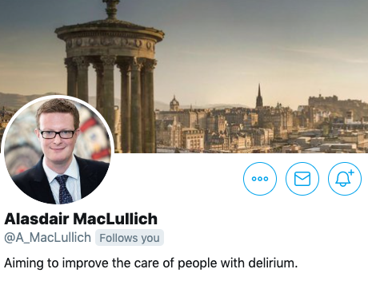
Tools
SQiD
4AT
CAM
………

Slide 18
SQUID Single Question to Identify Delirium
Has there been a sudden change in behaviour or confusion?

Slide 19
Alertness
AMT4: Age, DOB, place, Year
Attention: months of the year backward
Acute Change or Fluctuating Course
Normal (fully alert but not agitated) 0
Mild sleepiness after waking then normal 0
Clearly Abnormal 4
No mistakes 0
1 mistake 1
2 or more mistakes 2
7 months or more correct 0
Starts but score <7 or refuses to start 1
Untestable 2
No 0
Yes 4
4AT

Slide 20
Alertness
AMT4: Age, DOB, place, Year
Attention: months of the year backward
Acute Change or Fluctuating Course
Normal (fully alert but not agitated) 0
Mild sleepiness after waking then normal 0
Clearly Abnormal 4
No mistakes 0
1 mistake 1
2 or more mistakes 2
7 months or more correct 0
Starts but score <7 or refuses to start 1
Untestable 2
No 0
Yes 4
4AT

Slide 21
P
Pain
I
Infection
N
Nutrition
C
Constipation
H
Hydration
M
Medication
E
Environment
Codeine Phosphate 30mg, every 4 hours if required.

Slide 22
P
Pain
I
Infection
N
Nutrition
C
Constipation
H
Hydration
M
Medication
E
Environment
Codeine Phosphate 30mg, every 4 hours if required.

Slide 23
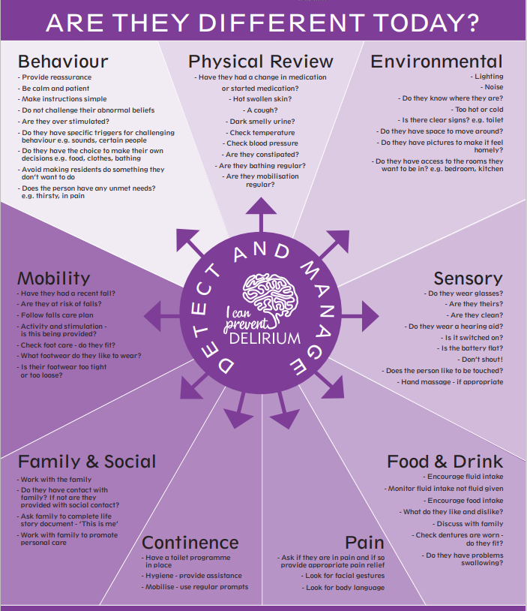
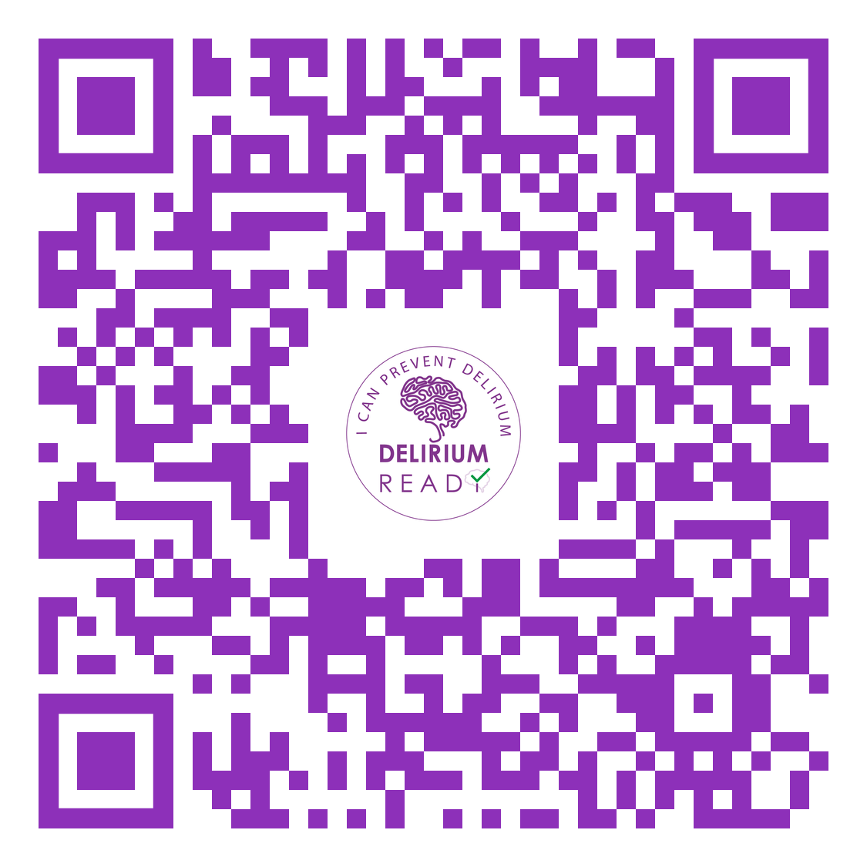

Slide 24
Management
Identify
Liaise
Support
Paul has delirium. 4AT 12. Timeline is in keeping with Codeine starting. He may be constipated and is in pain. Please check Pauls physical parameters and review as needed.
We will support.
Please see Paul.
He is confused.

Slide 26
Non Pharmacological
Care Plan

Slide 28
Pharmacological
There is no evidence based medication treatment for Delirium
Risk
Need
Side-effects
Chemical Restraint

Slide 29
Detection
Screening Tool
Medical review
Medication Review
Non-Pharmacological Intervention
Clear rationale of pharmacological intervention
Communication to patients /Family
Follow up

Slide 30
Awareness
Skills
Knowledge

Slide 31
Delirium Educational Videos
https://youtu.be/2Hg1VP-Enw4
https://youtu.be/BPfZgBmcQB8

Slide 32
We have launched a Delirium Wheel app for care homes
iOS or Google Play store

Slide 34
Resources Google – HEE NE Delirium

Slide 36
Take Home….
Delirium can be prevented / Risk Reduction
Try non-pharmacological approach before considering any medications
Delirium is a risk factor for Dementia and please do not forget delirium superimposed dementia
Delirium is everybody’s Business

Slide 37
15 March 2023
#WDAD2023

Slide 38
Thank You
Thank You.
@DeliriumKrish
@Fix_psych

Slide 39
Thank You
@DeliriumKrish
Thank You.
@charliemacksey

