Slide 1

Non-medical prescribing in end of life care in the community
Nigel Dodds
Consultant Nurse

Slide 2
We will cover
(Some of the) Issues around anticipatory prescribing in end of life care in the community
A focus on an audit of our practice
Learning and support for non-medical prescribers at St Christopher’s

Slide 3
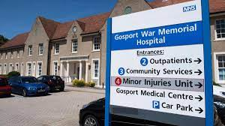
Safer anticipatory prescribing of injectable medications for symptom control in end of life care
Some recent relevant evidence…

Slide 4
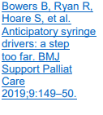
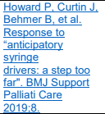
Safer anticipatory prescribing of injectable medications for symptom control in end of life care
Gosport enquiry – highlighting the potential dangers of prescribing ‘anticipatory syringe pumps’
Gosport enquiry does not fit with palliative care practice, focus on a hospital rehab unit
However has highlighted an issue we must consider – inappropriate medicines and doses being prescribed for someone before they need it
Bowers et al (2019) have advised against ‘Anticipatory syringe drivers’ - starting syringe drivers requires skilled planning and conversations, and we are not able to for see what person’s needs will be. CSCIs should be prescribed by the prescriber seeing the person
Howard et al (2019) have argued against this: EOL is foreseeable, and unambiguous + medication choices and doses unlikely to change from when PRN charts are written + starting a CSCI leads to on-going review

Slide 5
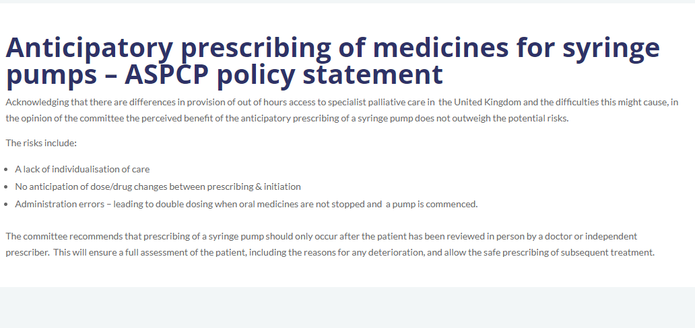

The Association of Supportive and Palliative Care Pharmacy (ASPCP) (2020)
Notes:
The Association of Supportive and Palliative Care Pharmacy (ASPCP) in a statement (opens a new page) dated August 7th 2020 acknowledged the differences in provision of out-ofhours access to specialist palliative care in the UK and the difficulties this might cause, in particular rapid access to injectable medications for symptom control. However, in the opinion of the committee, the perceived benefit of prescribing syringe pumps in anticipation of need does not outweigh the potential risks – these being a lack of individualisation of care, no anticipation of dose/drug changes between prescribing and initiation, and administration errors – for example, leading to double dosing when oral medicines are not stopped and a pump is commenced. The committee recommended that prescribing of a syringe pump should only occur after the patient has been reviewed in person by a doctor or independent prescriber. This would ensure a full assessment of the patient, including the reasons for any deterioration, and allow the safe prescribing of subsequent treatment.

Slide 6
Care of dying adults in the last days of life
NICE guideline [NG31] Published: 16 December 2015
1.6 Anticipatory prescribing
1.6.1 Use an individualised approach to prescribing anticipatory medicines for people who are likely to need symptom control in the last days of life. Specify the indications for use and the dosage of any medicines prescribed.
1.6.2 Assess what medicines the person might need to manage symptoms likely to occur during their last days of life (such as agitation, anxiety, breathlessness, nausea and vomiting, noisy respiratory secretions and pain). Discuss any prescribing needs with the dying person, those important to them and the multi-professional team.
1.6.3 Ensure that suitable anticipatory medicines and routes are prescribed as early as possible. Review these medicines as the dying person's needs change.
1.6.4 When deciding which anticipatory medicines to offer take into account:
  the likelihood of specific symptoms occurring
  the benefits and harms of prescribing or administering medicines
  the benefits and harms of not prescribing or administering medicines
  the possible risk of the person suddenly deteriorating (for example, catastrophic haemorrhage or seizures) for which urgent symptom control may be needed
  the place of care and the time it would take to obtain medicines.
1.6.5 Before anticipatory medicines are administered, review the dying person's individual symptoms and adjust the individualised care plan and prescriptions as necessary.
1.6.6 If anticipatory medicines are administered:
  Monitor for benefits and any side effects at least daily, and give feedback to the lead healthcare professional.
  Adjust the individualised care plan and prescription as necessary.

Slide 7
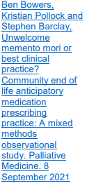
Bowers et al (2021)
Mixed methods study looking at EOLC anticipatory prescribing in the community
High volume of anticipatory prescribing
Observed frequent standard regimes and dosages – not person-centred
Often prescribed a long time in advance – even up to a year ahead
Observations that systems for good clinical governance not always in place to support safe prescribing when MAAR charts and medicines for anticipatory needs in place

Slide 8
Background to our audit
Anticipatory prescribing of injectable medications at EOL for community patients is good practice to achieve timely symptom control
We needed to review and ensure anticipatory prescribing is individualised
There is a significant cost/time investment in organising anticipatory medications (our practice unusual)
It is currently unclear how many of these are used/wasted in our community population
We know there are gaps in how people access EOLC medications in the community
Retrospect audit to evaluate baseline with aim to establish evidence based prescribing

Slide 9

Our steps so far…
Joint retrospective audit
 | Local NHS Trust | STCH
Looking at: | Anticipatory charts Prescribing practices Case note review | Anticipatory charts Prescribing practices Case note review
Written by: | Acute palliative care team | STCH team
For which patients? | Discharged from X to community for EOLC | Community patients (all 5 CCGs: Croydon, LSL, Bromley)
Time period | 3 month period in last year

Slide 10
Aims
Questions we were trying to answer:
What does our current anticipatory prescribing look like?
Are we achieving good symptom control?
Are MAAR charts being written in time?
Are we prescribing appropriate medicines/doses/ranges?
Are MAAR charts frequently needing to be re-written?
Are there training needs?
What does our dispensing cost us?
Are the drugs being used?
How can we improve current practice?

Slide 11

3. STCH AUDIT METHOD:
Number of patients with anticipatory charts written
cancer | 40
dementia | 15
frailty | 6
HF/COPD | 11
MND | 2
Other | 2
Bromley/BCC
= 73
28
66% male
Median age 80 (41 – 107)
Croydon = 62
Every 3rd patient reviewed in detail
25
<65 | 13
65-74 | 13
75-84 | 21
>85 | 29
LSL = 70
23
Total : 76 patients
Quiz Q: What percentage of anticipatory charts were written by doctors vs nurses?

Slide 12
3. AUDIT DATA:
6%
Nurses Doctors
55% 45%

Slide 13
Analgesia
3. AUDIT DATA:
% of
patients
Background opioid
* Morphine and Oxycodone total dose in 24 hours (including M/R and CSCI preparations)

Slide 14
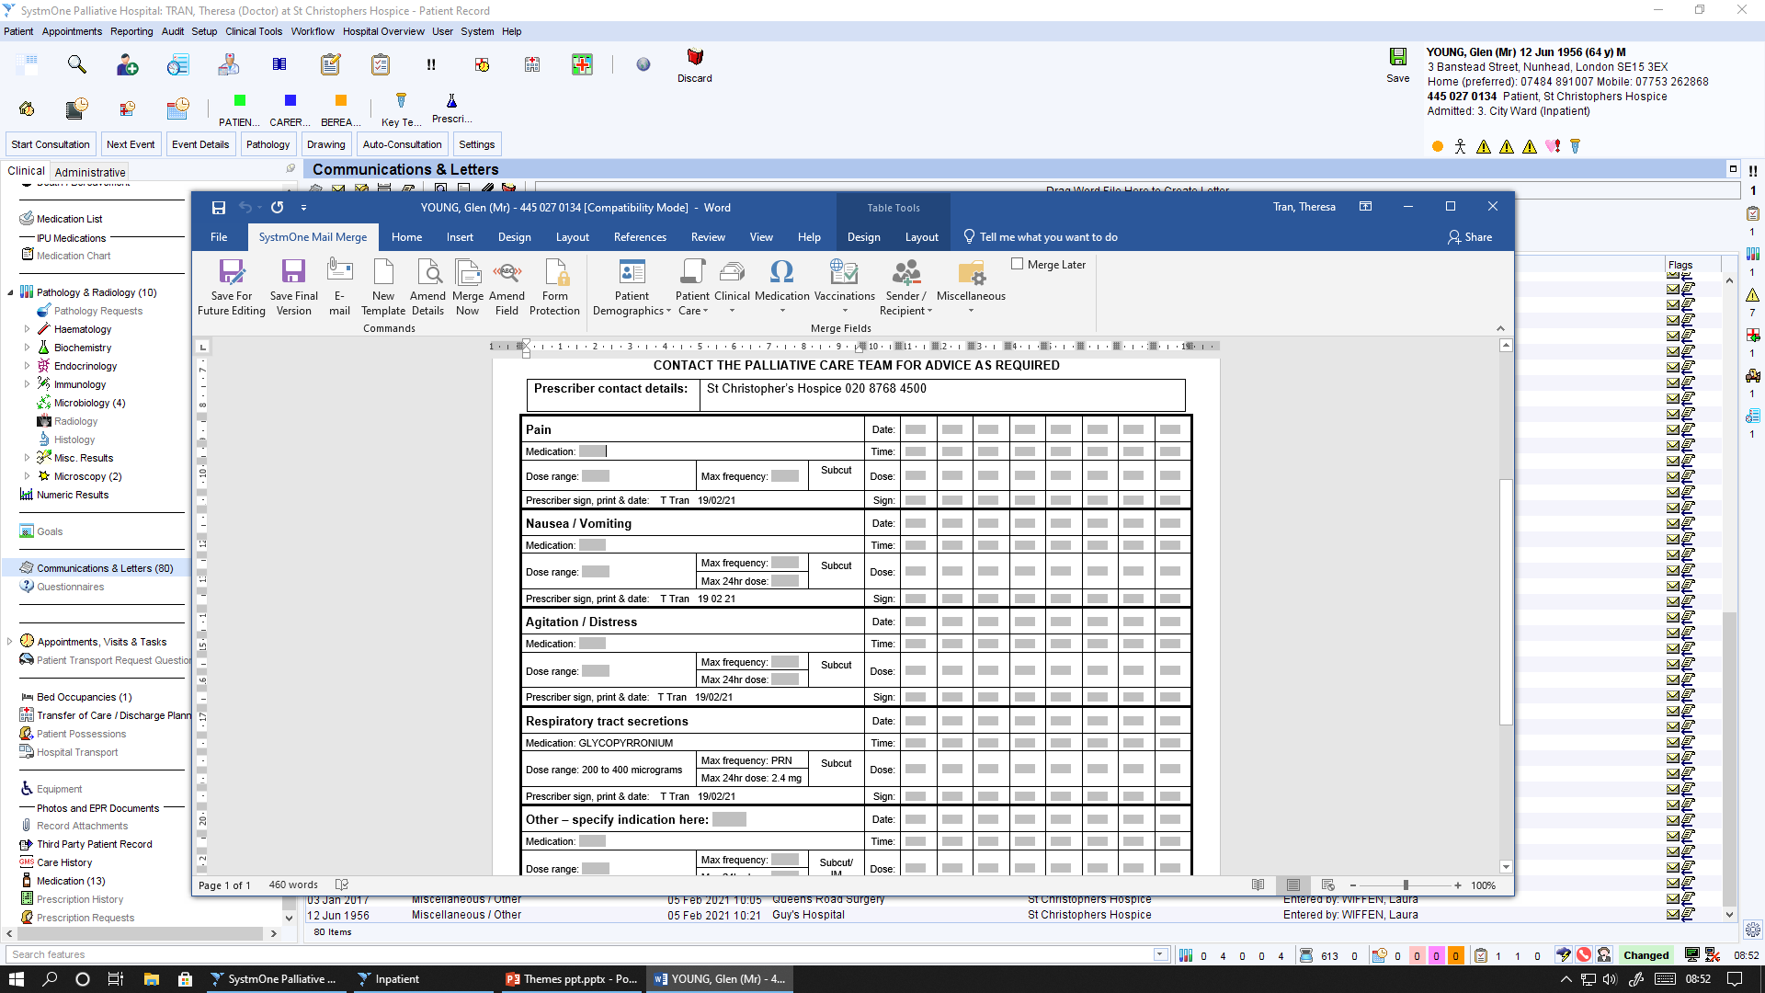
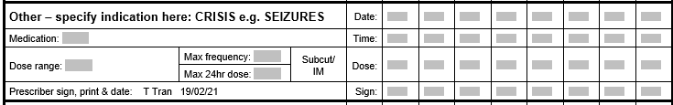
4. GENERAL THEMES:
Chart issues
Not always a max PRN frequency or max 24 hrs
Restrictive dose ranges → re-written
Charts not written in full → later re-written
  Hospital charts incomplete → re-written
  Charts not rewritten when background opioid increased
  Uncertainty around seizure management + doses
  Chart written ?too late
  LAS referred a patient unwell, dying, to remain home – charts weren’t done until patient became symptomatic the day before she then died

Slide 15
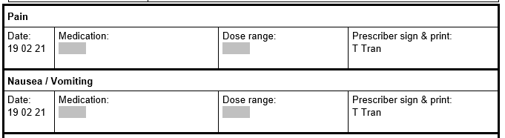
4. GENERAL THEMES:
Morphine
Doses/drugs given
2 mg – 5 mg
  PRN doses too small?
  Doses given not proportionate to the problem
  Stats given which are low in comparison to background
  Stats given because they are lowest end of the PRN chart (2 mg) despite CSCI 30 mg
Morphine
  Reluctance to use adequate dose haloperidol or midazolam
  Stats being given but not incorporated into the CSCI
10 mg – 30 mg
A lot of these are training/confidence issues

Slide 16
6. COSTINGS:
Not needing stats – 36%
Given stats – 64%
Quiz Q: Of those with anticipatory charts, how many were actually given stats?
NB: this may be an under-estimate as we don’t have access to the district nursing notes
Quiz Q: Of those given stats, what was given least often?
Analgesia?
Anti-emetic?
Anti-secretory?
Sedation?
analgesia | 40 | 53%
antiemetic | 12 | 16%
antisecretory | 18 | 24%
sedation | 31 | 41%

Slide 17
6. COSTINGS:
analgesia | 40 | 53%
antiemetic | 12 | 16%
antisecretory | 18 | 24%
sedation | 31 | 41%
PRN
Pain | Morphine | 46 | 61%
 | Oxycodone | 26 | 34%
 | Alfentanil | 4 | 5%
Anti-emetic | Haloperidol | 67 | 88%
 | Cyclizine | 9 | 12%
Secretions | Glyco | 74 | 97%
 | Hyoscine | 1 | 1%
 | None | 1 | 1%
Sedation | Midazolam | 75 | 99%
 | None | 1 | 1%
Quiz Q: Can we save some money here with our dispensing?

Slide 18

Quiz Q: What is the most expensive anti-emetic?
Haloperidol
5 mg/1ml
Cyclizine
50 mg/1ml
Ondansetron
4 mg/2ml
Metoclopramide
10 mg/2ml
Levomepromazine
25 mg/1 ml
£33.60
£14.36
£1.80
£1.44
£7.49

Slide 19
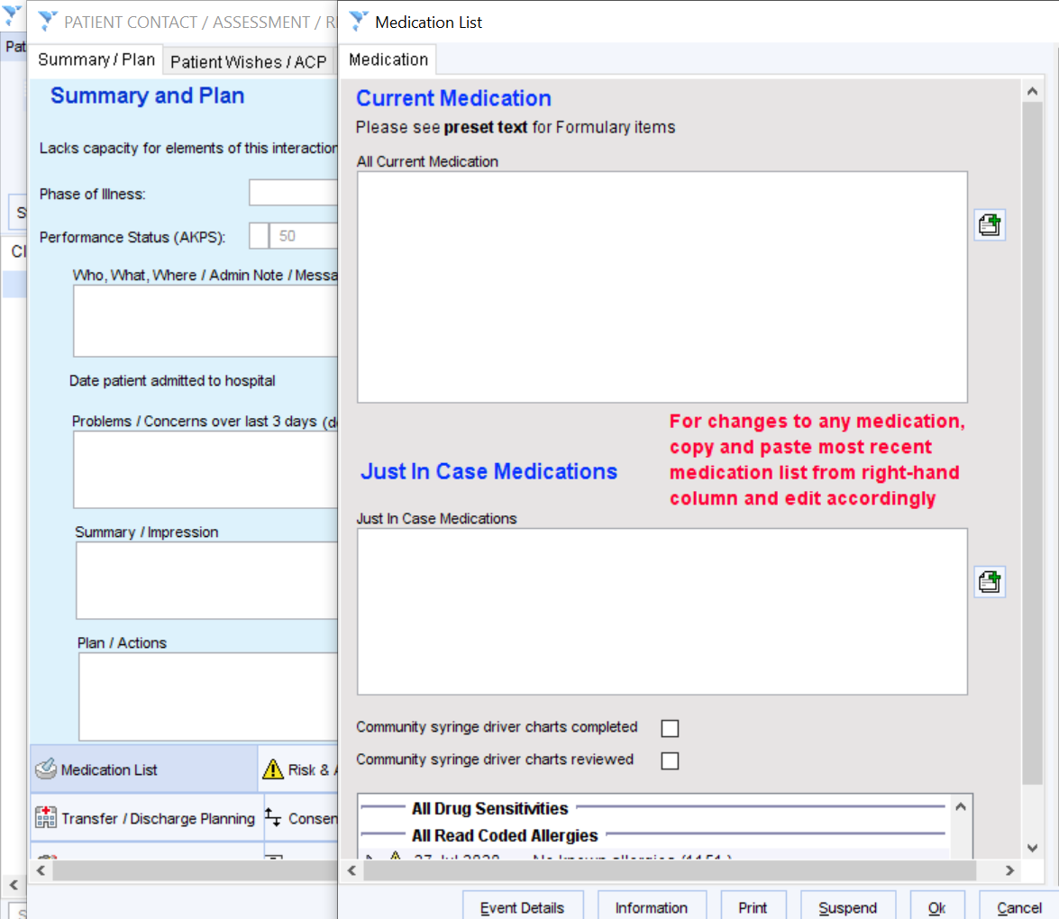

NB:
Likely an under-estimation of cost/waste – we only looked at 1/3 patients
Under-estimation of numbers – used code from S1 (tick box for JIC) to identify these patients
Quiz Q: What do you think each anti-emetic costs?
Most people get haloperidol
Only ~16% use it
e.g. For 100 patients all dispensed haloperidol |  |  | COST £3360
Only 16% use it |  |  | £537.6
Wasted drug/money |  |  | WASTED £2822.4
Haloperidol
5 mg/1ml
£33.60

Slide 20

6. COSTINGS:
The average JIC box meds dispensing (of morphine, glyco, midazolam and haloperidol) costs:
?could we dispense less often
JIC
Being more selective re: who we give it to - criteria for dispensing
OR we take them out and sign them back in if not needed?
Can we accurately predict who will need the meds urgently?
Are community set up to dispense quickly?
£51.67 PER PATIENT
Not needing stats – 36%
Given stats – 64%
?could we dispense only 5 instead of 10 ampoules
Won’t we need more boxes, more labelling?
Any other ideas/solutions?
?could we replace one drug for another e.g. replace haloperidol with levomepromazine
Can we save money here whilst maintaining efficacy, safety and reduce drug wastage?
Are they equivalent swaps? How do we measure the impact?

Slide 21
Also in the audit…
We looked into a number of case studies where we had dispensed medicines, to better understand how and why we are dispensing anticipatory medications
Locally there are concerns that we are frequently dispensing anticipatory medications when statutory services in a safer position to do this

Slide 22
Case study 1
78 year old woman with endometroid cancer discharged from acute trust on 10/11/21 with EOLC medicines (morphine x 10, midazolam x 10, glycopyronnium x 10.
By 26/12/21 needing CSCI, started by us and carried on by DNs
On 27/12/21 DNs called in requesting more midazolam – running low. Advised to contact 111/local GP
By 29/12/21 (not a bank holiday) DNs unable to access any medication from 3 local pharmacies
We dispensed midazolam 10mg/2ml x 10 amps on 29/12/21 to bridge gap
Died at home on 6/1/22
Question: If we hadn’t bridged this gap, how might things have progressed? How might this have looked locally?

Slide 23
Case study 2
96 old woman with frailty, in a residential care home in one of our boroughs (referred by team in home on 7/2/22) – prognosis ‘short months’
Call in on 11/2/22 (Friday)– dying – no injectable medication in home.
STCH prescriber emails GP/DN to advise we have written initial px but please continue to prescribe EOLC injectables
Medications taken out on 12/2/22 (Alfentanil and midazolam only) but not visited
13/2/22 – dying with symptoms. Further prescription for glycopyronnium – taken out on visit. CSCI started with alfentanil, midazolam, glycopyrronium. With plan DNs will take over CSCI
16/2/22 – call from DNs to advise not enough medication for CSCI today. Night team advise we will dispense and deliver
16/2/22 – email from GP surgery to advise alfentanil unavailable “so the doctor has given morphine 15mg/1ml as an alternative, or would you prefer oxycodone?”
Died in the care home on 18/2/22
Question: What might have been the implications of us not dispensing medications? How might this have looked locally?

Slide 24
Case study 3
75 year old woman with stomach cancer, discharged home from acute care on 20/1/22 with EOLC medications and MAAR charts – morphine (10 amps), midazolam (10 amps), haloperidol (10 amps), glycopyrronium (9 amps)
21/1/22 (Friday) OOH visit to give EOLC s/c and start CSCI. Email sent to DNs to request they take over
21/1/22 – 22/1/22 overnight – 2 visits overnight due to pain and agitation – given s/c morphine and midazolam at both visits
22/2/22 – agitated with escalating doses of morphine and midazolam. Further visits and took out morphine (10 amps) midazolam (10 amps) later new prescription for levomepromazine due to agitation)
23/2/22 – family member collects levomepromazine from STCH
24/2/22 – admitted to STCH where she died on 25/2/22
Question: We supplied medications at a weekend as insufficient to support symptom control + we added in a new medication due to increasing agitation. If we hadn’t done this, how would person have accessed medications? How might this have looked locally?

Slide 25
Some learning
Need to individualise prescribing
Training and support needed for large group of prescribers
Updating our guidance: St Christopher's | Resources for Professionals - St Christopher's (stchristophers.org.uk)
We need to support generalists to prescribe more, and upskill in writing MAAR charts
Linking in with SEL workstream

Slide 26
Led us to updating our guidance
St Christopher's | Resources for Professionals - St Christopher's (stchristophers.org.uk)

Slide 27
SE London….
Collaborative approach involving acute, primary, and third sector organisations – working together to review practice around anticipatory prescribing
Already highlighted practices which create concerns:
Around the evidence
Access to medications
Access to skilled professionals to prescribe and administer medications
Concerns around non-prescribers writing charts

Slide 28

Moving on….

Slide 29
Supporting non-medical prescribing at St Christopher’s
St Christopher’s have had a framework for non-medical prescribing since 2007
Now have 21 nurses who are non-medical prescribers
Historically, annual study day
Now monthly joint prescribers group
National (international) on-line Community of Practice

Slide 30
Monthly prescribers meeting
Expectation all prescribers (and those in training) will attend
Review individuals prescribing data from FP10s
Update around policy, guidance etc
Case study review (template based on RPS prescribing competencies)
– doctor and nurse
Feeds into out Medicines Optimisation Group
(feeds into Quality and Governance Committee)

Slide 31
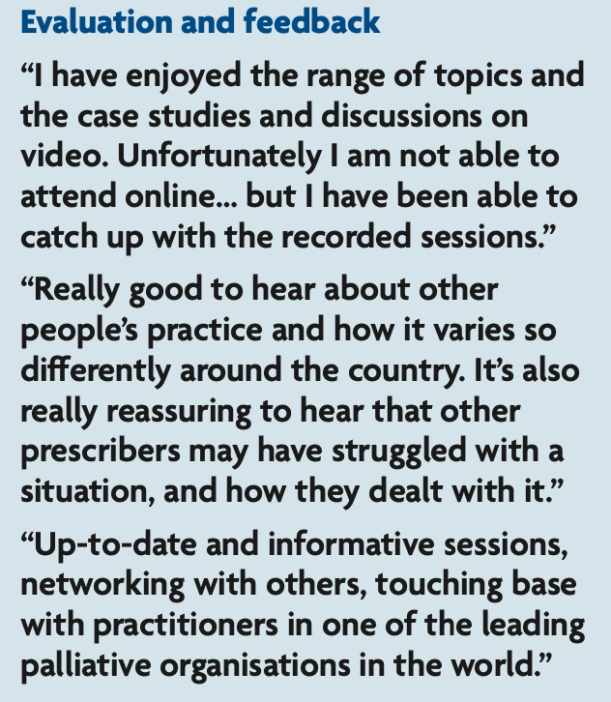
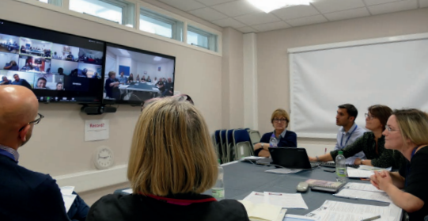
Non-medical prescribers Community of Practice
Developed quickly in 2020 in response to COVID pandemic
Led to monthly session – generally a didactic approach
12 sessions, with a focus on symptom management
Well evaluated…..

Slide 32
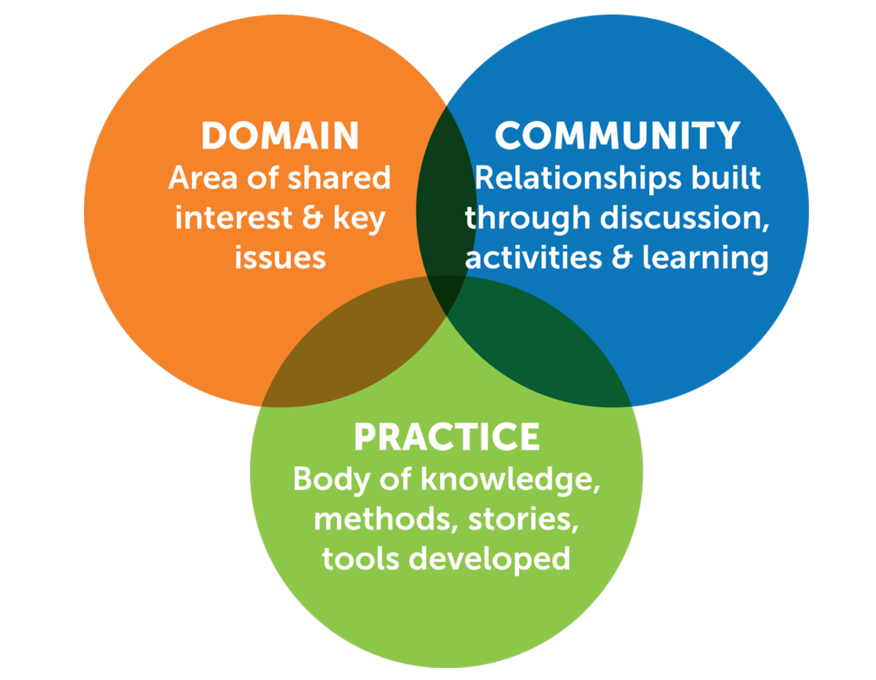
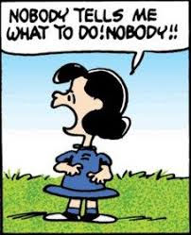
Community of Practice – REBOOT!

Slide 33
St Christopher’s CARE Community of Practice
Monthly learning supported by:
‘Curriculum’ co-created
Bi-monthly on-line session: case studies, group work, discussion
Bi-monthly input using Moodle, for journal review, discussion, activities

Slide 34

Join us….
https://www.stchristophers.org.uk/course/non-medical-prescribers-community

Slide 35
Summary
Reviewing our practice at St Christopher’s is proving to be a useful process
Connecting with others to do this is helpful
Increasing learning opportunities and addressing governance issues provides clinician support, safety and oversight

Slide 36
Nigel Dodds (Consultant Nurse) n.dodds@stchristophers.org.uk

