Slide 1


Improving Prescribing Practice & Competence:
Using the national prescribing competency framework
Rhea Crighton
Clinical Matron for Cancer Services
Sally Jarmain
Non-Medical Prescribing Lead

Slide 2
Overview
RPS Competency Framework for all Prescribers: key messages
How can organisations use the Competency Framework for all prescribers to support governance?
How can individual practitioners use the Competency Framework for all prescribers to demonstrate competence?
The new RPS Competency Framework for Designated Prescribing Practitioners

Slide 3
Why do we need a competency framework for prescribers?
Inform the design and delivery of education programmes for prescribers
Help identify areas for CPD once qualified
Support organisational governance of prescribers
Assure patients about the competencies of prescribers

Slide 4
History
2001-2006
NPC published different frameworks for different professional groups
2012
  NPC Single Competency Framework for all Prescribers

Slide 5
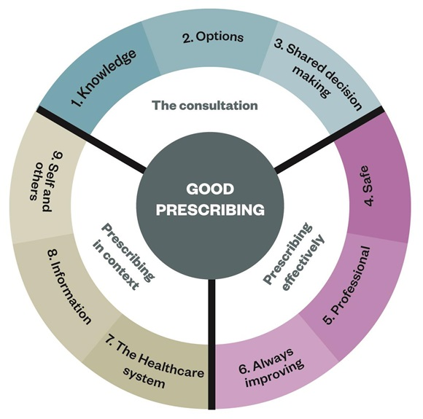
NPC Single Competency Framework for all Prescribers (2012)

Slide 6
History
2001-2006
NPC published different frameworks for different professional groups
2012
  NPC Single Competency Framework for all Prescribers
2016
  RPS reviewed and published Competency Framework for all Prescribers

Slide 7
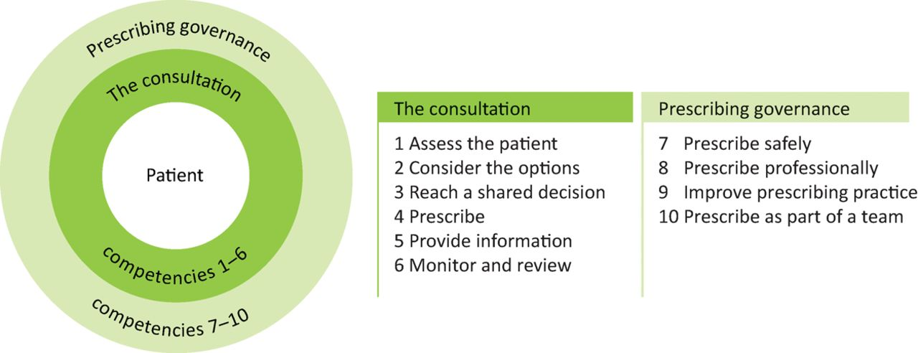
RPS Competency Framework for all Prescribers (2016)

Slide 8
History
2001-2006
NPC published different frameworks for different professional groups
2012
  NPC Single Competency Framework for all Prescribers
2016
  RPS reviewed and published Competency Framework for all Prescribers
  2021
  RPS currently reviewing Competency Framework for all prescribers (consultation closed 7th May 2021)

Slide 9
Review of RPS Competency Framework for all Prescribers
Assessing the patient (additional statements)
1.1 Undertakes the consultation in an appropriate setting.
1.2 Considers patient confidentiality, consent and dignity.
1.3 Introduces self and prescribing role to the patient/carer and confirms patient/carer identity.
1.4 Assesses the communication needs of the patient/carer and adapts consultation appropriately.
1.5 Demonstrates good consultation skills and builds rapport with the patient/carer.

Slide 10
Review of RPS Competency Framework for all Prescribers
Prescribe (additional statements)
4.1 Prescribes a medicine or device with adequate, up-to-date awareness of its actions, indications, dose, contraindications, interactions, cautions and adverse effects.
4.6 Prescribes appropriate quantities and at appropriate intervals necessary, to reduce the risk of unnecessary waste.

Slide 11
Review of RPS Competency Framework for all Prescribers
Improve Prescribing Practice (additional statements)
9.4 Takes responsibility for own learning and continuing professional development relevant to the prescribing role.
9.5 Makes use of networks for support and learning.
9.6 Encourages and supports others with their prescribing practice and learning journey.

Slide 12
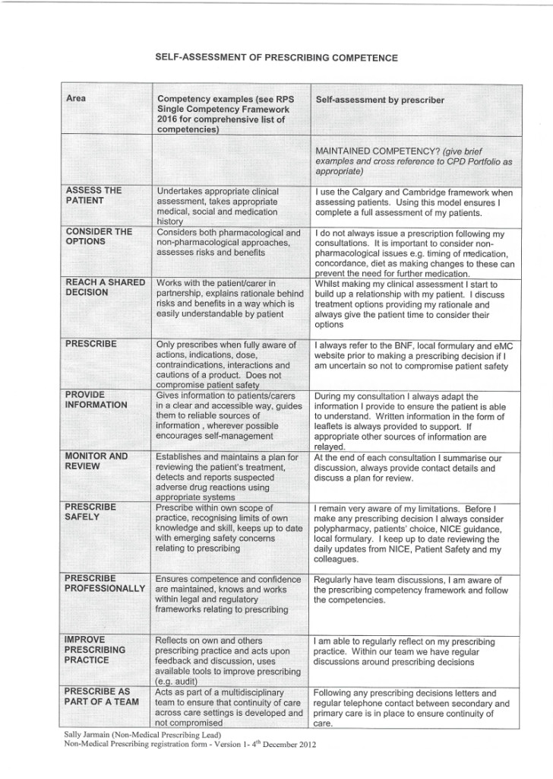
RPS Competency Framework as part of annual declaration

Slide 13
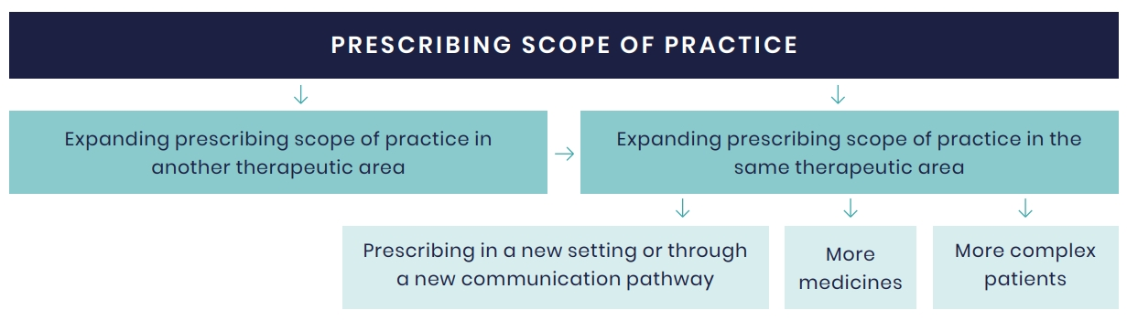
RPS Expanding Scope of Practice

Slide 14
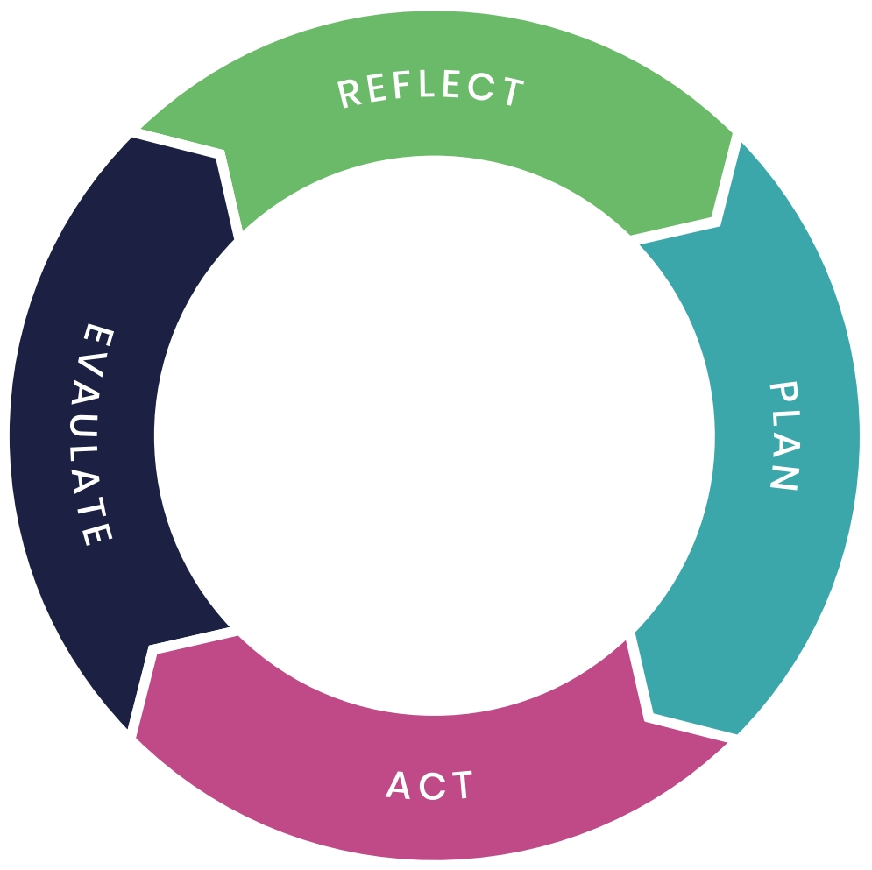
CPD Cycle

Slide 15
Expanding Scope of Practice
Reflect
Assess the patient | Setting of consultation Patient assessment
Identify evidence-based treatment options available for clinical decision-making | Management of condition/indication Understanding the pharmacology Management options Non-pharmacological and pharmacological
Present options and reach a shared decision
Prescribe | Understand the medicine(s): dose, indications, contra indications, cautions, side effects, drug interactions
Document the consultation
Monitor and review

Slide 16
Expanding Scope of Practice
Plan using SMART objectives
Carry out learning activities
Evaluate ensuring your learning needs in desired prescribing area have been met

Slide 17

Case Based Discussion

Slide 18
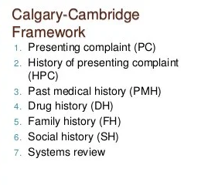
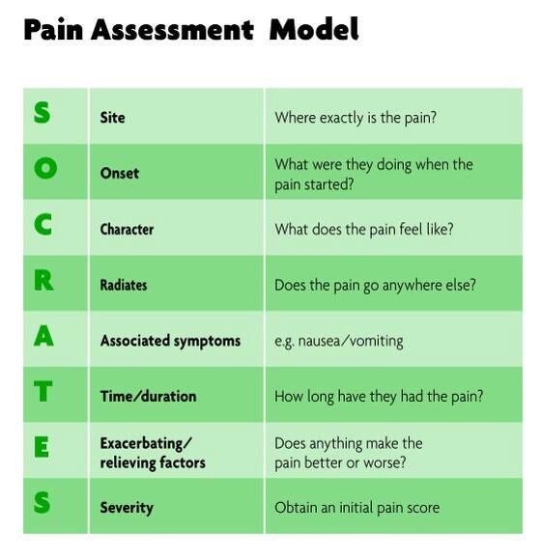
Competency 1 – Assess the patient
Notes:
40 year old male
PC – acute onset abdominal pain, moderate at rest, severe on movement, moderate impact on function (can sleep, speak but pain interfering with physical activity)
HPC – pain over last week, sharp and stabbing, all over abdomen but worse on right lower quadrant, some nausea, change of bowel habits – type 6 stool with mucous, feels fatigued, no night sweats, no weight loss
Medications – Methadone 60 ml OD, Mirtazapine 15 mg OD, Sertraline – 100 mg OD, Paracetamol 1g QDS,
Medical Hx – Chronic abdominal pain and bowel changes under investigation
SH – lives with partner and son, works in a manual job,
Psych Hx – depression, anxiety, PTSD, opioid addiction, good insight into previous dependency issues, avoids opioids

Slide 19
Competency 2 – Evidence based options
Competency 3 – Shared decision making
Pharmacological
Non-pharmacological
Mechanism of action
Possible side effects
Risks vs Benefits
Notes:
inc. opioids, non-opioids, adjuvants, self management, psychosocial support

Slide 20
Competency 4 - Prescribe
Checked BNF
Discussion with pharmacist regarding potential interactions with other medications
Discussed with pharmacist need to use an off formulary medication
Documentation of discussions
Notes:
in notes rationale for medication choice and need for ongoing prescribing and support by GP/Pain Team

Slide 21
Competency 5 – Provide information
Verbal
Written
Visual
Safety Netting
Notes:
Discussed
Provided an information leaflet re medicine
Signposted to websites/videos regarding pain management options and education
Advised regarding what to do if medication not effective or he experiences side effects

Slide 22
Competency 6 - Monitor and Review
Plan to review next day
Requested GP to review and support ongoing prescribing
Refer for ongoing support from outpatient pain service if needed

Slide 23
Prescribing Governance
7- Prescribe Safely
8 – Prescribe Professionally
9 - Improve prescribing practice
10 - Prescribe as part of a team
Notes:
7 - within own scope
8 – patients needs
9 - Reflection
10 – Advice and guidance from senior pharmacist independent prescriber as well as pain colleagues

Slide 24
RPS Competency Framework for Designated Prescribing Practitioners
Traditionally only doctors (DMPs) in this role- 2019 saw regulatory change
Experienced independent prescribers
Improve access to prescribing opportunities for the wider workforce
Support DMPs by distributing the supervision workload
Multidisciplinary learning remains key

Slide 25
Designated Prescribing Practitioner
Multi-professional framework = multiple titles for the role
  NMC = Practice Assessor and Practice Supervisor
  GPhC = Designated Prescribing Practitioner
  HCPC = Practice Educator
  Medics = Designated Medical Practitioner

Slide 26
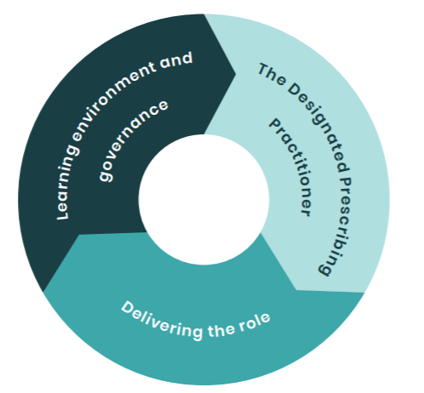
RPS Competency Framework for DPPs

Slide 27
RPS Competency Framework for DPPs
The DPP
Personal Characteristics
Teaching and Training Skills
Delivering the Role
Delivering the Role
Prioritising Patient Care
Governance
Learning Environment
Governance
Professional Skills and Knowledge
Developing the Role

Slide 28
Local Implementation
Process/structure should be the same for all DPPs regardless of profession
NMP Policy
NMP application
Training session (University/Trust)
Peer Support
Reflection

Slide 29
NMP application form
For completion by the Designated Prescribing Practitioner (DPP) The DPP is responsible for establishing a learning contract with the student, overseeing their learning in practice and verifying their competence at the end of the NMP course. I can confirm that I am competent in areas 1-3 (personal characteristics, professional skills and knowledge, teaching and training skills) of the RPS Competency Framework for DPPs. I have been qualified as a prescriber for at least three years. I have employer support to undertake the role of DPP. I will attend an update on NMP training with the University/NMP Lead (if not able to attend handouts will be provided). Name: Signature: Email address: Date:
For completion by the Designated Prescribing Practitioner (DPS) The DPS is responsible for acting as a role model, working alongside the student, providing support and giving feedback to the DPP on the progress of the student. I have been qualified as a prescriber for at least one year. I have employer support to undertake the role of DPS. I will attend an update on NMP training with the University/NMP Lead (if not able to attend handouts will be provided). Name: Signature: Email address: Date:

Slide 30
Trust Training
Online training session
Overview of scope and legal remit of different prescribing professions
Trust governance procedures
Relevant policies and procedures
Escalating concerns
Support for DPPs (learning sets, reflection)

Slide 31
Questions?

