Slide 1
Staffing for safe and effective care
Wendy Preston
RCN Head of Nursing Practice
Honorary Respiratory Consultant Nurse
Advanced Nurse Practitioner - OOH
@wendypresto

Slide 2
Why is safe staffing so important?
SAFE STAFFING
Patient safety
Lower mortality
Lower HAI
Fewer falls
Lower failure to rescue rate
Fewer medicine errors
Better patient experience
Nurse safety
Lower stress levels
Lower illness and absence rates
Better morale
Improved retention rates
Lower burnout rates
Notes:
Right numbers = safe patients, safe nurses
serious staffing shortages, the links between fair pay, staffing and patient safety

Slide 3
Notes:
This slide provides a timeline to the UK staffing for safe and effective care campaign to date.
Publications:
SSEC: The real picture: https://www.rcn.org.uk/professional-development/publications/pub-006195
published May 2017
SSEC: against the odds: https://www.rcn.org.uk/professional-development/publications/pub-006415
A summary of a member survey
Sept 2017
SSEC in the UK: https://www.rcn.org.uk/professional-development/publications/staffing-for-safe-and-effective-care-pub-008067
January 2020

Slide 4
Scale Over 20,000 responses, including 6,000 qualitative responses. Published, May 2022.
Location Across the UK
Sector NHS and independent
Settings Responses from those working in care homes, non-hospital urgent and emergency care, prison/police custody, hospitals, the community and more
www.rcn.org.uk/employment-and-pay/safe-staffing
Notes:
6,000 qual responses – when people told us much more

Slide 5
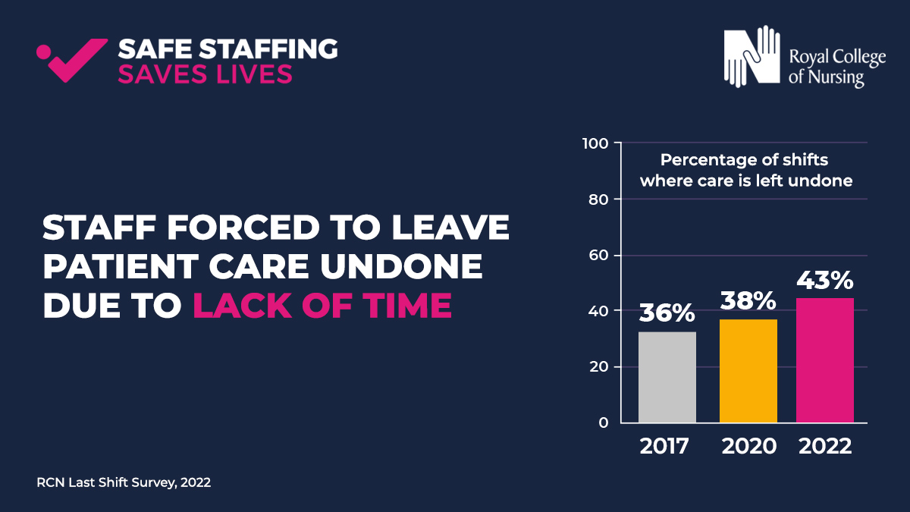
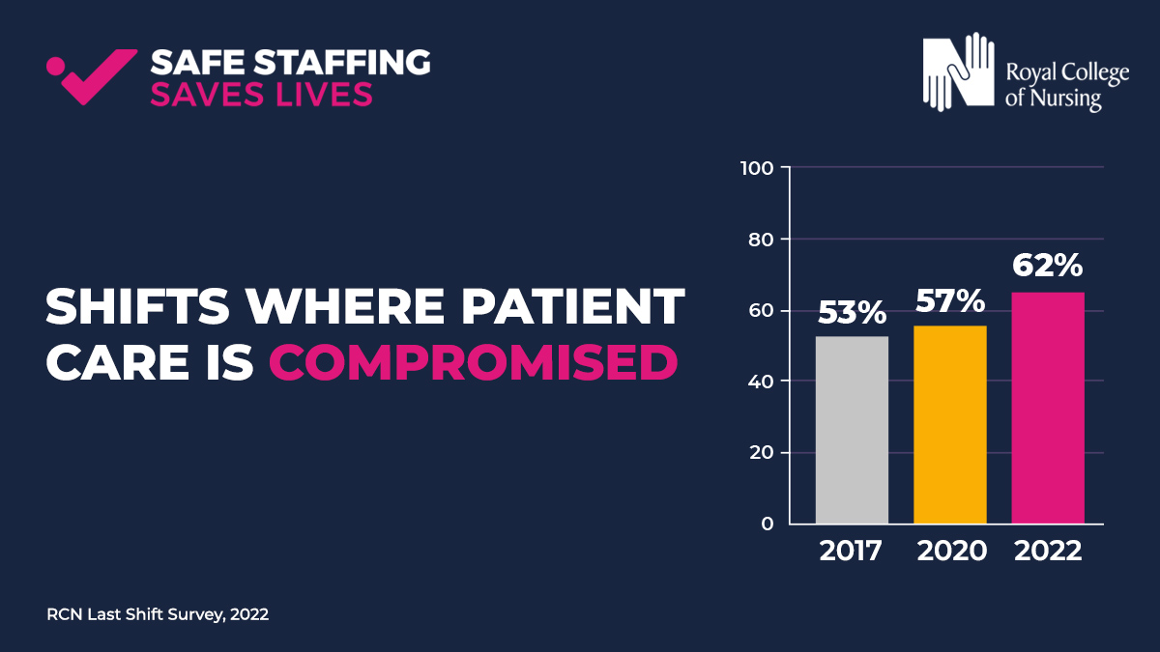
Last Shift survey report 2022
Notes:
Last Shift survey report - In March 2022, we invited nursing and midwifery staff from across the UK to tell us about their experiences of the last time they were at work. The survey provides valuable insight into the realities of staffing levels across the UK, and the impact on our members and the people they are caring for.
The questions address a number of issues, including adherence to the RCN Nursing Workforce Standards, planned and actual staffing levels and how these staffing levels affected patient care and the wellbeing of nursing staff.
TOP LEFT image - 83% of shifts lacked enough nursing staff to meet patient need, up from 73% in 2020.
TOP RIGHT image - Unreasonable pressures -nursing staff forced to leave patient care undone and this situation is worsening. NB Jane Ball's work
BOTTOM LEFT: 62% of 2022 respondents said patient care was compromised on their last shift – an increase from 2020, and 2017
BOTTOM RIGHT: Members said almost 70% of shifts lack the right skill mix needed to deliver safe and effective patient care (ref Standards 7, 10)

Slide 7
Legislation
England
Scotland
The RCN continues to demand that the Secretary of State for Health and Care is legally accountable for the provision of health and care workforce, as well as there needing to be legal UK Government accountability for assessing workforce requirements of the health and care system to respond to changing needs of the population and for planning and supply to meet those requirements.
The Health and Care (Staffing) Act received Royal Assent in June 2019 and a 2019 RCN report outlined in detail how the Act addressed the five RCN’s principles for staffing for safe and effective care. Work towards implementation of the Act was postponed due to the COVID-19 pandemic, however, the reasons for the prior passage of the Act have been made even clearer during the pandemic. The RCN has continued to emphasise the need for the implementation and the vital role of the legislation will play in addressing the ongoing workforce challenges. Plans now to progress.
Wales
Northern Ireland
In 2021 the RCN secured the Welsh Government’s commitment to extend section 25B of the Nurse Staffing Levels (Wales) Act 2016 to children’s inpatient wards. The College is now campaigning to challenge the Welsh Government to extend safe staffing legislation into community, mental health and care homes.
Following strike action by RCN members in Northern Ireland, a new safe staffing framework was agreed with the endorsement of the full Northern Ireland Executive and pay parity with England and Wales was restored. However, the RCN remains concerned at the pace of progress of the development of safe nurse staffing legislation in Northern Ireland, particularly as the country has been without a sitting government for three years.
Notes:
https://www.rcn.org.uk/professional-development/publications/rcn-raising-and-escalating-concerns-uk-pub-009425
On the standards webpage there are also links to:
Raising concerns letter re staffing for nurses
Raising concerns letter for nursing support workers
https://www.rcn.org.uk/covid-19/covid-19-raising-concerns-letter
https://www.rcn.org.uk/covid-19/covid-19-raising-concerns-letter-for-nursing-support-workers

Slide 8
https://www.rcn.org.uk/employment-and-pay/safe-staffing
Stanrds
Nursing Workforce Standards
Legislation
Escalation guidance
Pay
Staffing for Safe and Effective Care

Slide 9
About the Standards
The Standards apply across all areas of nursing and all sectors within the United Kingdom.
The Standards were co-created with expert consensus by the nursing professional body and the largest trade union for nurses.
The Standards are designed to support a safe and effective nursing workforce alongside each nation’s legislation. The 14 Standards are grouped into 3 key themes:
Responsibility and Accountability – 4 standards
Clinical Leadership and Safety - 6 standards
Health, Safety and Wellbeing - 4 standards

Slide 10
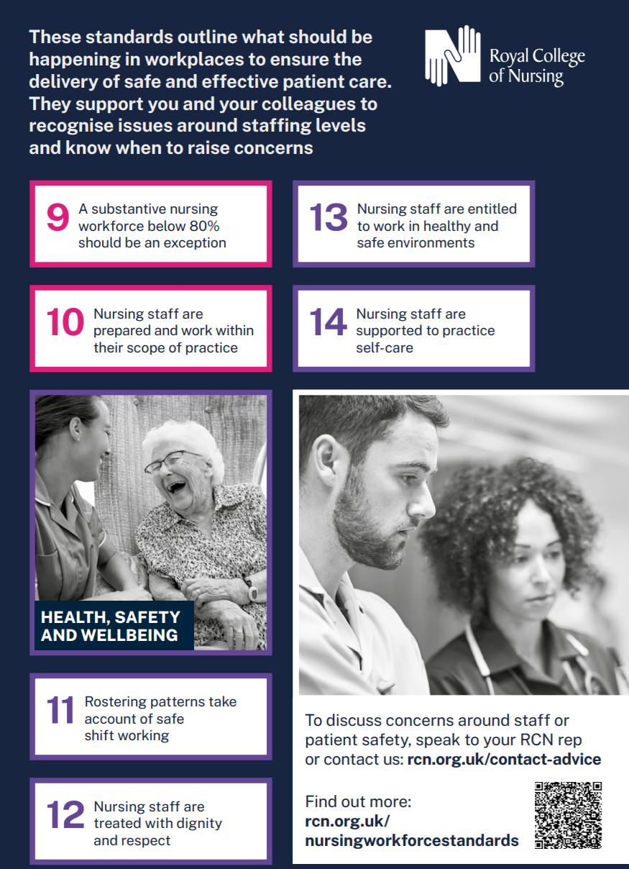

Slide 11
Executive Level Nurses
Standard
1
Examples
Responsibility and Accountability
1a – There should be an executive level nurse.
1b – If not (e.g. small organisation/ company) this should be a documented exception that is documented, reported and reviewed. This can then be supported or challenged by commissioners and regulators.
1c – Whole board are accountable.
1d - The nursing workforce establishment should be determined by the demand for services and the
need to provide safe and effective care.
1e. Setting the nursing workforce establishment should explicitly inform the organisation’s financial planning and be funded by revenue allocation rather than fitting a prescribed financial envelope.
1f - In setting the nursing establishment workforce planning and decision making should be underpinned by professional nursing knowledge and experience. The responsibility for setting nursing establishments remains with the executive nurse.
1g - Nurse leaders are integral to contracting and commissioning care in order to distinguish between nursing specific workload and that of the wider multi-professional workforce.
1h - Decisions on nurse staffing must be recorded. Discussions must detail the workforce requirements of the organisation/service in order to provide staffing for safe and effective care.
1i -Each organisation should have a board-approved risk management and escalation process in place to enable real-time nurse staffing risk escalation and mitigation with clear and transparent procedure to address severe and recurrent risks.

Slide 12
Executive Level Nurses
Standard
2
Examples
Responsibility and Accountability
2a – The nursing workforce will be a standing item for discussion at the board or accountable body for decision making in any organisation providing nursing services.
2b – Workforce data should be reviewed at least monthly and ‘red flags’ such as high rates of sickness or turnover investigated with transparency.
2c – A framework should be in place that enables regular review and decisions about service provision and workforce resourcing.
2d - A continuous quality improvement approach to staffing should be taken. A triangulated approach is required and will include:
professional judgement
patient-dependency/acuity
workload tools
clinical quality indicators
nationally agreed standards
peer reviewed published evidence
benchmark data from matched comparators who can evidence the delivery of high-quality person centred services and/or data linkage to care quality indicators.
2e - Once any review is completed, an action plan should be created to address any issues identified.
2f - Where there are nurses rostered within a multi-professional workforce rota, they cannot be counted twice.
2g. Staff who support the workforce,
such as clerical, housekeeping
and catering staff, should not be
considered within nursing workforce
numbers when determining the
nursing establishment to meet clinical
need.
2h. All nursing students must be
supernumerary when in training.

Slide 13
UK: Practising nurses per 1 000 population, 2000 and 2019 (OECD 2021)
Setting establishments: demand led – informing financial planning
Patricia Marquis, RCN director for England, has called on the House of Lords to ask MPs to reconsider the amendment.
“The government has rejected the opportunity to make an essential first step towards tackling the NHS workforce crisis. England’s nursing staff will be bitterly disappointed tonight and this moment will live long in the memory.
‘Ministers have defeated an amendment supported by all major health and organisations asking them to publish an assessment of how many nursing staff and others are needed to provide safe patient care.
‘The public and patients are demanding action from government to tackle nursing shortages, for now and in the longer term – they contribute to treatment delays and some patients even pay the highest price.’
UK ranking 22nd, below OECD avg.
Notes:
Setting up establishments based on demand not available budget
Mirrors our call for workforce assessment at national level
Prof. Buchan showed us where UK sits in terms of nurses per head of population

Slide 14
Registered Nurse Leadership
Standard
5
Standard
6
Examples
Registered Nurse Lead
Time & Resources to Lead
5a - Each team & service (e.g. Ward/ Community team/ Nursing Home) should have a registered nurse lead.
5b –If it is a wider MDT team and not managed by a RN then there must be a clear line to nursing leadership.
6a – Should be 100% supervisory (i.e. not planned to be in the numbers) – if not needs to be a documented exception and reported to board.
6b – list of what this resource and time is for.
6c – Role within leadership team needs to be included in job descriptions.
Notes:
DoN example

Slide 15
Executive Level Nurse examples:
A Director of Nursing presents the standards to the executive board particularly highlighting Standard 1c-i & 2a. With the nursing workforce now a standing item this is then used to work through the various standards highlighting where compliance exists and how to make step changes towards achieving this where there are gaps.
Examples:
Standard 6 set’s out the supervisory role of ward/team leaders, the DoN has worked with the nursing leadership team and determined currently this occurs on average 33% of the time. The amount of additional wte band 5/6 is calculated to initially get this to 50% within 1 year, 75% by year 2 and 100% by year 3. A business case can then be developed.
Standard 8 sets out what should be included to calculate uplift. 8a,b and c are used to evidence base a review and proposed new uplift % for the trust.
Standard 9 is used to instigate reporting every time substantive nursing workforce falls below 80%. The DoN can use the regular board agenda item to raise this which is a regular occurrence as agency/ bank use often above 20%. This is used to prompt a discussion regarding what can be done to both elevate and mitigate the problem as well as ensure risk recognised and recorded.
The internal quality assurance framework can also be reviewed and adjusted to incorporate the standards as part of the assessment process and to evidence base change. This is useful to prepare for regulator visits ect.

Slide 16
Independent sector example:
An Independent sector Chief Nurse is not currently executive level and reports to the Medical Director. Whilst on the senior management team they do not have a seat on the board.
The standards are used to highlight the need to an executive level nurse and if not 1b states that this should be a documented exception. This is used to start the conversation, challenge the corporate board and also 1c sets out that the whole board is accountable for nursing workforce.
Standard 2a also states that nursing establishment should be a standing item on each board meeting. All of these factors together make a strong case for the Chief Nurse to become an executive level post.

Slide 17
Care Home setting
The Nursing Workforce Standards are applicable to this setting and will be a very useful tool to drive change.
There are 14 standards and all have descriptors e.g. 1a,b,c
Standard
1
Standard
5
Examples
Accountability and executive level nurse
Registered Nurse Lead
1a – There should be an executive level nurse.
1b – If not (e.g. small organisation/ company) this should be a documented exception that is documented, reported and reviewed. This can then be supported or challenged by commissioners and regulators.
1c – Whole board are accountable.
5a - Each team & service (e.g. Nursing Home/ Care Home with nursing) should have a registered nurse lead (standard 6 sets out dedicated time & resources for this).
5b –If it is a wider MDT team and not managed by a RN then there must be a clear line to nursing leadership.

Slide 18
Care Home setting
Standard
10
Examples
Nursing staff are prepared and work within their scope of practice
10a - This includes access to CPD, education, support and development to ensure the nursing workforce has the knowledge, skills and competencies required to deliver evidence based, safe, person-centred care that is of high-quality.
As a minimum this needs to include:
safeguarding
mental capacity
consent record keeping
basic life support
competency frameworks specific to the area of specialty the principles of accountability and delegation
raising concerns
health and safety related training including moving and handling, infection prevention and control and fire training.
10b - The registered nurse lead will
ensure that:
individuals appointed to the nursing workforce, including those in management roles, are allocated a period of supernumerary induction / preceptorship
individuals with no previous experience should have a preceptorship period which includes structured induction and close supervision until specialty competence and confidence are achieved
for more senior/experienced staff taking on additional or different roles, a preceptorship period is still needed until competence and confidence are achieved.
10c - For staff who are lone workers, there must be clear access to advice, supervision and support at all times as well as compliance with necessary health and safety requirements.
10d - Fostering leadership capability is integral to all members of the nursing workforce throughout their career to embed a psychologically safe culture and strengthen the nursing voice.

Slide 19
Care Home examples
A care home with nursing is looking to recruit a registered manager that is not a registrant. Standard 5a can be used to argue against this as ‘each clinical team or service that provides nursing care will have a registered nurse lead’.
There is a high reliance on agency and temporary staff particularly on night shifts. Standard 9, states that when the substantive staff ratio falls below 80% this should be reported (to the corporate board, likely management board in smaller homes). 9a includes ensuring continuity of care.
One organisation suggested that they stopped having an RN overnight and substituted with a senior carer and an on-call RN available by phone. There are lots of reasons why this could be challenged, and the standards add to this: Standard 1 (accountability: board level, in this setting likely to include owners in smaller establishments) 1a – includes responsibility to those who contract or commission services. Standards 2 – all and particularly b,c very useful here.
Insufficient time for CPD, struggle to ensure statutory & mandatory training. Standard 10 sets out what is required and Standard 8 covers ensuring uplift in establishments is sufficient.

Slide 20
Nursing within a specialism
Clinical
Leadership
Education & research
Standard 2: Establishments meet demand, are reviewed and reported to board who are accountable
Standard 2b: Workforce data review at least monthly
Standard 2f: Double counting, for example, if on a multi-professional rota should not also be counted in nursing numbers for that clinical area
Standard 2h: Students are supernumerary.
Standard 9: Substantive 80%+
Standard 5a: Registered nurse lead for nursing teams
Standard 5b: Link to nursing leadership is essential (e.g. if part of wider MDT/rota)
Standard 6: Time to lead.
Admin support
Standards 6a&b: Leadership parts of job plan should be supervisory and not included in the numbers
Standard 6c: Role within leadership team needs to be included in job descriptions
Standard 7 : Practice development including CPD and clinical supervision
Standard 8: Uplift
Standard 8b: Sets out what must be considered
Standard 8c: Professional judgement considerations
Standard 10: CPD – appropriately prepared and work within scope of practice

Slide 21
Advanced Nursing Practice example:
An advanced clinical practitioner (nurse) is working on a multi-professional rota on the medical take, based mainly on the Acute Medical Unit. There are nursing staffing issues on AMU today due to sickness and vacancies and the Matron said in passing that they will need to also count you in the numbers today on AMU because if not the dashboard will be red.
Standard 2f states that this shouldn’t happen and that a nurse can’t be counted twice. This includes those that are rostered on any multi-professional rota.
Notes:
Case example: using the standards to influence change in advanced practice.
The standards can also work along side the RCN Advanced Practice Standards - https://www.rcn.org.uk/professional-development/advanced-practice-standards

Slide 22
Justice and Forensic Settings
Police custody
Prison
Court
Sexual Assault Referral Centres
Substance use services
Low, medium and high secure forensic mental health services
Community forensic mental health care

Slide 23
Justice and Forensic Settings
Standards
1 - 4
Examples
Responsibility and Accountability
Often independent providers in situ, sometimes without strong, audible nurse leadership, which impacts on the way in which the nursing voice is heard
In many areas, the medical model prevails which can impact on nursing support and development (e.g. clinical supervision)
Recruitment is a significant issue with poor understanding of the area by the wider nursing community, delays in security clearances and the provision of safe, effective workplaces for staff (e.g. converted cells as clinic rooms)
Business continuity plans need to take account of things not normally associated with healthcare including riots, civil unrest, security lockdowns and high levels of aggression
Some independent providers do not have equitable NHS T&C and there are sometimes no recognised relationships with trade unions
Notes:
Summary of standard 1

Slide 24
Justice and Forensic Settings
Standards
5 - 10
Examples
Clinical Leadership and Safety
Not always a registered nurse leader in justice settings
The nursing voice competes with the medical and security discourses. Strong nursing leadership is crucial
Chronic staff shortages lead to less time for senior nurses to focus on leading and managing the team
Models of service provision do not hold practice development in high esteem – focus on meeting immediate clinical need
Workforce planning does not take account of the physical environment – long distances across prisons and patients in small, confined spaces (cells)
Reliance on temporary staff, who become permanently temporary given constraints of access (security clearance)
Needs to be recognition that the preparation for the nursing role in these settings includes areas not traditionally related to healthcare (security, ‘jailcraft’, conditioning etc)
Notes:
Summary of standard 1

Slide 25
Justice and Forensic Settings
Standards
11 - 14
Examples
Health, Safety and Wellbeing
Rostering patterns can be entrenched in custom and practice, particularly with regards to long days and nights
Secure healthcare settings can be ‘hidden from view’ and staff can feel invisible from the nursing community. Can feel professionally unsupported when raising concerns. Particularly difficult when caring for mariginalised population about whom the public can be very negative
Physical working environment can be challenging – old buildings, small spaces, poor facilities for staff
Patient care and staff care are sometimes competing priorities. Self care needs to be role modelled by leaders
Notes:
Summary of standard 1

Slide 26
Stanrds
Nursing Workforce Standards
Legislation
Escalation guidance
Pay
Staffing for Safe and Effective Care

Slide 27
They are part of a suite of resources to drive standards towards ‘staffing for safe and effective care’.
They complement our guidance published in November 2020: Raising and Escalating Concerns
View the publication

Slide 28
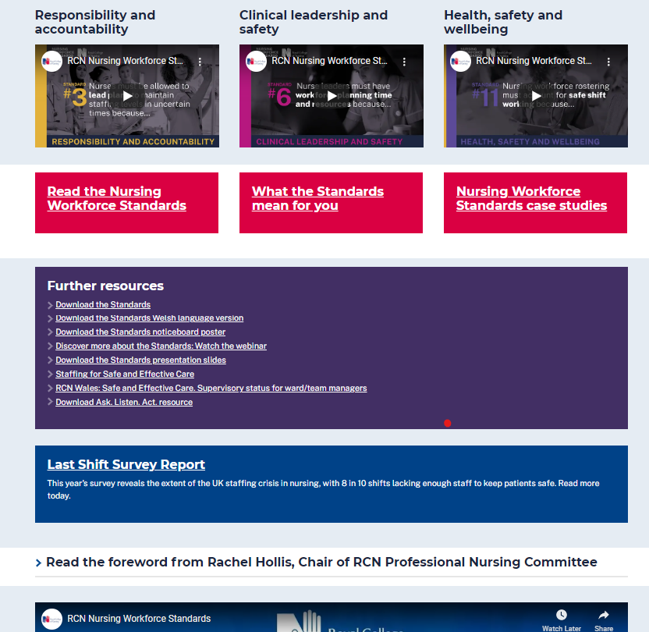
Resources:
Online resource : www.rcn.org.uk/nursingworkforcestandards
Notes:
Nursing Workforce Standards | Professional Development | Royal College of Nursing (rcn.org.uk)
FAQs Nursing Workforce Standards FAQs | Professional Development | Royal College of Nursing (rcn.org.uk)

Slide 29
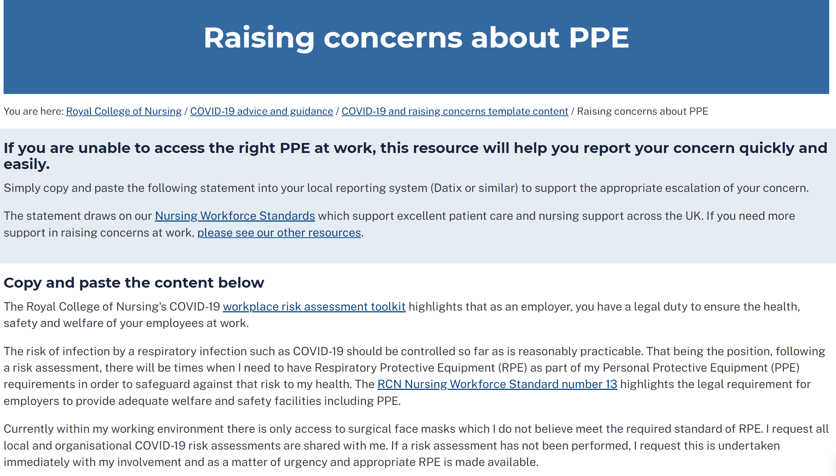

Slide 30
Support for the Standards
Andrea Sutcliffe, Chief Executive and Registrar of the NMC: ‘’This is useful guidance from the RCN that nurses and their employers can use to assist them navigate the operational challenges they face to deliver the safe, kind and effective care our communities need.”
Saffron Cordery, Deputy chief executive of NHS Providers: “We agree with the RCN that enough staff need to be recruited and retained not only to address existing workforce gaps, but to help build vital flexibility into the system to protect staff wellbeing and development. NHS bodies must recognise the specific workforce needs that have emerged or been reemphasised this past year, to ensure that the correct lessons are learnt.’’
Rebecca Smith, Managing Director of NHS Employers: “Employers will welcome these workforce standards for nursing. Nurses are at the heart of our NHS teams, and these standards will help to ensure that is recognised, so that nursing staff can continue to provide safe and effective care to patients and communities, while also ensuring they are properly cared for and supported themselves.”
QNI – workforce standards for district nursing

Slide 31
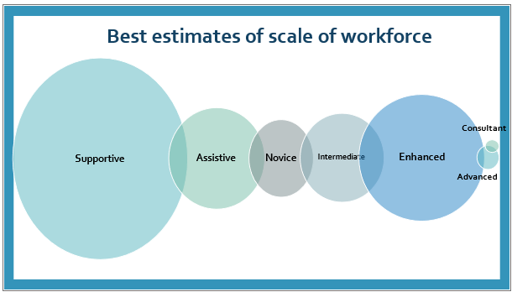
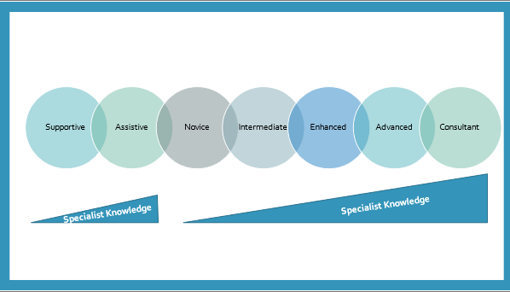
Professional Framework
Clinical Director
Clinical Lead
Consultant
Advanced Practice
https://www.rcn.org.uk/professional-development/your-career
Enhanced Practice
Registered

Slide 32
Any questions?

