Slide 1


The Impact of Covid-19 on Adult Safeguarding in Older Adults
Safeguarding Older Adults from Abuse and Neglect
Virtual Conference Friday 18th November 2022
Dr Sarah Donnelly,
Assistant Professor of Social Work, School of Social Policy, Social Work and Social Justice, University College Dublin
Twitter: @sarahmdonnelly1

Slide 2

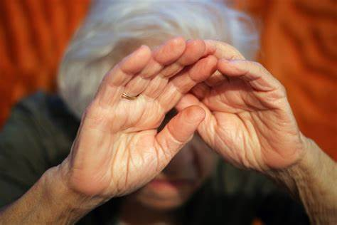
Today’s talk will cover
Elder Abuse within context of Covid19
Covid19 Institutional Abuse and Neglect?
Impact of Covid 19 on Older People
Care Homes as a Case Study of Abuse
Structural issues: Causes of abuse & neglect
Good practice principles outlined in the 2022 National Guidance ‘Revisiting Safeguarding Practice’
Developing and sharing best practice solutions that have developed in response to Covid-19

Slide 3
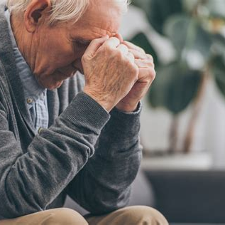
Defining Elder Abuse
Elder abuse is a distinct social problem. It can be defined as ‘a single, repeated act or lack of appropriate action, occurring within any relationship where there is an expectation of trust which caused harm or distress to an older person’ (WHO, 2002).
Elder abuse is increasing, and that it often goes unreported, with official numbers most likely underestimating the extent of the problem (Iborra et al, 2013).
Notes:
For example, there is debate around the assumption that the presence of harm presupposes a relationship of trust (Mackay et al, 2011). The lack of clarity around the interface between elder abuse and intimate partner violence, and the ability to distinguish mistakes and accidents from negligence, abuse or suspected crimes are also problematic (CPEA, 2020).

Slide 4

Abuse Across the Lifecourse
(Milne, 2021)
Childhood history of abuse has determining influence on abuse in later life (McDonald and Thomas,2013).
Gender is a risk factor for elder abuse, with women more likely to experience elder abuse.
Older women more likely than men to experience intimate partner violence, to be a victim of sexual assault, and have reduced access to healthcare(Crockett et al, 2018).
Racial and ethnic-based differences have been identified (Hernandez-Tejada, et al, 2020).
Poverty is main contributor of elder abuse in developing countries (Podnieks et al, 2010).
Notes:
The life course perspective is a multidisciplinary approach to understanding the mental and physical health of individuals
For older people it is a particularly helpful lens as it takes account of what has happened across that person’s life and considers how what has happened has affected their health, wellbeing & social context (Milne, 2020)
Abuse may be exacerbated as individuals from ethnic minority communities have been reluctant to complain about poor care, conveying a limited sense of entitlement to services and fair treatment (Moon, 2000; Bowes et al, 2011).

Slide 5
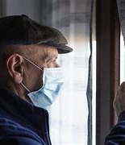
Elder Abuse in context of Covid 19
Elder Abuse is when: "trusted other" (… your country, the people in charge of the place where you live, your healthcare system) neglect your needs, or fail too act, in ways that cause you harm or distress…’ (Aronson,2020).

Slide 6
Covid19 -Institutional Abuse and Neglect?
Systemic abuse (also called institutional abuse) refers to rules, regulations, policies, or social practices that harm or discriminate against older adults. Systemic abuse includes rules that are developed for an apparently neutral purpose, but that hurt the person.
Neglect and acts of omission
Neglect and acts of omission may include:
ignoring medical, emotional or physical care needs
failure to provide access to appropriate health, care and support or educational services
the withholding of the necessities of life, such as medication, adequate nutrition and heating

Slide 7
The Lancet Commission on lessons for the future from the COVID-19 pandemic
( Sachs et al.2022)
Public policies did not properly address the profoundly unequal effects of the pandemic.
Heavily burdened groups include essential workers, who are already disproportionately concentrated in more vulnerable minority and low-income communities; children; women, who face employment, safety, and income losses, exacerbated by the adverse consequences of school closures; people living in congregate settings, such as prisons or care homes, especially for older populations; people living with chronic conditions and disability; Indigenous Peoples; migrants, refugees, and displaced populations; people without access to quality and affordable health care; and people who face the burdens of long COVID.

Slide 8
Emerging Risks in Covid-19 and Safeguarding in UK
(Constant, 2020)
Several concerns immediately present themselves:
the scamming of older people who live alone, by those purporting to be good neighbours;
higher incidents of domestic abuse, as families live cheek-by-jowl for unknown weeks ahead;
and the reduction of support and monitoring as an inevitable by-product of the lockdown.

Slide 9
Covid19 and Older People
Overview
COVID-19 has either exacerbated already existing or created new inequalities in relation to older people.
The pandemic has shone a spotlight on older adults, including our family members and friends and possibly ourselves, face an increased risk at this time (Centers for Disease Control and Prevention, 2020).
A number of significant strains over the past decade have impacted on care provision; cuts to social care budgets imposed by austerity measures, increasing numbers of older people with complex and unmet needs, and long-term under-investment in staff pay, training, and retention (Kusmaul,2020).
Institutional and structural ageism undermine both the nature and delivery of rights for older people and reframes mandatory rights as optional, specifically in times of crisis (Anand et al., 2013).

Slide 10

Covid19- A Shameful Time for Change?
More than 95% of the people dying from the virus in Europe were 65 years and older (Human Rights Watch, 2020).
Globally, older people are the most at risk of getting the virus and dying from the it. Although age is a significant contributor, it is its interaction with other factors, chronic conditions, poverty, and race that makes it a strong determinant (Cox,2020).
Many of the inequities we are seeing through this pandemic have long been present in our communities, institutions, and society.
They are often complex problems resulting from systemic bias and discrimination, including ageism and racism and their intersectionality, that are present at the micro, mezzo, and macro levels.
The lack of recognition, definition and implementation of human rights for older people is - paradoxically - aided and abetted by ageism (Duffy, 2016).
Notes:
These factors reflect disparities and systemic social injustices that interact to increase the vulnerability of older adults.
Each of these factors, as they intersect with health care, housing, employment, and education intersect to make specific groups of older adults at increased risk. Together, they underscore the relationship of inequality and vulnerability to the right to life itself.

Slide 11
Impact of COVID-19 on Community Dwelling Older People
Impact on Mental Health: social isolation, negative emotions, depression, anxiety and suicidal ideation (Brennan et al.2020;ALONE/TILDA,2020)
Impact on Physical Health: chronic illnesses such as COPD and diabetes having greater impact on quality of life during cocooning than previously. Increase in older people putting off medical treatment or examination, including after falls.(ALONE/TILDA,2020)
Impact of Cessation of Services and Supports.
Impact on Carers: cancellation or postponement of medical appointments, a marked decline in dementia symptoms coupled with an increase in responsive behaviours, the loss of routine for the person for whom they care and boredom and anxiety. Crisis and burnout (ASI,2020)
Impact of Digital Exclusion: lower levels of digital literacy, living in areas with poor connectivity, or simply not having access to the technology required to connect (Pentaris et al.2020)
Increased domestic abuse/violence/safeguarding issues (SCIE,2020)
Notes:
Impact of social distancing and cocconing include

Slide 12
COVID-19 Adult Safeguarding Insight Project - Second Report
( Biswas Sasidharan, Cooper and Harman, 2021)
Unprecedented and extraordinary impact on safeguarding.
Rates of safeguarding concerns during 2020 were overall higher than 2019.
Sharp decline in the rate of safeguarding concerns as lockdowns started, followed by steep increases immediately as lockdowns ended.
Safeguarding enquiries increased in a person’s home during the lockdown period and overall, there was a decrease in safeguarding enquiries in both nursing and residential home settings during the pandemic period. Councils commented on reduced access by professionals, families, and friends to care homes.
Increased levels of complexity in safeguarding activity. Challenges that social distancing brought to the safeguarding enquiry process, including being unable to undertake essential face-to-face visits.
Practicalities in progressing safeguarding enquiries became more difficult. which made Making Safeguarding Personal more challenging. The COVID-19 pandemic and lockdowns created complexity and barriers in how people could report as well as experience abuse and neglect.

Slide 13
Identified Barriers and Enablers
( Biswas Sasidharan, Cooper and Harman, 2021)
Councils innovated and adapted their communication methods, developed their approached the Section 42 enquiry process; improved how they worked with other agencies; increasing the frequency of meetings using technology; created new partnerships; increased professional curiosity; worked flexibly; and proactively to create bespoke solutions to issues that emerged.
Very specific barriers arose from the COVID-19 pandemic including reduced face-to-face contact, significantly increased workloads.
Use of video conferencing did not suit all people, particularly some older people. Some people preferred to use of their phones rather than their computer video participation. Issue of digital literacy and access to IT.

Slide 14
Covd19 and Older People in Care Homes/Nursing Homes
WHO estimates that older people in care homes represent 50% of all Covid-19 related deaths in Europe and describes the situation as ‘an unimaginable tragedy’.
While advanced age, and its associated health-related comorbidities, is linked to a higher mortality risk from COVID-19 this, of itself, does not explain the high rate of death, and serious harms, experienced by older care home residents across Europe.
Pandemic has served to expose great inequality in human rights protection of older people; inequality of access to protection from neglect, access to treatment to sustain life, and exposure to preventable death and harm (BASW,2020)
Prioritisation of acute care over health and social care (response, testing, PPE equipment, staffing)
Notes:
Most damaging consequences of the pandemic have fallen disproportionately on older people who live in care homes- excess deaths and excess mortality

Slide 15
Older People's Deaths in Care Homes between March-August 2020,
5 European Countries
(Comas-Herrera et al, 2020/And et al.2021)
Country | Number of deaths in care homes: March-August 20 (total no of older people in care homes in brackets) | Number of care home deaths as a percentage of the overall number of deaths
Finland | 147 (50,298) | 45%
Ireland | 1,500 (16,007) | 63%
Spain | 20,649 (333,920) | 68%
Sweden | 2,714 (82,217) | 47%
UK (& NI) | 35,500 (477,100) | 41%
Notes:
The next two slides identify two sets of data: deaths during T1 & T2 of the pandemic in CH’s in 5 of the 7 European countries reviewed for the EJSW paper - these were for info the UK, Finland, Sweden, Spain, Ireland, Italy & Estonia - and a number of egs of ways in which human rights (other than death) were violated.
The EJSW paper, and the updated data, are presented around violations of a number of Articles of the European Convention of HRs (1950).
Many of the ‘excess deaths’ experienced during the pandemic (both ‘phases or times’) were preventable: they violate Article 2 – right to life. Failure to protect life takes a number of forms - the prioritising of acute health services to the detriment of all other types of service was one such systemic issue in (at least) the UK, Ireland & Sweden: untested patients were discharged into CH’s in T1 in a number of countries where it spread like wildfire. For e.g. in Ireland hundreds of older patients were discharged into CH’s in an effort ‘to purge older people from acute beds’. In Sweden older residents were not given access to life saving treatment but were instead offered a ‘palliative cocktail’ of drugs described by one geriatrician as a process of ‘active euthanasia’. DNR orders were issued by some GPs in the UK for whole care homes without consulting with residents or their families.

Slide 16

Second wave…
Mixed evidence re deaths:
Some data suggests that deaths were lower in the second wave:
  In the UK fewer ‘excess deaths’ due to better PPE/testing, vaccines/acquired immunity & far fewer staff working across multiple sites
  Care home deaths represented only 26% of the 62,250 deaths registered between 31st Oct 20- 5th Feb 21 (compared with 41%)
  Finland: rate was 33% of all Covid deaths (22nd Jan 21) (45% in first wave)
Other data suggests that they were higher:
  In the UK whilst official figures show that the rate of increase of deaths among care home residents was much sharper in Time 1 the total number of deaths was greater from Sept to April 21 (21677)
Features of care homes with higher number of deaths (UK):
  For profit, larger homes, higher occupancy rates, lower levels of skilled well-trained staff, more limited access to clinicians (nurses, GPs), poorly rated care by inspection agency (CQC), higher numbers of residents are publicly funded
Notes:
T2 - fewer excess deaths = better PPE/testing, vaccines/acquired immunity & far fewer staff working across multiple sites… In the UK for eg care home deaths represented only 26% of the 62,250 deaths registered between 31st Oct 20 and 5th Feb 21. M: E&W – 20664 from March to Sept 20 & 21677 from Sept to April 21.
Data suggests too that CH deaths are highly correlated with no of excess deaths in the wider community outside the CH…
In the UK official figures suggest that between 20th March 20 & 30th April 21 there were 42341 deaths of CH residents involving Covid
The Science and Technology Committee stated that the ‘CH death toll in the UK was amongst the worst in Europe and could have been mitigated’

Slide 17
Impact on Older People in Care Homes
Care home residents viewed and treated through a lens of frailty, clinical status, or physical vulnerability (Mc Garry et al.2020).
Denial of face-to-face contact with family members
Older residents who died alone without the comfort and support of their family and friends and whose wishes regarding their preferred death were not accommodated- disenfranchised grief.
GPs not being able to visit care homes and care homes being discouraged ,or sometimes unable, to send residents to hospital for treatment for non -virus related health conditions (O’Dowd, 2020).
The failure to recognise and respond to the broader practical, emotional and social needs of residents during Covid19, their sense of well-being and sense of connection to their loved ones and local communities (Mc Garry et al.,2020).
To date there has been no demonstration of public mourning for the loss of so many older people nor condolences to families across countries- diminishing of dignity of life

Slide 18
Connect to Protect
RRR of the impact of visitor exclusion found that residents experienced higher levels of depression, anxiety, isolation and loneliness (Comas- Herrara et al., 2020; Valayudhan et al., 2020).
Intersecting impact of self-isolation, staff shortages, curtailed visits from family and friends, the constant presence of death and fear about becoming ill has been seriously damaging to mental health (Milne, 2020).
Visitor bans severely negatively impacted the mood and behaviour of residents+ significant increase in psychotropic medication use. Feelings of guilt, fear, worry and isolation in residents’ families (Low et al.2020; Levere et al.2021).
Many residents with dementia are becoming withdrawn and depressed; don’t understand why loved ones are no longer visiting, feel abandoned and losing cognitive and motor skills, including fundamental skills such as the ability to speak, eat or drink.
Some families have described their relative with dementia as ‘disappearing’ (Alzheimer UK,2020)
For residents with dementia, the absence of a loved one’s regular visit to a care home or nursing home may mean a life not worth living (Cahill,2021 in press)
Irish practitioners have highlighted the loss of residents’ sense of ‘connection’ to their families, communities; this connectivity is an especially important dimension of Irish culture (Brennan et al., 2020)

Slide 19
Other Violations of Human Rights (Anand et al.2021)
(Anand et al.2021)
Large number of residents died alone in inhuman or degrading conditions (Article 3):
Over a third of deaths of care home residents in the UK were a result of ‘being left alone without adequate food, water or pain relief’ - loneliness & neglect also played a role (Comas-Herrera et al., 2020; Mahese, 2022)
End of life care wishes disregarded (Ireland): ‘no visitors’ order meant many residents died alone:
‘… we just had no staff so when someone was dying we just had to pop in & pop out, it was inhuman’ (Manager, UK, July 21)
Very limited/no access to hospital care, primary care or emergency treatment
Many residents were confined to their room - partly for safety reasons - creating very high levels of loneliness, confusion, anxiety & distress: esp. challenging for people with dementia (most countries)
Dangerously low staffing levels mean that residents are being neglected (left in wet bedding, no baths, put to bed early so staff can attend to other residents): staff report care as ‘depressingly rushed’ & ‘wholly inadequate’ (UK)
Article 5: Right to liberty & security
Neglectful responses to protection e.g. residents subject to Deprivation of Liberty Safeguards placed directly in the path of Covid-19 (UK): a legal decision that is not in the residents ‘best interests’
Residents locked in quarantine or isolation rooms (Finland): a form of imprisonment
Residents moved to another home - with isolation facilities - without their, or their family’s, consent (Spain)
Article 8: Right to respect for private & family life
No, or very limited, access to visitors (most countries)
No visits from ‘oversight agencies’ or social workers (Anand et al, 2021)
Notes:
ADD: implications/consequences …
Mostly these are violations from wave 1 but some are updated/added from wave 2
Sorry but mostly UK data/evidence too as that’s all I’ve had time to gather

Slide 20
Knock-on Impacts
Covid-19- frailty associated with earlier death, longer time in hospital, and increasing frailty all associated with increasing rates of mortality.
Communication issues -few health systems recognised the need for transparent masks and hearing or vision aids to support effective communication, prevent delirium, and enable participation in care planning (O’Hanlon et al.,2021).
Restrictions in visiting - disproportionate effect on older patients with underlying cognitive impairment. May have contributed to observed increased prescription of chemical sedation (O’Hanlon et al.2021).
Provision of family and paid caregiving, whether funded by the state or privately, was affected during the pandemic and led to difficulty providing for care needs (Reckry, 2020).

Slide 21
Contributory Factors to Crisis: | Consequences for Residents:
Lack of Clinical governance and oversight. Access to PPE, infection control & specialist expertise/support. Staffing levels/ reliance on agency staff. Environmental challenges in managing isolation requirements. History of previous non compliance. | Viewed through lens of cocooning. Emotional & social needs unseen. Denial of physical family contact. Died without family/palliative support. Withdrawal of activities. Limited access to usual medical practitioner & acute care Safeguarding concerns during cocooning. Investment in protection, rather than connection. No public mourning.

Slide 22
Covid also highlighted structural issues of abuse and neglect….
Covid shone an uncomfortable light on the care home sector: vulnerability of residents was made visible as was the ‘off the radar’ status of residents & staff and amplified the role played by a number of structural issues including:
Care homes are institutions: in how many ‘homes’ are you locked in your room or need to have permission from an ‘external agent’ to receive a visitor
Residents have very limited freedoms, agency or choice: have to stay in the care home, moved to a new home without consent; v limited control over when to eat, bathe, go to bed; ‘mortification of the self’, ‘control is exercised through an assemblage of different actors’ & actions & inactions
Systemic poor practices (?abuses) are embedded in care home culture: routines that diminish agency, engagement with decisions, choice; limited attention paid to residents wishes/complaints; limited engagement with families
Private companies (84% care homes) are not bearers of legal duties under Human Rights Act: only residents who are publicly funded are covered by the Act
Notes:
Own home offers us scaffolding that structures and supports our sense of self and identity (esp impt if you have dementia) – relationships with our material world, about practices of ‘making home’ cannot easily be transferred to an institution. We shape our dwellings and afterwards our dwellings shape us
Decision free spaces are v v unhealthy – promote death: ‘mortification of the self’ (Goffman), ‘depersonalisation’ (Townsend), ‘instututionalisation’. Decisions are micro-opportunities for self-expression, reproduce the self & identity… all lost in institutions

Slide 23
Structural issues: Causes of abuse & neglect
Whilst abuse is routinely constructed as occurring in an interpersonal relationship, human rights are commonly thought of as a relationship between the state & the individual (Biggs & Haapala, 2013)
But… they are connected!
The state, neoliberal policies & the care home infrastructure intersect to create conditions where abuse & neglect are more likely to occur.
Francis inquiry (2013) identified institutional mores & practices as ‘systemic causes of abuse, neglect & preventable deaths’ in Mid Staffs hospital (lack of senior staff, limited qualified nurses, no supervision or training etc)
Long standing under-resourcing of the care home sector: fragmented, uneven quality, atomised, ‘off the radar’ of the state
Chronic workforce issues: mixed staff quality, poor pay & conditions, recruitment & retention challenges (100k shortage in UK)
Privatised (84% homes in the UK) & profit driven nature of the care home sector: limited governance from public agencies
Not considered in response planning in the early months of the pandemic at all
Statutory neglect: ‘neglect arising from legal and policy related systems & structural deficits’ (Jolly, 2020)
Ageism also plays a role: institutional & structural ageism undermine the status & rights of older people e.g. poor or neglectful practices are normalised, residents have very little power - ‘necessarily dependent’ on staff
Notes:
Explain about Francis…
Care homes separated from health care services in terms of provision, funding, and governance (Daly, 2020).
Lack of connectivity, invisibility of care homes in the public consciousness
Older people, especially those who are frail and who have dementia, are marginalized and dehumanized
Jolly (2020) terms ‘statutory neglect’ = neglect arising from legal and policy related systems and structural deficits

Slide 24
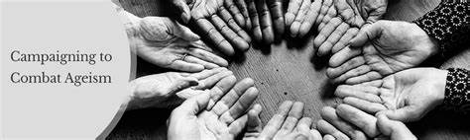
Do we need a Specific Convention for Older People?

Slide 25
Barriers to a Convention
Although at the request of OEWG a significant number of civil society groups representing older people have been recruited, the contrast with the grassroots lobby for the Disability Convention is striking .
Since its inception in 2010 OEWG has come under constant pressure, especially from members of GAROP, to bring a proposal for a convention on the rights of older people before the United Nations General Assembly.
The lobby has not succeeded. Reservations on the part of ‘the two key Western players’ – the US and the European Union.
While they have claimed that their stated objections were based on the lack of success of similar instruments their hesitation is more likely based on concern about the potential for a repetition of the considerable costs of implementing the CRPD (Harbison et al, 2016).

Slide 26
Good Practice Example-Irish Association of Social Workers (IASW) Liaison Nursing Home Model
IASW engaged in a successful macro-level advocacy campaign in relation to the human rights of nursing home residents to a private and family life under Article 8 of the European Convention on Human Rights (1950).
Social workers fought for nursing home residents’ right to communication support so that relationships with family members could be sustained in the context of blanket visiting restrictions, and so that access to end-of-life care and the right to safe family visitation once permitted by public health guidance were not jeopardized.
Advocacy work also involved the development and piloting of a model for a ‘Liaison Social Work Role in Nursing Homes’ (McGarry et al, 2020) in order to assist with the vital supports outlined above.
Through the sending of letters to key stakeholders outlining problems and providing suggestions for solutions, press releases, a social media campaign on Twitter (#ResidentsHaveRights), a webinar for members of the general public, and meetings with, among others, the Minister for Older People and the Health Service Executive who are responsible for health and social care provision (see IASW, 2021), nursing home residents’ situation was improved.

Slide 27
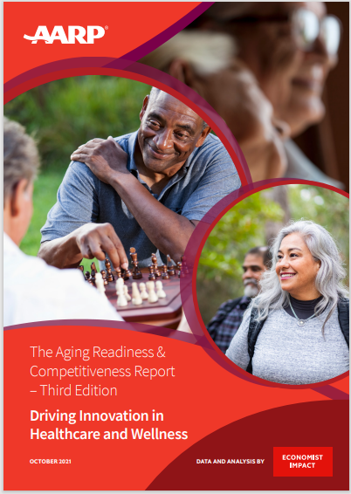
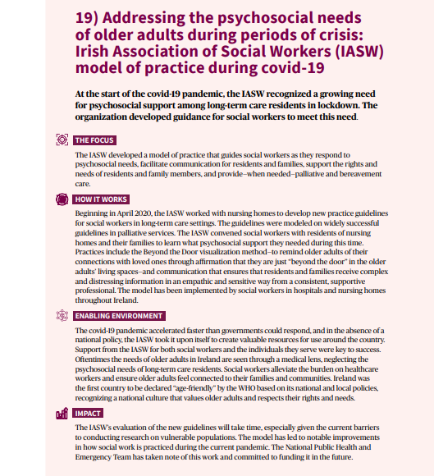
Connect to Protect

Slide 28
Human rights & care homes
Reflections
Challenge the inability of many people, including policy makers, SWs & care providers, to conceptualise that rights ‘belong’ to older people (Cahill, 2018)
ECHR is filtered through the legislative framework of each European country: human rights thus vary from country to country & are relatively weak in most of Europe
‘Collective action’ by residents is a fundamental challenge… where are the voices of residents heard & who is listening?
Political platforms pay almost no attention to care homes: eclipsed by wider issues relating to ‘social care’.
Public perceptions of care homes
rights for older people is aided and abetted by ageism (Duffy, 2016)
Notes:
One of the key barriers to engaging with HRs and CH residents is the inability of many people, including policy makers and SWs, to conceptualise what those rights look like or that they ‘belong’ to older people.
If we struggle to define them then how can be promote them or challenge agencies when they have been violated?
This is particularly the case for people living with (advanced) dementia where safety and protection always trump rights, agency & autonomy - why?

Slide 29
Human rights & care home residents: Levers
International Levers:
Human Rights Watch (2020) stated that:
‘As of Oct 20, the UK had the most Covid-19 deaths in Europe with 45,365 dying of complications from the disease, many of them in facilities for older people. Specific concerns arose around as to whether the UK government had acted swiftly enough to protect the rights to life and health of people in these facilities’
Amnesty International’s (2020) report ‘As if Expendable: The UK government’s failure to protect older people in care homes during the Covid-19 pandemic’ stated:
…’UK govt, national agencies and local level bodies (such as local authorities) have taken decisions and adopted policies that have directly violated the human rights of residents in care homes’
(Some) National Levers
Call for a public enquiry: e.g. in Northern Ireland, Scotland.
The Good Law Project: judicial review in England of links between lack of PPE & deaths of residents & staff
Some evidence of coherent responses from key national agencies including health services, organisations that represent the care home sector & older people (e.g. Care England, Age UK) & local government organisations
Professional bodies such as the British Medical Association
Notes:
Human Rights Watch, in its review of how specific countries had managed the pandemic concluded that… RATHER UK FOCUSED….

Slide 30
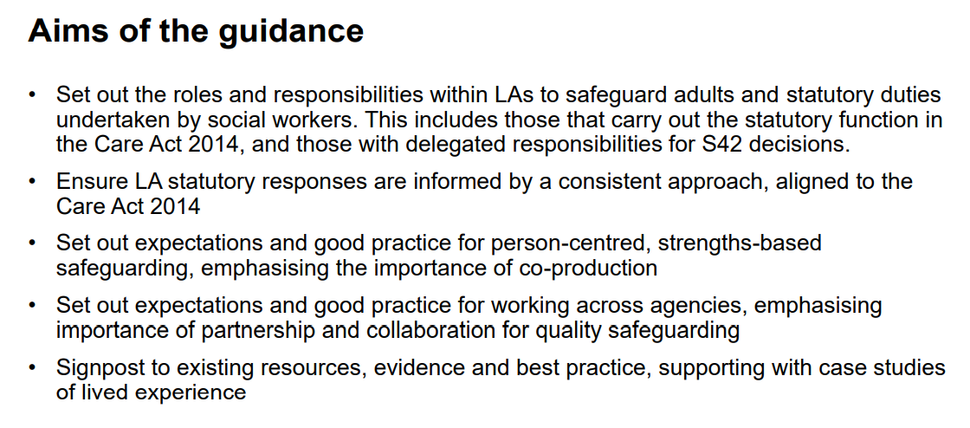
Revisiting safeguarding practice
Updated 31 March 2022
What good adult safeguarding practice looks like as a safeguarding practitioner
1.Empowerment
2. Prevention
3. Proportionality
4. Protection
5. Partnership
6.Accountability

Slide 31
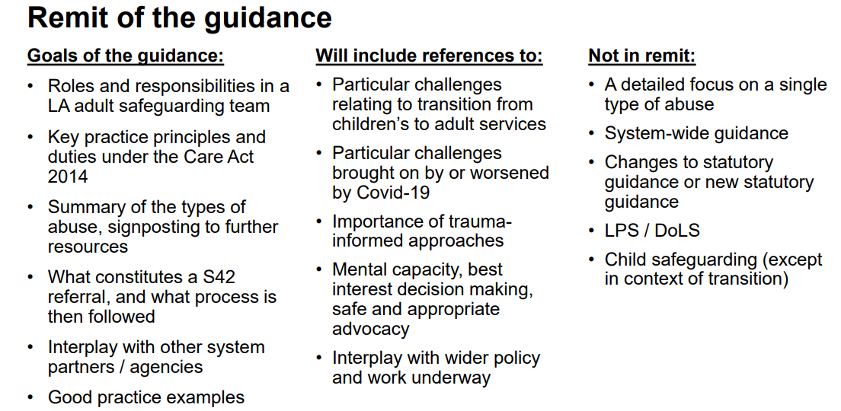

Slide 32
Developing and sharing best practice solutions that have developed in response to Covid-19
The pandemic has laid bare systemic and societal ageism across countries, as evidenced by de-prioritizing of health resources for older people in care and the initial lack of outcry about the restrictive measures put in place.
Whilst there was widespread recognition that older age and ill health are risk factors for Covid-19, care home residents were directly and indirectly discriminated against in most European countries’ planning and response to the pandemic (Xiaonan and Hong, 2020).
Attention should also be given to ways of operating with limited training and supervision as happened during the pandemic and with the need for extra and/or different supervision in accordance with the exposure to distressing experiences both at work and at home (Ben-Ezra and Hamama-Raz (2020); Manthorpe et al.2021
Ironically, the pandemic may, in the long term, be instrumental in rethinking older people’s rights, and creating new model of care across Europe.

Slide 33
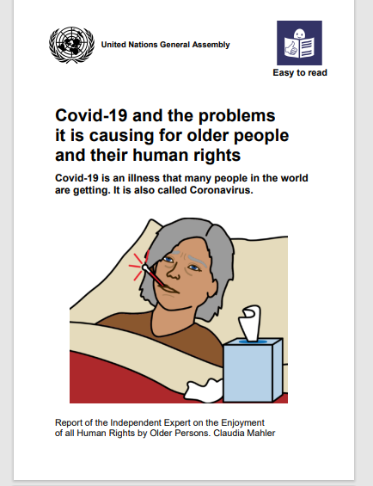
What needs to change?
Working with care homes directly:
  Advocating for the rights of care home residents
  Working with families e.g. running a relatives group
  Helping with training of care staff and managers e.g. regarding new legislation/policy
  Supporting the admissions process beyond the purely transactional
  Increased public awareness, preventative work and addressing underlying causes of abuse and neglect.
  Monitoring the quality of care,
  Being a trusted professional the care home can engage with outside of ‘a safeguarding alert’ or a crisis admission from hospital (Anand et al, 2021).
Notes:
Given care homes have been – albeit for a short while – brought into the glare of the public consciousness and it is acknowledged that Covid has dis-proportionately caused deaths and harms to CH residents then might it offer SW an opportunity to re/engage with CHs - and with HR’s too.
There are two key dimensions to this new reimagined role. In terms of working with CHs directly in the EJSW paper we suggest the following: avocating for the rights of care home residents, working with families e.g. running a relatives group, helping with training of care staff and managers e.g. regarding new legislation, supporting the admissions process beyond the purely transactional, preventing and addressing issues of abuse and neglect, monitoring the quality of care, and being a trusted professional the care home can engage with outside of ‘a safeguarding alert’ or a crisis admission from hospital.

Slide 34
Concluding Thoughts
Covid-19 has underscored the ways that age discrimination, race and poverty interact to compound the impact of lifetimes of social injustices on older adults (Cox,2019)
‘…UK government, national agencies and local level bodies have taken decisions and adopted policies during the pandemic that have directly violated the human rights of older residents in care homes’(Amnesty International,2020)
Specific United Nations conventions relating to rights for children, disabled people and women, no specific convention yet exists for older people, (Age International and Age UK, 2015).
Promote autonomy, self-determination and human rights of older people
Challenge ageist, discriminatory policies and homogenization
Issues of social isolation and increased reliance on neighborhood ties reiterate that importance of Community work. Addressing isolation and mobilizing neighborhood and local support requires building strong relationships with local services, groups and communities.
Fostering intergenerational solidarity
Collective advocacy through professional associations and third sector/NGO’s
Notes:
Encouragingly, there are some seeds of hope such as the recognition of the Irish COVID-19 Nursing Homes Expert Panel that social work services for older people in care homes are essential and the recommendation for increased governance and safeguarding protections for care home residents (Department of Health,2020)

Slide 35
References
Pentaris , P., Willis ,P., Ray ,M., Deusdad ,B.,Lonbay ,S., Niemi,M and Donnelly,S.(2020). Older People in the Context of COVID-19: A European Perspective, Journal of Gerontological Social Work.
Carter Anand,J., Donnelly,S ., Milne,A .,Nelson-Becker,H., Vingare,E.,Deusdad, B.,Cellini, G., Kinni, R.I. & Cristiana Pregno (2022) The covid-19 pandemic and care homes for older people in Europe - deaths, damage and violations of human rights, European Journal of Social Work, 25:5, 804-815, DOI: 10.1080/13691457.2021.1954886
Sachs et al.(2022)The Lancet Commission on lessons for the future from the COVID-19 pandemic. Lancet. 2022 Oct 8;400(10359):1224-1280. doi: 10.1016/S0140-6736(22)01585-9. Epub 2022 Sep 14. PMID: 36115368; PMCID: PMC9539542.
Hewitt J, Carter B, Vilches-Moraga A, Quinn TJ, Braude P, Verduri A et al (2020) The efect of frailty on survival in patients with COVID-19 (COPE): a multicentre, European, observational cohort study. Lancet Public Health 5(8):e444–e451
Cox,C (2020) Older Adults and Covid 19: Social Justice, Disparities, and Social Work Practice, Journal of Gerontological Social Work, DOI: 10.1080/01634372.2020.1808141
Ward et al.(2020). Loneliness and social isolation in the COVID-19 Pandemic among the over 70s: Data from The Irish Longitudinal Study on Ageing (TILDA) and ALONE. https://tilda.tcd.ie/publications/reports/pdf/Report_Covid19SocialIsolation.pdf
Alzheimer Society of Ireland (2020). Caring and Coping with Dementia during COVID-19. https://alzheimer.ie/wp-content/uploads/2020/07/ASI-Follow-Up-Covid-Report-Final.pdf
Brennan, J., Reilly, P., Cuskelly, K., & Donnelly, S. (2020). Social Work, Mental Health, Older People and Covid19. International Psychogeriatrics, 1-11.doi:10.1017/S104161022000
Howard R, Burns A, Schneider L (2020) Antipsychotic prescribing to people with dementia during COVID-19. Lancet Neurol 19(11):892
O’Hanlon, S., Dhesi, J., Aronson, L. et al. Covid-19: a call for mobilizing geriatric expertise. Eur Geriatr Med (2021). https://doi.org/10.1007/s41999-021-00500-9
Reckrey JM (2020) COVID-19 confrms it: paid caregivers are essential members of the healthcare team. J Am Geriatr Soc 68(8):1679–1680

Slide 36

Thank You for listening and happy to answer any questions!

