Slide 1

Leah Callighan
Matron, Bradford Teaching Hospitals NHS Foundation Trust

Slide 2
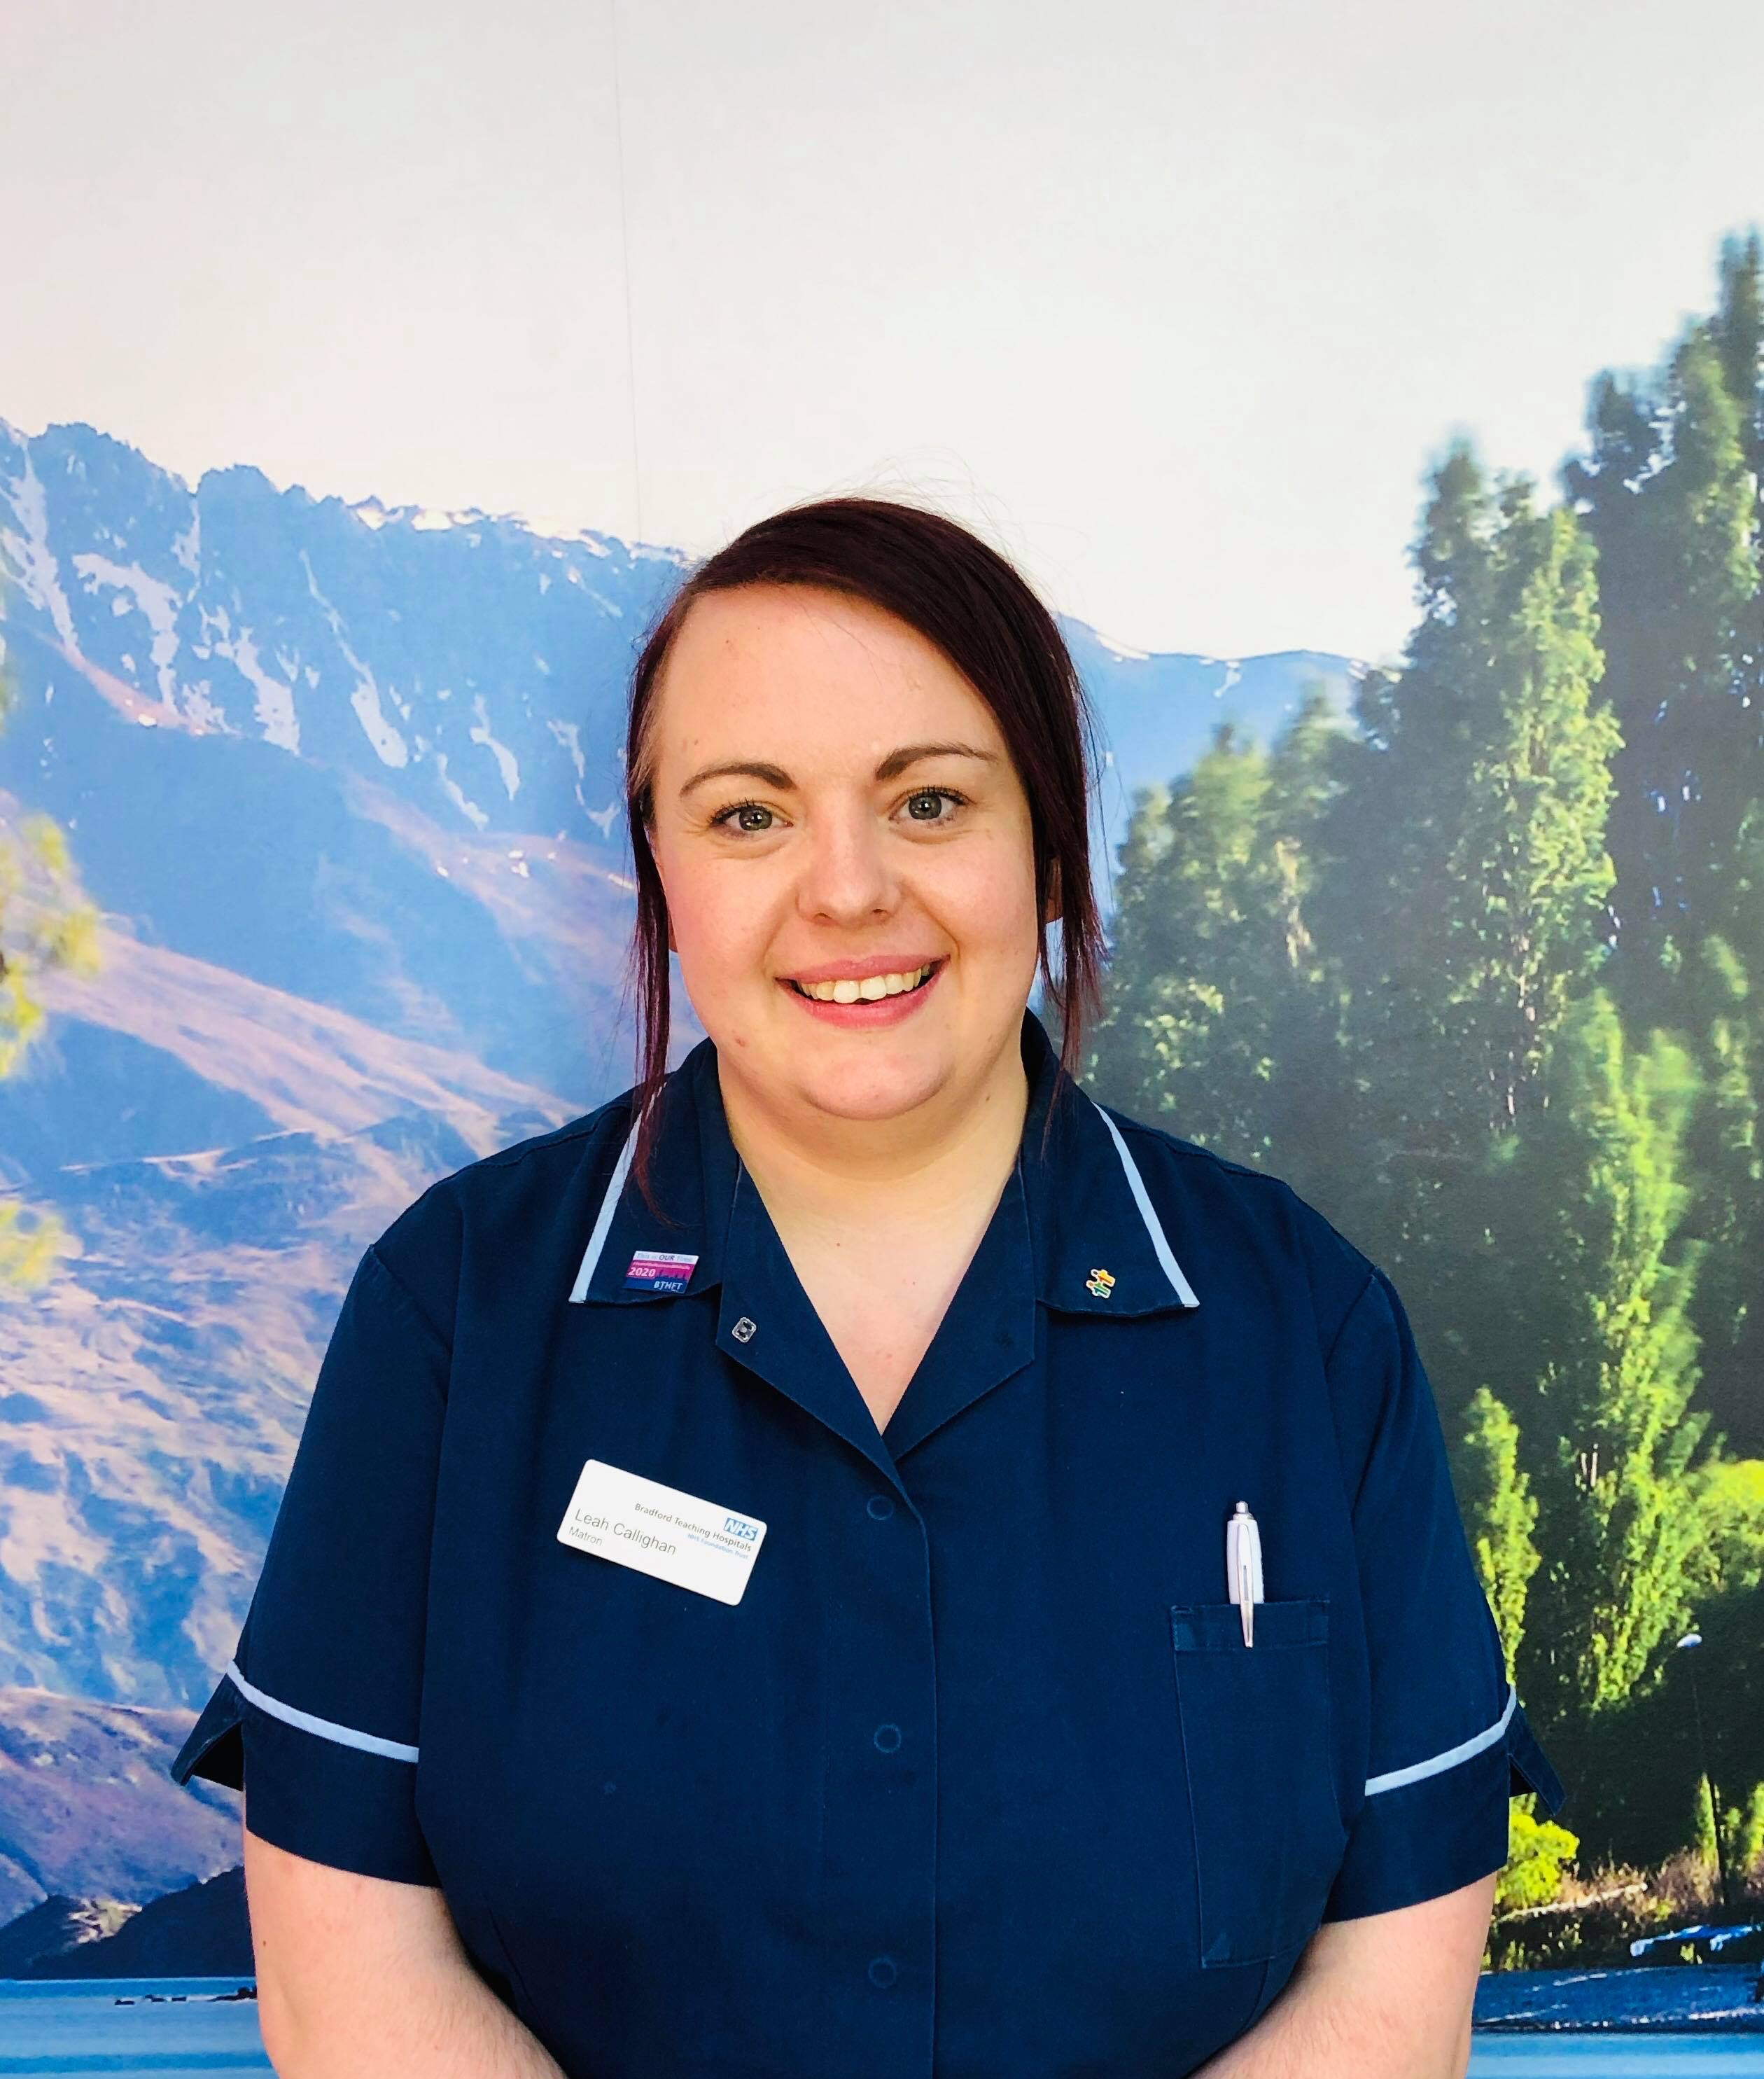
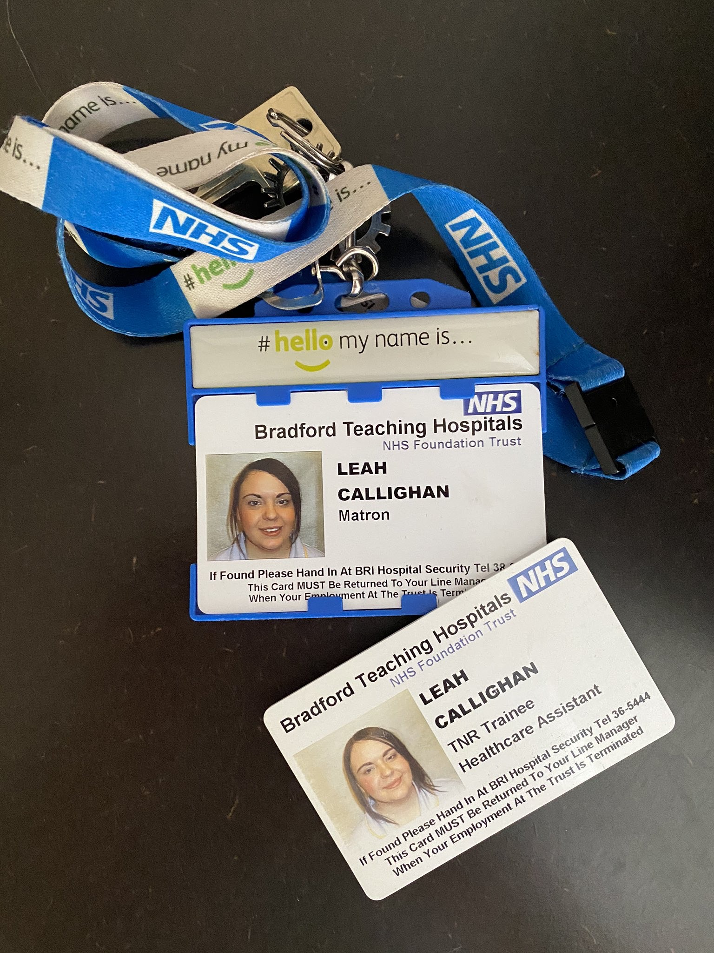
Trainee HCA to Matron in 10 years

Slide 3
My career
I joined Bradford Teaching Hospitals as a 17 year old school leaver
  Apprentice Receptionist > Trainee HCA > SN > Sister > Ward Manager > Matron
Developed a passion for leadership as loved working with patients, developing teams, coaching and allowing individuals the flourish and the opportunity to make a difference through transformation
Challenged self, worked outside comfort zone, worked in various specialities

Slide 4
Band 5 to Band 6… the leap of faith!
Hardest career move to date
New accountability and responsibility
Built up trust, integrity and respect amongst team
Realised it came down to 4 key parts:
  Patient care
  Patient safety
  Patient flow
  Patient experience
Have ability to create happier working environments
Happy staff = happy patients ☺

Slide 5
What I wish I’d have know when I first became a Junior Sister
Managing people
Self belief
It is not perosnal
Be open to feedback
Acknoweldge problems
Don’t be afraid to ask for help

Slide 6

What characteristics have I learned to be an effective Ward Manager?
Lead by example
One team, many talents
Mentor and support
Create clarity
Delegate & organise
Be human
Challenge yourself & be open to change

Slide 7
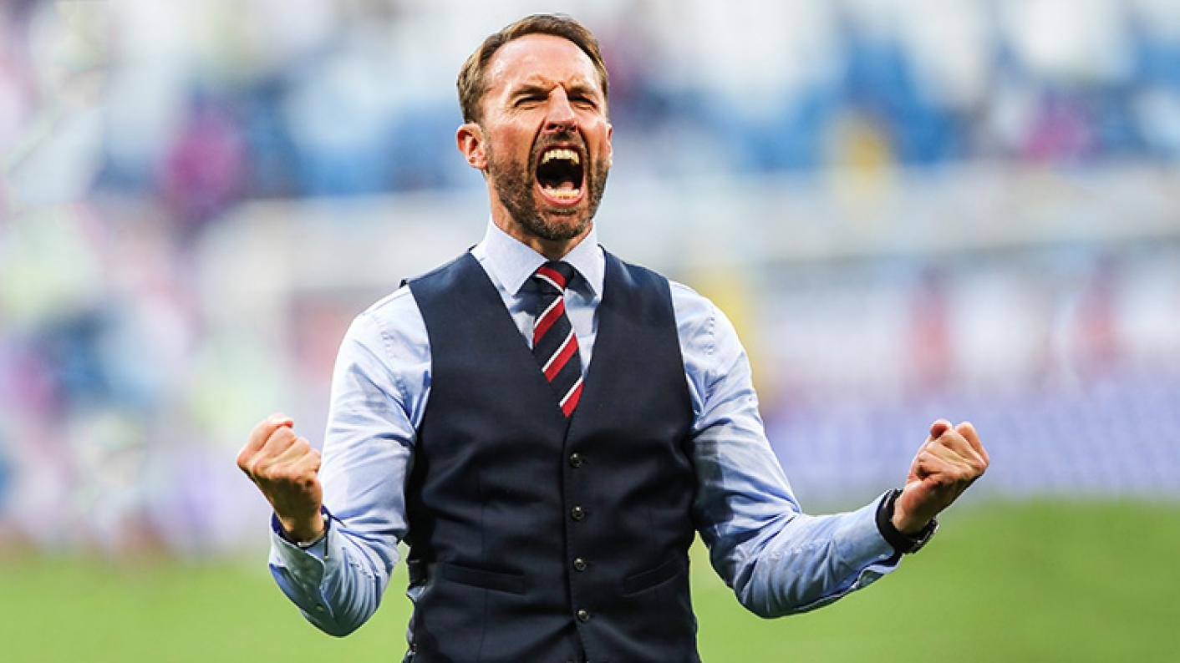
What did I learn from Gareth Southgate as a leader in the World Cup 2018?
Notes:
We need to have the confidence to challenge performance if it is effecting how the team is functioning all together. Establish why, how we can fix it and support them to get back to standards
We need to learn from previous mistakes and show empathy.
We need to be approachable to our team and not be judgemental when mistakes happen.
We need to keep positive whatever is thrown at us.
Spread joy at the workplace! Smile even when things are not going according to plan
We need to treat staff and patients as people instead of numbers and performers
I think the most important thing to have about your job is passion! If we shown how much we care we are bound to be successful leaders

Slide 8
Continued…
Challenge performance & support individuals
Learn and reflect from mistakes
Show empathy and kindness
Approachable
None judgemental
Keep smiling (even when the day is tough!)
Have passion & pride in your job – this is infectious!

Slide 9
Value & Praise – you do it enough!
Ward 18 ‘Employee of the Month’

Slide 10
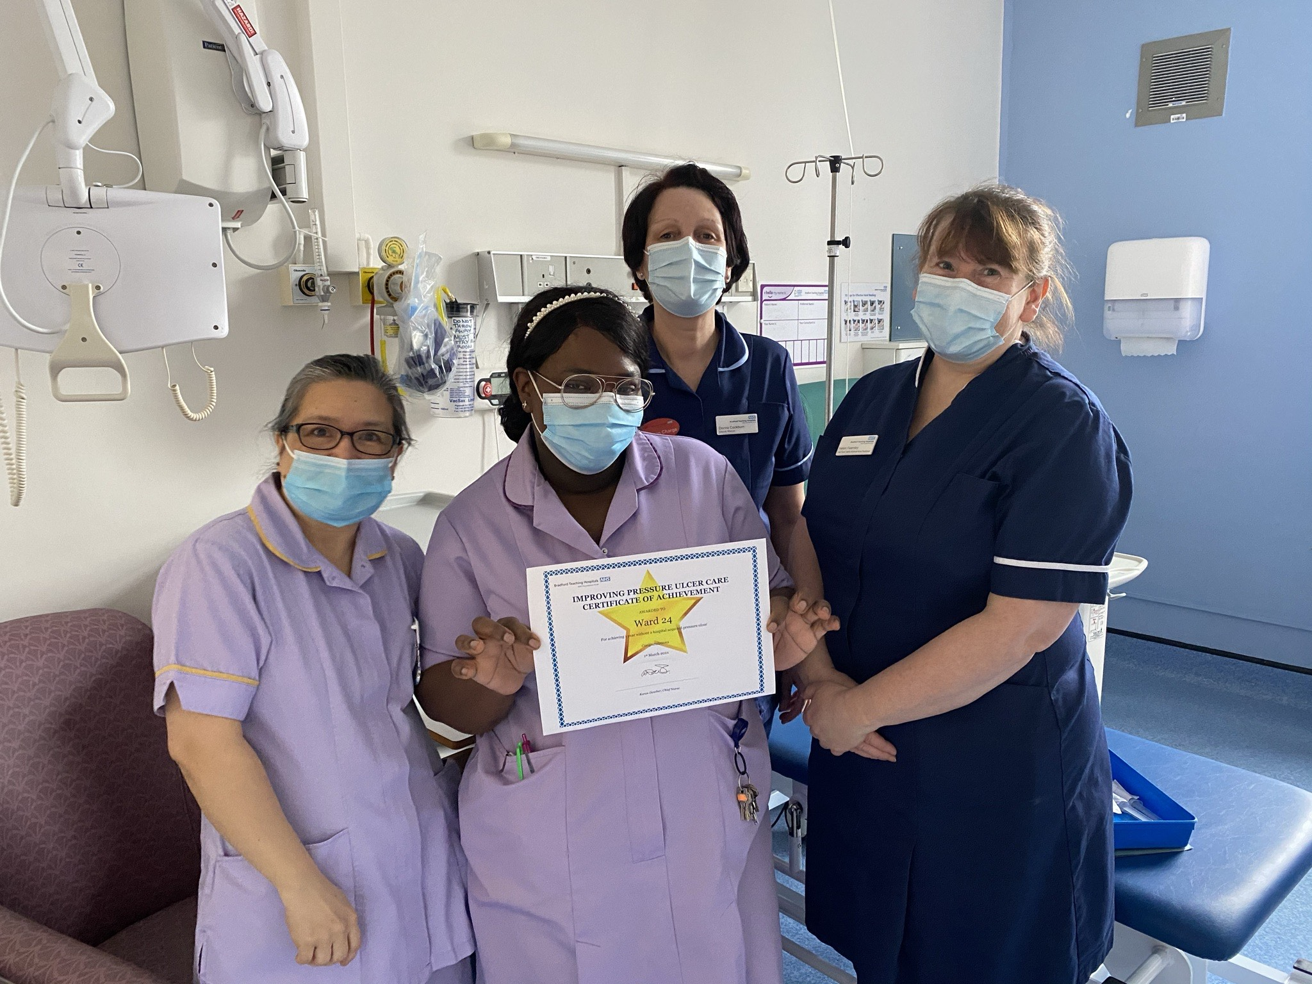
What have your teams achieved?

Slide 11
Ward Rounds have to be key
Patient Flow
Patient Experience
Patient Safety
Patient Care
Notes:
Ward rounds have to be key and when done right will improve patient flow, safety, care and experience we should all be striving to achieve.
Some changes I have made to my ward round to make them more effective include
Don’t stick to routine, ask patients to be seen in different orders – see unwell patients and those eligible for discharge first
Do simple tasks there and then such as give patients a family and friend test, remove cannulas, repeat obs
Set criteria led discharges to avoid medical reviews later on in the day as well as giving nursing staff more conifedence as they are workin automously
Chase clinicians directly if patients have not been reviewed, escalating any barriers as appropriate
Escalate concerns such as safegaurding, pressure ulcer and falls risk as MDT working will have a better outcome for the patient
Summarise each patients plan after ward round and liaise with junior medical staff the priorities. Share the information with nursing team and delegate tasks as appropriate

Slide 12
Ward Round Ideas
See sickest patients first, then those eligible for discharge
Do simple tasks there and then
Criteria Led Discharges
EDD
Chase clinicians directly if no review and escalate
Prep TTO in advance
MDT working will have a better outcome for the patient – discuss all aspects of care
Huddle after Ward Round and set the team prioritise & delegate

Slide 13
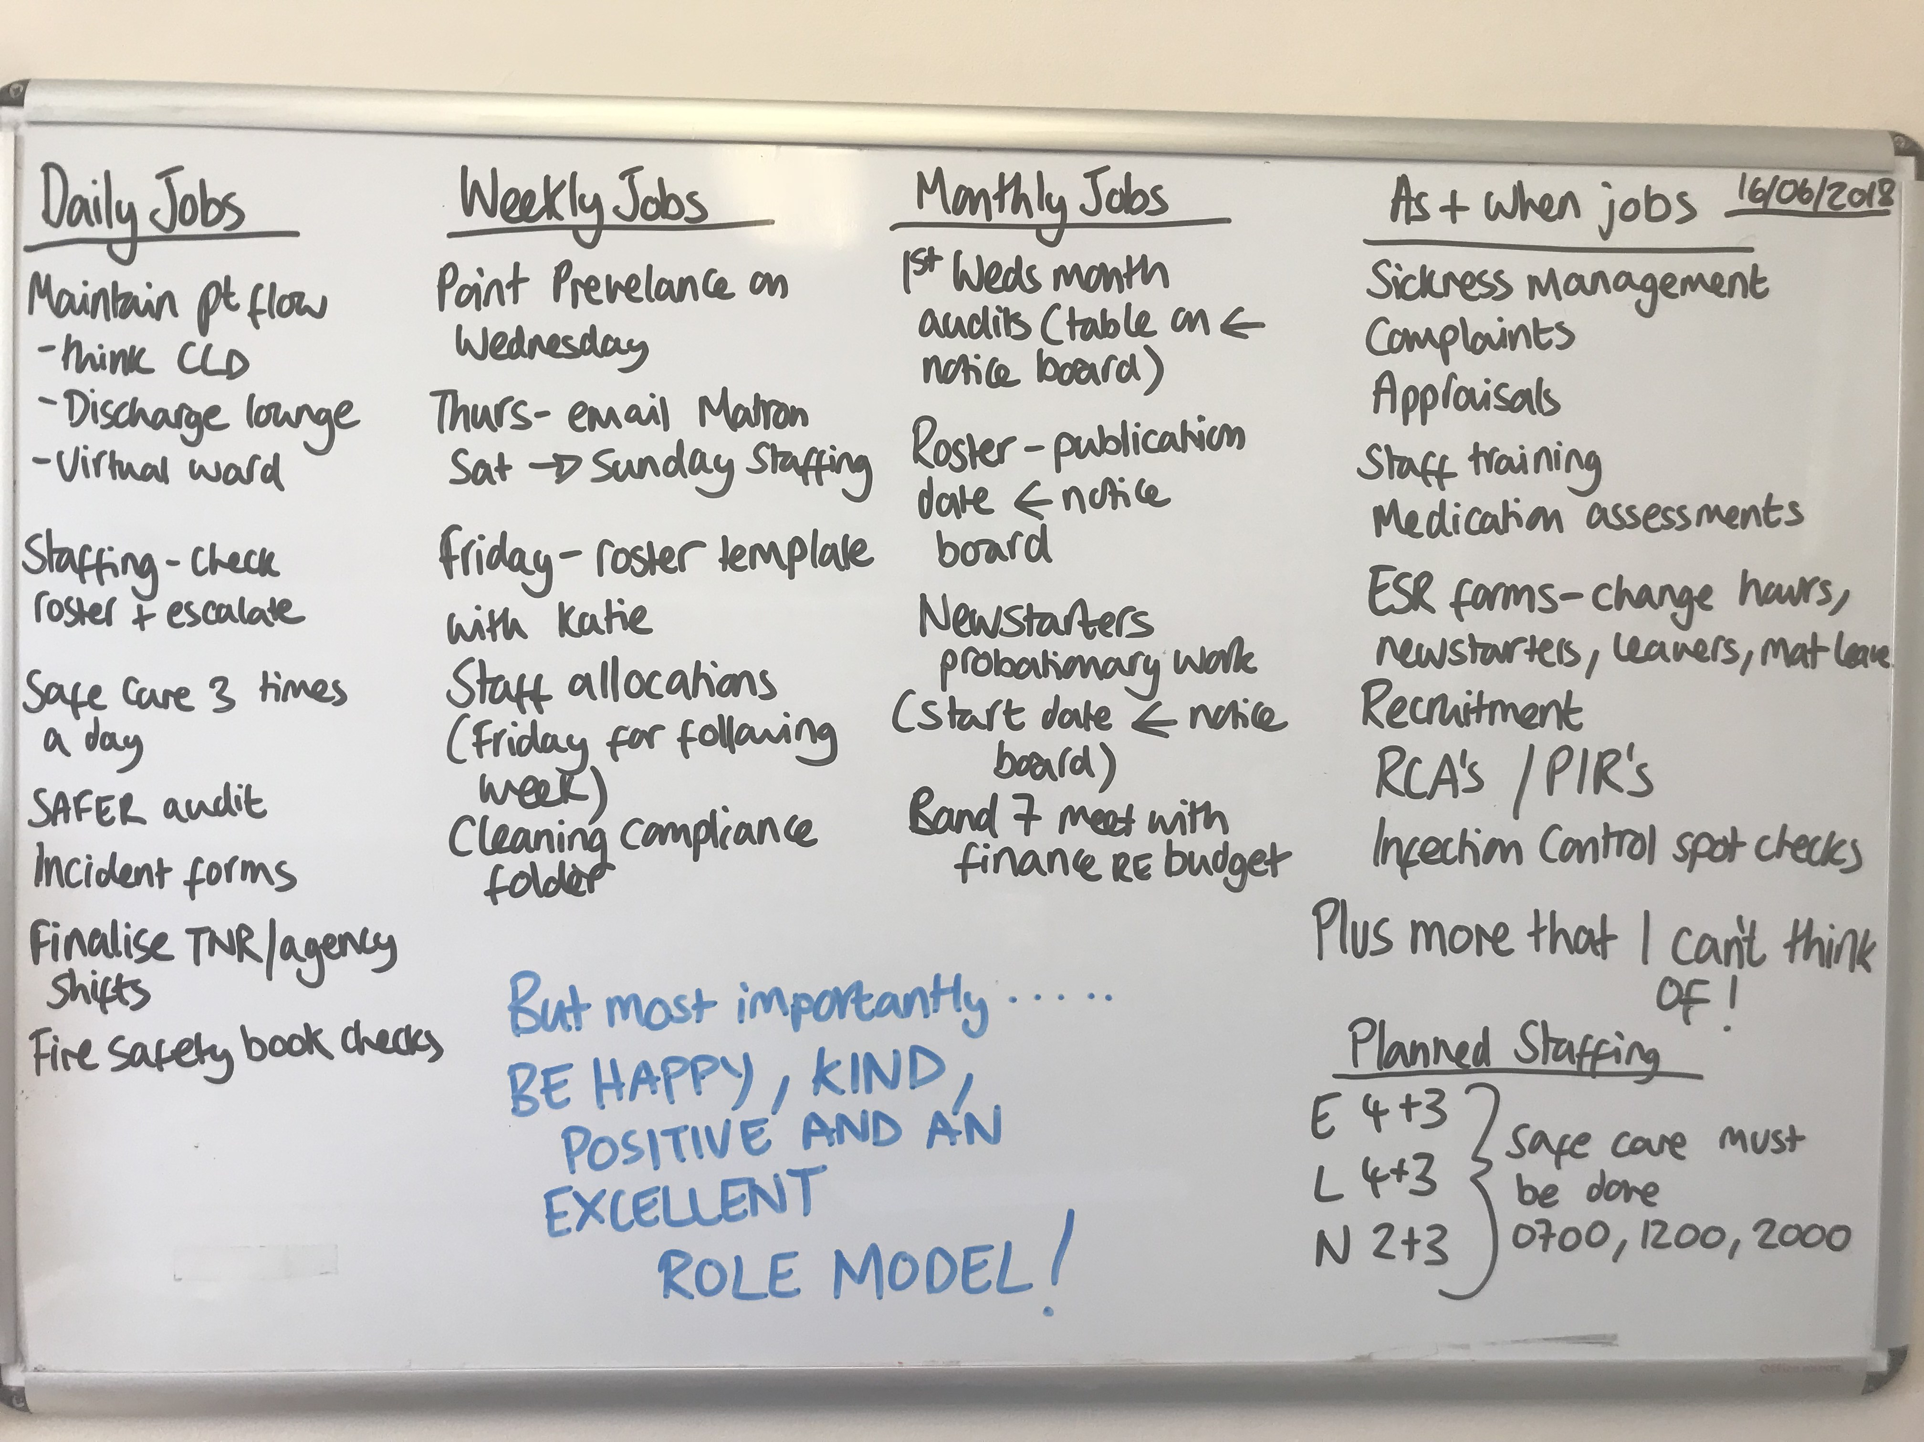
Organise and Develop your team

Slide 14
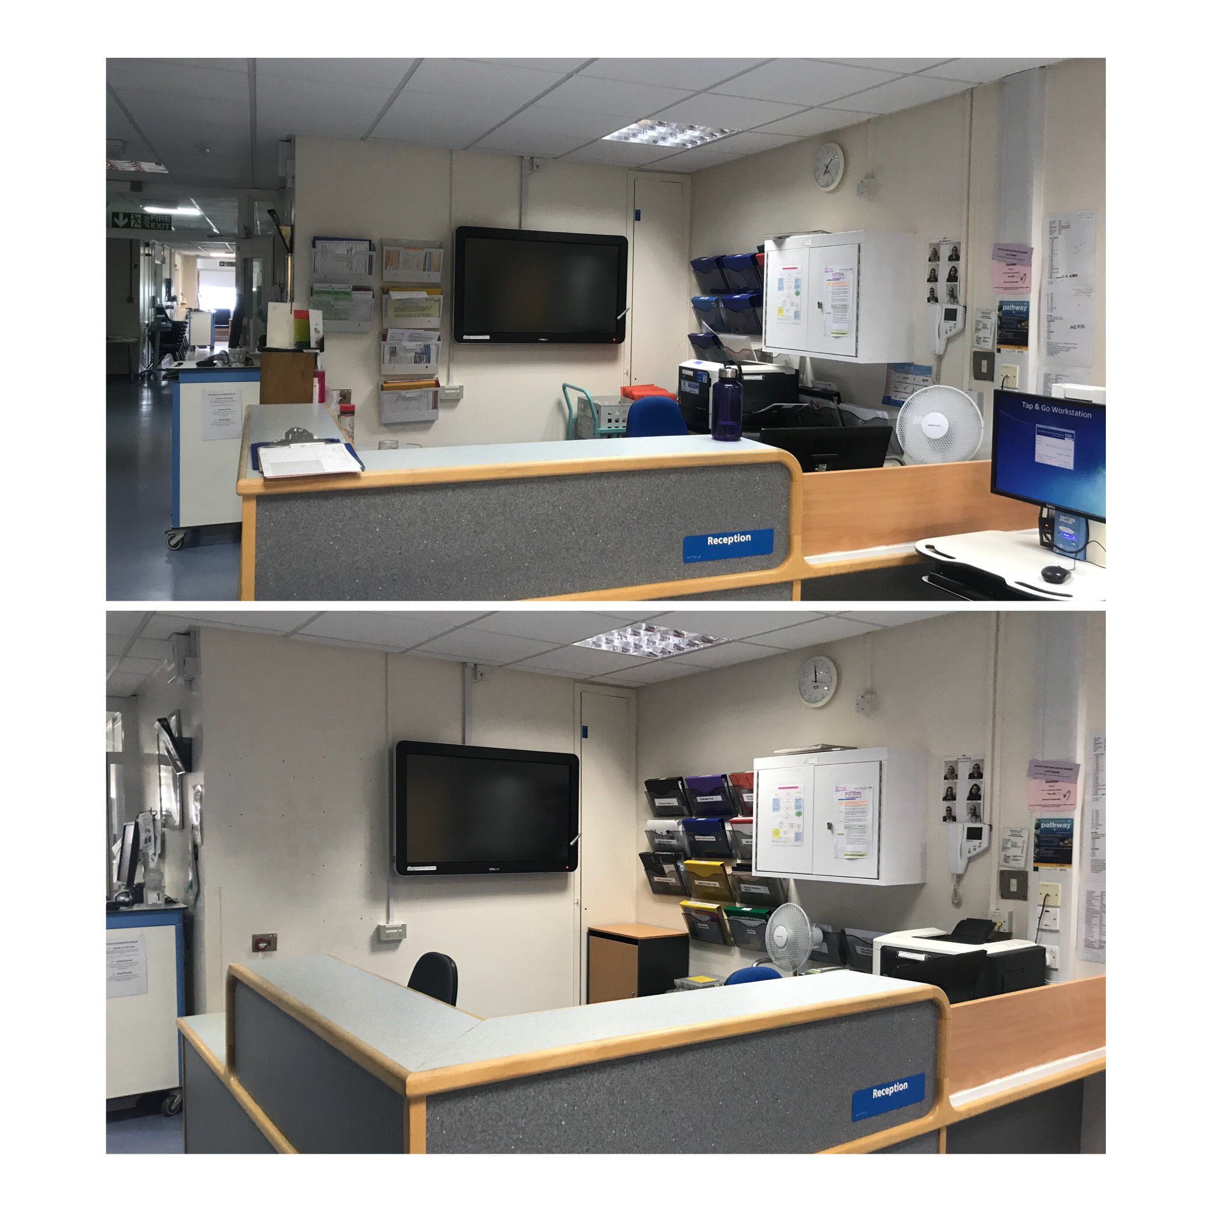
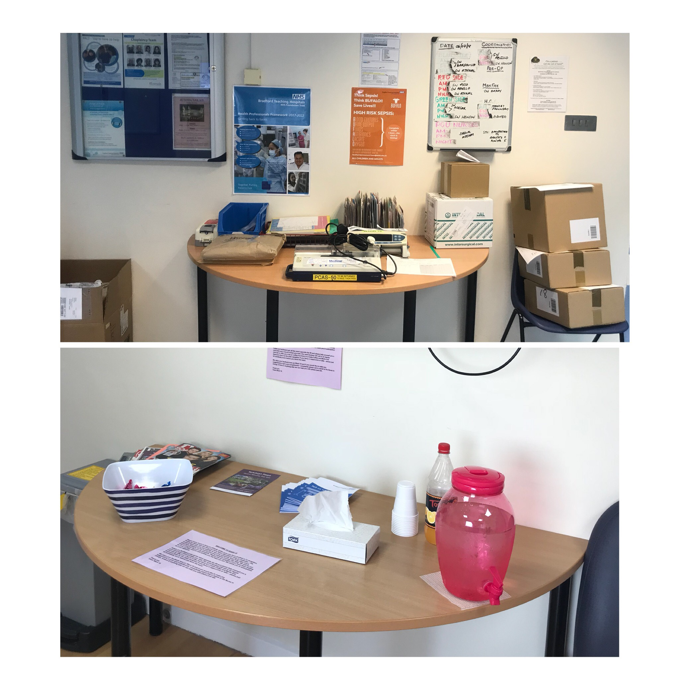
15 step challenge

Slide 15
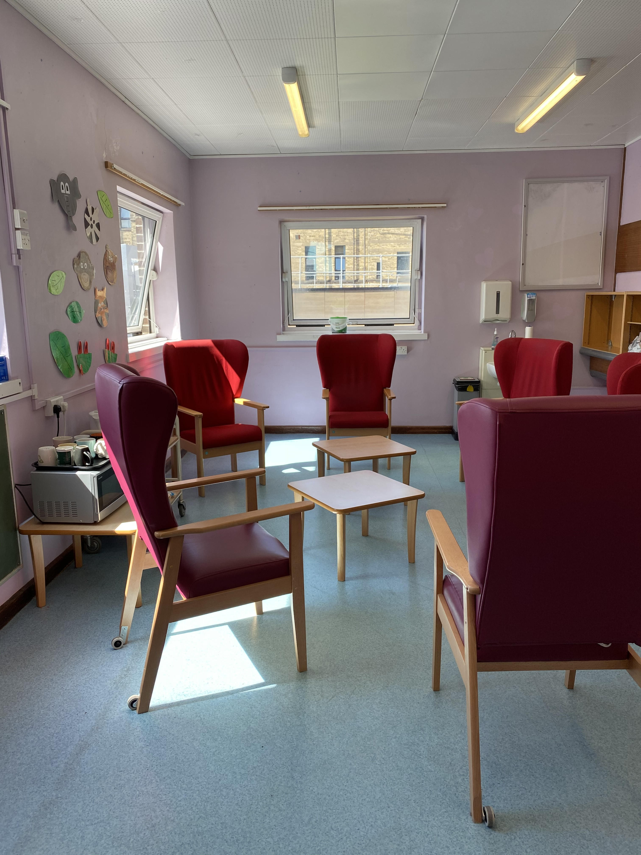
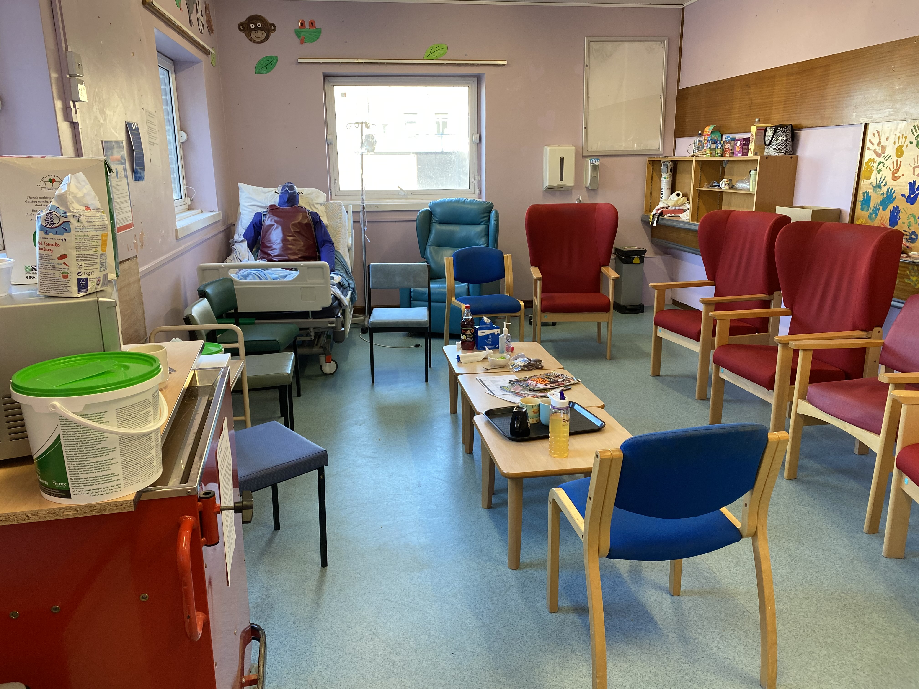
Staff break areas

Slide 16
Lessons I’ve learned about my own work life balance
Get 8 hours sleep each night
Noticing my stress and fatigue
Time management (at home & work!)
Asking for help
It is ok to delegate
Again…… I’m only one person

Slide 17
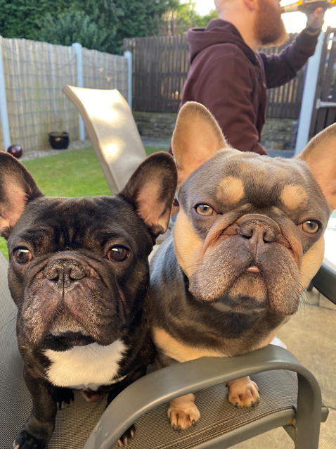
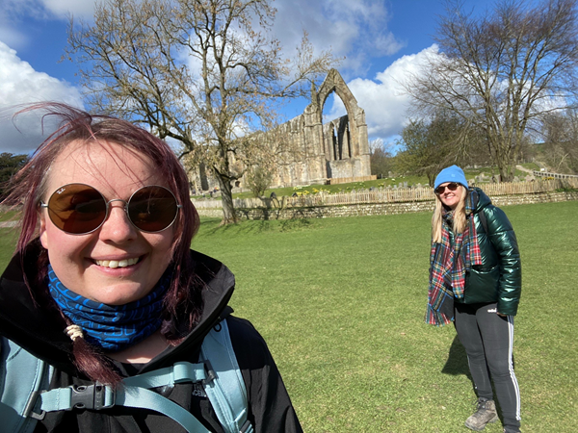
To unwind and relax I love the great Yorkshire outdoors with my dogs!
What will you do?

Slide 18
The things that reduced me to tears
Abusive relatives
No support from colleagues
Colleagues not speaking to me
Lack of belief
Frustration
Exhaustion

Slide 19
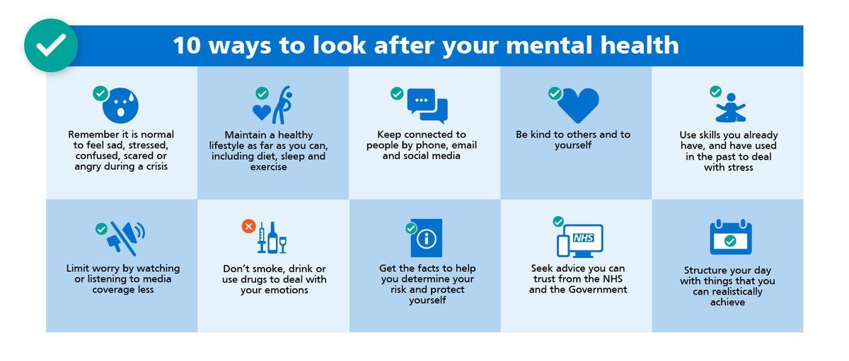
It is ok not to be ok

Slide 20
What support did I need during my first year as a Ward Manager?
A coffee, chat and moan with other Ward Managers
Regular 1:1’s with Matron and have an effective appraisal
Clear expectations – when things aren’t clear, I asked
Corporate news
My Trusts agenda
Reflection and learning
Networking – corporate teams

Slide 21
Final thought……
MAGIC HAPPENS WHEN YOU STEP OUT OF YOUR COMFORT ZONE

