Slide 1




Day Stay Surgery
The background and state of play in OMFS

Slide 2
History
Patients stayed in for simple procedures
Removal of wisdom teeth in 1970s = 2 night stay
Orthognathic and trauma often 4 or 5 nights

Slide 3
Why? General apathy
Clinical
  Pain management
  Anaesthesia
  Patients in IMF needed to be able to feed post discharge
  Management of swelling
Organizational
  Patients admitted day before surgery
  Lack of preoperative preparation
  Lack of day case units
  No bed shortages
    Specialties wanted to keep their beds full

Slide 4
What changed
Organizational
  Bed pressures
  Increased need for financial control in NHS
  1985 RCS Guidelines for day case surgery
  BADS
  2002 NHS Plan 75% surgery day stay
Clinical
  Better anaesthesia
  Better pain control E.g. use of local at operation site
  Increasing use of steroids in surgery and anaesthesia
  Better management of bleeding especially in orthognathic surgery
  Increasing use of rigid internal fixation instead of IMF

Slide 5
So where are we now
Majority of dentoalveolar surgery where there is GA is done as a day stay
Trusts are beginning to think of OMFS trauma as a day stay procedure
Having a drain does not automatically generate an overnight stay
Seeds of change in orthognathic surgery
However still significant variation

Slide 6
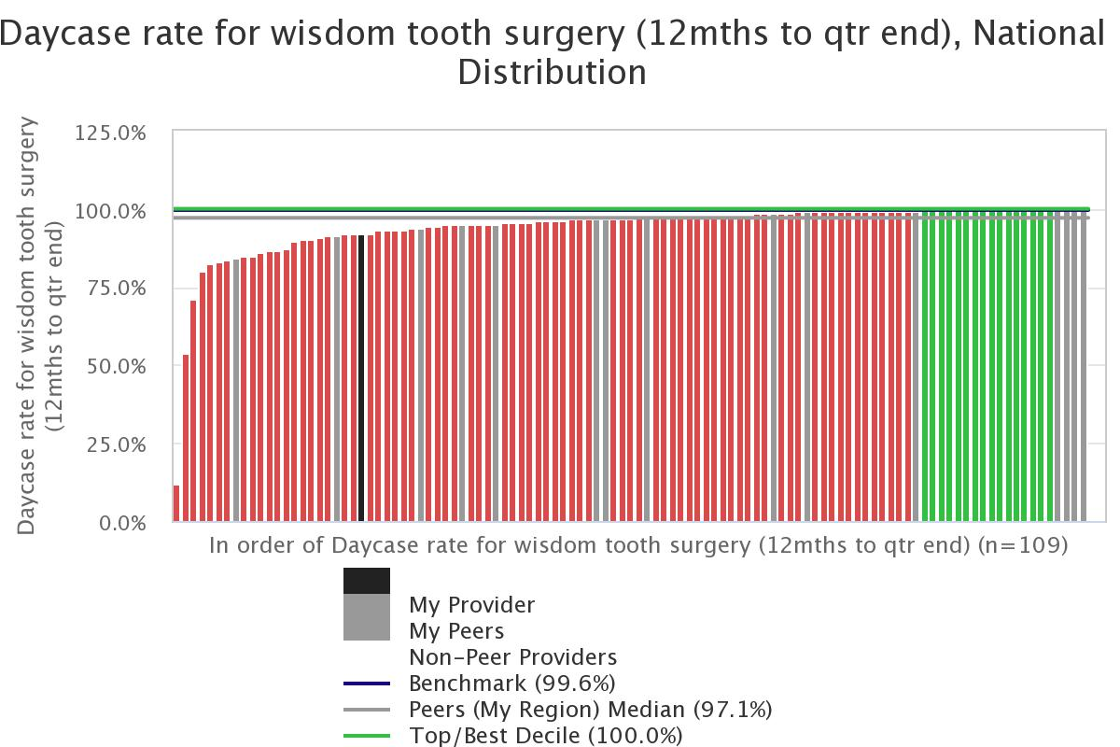

Slide 7
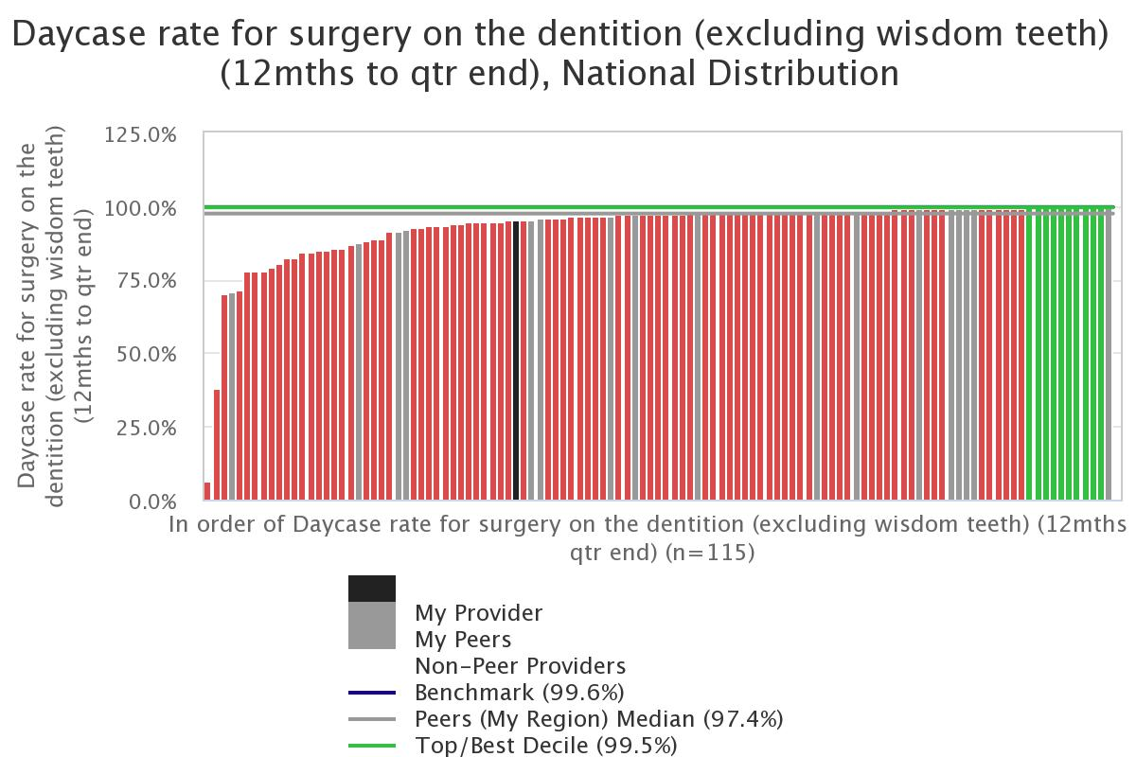

Slide 8
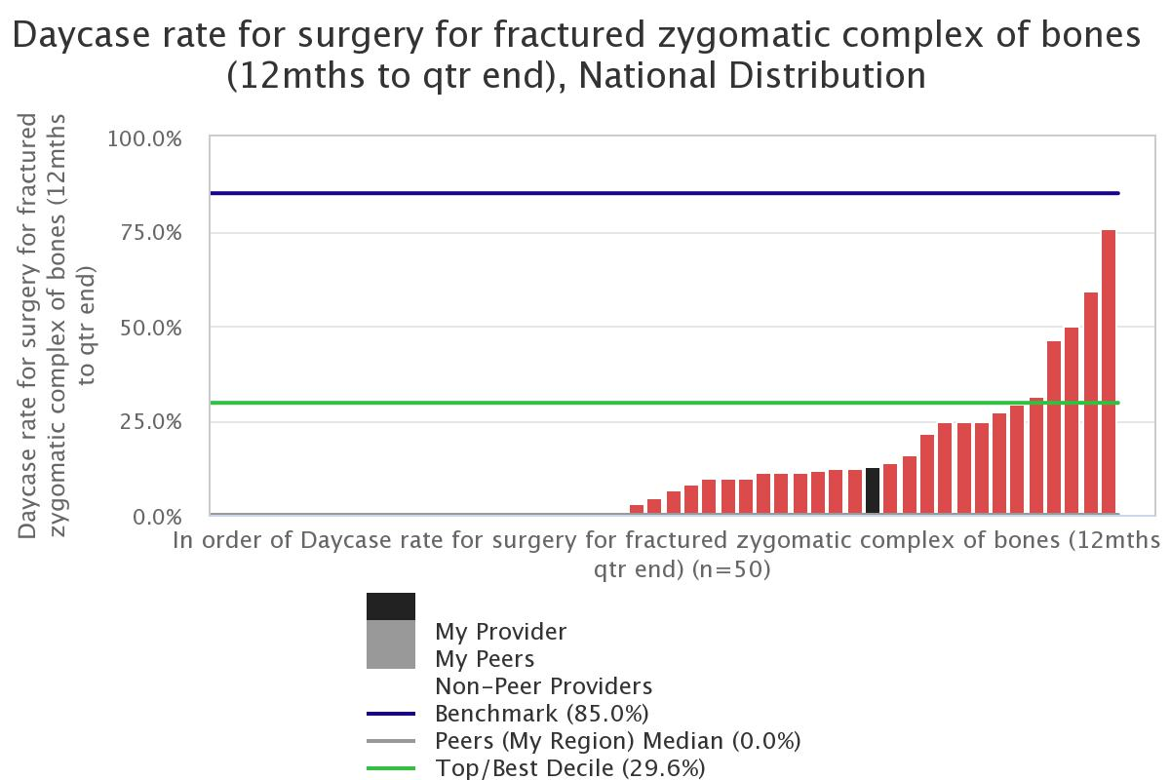

Slide 9
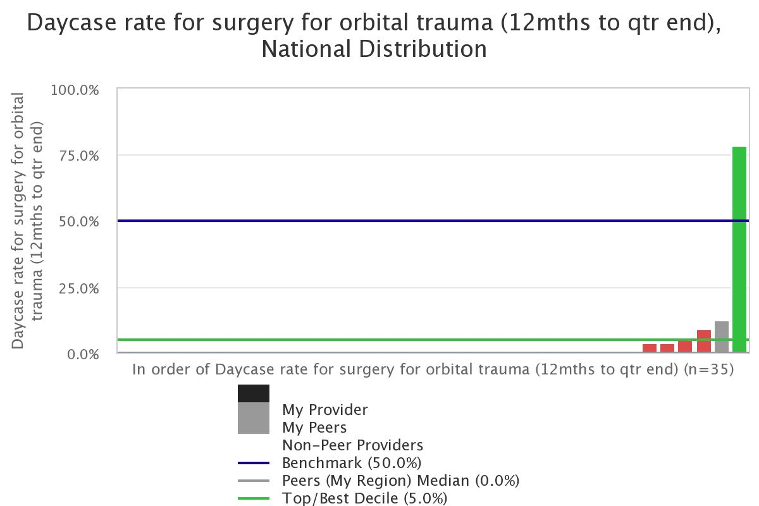

Slide 10
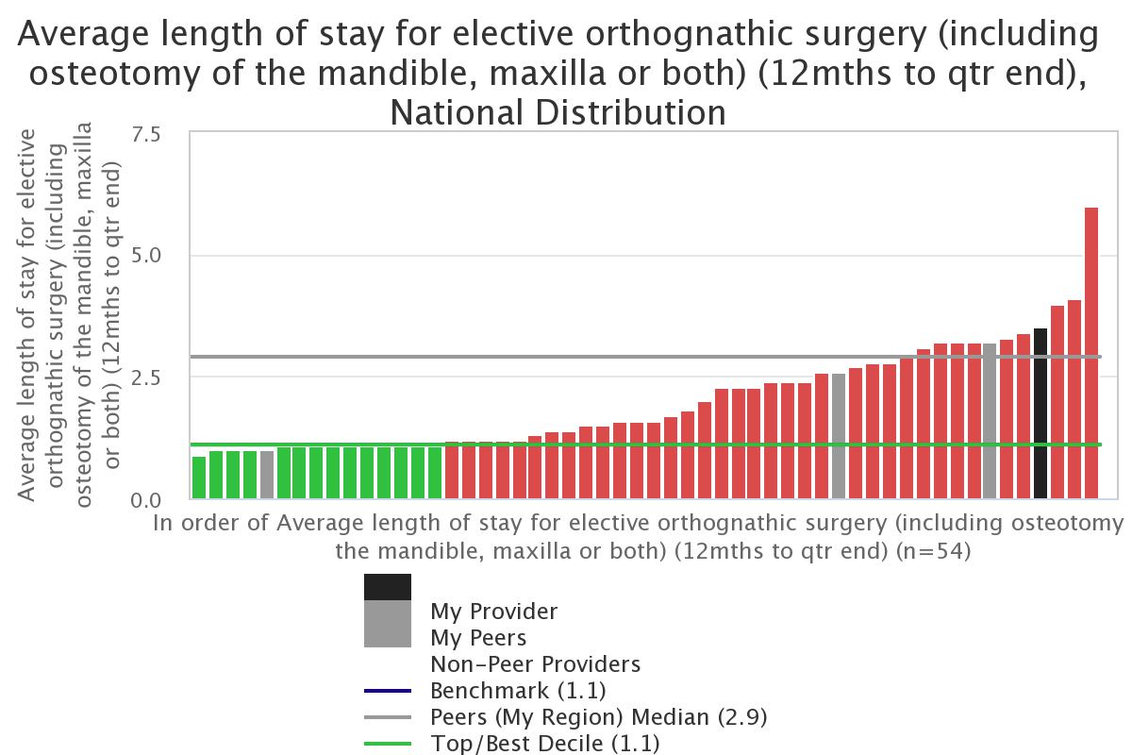
Orthognathic surgery currently day case rates very low room for improvement

Slide 11
SO HOW TO IMPROVE
Share ideas
Publish
Report good practice
  Webinars!
  Conference papers and abstracts
  Show what is possible and safe
Patient experience reports

Slide 12


Thank you for Listening

