Slide 1
Developing your Daycase General Surgery Services ‘Covid-19 and the “New Normal” for the Day Surgery Pathway ’
Douglas McWhinnie
President
International Association of Ambulatory Surgery

Slide 2
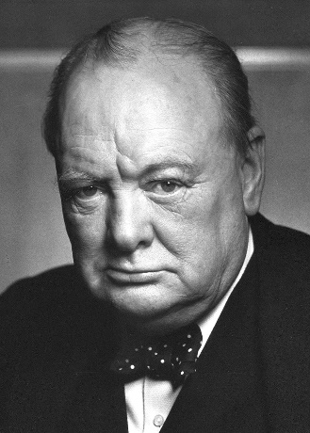
COVID-19 Pandemic
“A pessimist sees the difficulty in every opportunity; an optimist sees the opportunity in every difficulty”
Winston Churchill

Slide 3
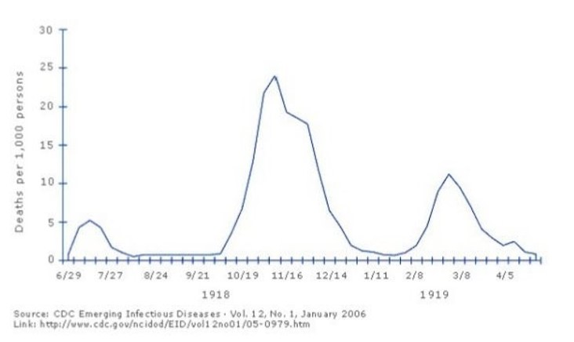
Spanish Flu Deaths by Month 1918-1919 England and Wales

Slide 4
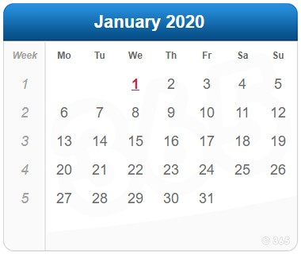
Timeline COVID-19 in England

Slide 5
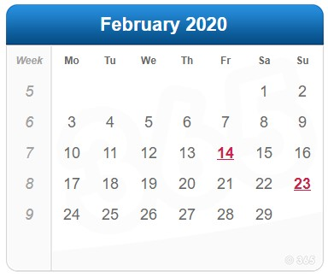
Timeline COVID-19 in England
School Holidays

Slide 6
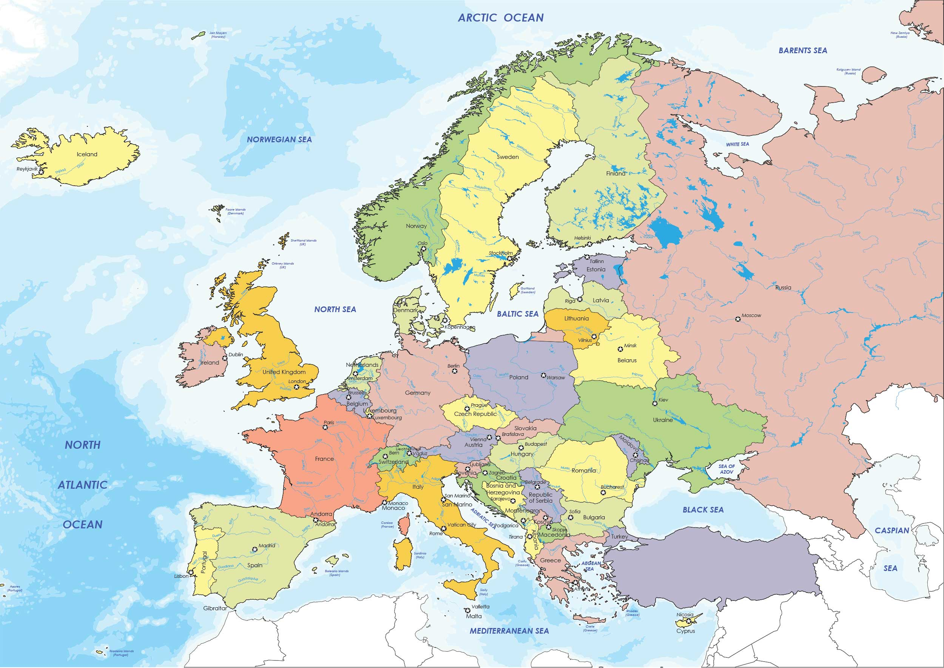
https://virological.org/t/preliminary-analysis-of-sars-cov-2-importation-establishment-of-uk-transmission-lineages/507
Transmission Lineages n=1356
0.08% from China
2.07% from USA
3.1%
4.5%
6.5%
28.5%
3.0%
14.4%
33.6%

Slide 7
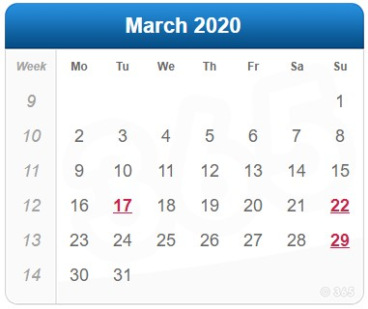
Timeline COVID-19 in England
Director-General Tedros Ghebreyesus
March 11 : 52,000 spectators
March 11 : COVID-19
Declared a Global Pandemic
March 10-13 : 248,500 spectators

Slide 8
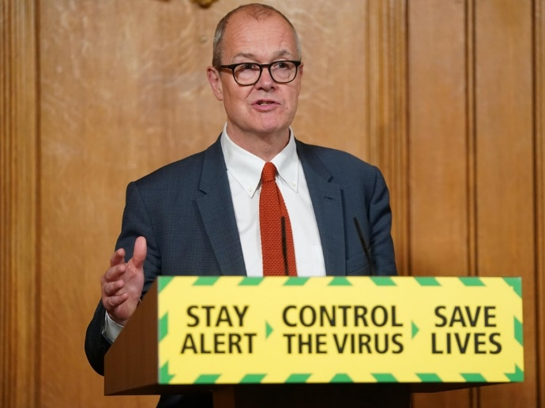
Timeline COVID-19 in England
Sir Patrick Vallance :
Chief Scientific Adviser
Boris Johnson :
Prime Minister
March 13…. the thinking behind the government's approach was to try to "reduce the peak", and because most people would only get a "mild illness", to "build up some degree of herd immunity"…
" 60% of the population would need to become infected for society to have "herd immunity" - effectively some 40 million people in the UK.
? Lack of Testing Infrastructure ?

Slide 9
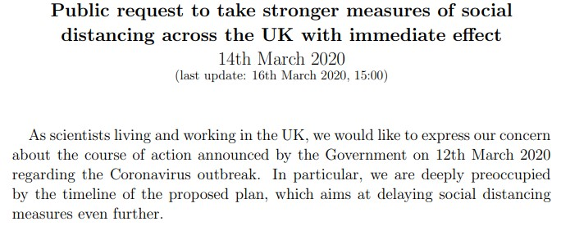
Timeline COVID-19 in England
March 14 Open letter to government by >295 academics encouraging the early introduction of social distancing measures

Slide 10
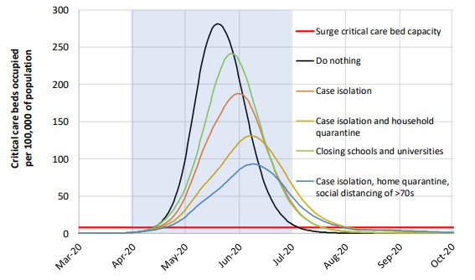
Timeline COVID-19 in England
Imperial College COVID-19 Response Team
Report 9: Impact of non-pharmaceutical interventions (NPIs) to reduce COVID-19 mortality and healthcare demand
https://www.imperial.ac.uk/media/imperial-college/medicine/sph/ide/gida-fellowships/Imperial-College-COVID19-NPI-modelling-16-03-2020.pdf
40-50% of infections not identified as cases
asymptomatic
mild disease
under-ascertainment

Slide 11
Timeline COVID-19 in England
Free-up the maximum possible inpatient and critical care capacity
Postpone all non-urgent elective operations
Urgently discharge all hospital inpatients who are medically fit to leave.
Block-buy capacity in independent hospitals.
Prepare for large numbers of inpatients requiring respiratory support
Improve oxygen supply to hospitals
National procurement for mechanical ventilation
Improve PPE distribution

Slide 12
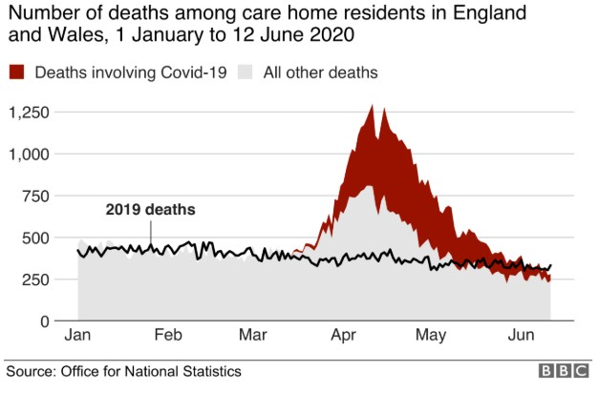
Timeline COVID-19 in England
25000 patients sent to care homes but not tested

Slide 13
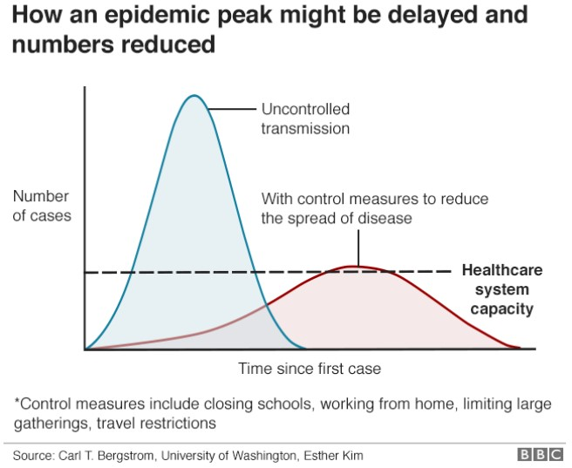
Timeline COVID-19 in England
Fears over NHS being overwhelmed by COVID-19
“Lockdown”

Slide 14
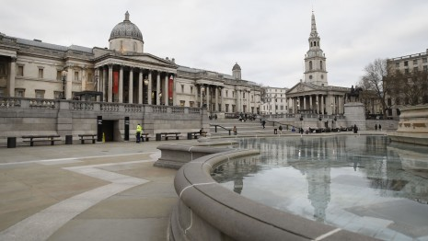
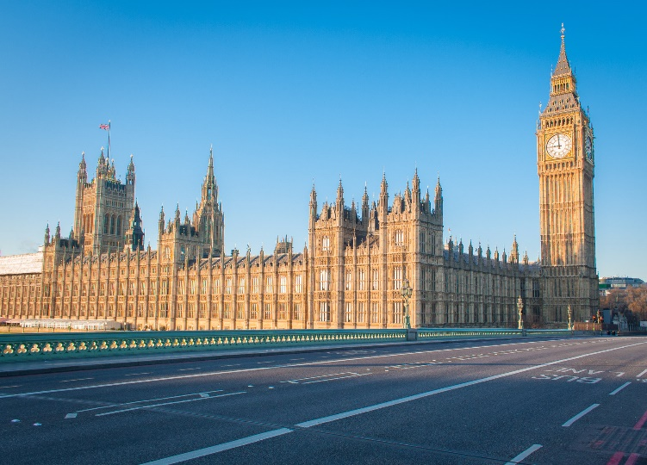
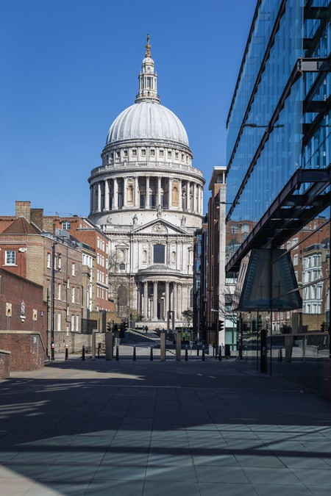
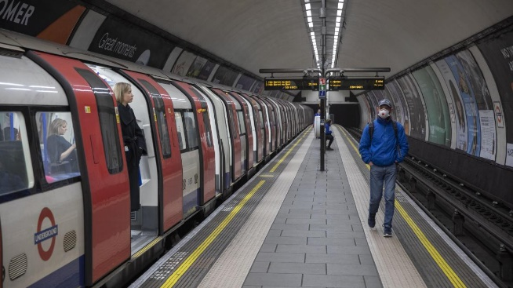
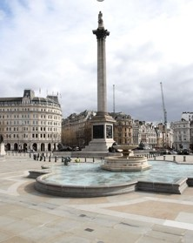
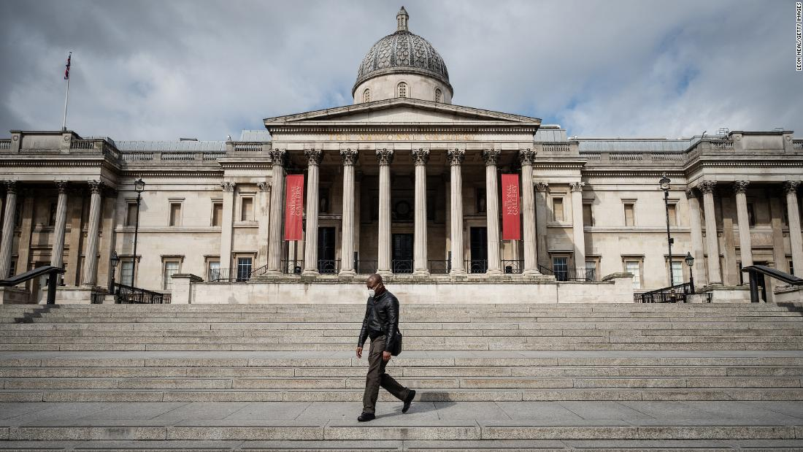
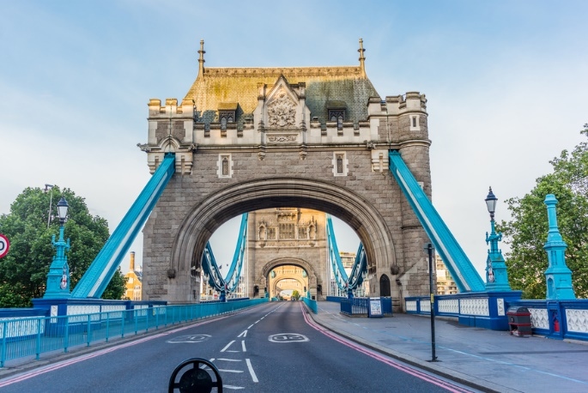
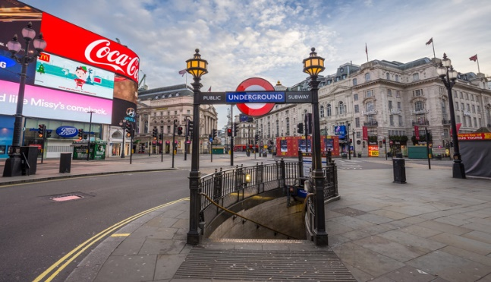
London Lockdown

Slide 15
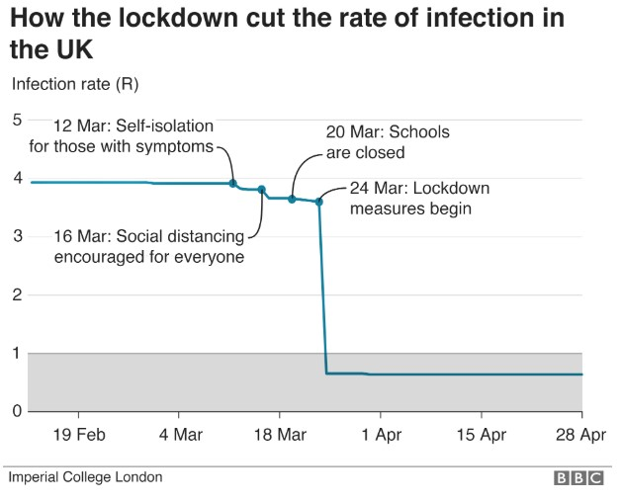
Timeline COVID-19 in England
Basic reproduction number (R₀)

Slide 16
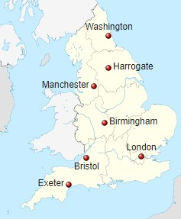
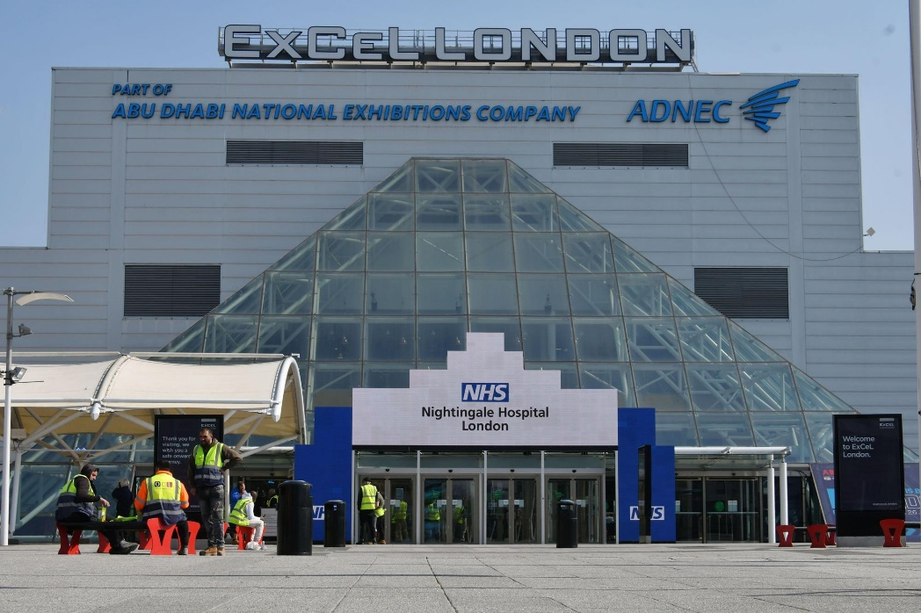
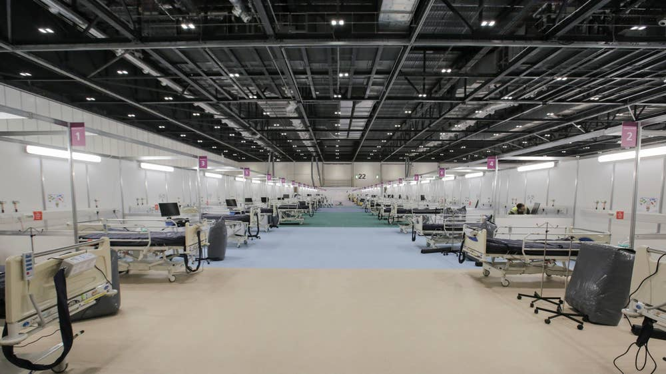
Timeline COVID-19 in England
Plan for emergency field hospital capacity
‘Nightingale Hospitals’
7 centres
4148 beds
Flexibility to >10,000 beds
Nightingale Hospital London opened 3 April 2020

Slide 17
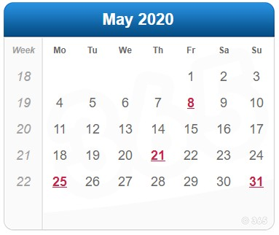
Timeline COVID-19 in England
News 14 May 2020
NHS roadmap to safely bring back routine operations
Health leaders have today set out a series of measures to help local hospitals plan to increase routine operations and treatment, while keeping the necessary capacity and capability to treat future coronavirus patients.
https://www.england.nhs.uk/2020/05/nhs-roadmap/
“Patients will be required to isolate themselves for 14 days and be clear of any symptoms before being admitted.
Testing will also be increasingly offered to those waiting to be admitted”

Slide 18
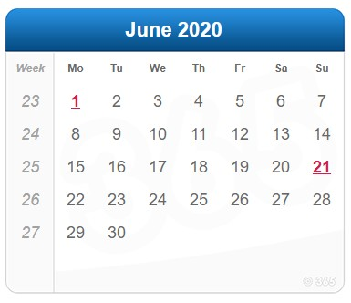
Timeline COVID-19 in England
WHO has updated its guidance to advise that to prevent COVID-19 transmission effectively in areas of community transmission, governments should encourage the general public to wear masks in specific situations and settings

Slide 19
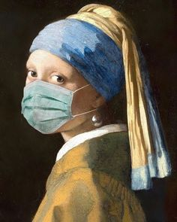
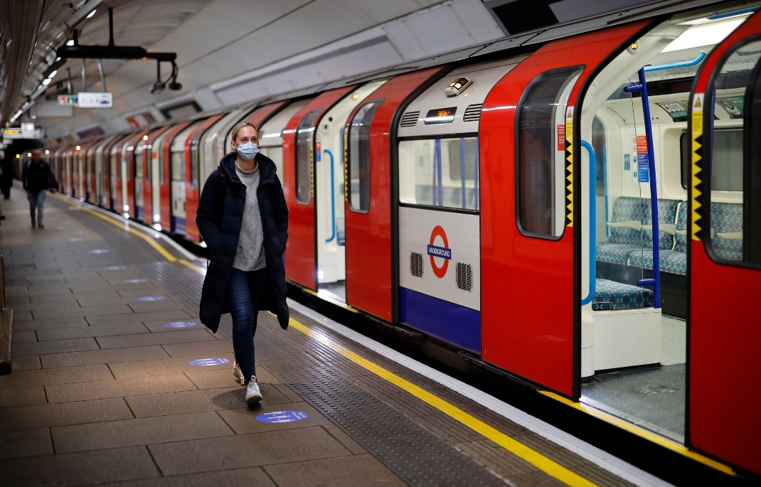
Timeline COVID-19 in England

Slide 20
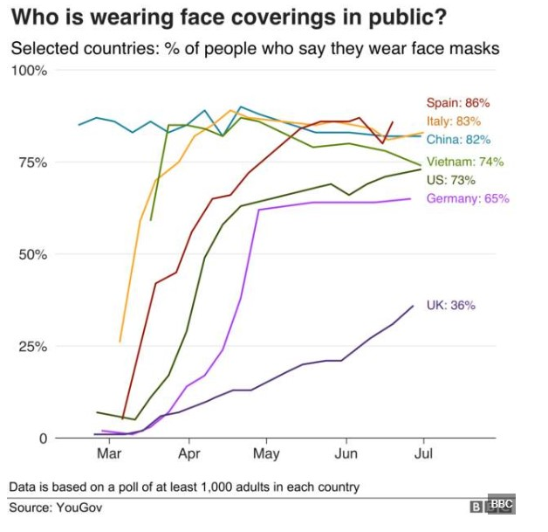

Slide 21
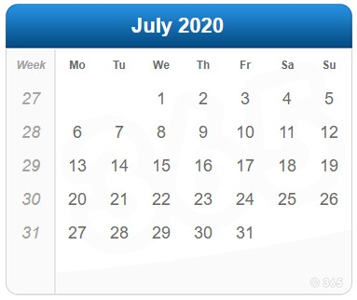
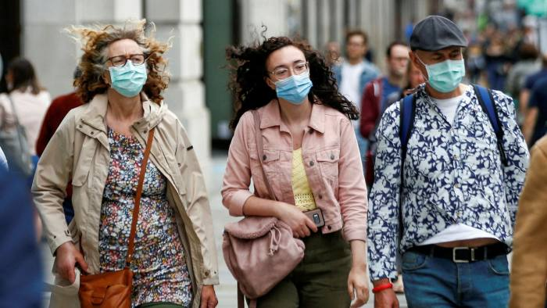
Timeline COVID-19 in England
Face masks required in public places where social distancing impossible
Enforcement power of £100 fine

Slide 22
Timeline COVID-19 in England
Limited facilities for elective day surgery
- Conversion to ITU/HDU
- Staff redeployed
Many patients reluctant to undergo surgery
Fears of catching COVID-19 in hospital
Risk factors
Non-essential surgery
Unable to self-isolate/social distance
Need to return to work after lockdown
Unable to have carer at home
No social bubble

Slide 23
Timeline COVID-19 in England
Advise patients to:
- follow comprehensive social distancing and hand
hygiene measures for 14 days before admission
- have a test for Sars-CoV-2 from 3 days before
admission, and ensure the results are available
beforehand
- self isolate from the day of the test until
admission

Slide 24
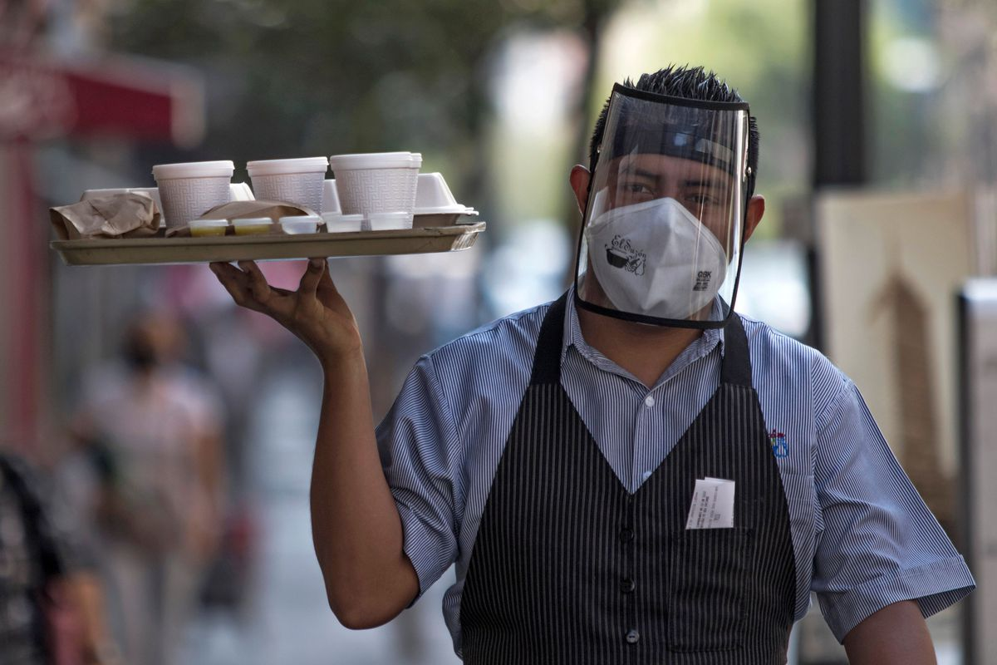
Relaxation of Restrictions

Slide 25
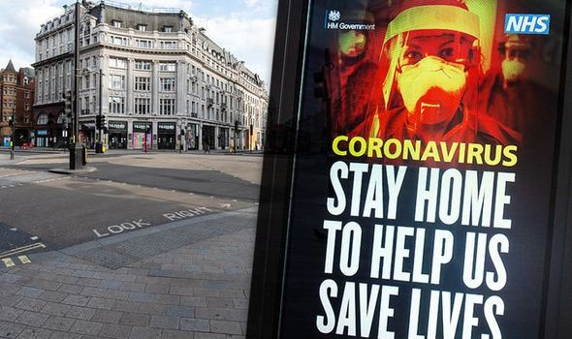
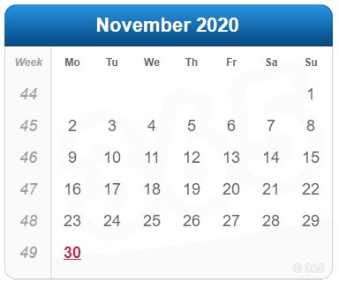
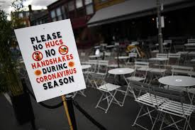
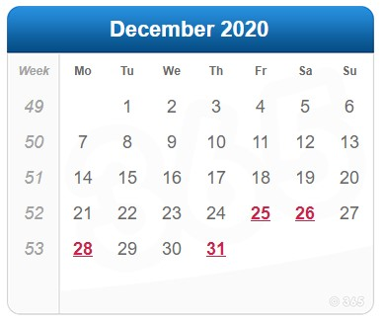
2nd Lockdown in England

Slide 26
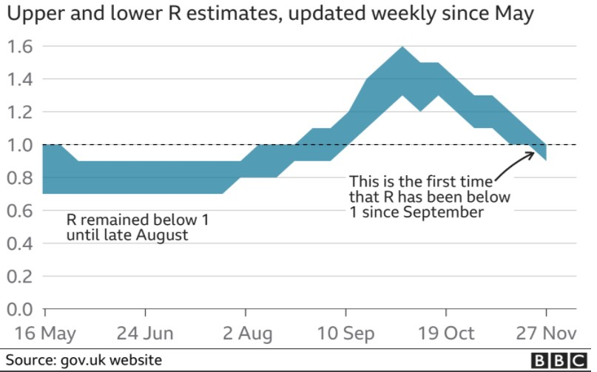
Timeline COVID-19 in England

Slide 27
Pre-assessment
Pathway
Patient Referral
Preassessment
Selection Patients + Procedures
Scheduling
Peri-operative care
Admission
Recovery
Discharge Process
Discharge
Carer at Home
Follow-up

Slide 28
COVID-19 and the Effect on Day Surgery
First Wave
Create capacity for Covid patients
Stop/reduce elective surgery
Restart Surgery
Capacity in Stand-Alone Units
Driver for Day Surgery
Second Wave
Covid protection in place
Day Surgery Maintained

Slide 29
Patient Referral + Preassessment
Reduce face-to-face interactions between patient and healthcare professional
Remote consultations……
If possible

Slide 30
Surgical Remote Consultation Pathway
No Examination required
Examination required
AND
Safe and Accurate Clinical Decision
OR
Patient has capacity
Unsure of patient’s capacity
Remote Consultation
Face to Face Consultation

Slide 31
Patient Selection
Pre-COVID-19
Post-COVID-19
Age – biological not chronological
Body Mass Index – universal policy or procedure specific
Co-Morbidities (ASA Status)
Is patient selection altered ?

Slide 32
Patient Selection
Pre-COVID-19
Post-COVID-19
Age – biological not chronological
Body Mass Index – universal policy or procedure specific
Co-Morbidities (ASA Status)
Is patient selection altered ?
Risk Factors for
- Ambulatory Surgery
- Covid
Testing for Covid

Slide 33
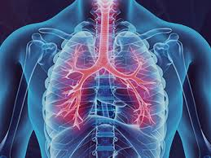
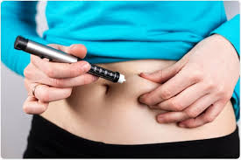
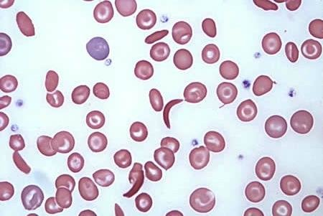
Risk Factors for COVID-19
Age Males Ethnicity Obesity
Co-Morbidities
- Respiratory disease : COPD and asthma
- Heart conditions : Coronary artery disease and Cardiomyopathies
- Endocrine disease : Uncontrolled diabetes
- Haematological disease : Sickle cell disease
- Immunocompromised patients
- Cancer

Slide 34
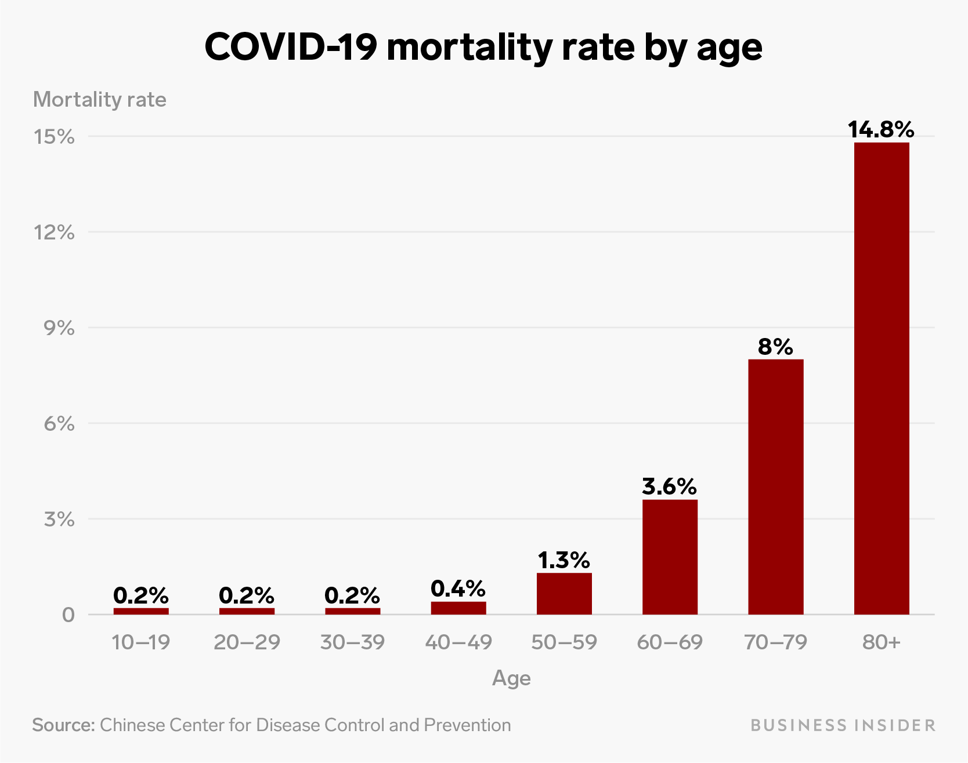
Risk Factor : Age
RELATED TO INCREASED CO-MORBIDITIES
No upper age limit for Ambulatory Surgery

Slide 35
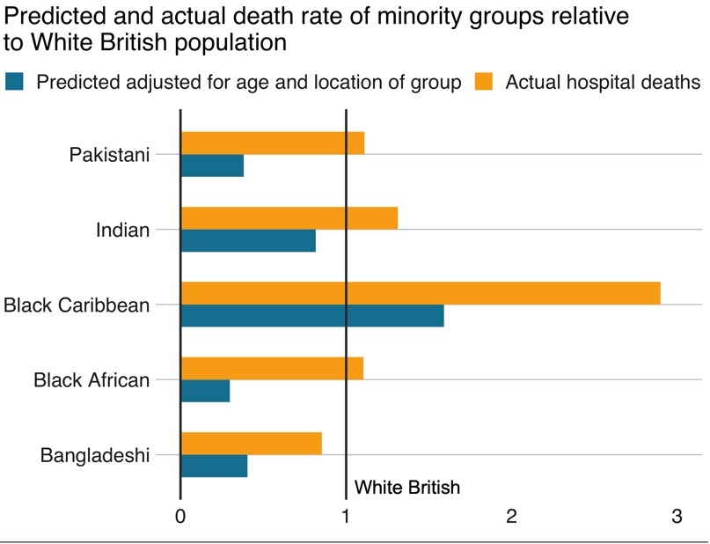
Risk Factor : Ethnicity Death rate in minority groups in UK
London, 2020

Slide 36
Risk Factor : Obesity
Lockdown Diet
Barbie
Carbie

Slide 37
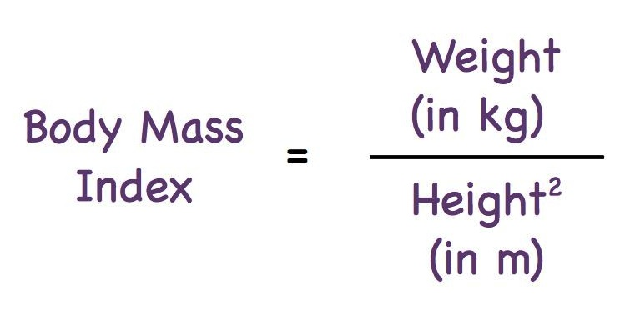
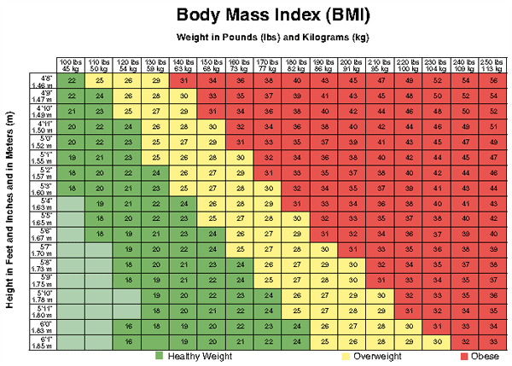
Risk Factor : Obesity
A person with a BMI of 30 or more is generally considered obese. A person with a BMI equal to or more than 25 is considered overweight.

Slide 38
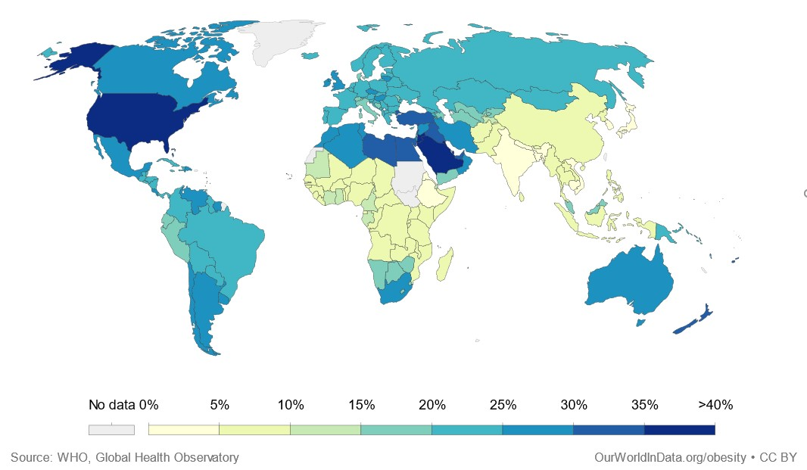
Obese adults 2016 (BMI>30)

Slide 39
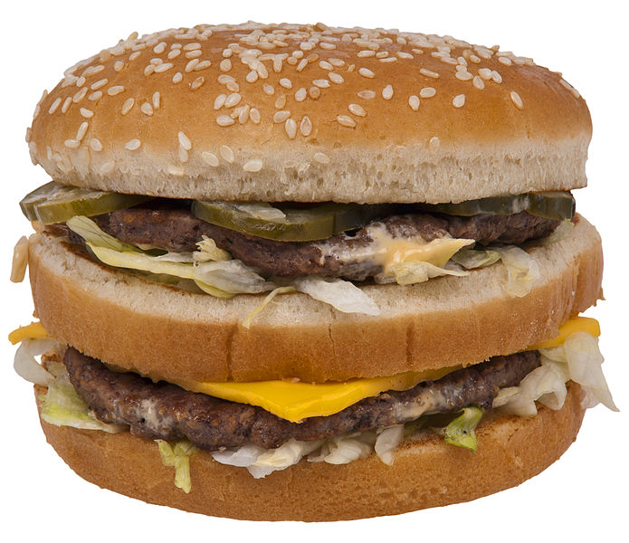
Obese adults 2020 (BMI>30)

Slide 40
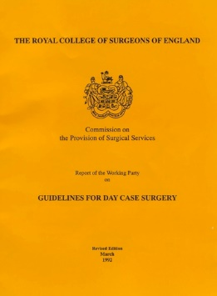
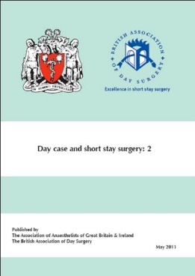
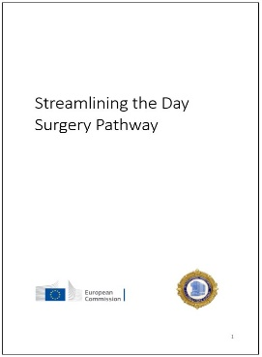
BMI Limitations
1992
“BMI < 30”
“Fitness for a procedure should … not be limited by arbitrary limits
body mass index
age
ASA status”
2011
“With experience units now successfully manage selected patients with a BMI of up to 40 “
2019

Slide 41
Co-Morbidities
Day Surgery
American Society of Anesthesiologists Physical Status Classification
ASA I
Normal Health
ASA II
Mild systemic disease
ASA III
Severe systemic disease
ASA IV
Severe systemic disease that is a constant threat to life
ASA V
Moribund, not expected to survive without operation
ASA VI
Declared brain-dead
E
Suffix for patient undergoing emergency surgery

Slide 42
Patient Selection
Shared decision-making
Discuss :
Benefits and risks of surgery
Going ahead vs risks from delay
Alternative options
Risk factors
Living or working conditions
Local COVID prevalence
Optimise health beforehand
https://www.nice.org.uk/guidance/ng179

Slide 43
Patient Selection in Covid Era Shared Decision-Making
https://www.nice.org.uk/guidance/ng179
Benefits, Risks
Alternative Options
Going ahead vs risk of delay
Risk Factors
Working or Living Conditions
Local Covid Prevalence
Optimise Health Beforehand

Slide 44
Preoperative Patient Preparation Determined by local policies
No COVID risk factors
COVID risk factors
Social Distancing for 14 days before surgery
(2 metres/facemask)
COVID Antigen test 72 hours before surgery
Self-isolation for 72 hours before surgery
Self-isolation for 14 days before surgery
COVID Antigen test 72 hours before surgery

Slide 45
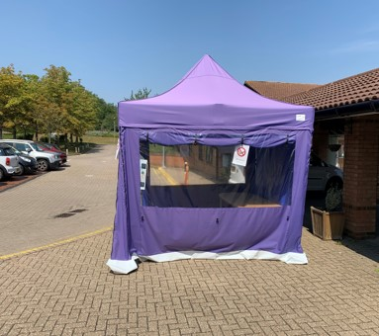
Testing for COVID-19
Testing Station Saxon Clinic Milton Keynes

Slide 46
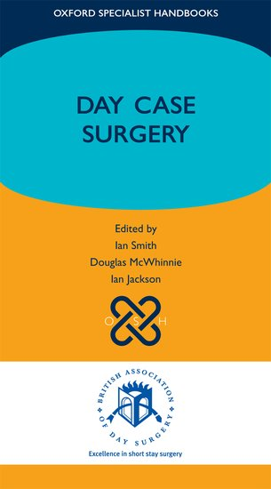
Procedures Selection
No Definitive List
- Different countries have their own list of procedures
- Required for patient safety or reimbursement
Lemos P, Jarrett P, Philip B
IAAS, London; 2006
Jackson I, McWhinnie D
BADS, London; 2006
Jackson IB, 2014;
www.iaas-med.com/files
Smith I, McWhinnie D, Jackson I
OUP, Oxford; 2012

Slide 47
Target Percentages for Length of Stay Management

Slide 48
Procedure Selection
Most Ambulatory procedures are life-enhancing rather than life-saving
“Any surgical procedure conducted on a COVID-19 positive patient carries a risk of postoperative pulmonary complications in half of cases”
COVIDSurg Collaborative. Lancet 2020;396:27-38.
The COVID pandemic has highlighted unnecessary surgery
“Any surgical intervention that is either not needed, not indicated, or not in the patient’s best interest when weighed against other available options, including conservative measures”
Why do surgeons continue to perform unnecessary surgery? Stahel PF, VanderHeiden TF, Kim FJ Patient Saf Surg 2017;11:1

Slide 49
Waiting times for non-urgent treatment
2010 Patient right
18 weeks RTT
2012 Statutory requirement 92%
to achieve 18 weeks RTT
2013 No wait > 52 weeks
DoH London 2010

Slide 50
Patients awaiting treatment Pre-COVID-19

Slide 51
Waiting List Plan
Private Sector NHS Contract
(%age contracted hours)
60% Inner London
70% Outer London
75% Rest of England

Slide 52
Scheduling of Surgery
Lock down Day Surgery List :
Staff, patient, theatre availability
6 weeks before
4 weeks before
2 weeks before
Plan List
Confirm List
Lock Down List
Day Surgery List

Slide 53
Scheduling of Surgery
No longer possible to replace late unavoidable cancellations with substitute patients
COVID-19 Incubation period
Mean 5-6 days
Range up to 14 days
Asymptomatic 1-3 days
World Health Organisation. 2020, Coronavirus disease 2019 (COVID-19) Situation Report – 73 www.who.int/docs/default-source/ coronaviruse/situation-reports/20200402-sitrep-73-Covid-19

Slide 54
Admission
Patient admitted to the Day Surgery Unit
on their own without a friend or relative
EXCEPT
parent with child
caring for the vulnerable adult
Patient and clinical staff to wear loose-fitting surgical facemasks covering the nose and mouth
One-Way Protection

Slide 55
Aerosol Generating Procedures
Aerosol generating procedures
Non-aerosol generating procedures
Anaesthetic
Intubation
Extubation
Suctioning respiratory tract
Laryngeal Mask Anaesthesia
Surgery
ENT procedures
Endoscopy
Laparoscopy
Anaesthetic
Spinal
Regional
Local
Surgery
Open surgery

Slide 56
Non-Valved Surgical Respirators Two-Way Protection
The equivalent respirator class to FFP2 and N95 in China is KN95, in Australia and New Zealand AS/NZ P2, in Korea 1st Class, and in Japan DS FFRs.

Slide 57
Admission Operating Theatre + Stage I Recovery Risk
FFP3 respirator, eye protection, fluid-resistant gowns, double gloves
Spanish Flu
Pre-COVID-19
COVID-19

Slide 58
WHO Team Briefing
All the team !
Surgeon(s)
Anaesthetist
Anaesthetic Assistant
Scrub Nurse
Circulating nurses

Slide 59
Sign in
Time out
Sign out
Check COVID results of 72 hour swab

Slide 60
Gap or turnaround time : Multiple case day surgery list
Key
Operating
Turnaround

Slide 61
Safe Turnaround Times in COVID-19 Era
Each air exchange replaces 63% of the air, and the same proportion of potentially virus‐bearing aerosols
The remaining air quantity is 37% after one exchange
After n air exchanges 0.37^{n} remains
After two exchanges 0.37² (14%) remains, after five 0.7%, after 7 0.01% and after 10 exchanges 0.004%.
Cook TM, Harrop-Griffiths W. Anaesthesia 2020, 75, 1122–3

Slide 62
Turnaround Times
Air changes/hour and time required for airborne-contaminant removal by efficiency
https://www.cdc.gov/infectioncontrol/guidelines/environmental/appendix/air.html

Slide 63
Turnaround Times
Air changes/hour and time required for airborne-contaminant removal by efficiency
https://www.cdc.gov/infectioncontrol/guidelines/environmental/appendix/air.html

Slide 64
Discharge from Day Unit
Protocol-based Discharge
Active management to identify postoperative deterioration
Discharge home if criteria are fulfilled

Slide 65
Discharge
Patient escorted to waiting area to meet friend or relative

Slide 66
Carer at Home
Official UK National Health Service guidance
‘It’s a good idea to have an adult available to help you for at least 24 hours after surgery’
www.nhs.uk/Conditions/surgery/Pages/after-surgery.aspx
Many patients falsely claim to have help at home the first night after surgery, especially if they do not have a ‘support bubble’

Slide 67
Carer at Home
Essential
Elderly
Invasive surgery
Airway at risk
Pragmatic
Non-invasive surgery
Practice guidelines for post-anesthetic care .
Anesthesiology 2002; 96: 742-52.

Slide 68
Follow-up
Remote follow-up
Next-day phone call

Slide 69
Pre-assessment
Pathway
Patient Referral
Preassessment
Selection Patients + Procedures
Scheduling
Peri-operative care
Admission
Recovery
Discharge Process
Discharge
Help at Home
Follow-up

Slide 70
COVID-19 Pandemic
“A pessimist sees the difficulty in every opportunity; an optimist sees the opportunity in every difficulty”
Winston Churchill

