Slide 1
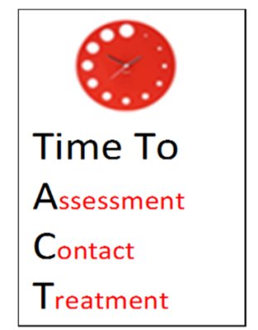

Identifying the Deteriorating Patient
Sara Blakeley
Portsmouth Hospitals University NHS Trust
sara.blakeley@porthosp.nhs.uk

Slide 2

Identifying, responding (& proving)
What do we mean by a deteriorating patient?
What can we do to improve response and recognition?
Data collection and analysis

Slide 3
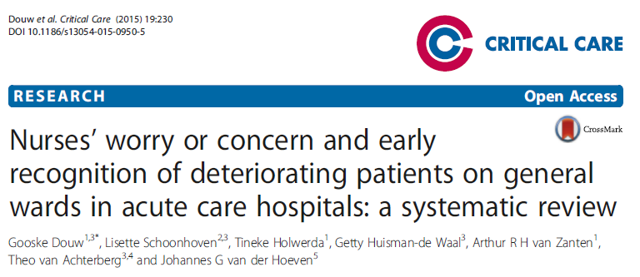
Identifying, responding (& proving)
What do we mean by a deteriorating patient?

Slide 4
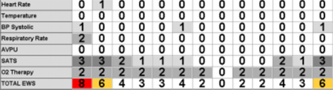
Where is the deterioration?
Easy isn’t it??

Slide 5
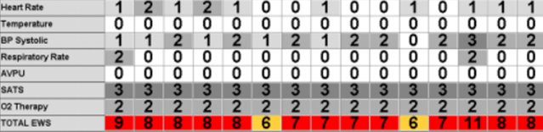
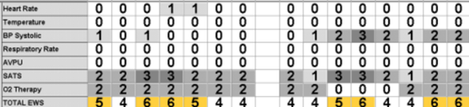
Where is the deterioration?

Slide 6
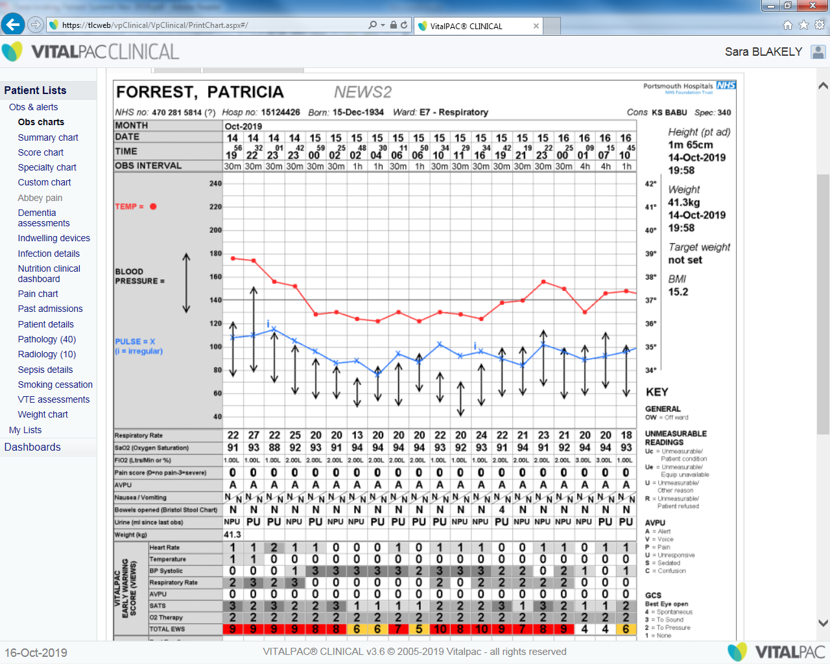
Score based deterioration?
Is this where the patient deteriorated?

Slide 7
Trend?
Or was it back here?

Slide 8
NEWS blindness

Slide 9
Identifying, responding (& proving)
What do we mean by a deteriorating patient?
What can we do to improve response and recognition?
Data collection and analysis

Slide 10

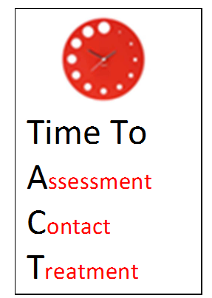
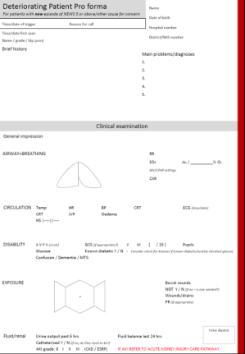
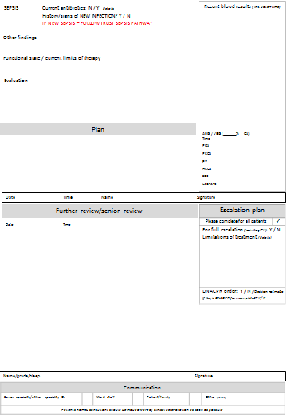

Our experience
When your patient is deteriorating, it’s
Appropriate & timely ASSESSMENT of vital signs
The deteriorating patient pro forma should be used to document the focused clinical assessment, TREATMENT plan, senior review and escalation plan. It is filed in the medical notes.
CONTACT should be made with the appropriate clinician if the patient deteriorates (elevated NEWS or other cause for concern)

Slide 11
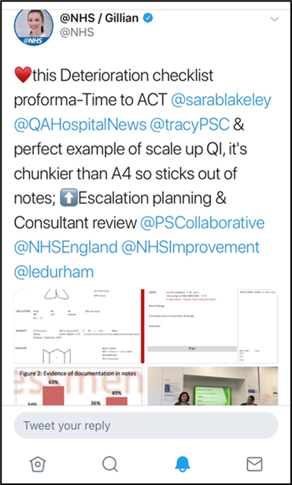
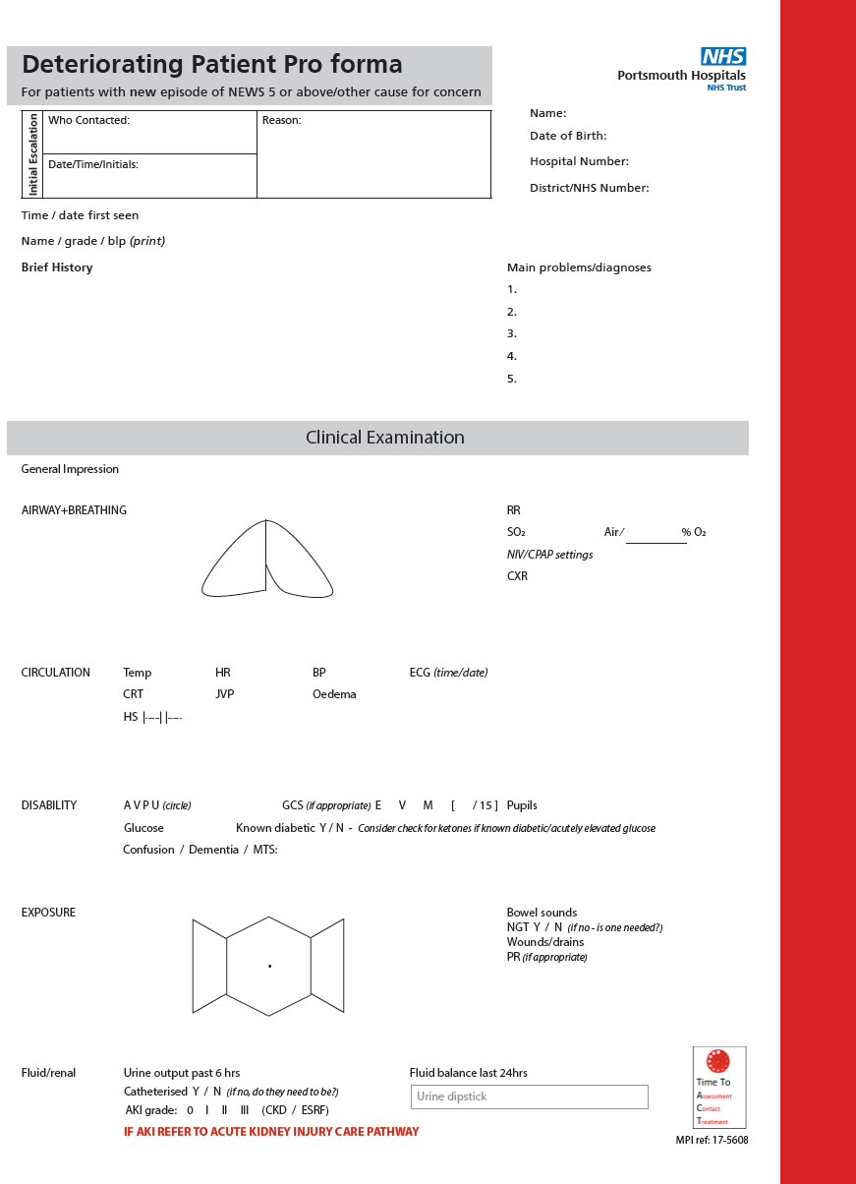
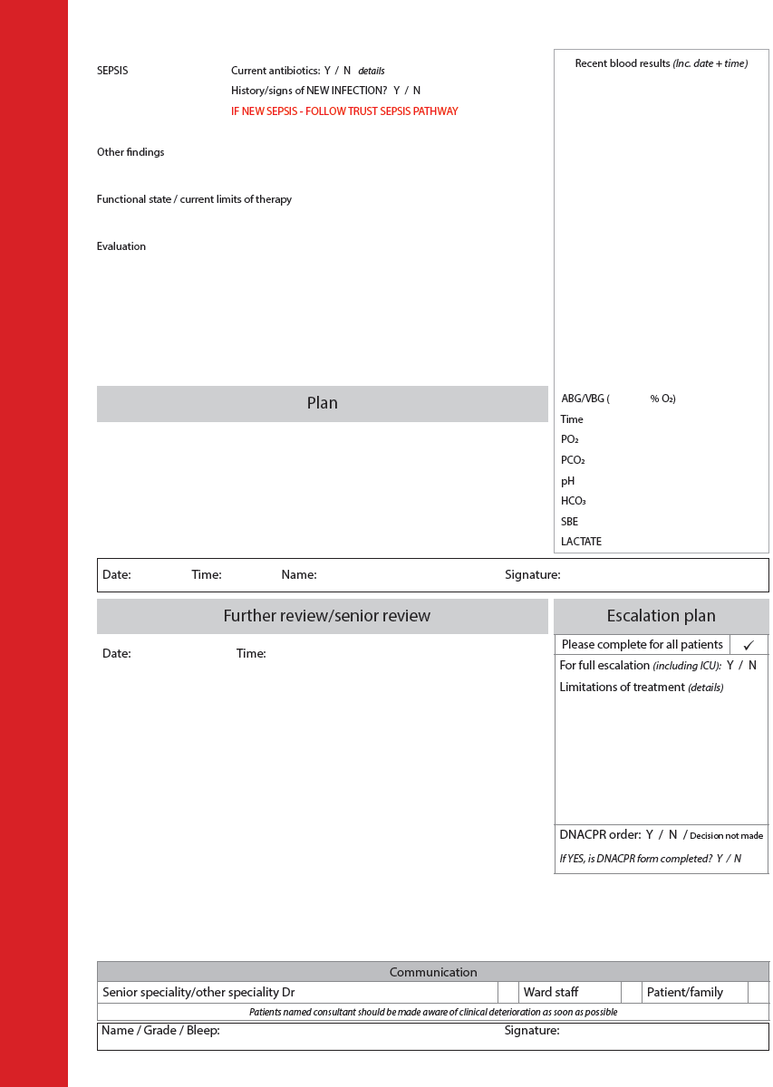
“I could have done with this at 2am when I was starting to flag”
Junior Doctor
“Why don’t we have this in obstetrics?”
Registrar
“This is a very good way of escalating deteriorating patients as it can be very difficult at times”
Staff nurse

Slide 13
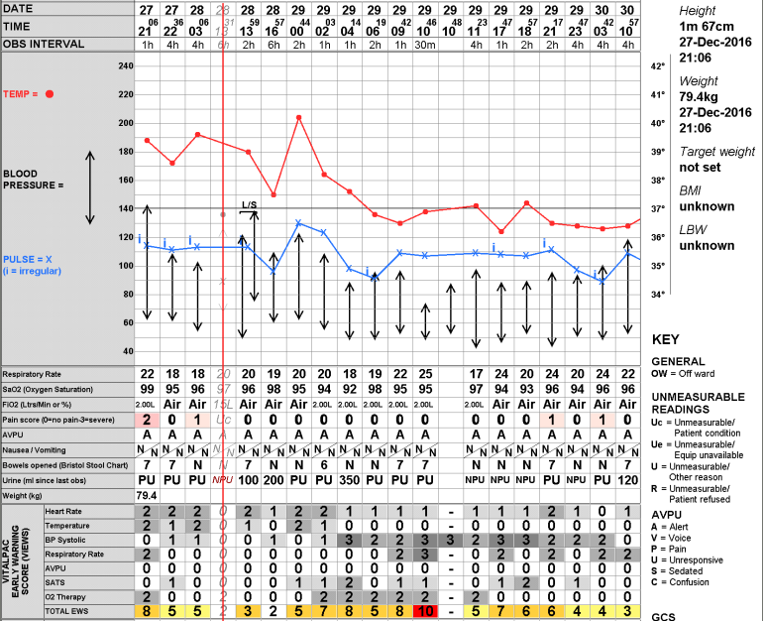
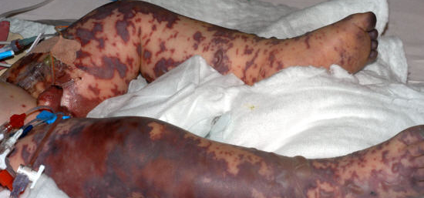
Sign posts to other pathways
Because sepsis doesn’t always look like this….
SEPSIS / DETERIORATION
DETERIORATION / SEPSIS
But it can look like this….

Slide 14
Identifying, responding (& proving)
What do we mean by a deteriorating patient?
What can we do to improve response and recognition?
Data collection and analysis

Slide 15
Data capture - considerations
Definition of a deteriorating patient
NEWS 2: What level? Delta NEWS?
What about cause for concern?
What about high scoring baseline?
How can you capture data?
Electronic vs paper?
Real time vs retrospective?
Clinician vs ‘data collector’?
What data can you collect?
Identification?
Escalation by nursing staff?
Clinical response?
Is response appropriate?
Outcome and balancing data?
Cardiac arrest rate?
Mortality?
Unplanned ICU admission?
Outreach referrals?

Slide 16
How did/do we capture data
Our definition of a deteriorating patient
New NEWS 5 and above OR cause for concern by the nursing staff
Initiation of the deteriorating patient pro forma
How we capture data
VitalPAC sweep identifying all NEWS 5 +
Real time review of notes (+ feedback)
Data collection by a clinician
Emergency (ward) admissions to ICU
45-50 deteriorations monthly March 19-Feb 20 (quarterly since)
Data we collect
Appropriate frequency of vital signs monitoring
Number of patients escalated by staff
Clinical review by appropriate clinician in appropriate time frame (local policy)
Actions following clinical review
Night vs day, by ward area and by score
Grading of response
Outcome and balancing data
Bed occupancy & nursing shifts covered
Cardiac arrest calls
Sepsis mortality
Emergency ICU admission rate
Number of outreach referrals

Slide 17
Improvement in number of deteriorations escalated by nursing staff…..
What about the missing 40% ?
Grade of care | Quarter 3 2019-2020
Not seen – appropriate (grade 4) | 25% ↑
Not seen – INAPPROPRIATE (grade 5) | 12% ↓

Slide 18
Limited observations
Bespoke observation monitoring frequency determined (and documented) by the clinician
  High baseline patients
  Those approaching (but not at) EOLC
  Those with ceiling of care
Documentation on the ward round
  Consideration of TEP
  Consideration of DNACPR status
  Re-review date

Slide 19
Identifying, responding (& proving)
What do we mean by a deteriorating patient?
What can we do to improve response and recognition?
Data collection and analysis

Slide 20
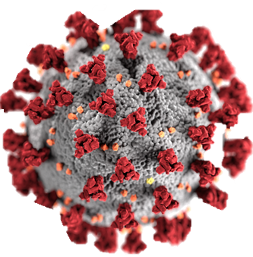
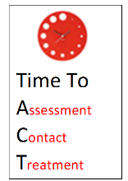
Our journey with Time to ACT
Mar
2020
Treatment escalation plan TEP form
Mar
2020
NEWS2 launch and Time to ACT re-energised
Development of buddy ward system
Feb
2019
2019
Limited observations function introduced
Dec
2017
Time to ACT Deteriorating Patient pro forma and educational package launch
Sept
2016
38 clinical areas
Reviewed a total of 386 deteriorations (New NEWS 5+ or cause for concern)

Slide 21
Sustained impact on response to deteriorating patients
% of deteriorations seen by clinician
Documentation of escalation plan in medical notes in response to deterioration

Slide 22
Sustained impact on response to deteriorating patients
Improvement in vital signs compliance during Covid Pandemic
Improvement in vital signs compliance on medical ward

Slide 23
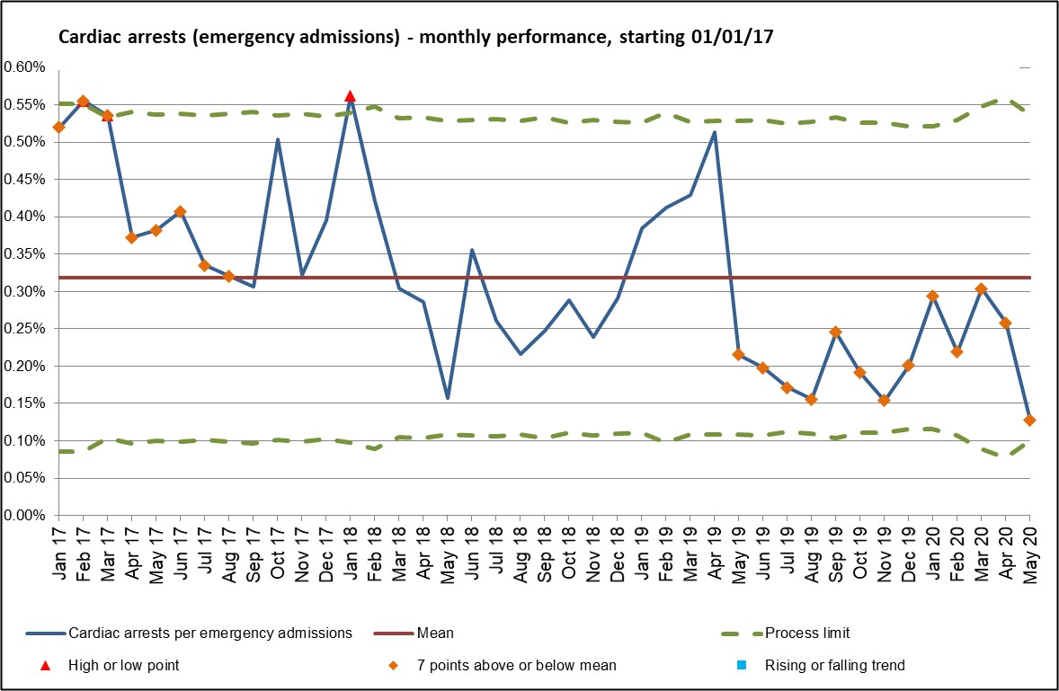
Sustained impact on response to deteriorating patients
01
NEWS2 &
TTACT refresher
TTACT launch

Slide 24
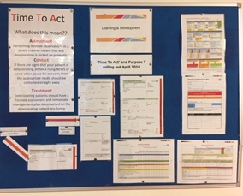
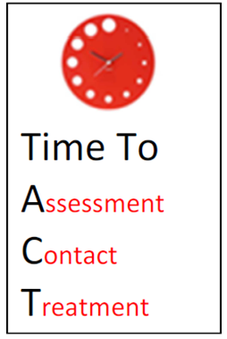
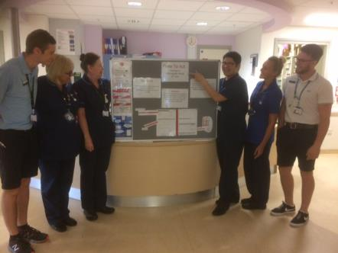
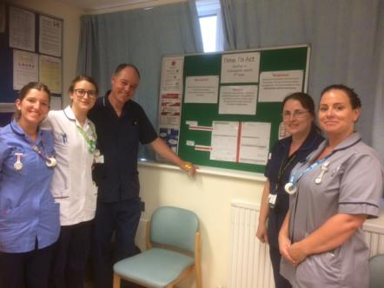
Education
Data analysis & reporting
Deteriorating patient pro forma
Vital signs compliance
Treatment escalation plan form
Limited observations function
Engagement

Slide 25
Conclusion
Decide what deterioration looks like in your setting
  Educate on the reason for the number, not just the number
  Give staff tools to escalate on NEWS and also cause for concern
Look at who you are not responding to (and why)
Data should be collected to help you shape your service
  Collect data for yourself, not just because you have to
  Human AND automated data collection

Slide 26
Questions?

